Slide 1





ITU Workshop on
“Disaster Relief Systems, Network
Resiliency and Recovery”
(Phuket, Thailand, 20 May 2013)
Recent Resilient ICT R&D Activities in NICT, Japan
- At the Entrance to the Smarter Communication World -
ICT for Sustainable World Human Happiness
Fumihiko “Tom” Tomita, Dr.
Chief R&D Officer, Vice President,
National Institutes of ICT (NICT), Japan
ftomita nict.go.jp

Slide 2

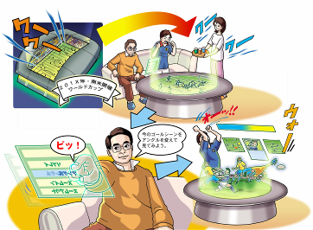


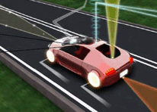

ICT for Sustainable World Human Happiness
JARI
Virtual but Realistic Communications
Human happiness and
Doko-demo-Door
“The Door to anywhere you like.”
One of the DORAEMON tool
Human happiness and
Doko-demo-Door
“The Door to anywhere you like.”
One of the DORAEMON tool
Smart Car and New Mobility

Slide 3
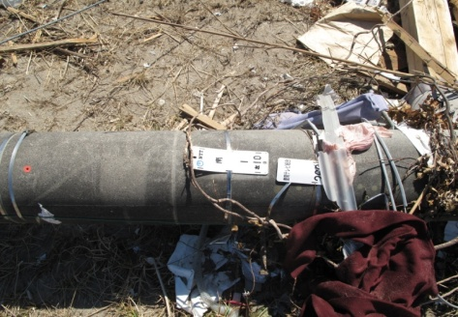
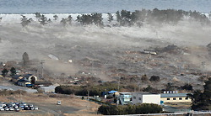
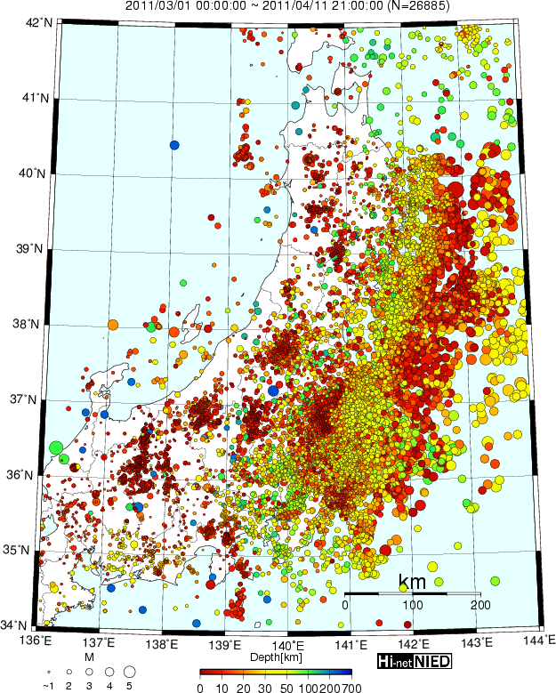
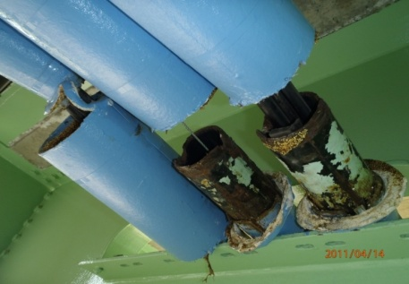
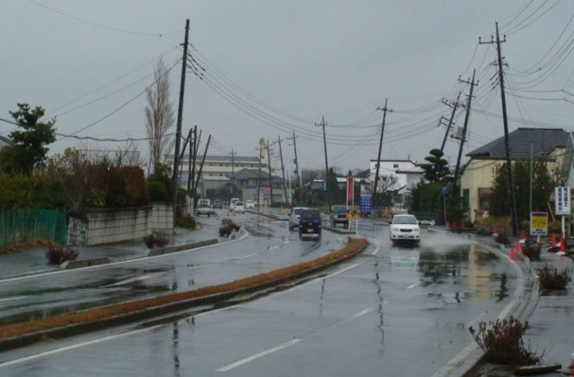
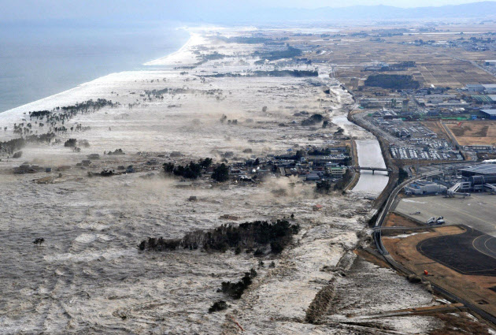
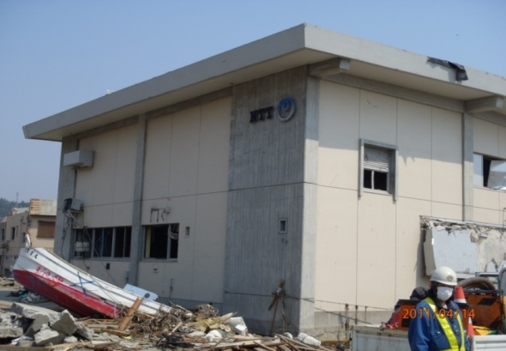
3.11 Disaster and Endurable ICT
Sendai
Fukushima
Tokyo
500 km
200 km

Slide 4
Background and Motivation
Triple Disaster:
Giant Earthquakes, Huge Tsunami,
and Fukushima Nuclear Plant Failure
Tsunami destroyed away almost All Network Infrastructure on the ground
Traffic congestion: x50~60 more than usual
80~90%(max) call restriction by operators
Mobile NW: ~29,000 Base stations shutdown
Communications unavailable !!!
Important communications links among local gov., Self Defence Force, hospitals, etc. are shut down
Aspect cannot be informed
Appropriate rescue activities cannot be done
Really robust information network is essential to save residents lives
R&D of “Resilient ICT Networks” was started as the Japanese National Project

Slide 5
Communication Tool in Disaster Situation
Initial response just after disaster
~ 1 week
1 week to a month
1 month ~
Main subject
Alarm of disaster occurrence, Inform evacuation program
Safety confirmation, Evacuator identification
First aid, Inform to evacuator and/or evacuation site
Unification of information toward recovery
Total recovery assistance
Radio is mainly used when television, cellular phone and Internet cannot be worked
Television, cellular phone, Internet
Information on earthquake, tsunami, evacuation order and direction, etc.
Radio including Community FM
Information on nuclear plant and radiations
Communication tool, needed information, etc.
Safety confirmation for family etc.
Lifeline information such as water, gas, electricity etc.
- Announcing paper and bulletin board by municipality
- Word-of-mouth communication
Information on daily goods such as food and gasoline
Traffic information on road, railway, bus
Information such as refuges and temporary houses
Time
Information necessary for industrial activity

Slide 6
Resilient ICT R&D Project on 2012 Fiscal Year
Alarm of disaster occurrence, Inform evacuation program
Safety confirmation, Evacuator identification
First aid, Inform to evacuator and/or evacuation site
Unification of information toward recovery
Total recovery assistance
NHK etc: Combining Broadcasting and Telecomm. Project #6
NTT Data etc: Transmission of Disaster Information on Multilayer Telecommunication Medium Project #10
NICT: Information Distribution Platform Test Bed Project
NTT Docomo etc: Measures of Traffic Congestion and Dynamic Control Project #1
Mitsubishi electric etc: High Compression and Low Latency Video Transmission Project #7
- Tohoku Univ. etc: Multi-layer Network Project #4
- NICT: Wireless Mesh Test Bed Project
- Sky-Perfect TV: VSAT Project #5
- NICT: Satellite Telecommunication Test Bed Project
- KDDI etc: Disaster-proof Network Control Project #3
- NICT Optical Network Test Bed Project
NTT etc: ICT Resource Unit Project #2
Example:
DX antenna: CATV Emergency Restoration Project #8
Mainly carrier and media responds
Mainly municipality responds
Kyocera Comm: CATV Emergency Restoration Project #9

Slide 7

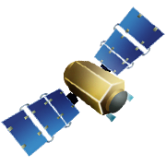







Resilient ICT Network Project
Collaboration among ＮＩＣＴ, Tohoku Univ.and Industries
Test bed construction in Tohoku University by NICT
① Robust Photonic
Network Platform
Universities and Industries
Resilient ICT Research Center
Test Bed / Platform
Unbreakable Networks, etc.
② Dependable Wireless & Satellite Network
③Anti-disaster Information Distribution Platform

Slide 8


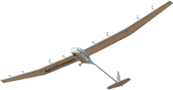

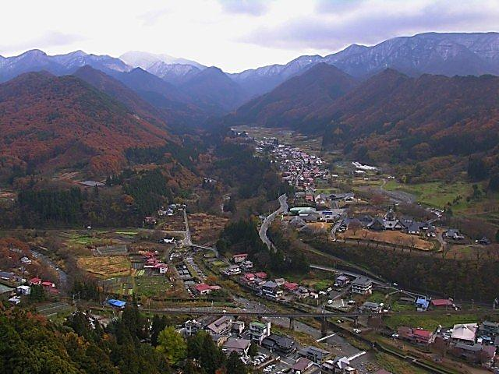
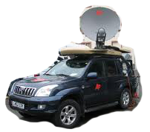

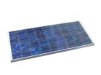

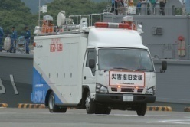
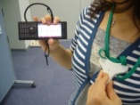

Dependable Wireless Mesh / Satellite Networks
Flexible bridging networks by satellite / UAV
Satellite
UAV
Full-automatic mobile earth terminal
Connecting isolated areas such as
mountainous areas and islands
Dependable private wireless mesh networks which can provide social services in normal time
Mobile node
Vital data transmission
Refuge B
Dependable information system for environmental or health monitoring usable in both normal and emergency situations
Refuge A
Transportable node
Rescue HQs
Sensors, etc.

Slide 9
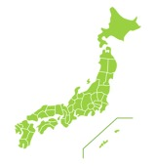
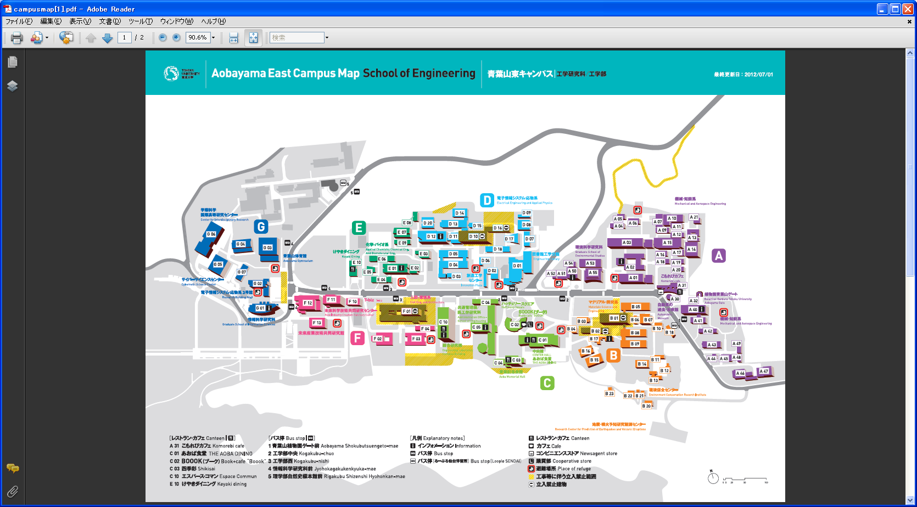
Mesh Network Test-bed in Tohoku University
W56 link
Roof-top mesh nodes w/ Wi-Fi AP
WiMAX logical link
Roof-top mesh nodes w/o Wi-Fi AP
Link to LED town light nodes
Mesh nodes integrated to LED town light
Tohoku University
Roof-top WiMAX base stations
2.4GHz coverage
2.4 GHz service link with poor conditions
2.4 GHz service link
D18
工事
道路拡張
8

Slide 10
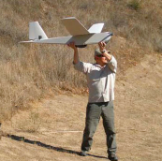
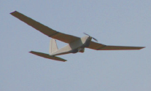
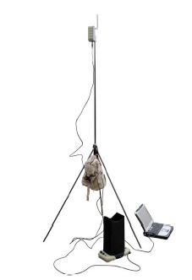
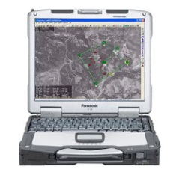
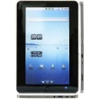
Wireless Relay Trial Using Small UAV
UAV: Unmanned Aerial Vehicle
Purpose: To keep a minimum/temporal communication link
in the seriously damaged areas
Advantages
・Rapid and easy setup
(No special operation skill / Backpack deployment available)
・Lower cost for limited missions than the network using manned
aircrafts or satellites
Autonomous/program flight
Circling at fixed points
Photo: AV Inc.
Mesh network
WiFi terminals

Slide 11
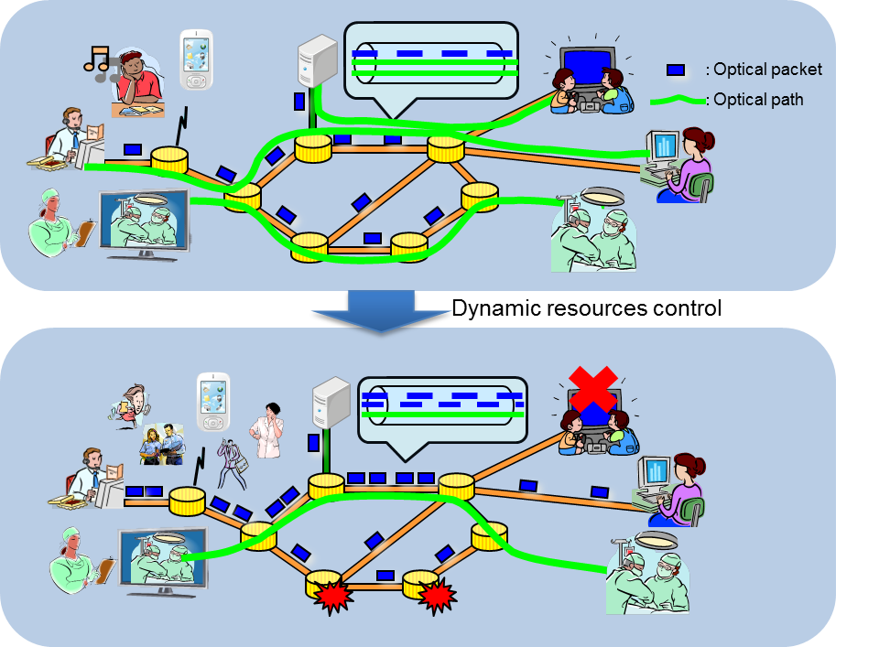
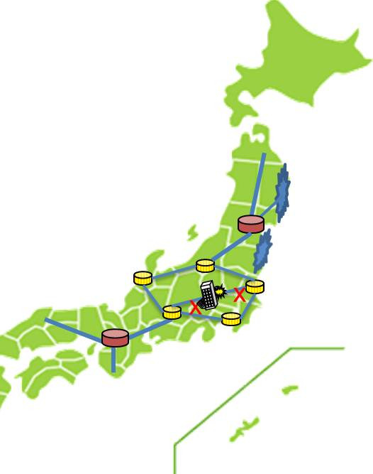
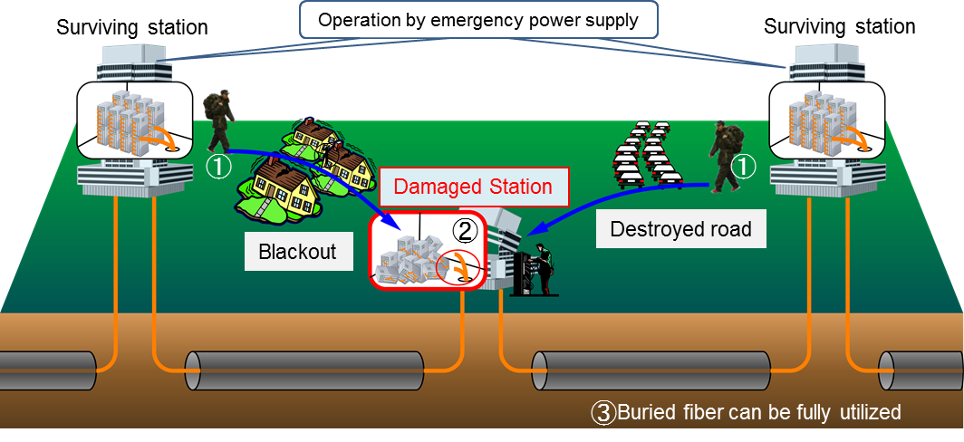
Robust Photonic Network Platform
Dynamic resources control
Reconstructing networks by utilizing survived resources
Embedded fibers
Survived switches
Other resources

Slide 12
Anti-Disaster Information Distribution Platform

Slide 13
Organized R&D Structure
NICT
Tohoku Univ
Resilient ICT R&D Center
Photonic Network Research Institute
Robust Network Platform Lab.
Collaborations
Research Institute of Electrical Comm
Graduate School of Engineering
Wireless Network Research Institute
Wireless Mesh Network Lab.
Graduate School of Info. Science
Universal Comm. Research Institute
Information Distribution Platform Lab.
Tokyo Univ,
Kyoto Univ, …
Collaborations
NICT R&D Advisory Board
Collaborations
Industry (Trustees of MIC’s Research Fund)
Project 1
Project 2
Project 10
NTT
Group
KDDI
Group
NHK
JSAT
MELCO

Slide 14
Outline of Schedule and Future Plan
Calendar Year | 2012 |  |  |  | 2013 |  |  |  | 2014 | 2015
Testbed construction in Tohoku Univ. by NICT Photonic Network Platform Wireless Mesh Network Info-Distribution Platform
R&D in Industry / Univ. (MIC’s funds -1)
Follow-on Projects (MIC’s funds -2)
Follow-on Projects (MIC’s funds -3: expected)
System design
Info-Platform operation
Manufacturing & Testing
Resilient photonic/wireless network integration
Verification
Migration to practical systems
Spec. design
Joint Demos
Installation
Two faces of project mission:
To provide essential technologies as soon as possible (~Mar. 2013)
To provide wide range of needed technologies consecutively (~2015)
Migration to practical systems:
Implementation to commercial networks and terminals
Implementation in rebuilding cities (collaborations with local gov.)

Slide 15
Summary
We learned from The Great East Japan Earthquake
  Information network has become essential infrastructure of our lives
  Current network is not sufficiently robust against large-scale disaster
Really robust Information network must be developed
“Resilient ICT” R&D as the national project
  NICT is developing test beds in the campus of Tohoku University
  NICT, industries and universities will demonstrate newly developed technologies utilizing the test beds, independently or jointly
  Collaboration between industry, academia and public sector including NICT and local government is the key
Developed technologies should be practical :
  For recovery and rebuilding in disaster stricken areas (Global )
  To prepare predicted large-scale earthquakes in near future (Domestic)

