Slide 1
ITU Workshop on “Voice and Video Services Interoperability Over Fixed-Mobile Hybrid Environments, Including IMT-Advanced (LTE)" ” Geneva, Switzerland, December 1st 2015
VoLTE and Video over LTE: Challenges and opportunities from regulatory perspective
Hichem Besbes
Telecommunication National Regulatory Authority of Tunisia (INTT)
hichem.besbes@intt.tn

Slide 2
MNOs always say: Regulation slows innovation
Why should we have this presentation ?

Slide 3
Outline
Some key statistics
Technical specifications of the LTE
Key considerations for providing voice and video over LTE
Regulatory challenges
Summary

Slide 4
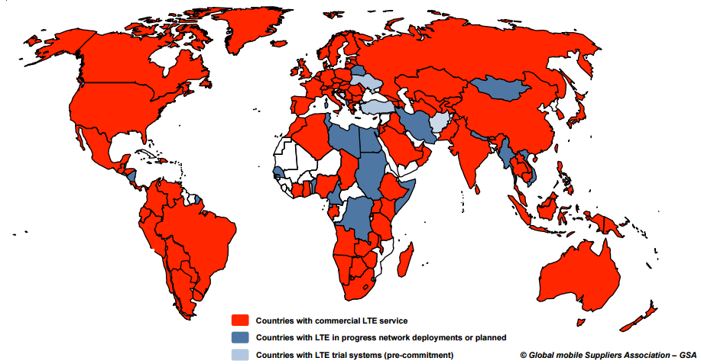
Some key statistics (1/3)
442 LTE networks commercially launched in 147 country
755 million LTE subscriptions Worldwide
111 operators investing in VoLTE and 30 lauched VoLTE – based HD voice
In Tunisia a 4G tender was opened in nov 2015

Slide 5
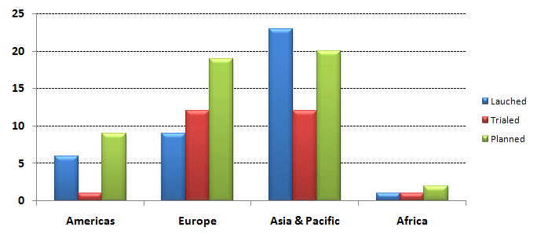
Some key statistics (2/3)
Number of operators committed to provide VoLTE service

Slide 6
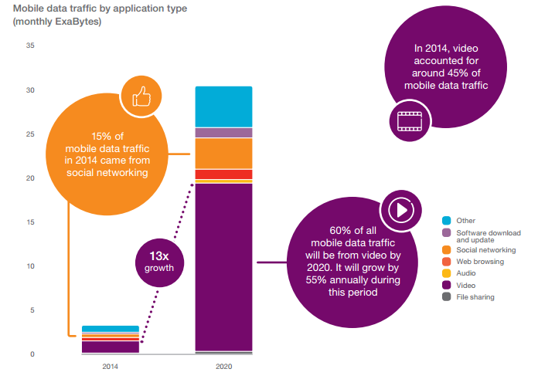
Some key statistics (3/3)
Source: Ericsson mobility report 2015

Slide 7
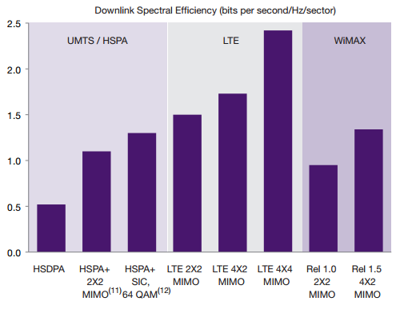
Technical features (1/2)
Source: Capgemini TME Strategy Lab Analysis; Motorola Whitepaper, Upgrade Strategies for Mass Market Mobile Broadband, 2009

Slide 8
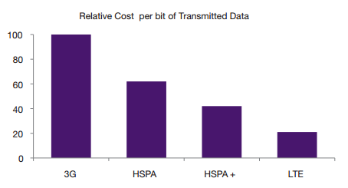
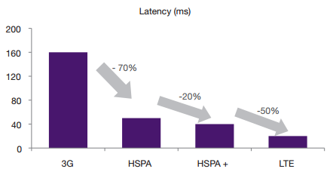
Technical features (2/2)
Source: Capgemini TME Strategy Lab Analysis; Motorola Whitepaper, Upgrade Strategies for Mass Market Mobile Broadband, 2009

Slide 9
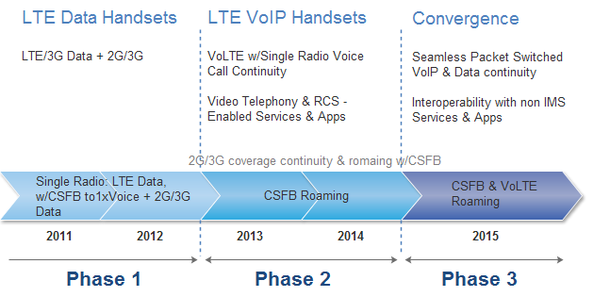
VoLTE & ViLTE: Key considerations (1/2)
The 3 phases of LTE voice evolution

Slide 10
VoLTE & ViLTE: Key considerations (2/2)
From the end user perspective
From the network perspective
Better call set up time
Voice quality depending on codec usage
Variable paths compared to legacy voice which has its dedicated path for signalling and user plans
VoLTE shares its user and signalling paths with packet switched traffic
VoLTE signalling is carried inside a data user plan
VoLTE compared to Legacy

Slide 11
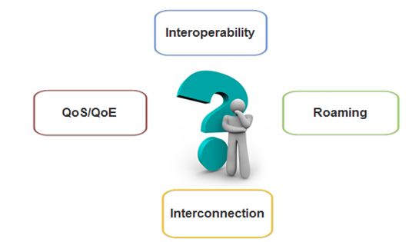
Regulatory Challenges (1/7)

Slide 12
Regulatory Challenges (2/7)
1
Interoperabilty
Interoperability of devices is still not guaranteed due to:
Different client software settings,
Different software versions,
Differences between processor technologies,
Variability of parameters established in the core network,
Different LTE frequency bands,
Devices must have the same codec voice and QoS bearer in order to enable VoLTE to VoLTE voice calls

Slide 13
Regulatory Challenges (3/7)
2
Interconnection
There is a need to adapt rules and pricing models for an IP interconnection model
Interconnection for the provision of VoLTE will pass through the deployment of IPX which has crucial problem: time‐based billing mechanisms

Slide 14
Regulatory Challenges (4/7)
3
Roaming
Various parameter settings defined in the IMS core network and the VoLTE client can vary from carrier to carrier, which can prevent a device from one carrier registering on another network
Most existing charging and routing models have certain limits:
Negative impact on voice quality
Lack of support of emergency calls and lawfull interception
Have no or limited control of routing or termination rates

Slide 15
Regulatory Challenges (5/7)
3
QoS/QoE
VoLTE requires full implementation of QoS on bearer level, IP and lower levels,
QoS for VoLTE is somehow a bit specific taking into account the difference in network architecture compared to legacy voice/circuit-switched network

Slide 16
Regulatory Challenges (6/7)
3
QoS/QoE
QoS measurements of VoLTE can be done either in the handset or the network,
QoS measurements done in the handset are similar legacy voice QoS measurements (measurement of the incoming stream based on some KPIs)
QoS measurements made on the network are done differently due to differences in networks architectures

Slide 17
Regulatory Challenges (7/7)
3
QoS/QoE (KPIs)
KPIs of typical voice service | KPIs relevant to VoLTE
−Voice Quality −Call success rate −Call setup success rate −Call drop rate −Call setup time | −SRVCC −RTP packet loss −RTP jitter −IMS KPIs (e.g. Initial Registration Success Rate) −EPC KPIs (e.g. Bearer Establishment Success Rate)

Slide 18
Summary
Successful implementation of VoLTE depends, from a regulatory point of view, on ensuring:
no discrimination between users: geographical discrimination, price discrimination, universal service
end-user satisfaction in term of QoS/QoE
Lack of interoperability: back to “on-net club”
Regulation will have to try to overcome all challenges related to VoLTE and ViLTE provision.

