Slide 1
VoLTE Device Interoperability Challenges
Thomas Eyring
Director of Engineering
MNO Test Solutions
Thomas.Eyring@rohde-schwarz.com
Notes:
Thank you very much for the nice introduction and also welcome from our end to another Rohde&Schwarz webcast about LTE. Also this time we will focus on upcoming challenge with LTE as of 3GPP Release 9. After talking earlier this year about broadcast and multicast in LTE, known as evolved MBMS, we are going to talk this time about supported positioning methods in LTE and how to test this on a terminals receiver.
And when I say WE, than I mean that I tag team this time with one of my coworkers. Me, that’s Andreas Roessler. I’m Technology Manager focusing on LTE and LTE-Advanced, dedicated to the North American market. And I’m very happy to have support from one of my colleagues but I let him introduce himself: Meik… [PAUSE]
Thanks Meik. And that brings to our agenda…
→ NEXT SLIDE

Slide 2
VoLTE Device Interoperability What are the challenges today?
LTE provides all over IP network, discontinuing the CS-based voice of legacy wireless standards
No straight forward path to introduce Voice over LTE for MNOs
OTT application already support Voice over LTE today
Network operators have the opportunity to differentiate with fully integrated voice service based on IMS/VoLTE and additional rich communication services

Slide 3
Introduction Voice over LTE From IMS to VoLTE
IMS
IMS standardization laid the ground work with an all-over-IP service network architecture already in 3GPP Rel5
Network roll-out hampered by “IMS complexity trap”
One Voice
One Voice Industry Initiative specified a particular profile for voice & SMS over IMS to reduce complexity and specify a minimum feature set
Includes Single Radio Voice Call Continuity (SRVCC)
IR.92
(VoLTE)
GSMA VoLTE Initiative has adopted One Voice specification
Focus on entire end-to-end voice & SMS service and emphasize on roaming and interconnect interfaces
Promoting CSFB
VoLTE is common standard for Voice in LTE
Now industry standard but is this sufficient?

Slide 4
LTE Device Testing in Lab and Field
Methods for Device Testing and Certification
Field / Lab IOT
Carrier Acceptance Test
GCF / PTCRB
Conformance Testing
Real user experience
Limited test coverage, e.g difficult to test failure cases and bound to BS feature support
Requires significant resources and planning
Limited scalability
Limited reproducibility
Tailored to specific MNO needs
Flexible and fast delivery of test solutions suitable for new technology introduction
Requires investment and resources
Based open standards for testing (3GPP, OMA)
Industry recognized committees
Scalable due to Industry consensus
Foster open market devices
Consensus driven approach hampering progress sometimes
✓
✓
✓
û
û
û

Slide 5
LTE Device Testing GCF / PTCRB Device Certification
Device certification verifies that a terminal is compliant with a particular version of the 3GPP Specification
Validated test equipment is provided by the test industry now
Description | GCF | PTCRB
LTE 34.229 IMS-Call Control (CC) / MTSI | WI-103,WI-198 | RFT053/106
LTE SMS over IMS | WI-128 | RFT092
LTE 36.523 Service Specific Access Control (SSAC) | WI-171
FDD Conformance TCs IMS emergency call over LTE | WI-154 | RFT097
TDD Conformance TCs IMS emergency calls over LTE | WI-154
LTE 36.523 Single Radio Voice Call Continuity in alerting phase (aSRVCC) | WI-172
LTE 36.523 Single Radio Voice Call Continuity before ringing phase (bSRVCC) | WI-225
LTE 36.523 Service Specific Access Control (SSAC) Connected Mode | WI-226
✓
✓
✓
✓
✓
✓
✓
✓

Slide 6
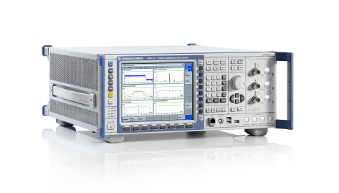
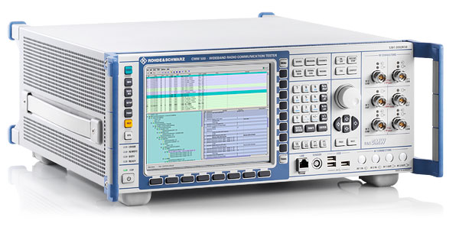
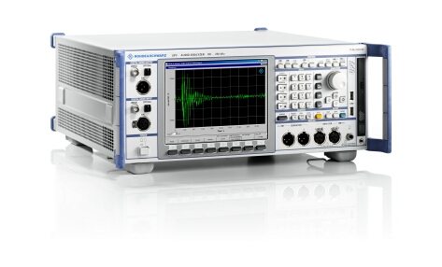
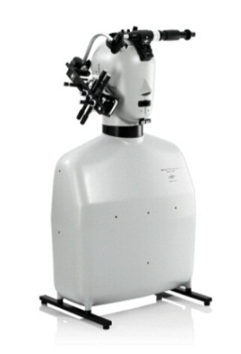
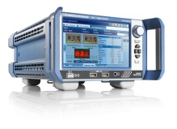
IMS Device Testing Overview Areas of Testing
Verify audio quality using PESQ®
and POLQA® algorithm
Acoustic analysis: 3GPP TS 26.132
→ LTE attach procedure
→ IMS registration
Session Initiation Protocol (SIP)
Audio: echo verification in loopback mode
Performance
Testing
Quality
Testing
Functional
Testing
R&S®CMW500
LTE Call-box
R&S®CMW500 LTE Protocol Tester
R&S®CMW-PQA
R&S®UPV
Audio Analyzer
R&S®VTE
Video Analyzer
end-to-end performance
Impact of noise and fading
IP traffic impairment (Jitter, Packet loss, Delay)

Slide 7
VoLTE Challenges Interoperability of VoLTE deployments
Goal of VoLTE was to narrow down IMS options for voice
Most MNO roll-outs of VoLTE are not interoperable. Key issues are
different EPS bearer setup
proprietary simplification of SIP call flows
operator specific introduction of SIP headers
different security configuration (AKA, IPsec, …)
None interoperable roll-out of VoLTE hampers national as well as international roaming and leads to fragmentation in the market

Slide 8
VoLTE Challenges Service Parity and Standardisation
Customers expect at least same user experience in VoLTE as they know from CS-Voice.
CS-Voice is tightly specified based on 3GPP NAS protocols CC/MM includes
State machines & timers
Error and failure case specification
Implementation of IMS/VOLTE is much more proprietary and varies from device to device, e.g.
Device behavior when receiving SIP error message
Device behavior when LTE connection is lost

Slide 9
Interworking of VoLTE with CS-Voice
Technique | Description | Use Case
Dual Stand-by | Independent radios for Voice (GSM, 3G, CDMA2000) and Data (LTE) | Useful to provide voice over legacy network
Circuit Switched Fallback (CSFB) | HO to legacy technology to establish common CS call LTE connection suspended | Required for roaming support
Single Radio Voice Call Continuity (SRVCC) | During VoLTE Call HO to legacy technology and establish common CS call CS voice handled as IMS service | Maintain speech connection when running out of LTE coverage
CSFB and SRVCC support is necessary to cope with handover and roaming scenarios
Dual Stand-by is required in selected markets

Slide 10
VoLTE Emergency Call
VoLTE Emergency attach request is specified in 3GPP Rel9
In addition regulatory requirements required support of Location based Services
US FCC E911: requires that location information is automatically reported by UE to identify the closest PSAP (Public Safety Answering Point)
In Europe, mobile operators have to supply the „best location information available“ per requirement of the EU directive E112
Location Based Service (LBS) can be achieved by various combination of different techniques and protocols
Based on satellite (GPS, GLONASS) or network (OTDOA, eCID)
Based on C-Plane protocol or SUPL 2.0
Different combinations of VoLTE Emergency Call and LBS services needs to be considered to cope with local regulatory requirements

Slide 11
Summary
Deployment of VoLTE is ongoing and already >30 MNOs have launched VoLTE Services.
UICC interoperability is not given in most cases due to VoLTE “dialects” not interoperable with each other
Support of VoLTE / CSFB / SRVCC / VoLTE Emergency Call remains a challenging target for some time
Required activities to avoid further fragmentation of the market and lay foundation for VoLTE roaming
Industry agreement to narrow down the VoLTE standard even further
Advanced testing e.g. GCF/PTCRB device certification
Lessons learned from IR.92 should be considered for IR.94 (Video over VoLTE), VoLTE over WiFi and RCS

Slide 12
Thank you
for your attention
Please join our demonstration outside

