Slide 1
ITU Workshop on “Voice and Video over LTE” Geneva, Switzerland, 1 December 2015
ACTIVITIES OF THE ITU-T SG11 TOWARDS IMS AND VoLTE/ViLTE INTEROPERABILITY AND INTERCONNECTION
Martin Brand,
Vice Chairman of SG11, Chairman of WP 4/11
A1 Telekom Austria AG
martin.brand@a1telekom.at

Slide 2
Content
Background and general issues
Current ITU-T activities on SIP-IMS conformity assessment
Actions needed by ITU-T to achieve SIP-IMS interoperability
Steps towards IMS and VoLTE/ViLTE interoperability and interconnection
Future plans of ITU-T SG11

Slide 3
BACKGROUND
Most telecom operators have already implemented the IMS platform, connecting their customer’s Terminal Equipment (TE) through SIP-IMS protocol
Different implementation of SIP-IMS protocols may result in additional operator’s efforts (budgets) to adapt TE to the installed IMS platform
The roaming for VoLTE-based services among operators is not guaranteed due to the different implementations/options of VoLTE, the lack of unified standardized interconnection requirements and signaling protocols
International standards (such as ITU-T Recommendations) are the best tool to achieve interconnection between worldwide telecom operators

Slide 4
GENERAL ISSUES
Interoperability issues related to impossibility of terminal equipment to establish e2e voice or video sessions due to incompatibility of their codecs (transcoding is needed).
Interconnection issues (roaming) related to impossibility of establishing e2e connection between two operators due to the lack of the agreed interconnection procedures (scenarios of the interconnection) and different implementations of signaling protocols

Slide 5
SIP-IMS conformance testing
under Q11/11 “Protocols and networks test specifications; frameworks and methodologies”
http://www.itu.int/en/ITU-T/C-I/Pages/SIP/IMS.aspx

Slide 6
OBJECTIVES OF SIP-IMS STANDARDIZATION PLAN
Collect all standards on SIP-IMS profile in ITU-T and amend it with missing standards (e.g. requirements, test specifications, use cases, etc.)
Establish a framework for the conformity assessment of SIP-IMS profile which may be used by all fixed telecom operators in the world for testing equipment based on SIP-IMS profile
Support the conformity assessment of equipment against ITU-T Recommendations on SIP-IMS profile (Testing Laboratory and other interested parties are invited)
Create a list of TEs based on SIP-IMS profile which comply with ITU-T Recommendations (e.g. signalling protocol, voice QoS/QoE)
Align and develop ITU-T Recommendations in collaboration with ETSI TC INT

Slide 7
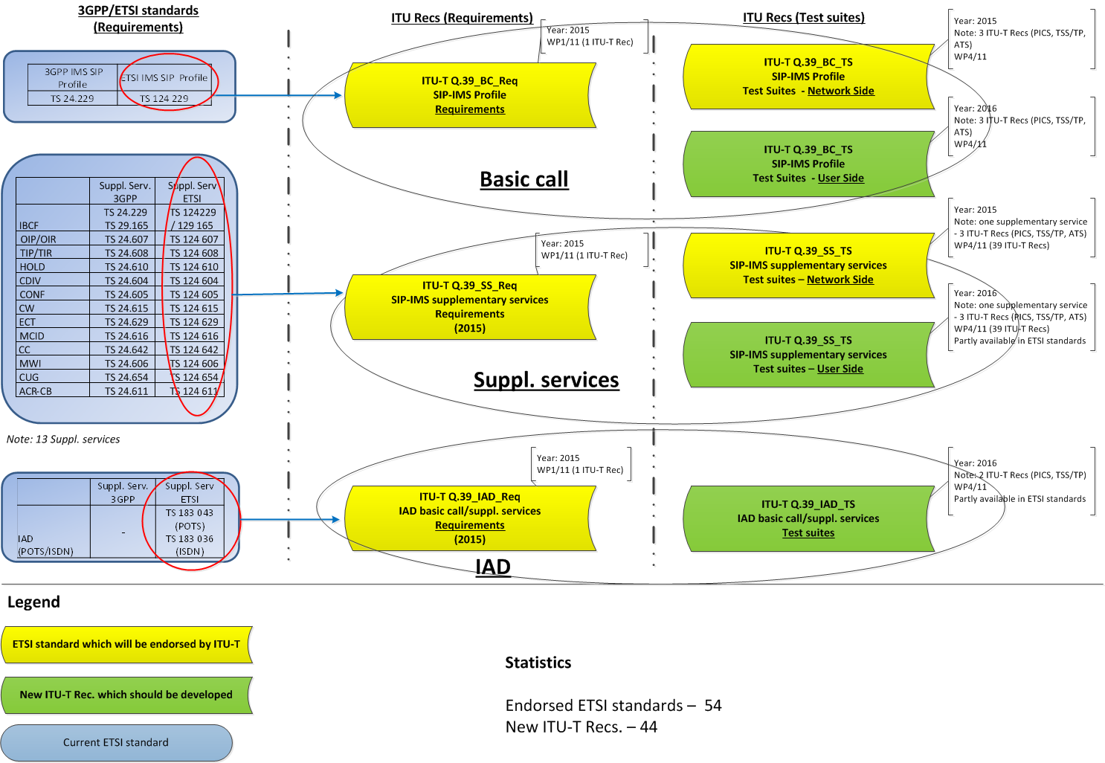
WORK PLAN ON SIP-IMS STANDARDIZATION

Slide 8
ACTIONS NEEDED BY ITU-T TO ACHIEVE SIP-IMS INTEROPERABILITY
To ensure the interoperability between IMS platforms used by operators ITU-T SG11 must define:
The extension/adaptation of the ITU-T Q.1912.5 interworking and its applications for IMS Platforms (e.g. SIP header fields)
Internet Protocol (IP) multimedia call control protocol based on Session Initiation Protocol (SIP) and Session Description Protocol (SDP) the services needed for interconnection
Service requirements for the IP multimedia core network subsystem
Telecommunication management and charging management
SBC functionalities and Security requirements
ENUM procedures and functionalities in the NGN

Slide 9
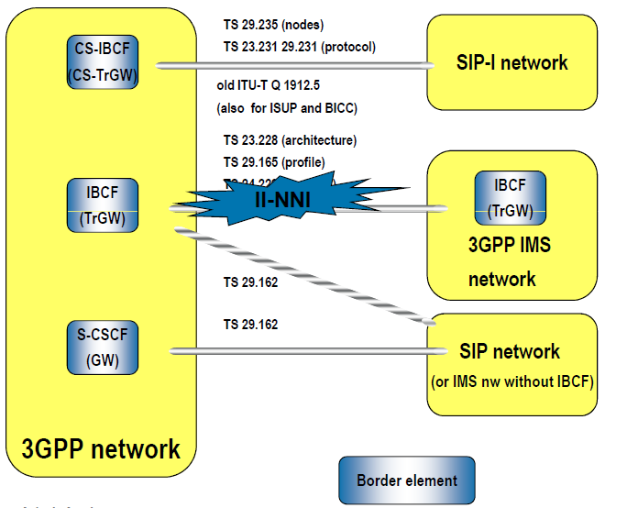
IMS INTERCONNECTION INTERFACES
24.229 Mx Interface
24.229 Mx Interface
24.229 Mx Interface

Slide 10
STEPS TOWARDS IMS AND VoLTE/ViLTE INTEROPERABILITY
Make the best use of ITU-T standardization process to ensure the international interoperability of services
Join efforts with other SDOs (such as ETSI TC INT) to maximize the resources available to perform this work
Endorse and adapt the current ETSI IMS standards which are needed for the interoperability according to the ITU-T NGN architecture
Develop the missing IMS conformance test specifications for the user and network sides

Slide 11
PLANS FOR ITU-T SG11 MEETING ON SIP-IMS AND VoLTE
Discuss the following items during ITU-T SG11 meeting (2-11 Dec 2015):
a new draft ITU-T Recommendation “Framework of interconnection of VoLTE/ViLTE-based networks”, which aims to enable a gap analysis of requirements for VoLTE/ViLTE-based networks (see next slide).
a revision of the ITU-T Q.1912.5 “Interworking between SIP and BICC protocol or ISDN User Part” according to the IMS requirements.
A Collaboration agreement between ITU-T SG11 and ETSI TC INT to develop technically aligned standards on SIP-IMS, VoLTE interconnection and Internet speed measurement.

Slide 12
NEW DRAFT ITU-T RECOMMENDATION Framework of interconnection of VoLTE/ViLTE-based networks
The content of the proposed ITU-T Recommendation includes:
General description of the interconnection of the VoLTE-based networks
Network architecture of interconnected VoLTE-based networks
Scenarios of e2e VoLTE/ViLTE communications on domestic and international levels
Interconnection scenarios
Requirements to signaling protocol used on interconnection
Use cases of the implementation VoLTE/ViLTE on the existing operators’ networks

Slide 13
FUTURE PLANS
To discuss contributions on VoLTE and SIP-IMS submitted to the forthcoming ITU-T SG11 meeting (2-11 December 2015)
To finalize SIP-IMS standardization work plan by WTSA-16
To develop test specifications for signalling protocols used for interconnection of the VoLTE-based networks

Slide 14
ALL STAKEHOLDERS ARE INVITED TO JOIN THE DISCUSSION IN ITU-T SG11
All interested parties are invited to participate in ITU-T SG11. The discussion of the new draft Recommendation will be held during Question 2/11 meeting, scheduled on 4 December 2015 (starts 14:30 in ITU HQ, Geneva).
Remote participation may be provided upon request.
Online registration is available on the SG11 web page.
For more information, please, contact tsbsg11@itu.int

Slide 15
Thank you!
Martin Brand
Vice Chairman of SG11, Chairman of WP 4/11
A1 Telekom Austria AG martin.brand@a1telekom.at

