Slide 1
ITU Workshop on “Voice and Video over LTE”
Geneva, Switzerland, 1 December 2015
China Mobile VoTLE Status and Further Consideration
Yachen Wang
Senior Manager of Network Technology Dept
China Mobile
wangyachen@chinamobile.com

Slide 2
Agenda
Why VoLTE?
China Mobile VoLTE status
China Mobile VoLTE further consideration

Slide 3


Alternative LTE Voice Solutions
There are two kinds of LTE terminals: LTE multi-mode dual standby and LTE multi-mode single standby.
Voice service of LTE multi-mode dual standby terminals is provided by CS network.
Voice service of LTE multi-mode single standby terminals is provided by LTE(VoLTE) or CS(CSFB)network.
TD-LTE Multi-mode
Dual Standby
TD-LTE Multi-mode
Single Standby
LTE support data only
LTE support voice& data
Multi-mode dual standby
Terminal resident in LTE and CS ，voice service provided by CS and data service provided by LTE.
CSFB
Terminal prefer LTE residence ，Fallback to 2/3G when using voice service.
VoLTE/SRVCC
In LTE coverage, provide IMS voice, support SRVCC to provide voice continuity.
CS
④
VoCS
CS
①
CS
Voice
Sv
Fallback
SGs
SRVCC
HO
TARGET
SOLUTION
DS phone
Data
TRANSITION
SOLUTION
②
TRANSITION
SOLUTION
LTE
LTE
VoIP
LTE
CSFB phone
③
Data
VoLTE phone

Slide 4
VoLTE Overview and Basic Features
VoLTE supports HD voice and Video in the mean time, interworks with CS voice.
FEATURE1：
VoLTE call control & service trigger based on IMS
FEATURE2：
EPC provide Guaranteed QoS for VoLTE
FEATURE3：
Before full coverage, eSRVCC can provide voice call continuity
All IP
Low cost
HD voice
& video
Capacity
improved
Call
Setup time
Service
expansion
↓70%
X2
X2.5
↓50%
XN

Slide 5
Agenda
Why VoLTE?
China Mobile VoLTE status
China Mobile VoLTE further consideration

Slide 6




China Mobile at a glance
VoLTE deployment will migrate 820 million CMCC voice service users from CS to IMS.
820 million
500+
2G/3GSubscribers
31
1 Million+
Roaming Partners
TD-LTE stations
IMS Domains
268 million
4G Subscribers

Slide 7
VoLTE Commercial Launch
China Mobile starts commercial launch from July 2015.
By Sept, Hangzhou and Beijing became the first two commercial cities with 4081 subscribers.
China Mobile is planning to roll out VoLTE in 145 cities by the end of 2015.
Hang
Zhou
Bei Jing
18 more cities
21 more cities
104 more cities
VoLTE commercial launch plan
2015.08
2015.09
2015.10
2015.11
2015.12

Slide 8


High level functional architecture
Application Layer
VoLTE AS
SCP AS
Value added AS
BOSS
HSS
BOSS
Core Network
DRA
PCC
EPC
IMS
2G/3G
MSC
NMS
IP bearer
Access
LTE
eNodeB
BTS/BSC
OMC
2G
Terminal
VoLTE UE
VoLTE major functionalities have been developed:
  Network attach, IMS registration, HD voice & video call
  Mobility management, including eSRVCC
  IPv6 supported
  Policy Charging Control…

Slide 9
VoLTE Service
Supplementary service
Intelligent network service
Value added service
HD Voice
HD Video
eSRVCC
IMS
Emergency call
International Roaming
Supported
TBD

Slide 10
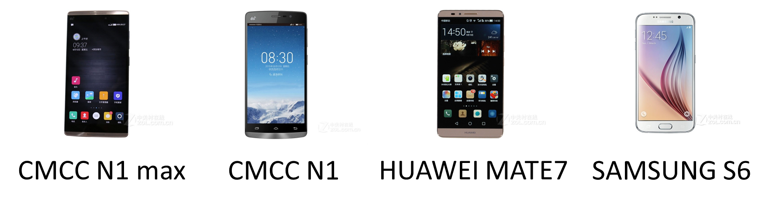
TD-LTE VoLTE Terminals
4 types of TD-LTE commercial terminals are provided for VoLTE by Sep. 2015.
Around 20 types of TD-LTE terminals are proposed for VoLTE launch by the end of 2015.

Slide 11
Suggestions in VoLTE Deployment
Services Migration
User Experience
Charging Policy
Various Services Exist:
  Supplementary Services
  Value-added Services
  IN Services
No unified Solution for Service Migration
Operators need to carefully develop Service Migration Solution, according to their own service situations
#1 Introduce New Features:
  eSRVCC
  aSRVCC
  bSRVCC
  Mid-call SRVCC
#2 Extend LTE Coverage
Operators need to balance between #1 and #2
Minutes Based Charging
vs.
Volume Based Charging
More things to think about on VBC
  CDR correlation
  Content charging
  Roaming charging
Operators need to pay more attention to charging policy

Slide 12
Agenda
Why VoLTE?
China Mobile VoLTE status
China Mobile VoLTE further consideration
  International Roaming
  VoLTE Interoperability
  “VoLTE+” Project

Slide 13
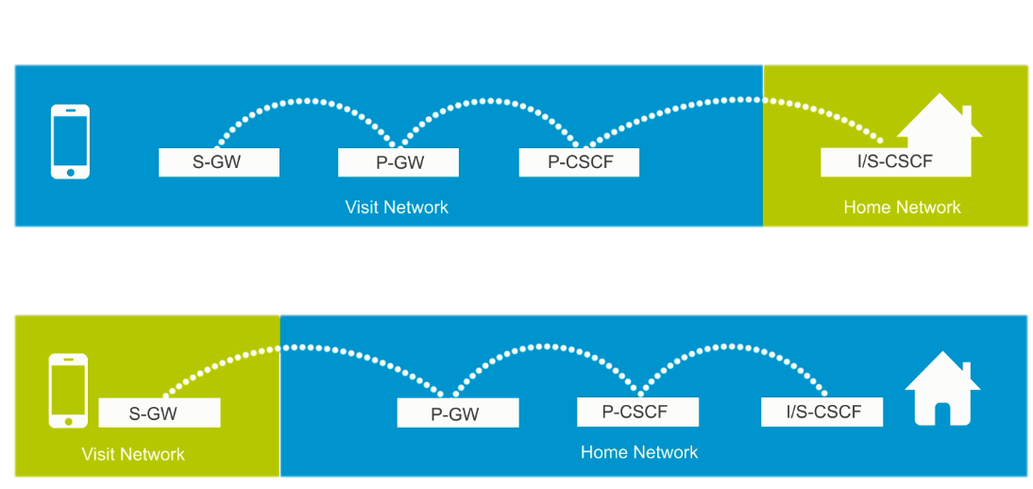
International Roaming
GSMA’s endorsement of two roaming architectures that can’t interworking with each other is leading to market fragmentation between operators.
The main contradiction is whether access IMS in Visited network or in Home network.
RAVEL: Roaming Architecture for Voice over IMS with Local Breakout
S8HR: S8 Home Routed

Slide 14
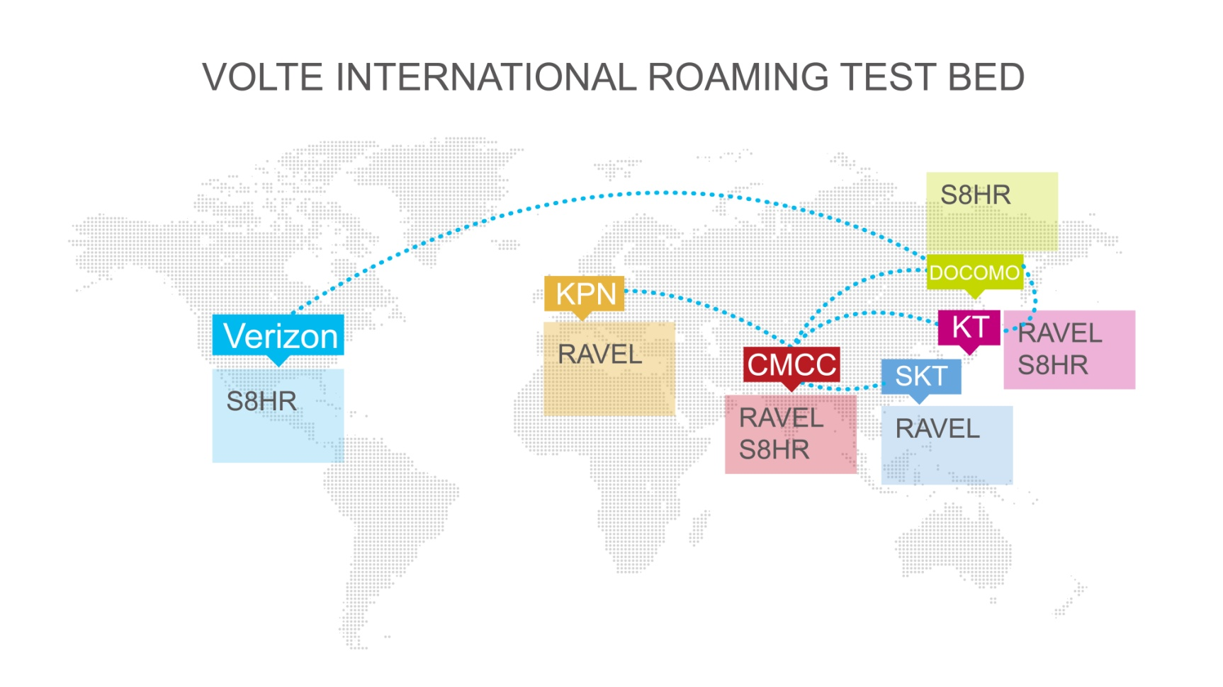






International Roaming Trials
China Mobile drives VoLTE International Roaming Trial in GSMA, and release “VoLTE International Roaming Trial Guidance”.

Slide 15

VoLTE Interoperability
VoLTE Interoperability issue (UNI & NNI) delayed VoLTE deployment
  Significantly increased support burden and cost for OEMs
  Operators must complete complex integration and IOT test
GSMA launches “VoLTE Interoperability Initiatives”
  VIRTUE: improvement to GSMA Specs
  China Task Force Light House project:
    Lead by China Mobile, along with other China operators and Huawei, ZTE, Qualcomm, MTK etc.
    Define detailed VoLTE UNI profile to eliminate IOT issue
    Conformance test
    Support VoLTE Open Market Device

Slide 16
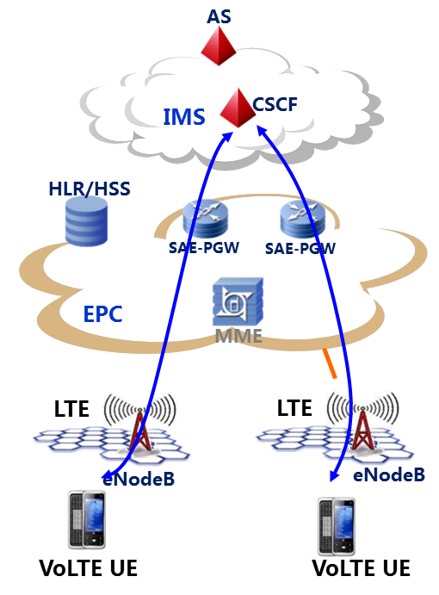
China Mobile“VoLTE+” Project
+
: Improvement of user experience
VoLTE
+ new access types
(VoWiFi… )
+ new services/features
(multi-party Video call…)
+ new type of terminals
(WebRTC terminal…)

Slide 17
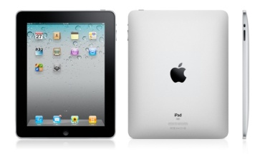










1、VoWiFi (VoLTE Wifi offload)
Core Network and Services
2G/3G/LTE
Internet and
Internet Services
User Equipment
WiFi Access Point
Voice continuity between LTE and Wifi
Better indoor coverage when higher LTE frequency bands are used.
Widely available and supported by UEs/handsets, tablets, laptops.
Lower charging strategy especially when roaming.

Slide 18

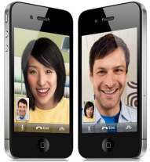


2、Multi-party video call
IMS
AS+
Expansion of VoLTE services
HD multiparty video call compared with OTT
Without installing APP
EPC
HD Video
Multiparty Video Call

Slide 19


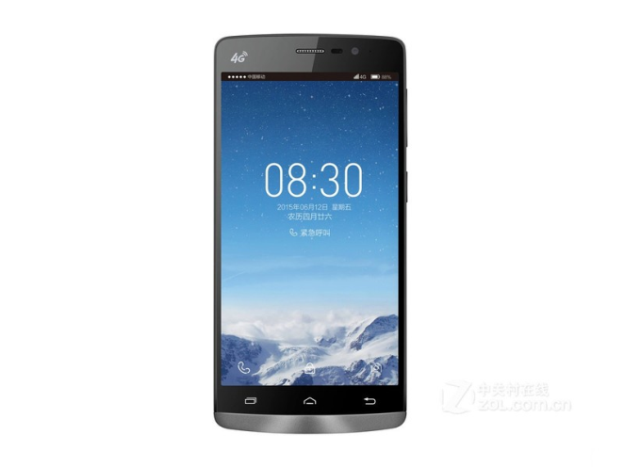

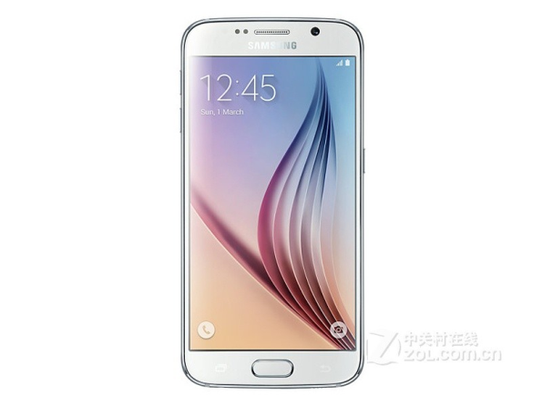


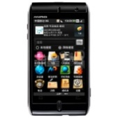
3、WebRTC & VoLTE capability exposure
Expansion of telecom capability
New type of terminals access to IMS
New experience for browser users
New mode for service capability exposure
New features introduced from OTT service
VoLTE
WLAN/3G/LTE
VoLTE terminal
WebRTC terminal

Slide 20
Summary
Collaborations are important on VoLTE international roaming through standardization and tests for its commercial use.
VoLTE UNI profile could advance the fast development of VoLTE gloably.
ITU Standardization on “VoLTE +” would be beneficial for operators to find a way for the next step of network and service evolution.

Slide 21
Thanks!

