Slide 1
Joint ITU-UNIDO Forum on Sustainable Conformity Assessment for Asia-Pacific Region
(Yangon City, Republic of Union of Myanmar 25-27 November 2013)
The ITU Conformity & Interoperability Programme
Pillars 3 and 4
Sameer Sharma
Senior Advisor ITU
Regional Office for Asia-Pacific
sameer.sharma@itu.int

Slide 2
Background and Context
ICT - Key driver for socio-economic development and regional integration
ICT users have certain expectations regarding interoperability of products and services (regardless of who is the manufacturer or service provider)
International Standards, national regulation and compliance
Conformance assessment increases the probability of interoperability
Notes:
Information and Communication Technologies (ICTs) and their related services are widely recognized as key drivers for socio-economic and cultural development, as well as for regional integration.
In a global economy characterized by rapid technological change, a variety of ICT solutions and by the convergence of telecommunication networks and services, ICT users – public entities, businesses and consumers - , have understandably certain expectations regarding interoperability, quality and safety, as well as environmental sustainability of products and services.
In this regard, to facilitate a safe usage of products and services anywhere in the world, regardless of who is the manufacturer or the service provider, it is crucial that products and services be developed in accordance with relevant international standards, regulations and other specifications, and that their compliance be tested.
Conformance assessment is assured by performing the special testing procedures in recognized laboratories capable of verifying that concerned ICT equipment are build according to international standards.
Conformity assessment increases the probability of interoperability, e.g. equipment built by different manufacturers are capable of communicating successfully. In addition it helps ensuring that products and services are delivered according to expectations. Defining more interfaces where interoperability can be tested increases competition and reduces the chances of being locked into a single product/proprietary solution.
Availability of high quality performing products will accelerate widespread deployment of the infrastructure, technologies and associated services allowing people to access to the Information Society regardless of their location or chosen device and contributing to attaining the Millennium Development Goals Between products in a multi-vendor, multi-network and multi-service environment.
Such as ETSI, 3GPP, ITU, etc.

Slide 3
Problems Faced
Lack of performance and of compliance to conformity and interoperability requirements
Market with large percentage of counterfeit products
Legacy, regulatory, contractual and legal issues
Developing Countries linked to one vendor; poor market competition and lack of technology neutrality
Notes:
Problems faced – this summary was based on the inputs that lead to the Approval of the C&I Resolution.
Also were based on the Questionnaire

Slide 4
Conformity Assessment Benefits
Conformity assessment builds consumers’ trust and confidence in tested products and consequently strengthens business environment and, thanks to interoperability, the economy benefits from business stability, scalability and cost reduction of systems, equipment and tariffs.
Notes:
PROBLEM STATEMENT
Conformity assessment builds consumers’ trust and confidence in tested products and consequently strengthens business environment and, thanks to interoperability, the economy benefits from business stability, scalability and cost reduction of systems, equipment and tariffs.
While economically Conformance and Interoperability (C&I) increase market opportunities, encourage trade and technology transfer and contribute to the removal of technical barriers, they socially help spreading ICT services availability and affordability to all people at a good level of quality.
To increase the benefits of C&I, many countries have adopted harmonized C&I regimes both at national and bi- or multi-lateral level. However, some developing countries, such as Southern African countries, have not yet done so because of a number of major challenges, such as the lack of appropriate/adequate regulatory frameworks, human capacity and infrastructure, to be in a position to test or to recognize tested ICT equipment (laboratories and related infrastructure).
World Telecommunication Standardization Assembly 2012 (WTSA-12), Dubai, Resolution 76.

Slide 5
Conformity Assessment Benefits
While economically Conformance and Interoperability (C&I) increase market opportunities, encourage trade and technology transfer and contribute to the removal of technical barriers, they socially help spreading ICT services availability and affordability to all people at a good level of quality.
Notes:
PROBLEM STATEMENT
Conformity assessment builds consumers’ trust and confidence in tested products and consequently strengthens business environment and, thanks to interoperability, the economy benefits from business stability, scalability and cost reduction of systems, equipment and tariffs.
While economically Conformance and Interoperability (C&I) increase market opportunities, encourage trade and technology transfer and contribute to the removal of technical barriers, they socially help spreading ICT services availability and affordability to all people at a good level of quality.
To increase the benefits of C&I, many countries have adopted harmonized C&I regimes both at national and bi- or multi-lateral level. However, some developing countries, such as Southern African countries, have not yet done so because of a number of major challenges, such as the lack of appropriate/adequate regulatory frameworks, human capacity and infrastructure, to be in a position to test or to recognize tested ICT equipment (laboratories and related infrastructure).
World Telecommunication Standardization Assembly 2012 (WTSA-12), Dubai, Resolution 76.

Slide 6
C&I Programme
To tackle different obstacles to the achievement of conformity and interoperability, expressed by member states in ITU`s Decisions.
C&I Task Force
Regional Presence
Notes:
C&I Task Force evolving all Sectors
C&I Action Plan

Slide 7
ITU’s Decisions – C&I Action Plan
Resolution 177 ITU Plenipotentiary Conference (PP-10)
Resolution 47 ITU (WTDC-10)
Resolution 76 ITU World Telecommunication Standardization Assembly (WTSA-12)
Resolution 62 Radiocommunication Assembly (RA-2012)
ITU Council Decisions (2009, 2010, 2011,2012, 2013)

Slide 8
“The four Pillars”
C&I
1 Conformance Assessment
4 Testing Centers (Labs/MRAs)
2 Interoperability
3 Capacity Building
Notes:
Brief description and Action Plan Status

Slide 9
Pillar 3
C&I
1 Conformance Assessment
4 Testing Centers (Labs/MRAs)
2 Interoperability
3 Capacity Building

Slide 10
Training Goals
The ITU Training on C&I – is a capacity event in the framework of the Conformity and Interoperability Programme that has as objective:
Improve knowledge of participants through the presentation of up-to-date information/technologies
Contribute to increase awareness on the relevance of C&I testing

Slide 11
Training Goals
Provide the necessary tools for participants to replicate knowledge in their country, taking into consideration national specificities
Promote experience-sharing on Certification/Homologation process, Lab. Accreditation and testing among the participants from different countries in Conformance and Interoperability field
Present a practical learning on standards, regulations, real Lab experience and accreditation procedures.

Slide 12
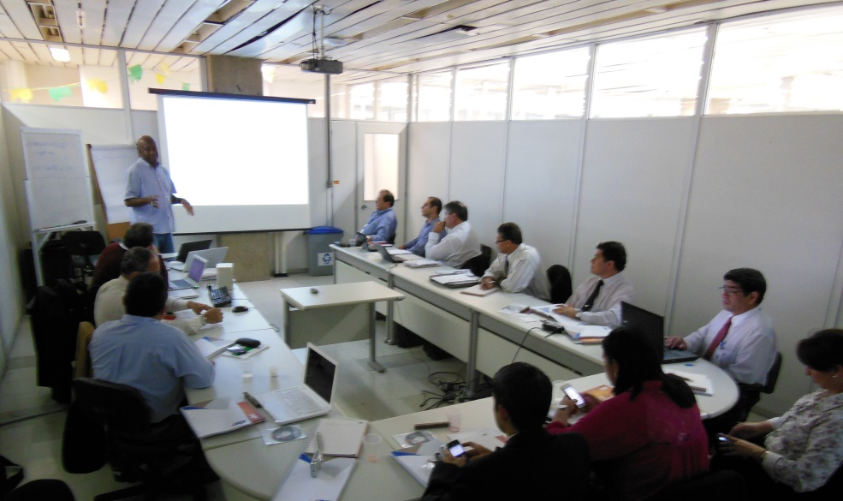
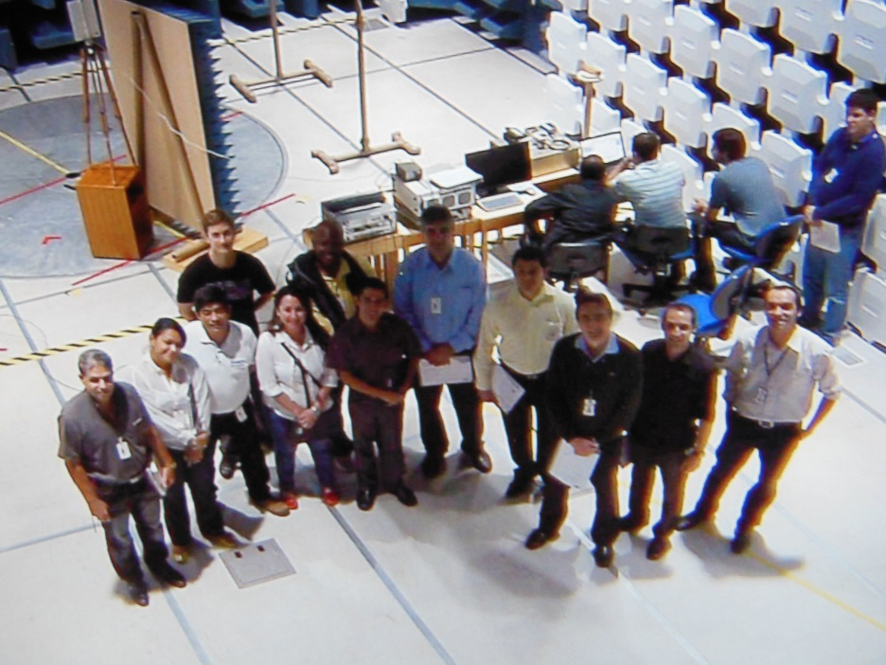
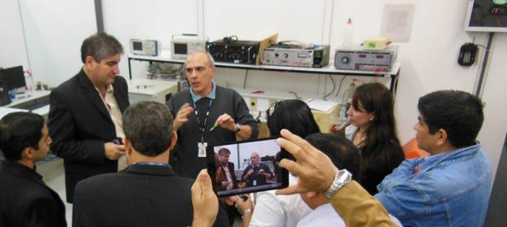
Training on C&I

Slide 13
Capacity Building Events (2013)
Training on Conformance and Interoperability for Arab Region (Tunis, 2-6 April 2013)
Training on Conformance and Interoperability for Americas Region (Campinas, 24-28 June 2013)
Forum on Conformance and Interoperability for Asia-Pacific Region (Myanmar, 25-27 November 2013)
Training on Conformance and Interoperability for Africa Region (Tunis, 28 October - 1st November2013)
Subregional Workshop for SADC (Southern African Development Community) - Harmonized C&I programmes (16-20 December 2013)
ITU Academy – C&I training
Link: Training details and previous events
Notes:
This year the trainings focused on Theory and practical EMC and Radio training (agenda): an overview of the test equipment and test setup; new approach directives; EMC fundamentals, International Standards; case study of ITU K.43 and K.48; ITU Recommendations; Immunity to electrical fast; Practical measurements in laboratory;

Slide 14
C&I Guidelines
Guidelines for developing countries on Establishing Conformity assessment Test Labs in Different Regions (2012)
Guidelines for the development, implementation and management of MRAs on conformity assessment (2013)
Feasibility Study for the establishment of a Conformance Testing Centre (2013)
Guidelines for establishing and Defining Conformance & Interoperability Regimes for Developing Countries (2014)
Notes:
.- Guidelines for developing countries on Establishing Conformity assessment Test Labs in Different Regions (2012). These guidelines include: the process required for building testing labs; a site analysis (e.g. existing testing labs, knowhow); collaboration mechanisms; best practices; reference standards and ITU Recommendations.
- Guidelines for the development, implementation and management of mutual recognition arrangements/agreements (MRAs) on conformity assessment (2013). These guidelines aim at promoting the understanding and establishment of MRA, known as efficient tools to promote regional integration. Through the share and efficient use of Conformance and Interoperability (C&I) infrastructures – as laboratories, accreditation bodies and regulatory practices – technical requirements can be harmonized and the transit of ICT goods and services can be facilitated, increasing trade and regional development. The terms of reference are available on line.
- Feasibility Study for the establishment of a Conformance Testing Centre (2013). This feasibility study describes environments, procedures and methodologies to be adopted to establish, manage and maintain a testing center covering different kind of conformance and interoperability testing areas. Different Type Approval Testing domains (e.g. electromagnetics, safety, fixed and mobile networks, broadcast) will be considered. The feasibility study will address all necessary aspects: i) Implementation; ii) Functional Model of Type Approval Institution; iii) Sustainability of operations; iv) Pricing policies; v) Proposal of the Organization Scheme; vi) Technical requirements for Type Approval Laboratories; vii) Staff requirements; viii) Project Implementation Recommendations; and ix) Investment costs estimation (summary).
- Guidelines for establishing and Defining Conformance and Interoperability Regimes for Developing Countries (2014). They will be made available soon through the ITU web (summary) and will be made available during the concerned ITU events on C&I.

Slide 15
Pillar 4
C&I
1 Conformance Assessment
4 Testing Centers (Labs/MRAs)
2 Interoperability
3 Capacity Building

Slide 16
Assessment Studies
The Assessment Studies looks for promoting the establishment of Harmonized C&I Programmes, when possible.
It will collaborate to improve regional integration and foster the availability of highly qualified institutions (as Laboratories, Certification and Accreditation Bodies)

Slide 17
Assessment Studies
In an overall analysis, the Assessment Studies contributes to:
Bridging the Standardization Gap,
Reducing the Digital Divide, and
As is inherent to ICT technologies development, strengthens business environment for global players.

Slide 18
Assessement Studies
C&I infrastructure in regions/sub-regions/countries are being assessed
Analysis of status in regions conducted
Promoting regional agreements about possible locations for resources (Labs), agreements and testing capabilities
Close collaboration with regional experts for capacity building , accreditation and type approval testing
Moving forward to establishing regional test centers

Slide 19
Assessment Studies
Roadmap
Conformity Assessment Bodies will contribute with an orderly telecom apparatus market place
Once standards and test suites are in place, test labs can check equipment for compliance
Sharing test labs resources amongst countries and regions lowers overall costs while continues addressing regional priorities
Setup of a robust framework (base on international procedures – ITU, ISO, IAF, ILAC, etc.) needed for trust and confidence in test results and among test labs

Slide 20
Assessment Studies
Roadmap
Conformity Assessment Bodies will contribute with an orderly telecom apparatus market place
Once standards and test suites are in place, test labs can check equipment for compliance
Sharing test labs resources amongst countries and regions lowers overall costs while continues addressing regional priorities

Slide 21
Assessment Studies
Roadmap
Setup of a robust framework (base on international procedures – ITU, ISO, IAF, ILAC, etc.) needed for trust and confidence in test results and among test labs

Slide 22
Direct Assistance
A number of countries have expressed strong interest and requested direct assistance (e.g. Sri-Lanka, Nepal, Kiribati and Mongolia) in establishing C&I infrastructure.
The Direct Assistance provided through the Regional Offices will provide support taken into consideration all C&I aspects, as:
Regulatory framework
Institutions roles and typical procedures
Mutual Recognition Agreements
Funding
Regional test centres and harmonized C&I programmes.
Notes:
Institutions: Accredita

Slide 23
Partnership and Collaboration
The ITU Secretariat signed MoUs with:
CERT (Research and Studies Telecommunication Center, Tunisia)
CPqD (Brazil)
Sintesio (Slovenia)
Tilab (Telecom Italia)
ZNIIS (Russia)
International Accreditation Forum (IAF) and
International Laboratory Accreditation Cooperation (ILAC)
International Standardization Organization (ISO)
UNIDO

Slide 24
Special Thanks to Riccardo Passerini
C&I Portal

