Slide 1
ISO 9001 Management System: A survey on its relevance and impact in Asian Developing Economies
Joint ITU-UNIDO Forum on Sustainable Conformity Assessment for Asia-Pacific Region
(Yangon City, Republic of Union of Myanmar 25-27 November 2013)
Dr Nigel H Croft
Senior Consultant, UNIDO
nhc@tcaglobal.org

Slide 2
Project Partners
Overall international coordination:
UNIDO Trade Capacity Building Branch
Ouseph Padickakudi (Project Manager) / Nigel Croft (Lead Consultant)
Financing
NORAD (Norwegian Agency for Development Cooperation),
Technical collaboration on survey methodologies
ISO (International Organization for Standardization)
Sean MacCurtain (Head of Conformity Assessment)
IAF (International Accreditation Forum)
B.Venkataraman (Co-chair; IAF/ILAC Development Support Committee)
Statistical Analysis of Project results
Institute of Applied Statistics & Quality Management, (Lucknow, India)
Local coordination
National Standards Body, Local Accreditation Body & Local UNIDO Offices

Slide 3
Key questions to be answered….
(Taken from original project proposal)
Are organizations in Asian developing countries deriving tangible benefits through ISO 9001 certification?
Are certification bodies carrying out the certification process effectively?
Are the various expectations of different stakeholders being met?

Slide 4
Number of certificates in the countries involved…….
Country | Standards Body | Accreditation Body | Dec-09*
Bangladesh | BSTI | BAB | 852
Bhutan | SQCA | - | 7
India | BIS | NABCB | 37,493
Nepal | NBSM | - | 55
Indonesia | BSN | KAN | 5,476
Malaysia | Standards Malaysia | Standards Malaysia | 6,463
Maldives | MSMU/ MED | - | 5
Pakistan | PSQCA | PNAC | 2,112
Philippines | BPS | PAO | 1,992
Sri Lanka | SLSI | SLAB | 678
Thailand | TISI | NAC | 6,097
Vietnam | STAMEQ | BOA | 7,333
* Numbers relate to the TOTAL number of certificates, including those issued under overseas accreditations.
(Data from ISO Survey)

Slide 5
What is the aim of certification?
TO PROVIDE CONFIDENCE
By demonstrating that the organization does have a management system conforming to the requirements of ISO 9001
By showing that the system is effective in achieving the desired outputs……..
“Consistent conforming products”
“Enhanced customer satisfaction”

Slide 6
“Chain” of confidence-promoting activities
(ISO/CASCO)
ISO/IEC 17011
+ IAF mandatory and
guidance documents
IAF Multi-lateral Agreement
Confidence
Accreditation Body
(ISO/CASCO)
ISO/IEC 17021
+ IAF mandatory and
guidance documents
Confidence
Certification Body
Confidence
ISO/TC176
ISO 9001:2008
Organization
Confidence
Confidence
National Body
(Translation if needed)
Customers

Slide 7
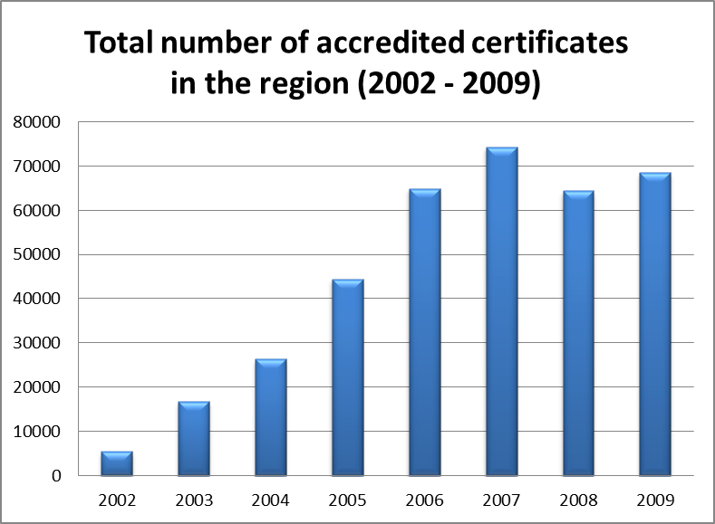

Slide 8
Project Timeline
Late 2009 / early 2010
Survey of 429 customers’ perspectives about the effectiveness of ISO 9001 certification
Mid-2010
Survey of 604 certified organizations to obtain their perspectives about ISO 9001 and the certification process
One-day “Market Surveillance” visits to 561 organizations to evaluate the effectiveness of the ISO 9001 certification process
Not “repeat audits”!
Aimed at assessing “confidence level” rather than “conformity/nonconformity”
Late 2010 / early 2011
International and local workshops (Oct 2010 – March 2011)
Formal report (scheduled for publication May 2011)

Slide 9
Confidence levels for visits to certified organizations
Grade 5
“Benchmark” – Excellent – “We can be proud”
Grade 4
“Clear evidence of conformity”
Grade 3
“No reason to doubt”
Grade 2
“Not convinced”
Grade 1
“Little or no confidence - something seriously wrong”

Slide 10
Summary of results and recommendations

Slide 11
Important to emphasize……….
Project was limited to
manufacturing and construction-based industries
“business-to-business” transactions
Participation was voluntary
organizations could not be required to take part.
results were necessarily skewed towards a “favourable” outcome

Slide 12
Economic impacts
Empirical evidence of positive impact
benefits derived by purchasers who use ISO 9001 certification as a basis for supplier selection and evaluation
benefits experienced by certified organizations in terms of improved performance, reductions in rework and waste, and overall operational effectiveness.

Slide 13
Institutional purchasers
82% either “rely heavily” on ISO 9001 or “use it frequently”
79% use ISO 9001 as a basis for their supplier evaluations
Satisfaction with a number of parameters related to ISO 9001-certified suppliers is generally good
Significant majority of certified suppliers perform “better” or “much better” than non-certified suppliers.
One criticism from purchasers is customer complaints handling
Need for greater promotion of ISO 10002 “Guidance for complaints handling in organizations”
“Good practice” guidance being developed for CB auditors

Slide 14
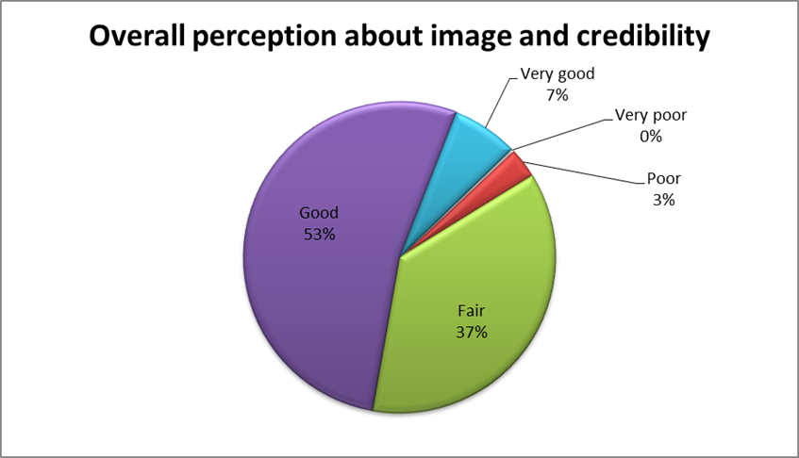
429 Institutional Purchasers
Overall opinion about the credibility of accredited certification to ISO 9001)

Slide 15
Certified organizations
Main reasons for seeking certification
54% internally-motivated
seeking internal improvement or responding to corporate or top management initiatives
39% externally-motivated
seeking to access international markets or responding to customer pressures
Some benefits mentioned:
“We have derived significant benefit from implementing ISO 9001”
“ISO 9001 certification has helped improve the way we work”
“Our customers give us credit for our ISO 9001 certification when they choose their suppliers”
“ISO 9001 has helped us to focus on continually reducing internal re-work and waste”

Slide 16
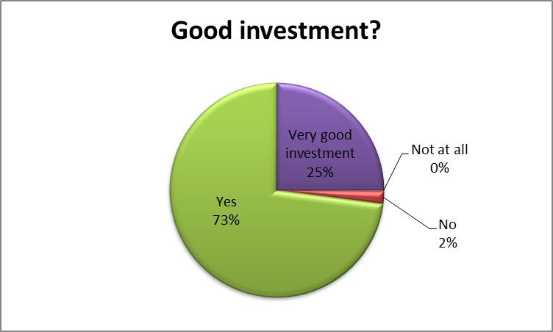
604 Certified Organizations
Regardless of how much you spent, do you consider the implementation of ISO 9001 and certification to have been a good investment?

Slide 17
Use of consultants
Over 80% of certified organizations surveyed had used a consultant
More pronounced for micro, small and medium organizations
Consultants not always used properly
Need to promote awareness of ISO 10019:2005 “Guidelines for the selection of quality management system consultants and use of their services”.

Slide 18
Poor recognition of “accreditation”
Only around 1/3 of purchasers could name the national AB or any foreign AB
Only 1/3 of purchasers knew about the IAF and what it does
Many purchasers not aware of the concept of unaccredited certification.
Less than ½ of the purchasers request copies of their suppliers’ ISO 9001 certificate
Less than 1/3 actually check the certificate has an accreditation mark
Need for a significant awareness-building campaign to:
raise the profile of accredited certification,
explain potential perils of unaccredited certification
clarify role of the IAF and ISO
(Important if developing countries are to use the IAF mark for trade capacity building purposes).

Slide 19
Lack of transparency / “Openness” of some CB’s and AB’s
Lack of transparency by some CB’s regarding information about certified clients
Big variation in the way AB’s are enforcing requirements in ISO/IEC 17021:2006 for CB’s to have “publicly-accessible directory of certified clients”
Recently reinforced by IAF Technical Committee decision (March 2011)
Single, international database of certified organizations under discussion within ISO

Slide 20
Performance of certified organizations
Based on 561 one-day visits, overall level of confidence was good:
6% “We can be proud to use this organization as a benchmark”
43% “Clear evidence that the intent of ISO 9001 is being met”
43% “OK - No reason to doubt that this is being addressed correctly”

Slide 21
BUT………..
8% of the organizations visited fell into the categories
“Little or no confidence” (1%)
“Some evidence presented, but not at all convincing” (7%)
Percentages are small, but they represent a significant number (over 5000 certificates in the region).

Slide 22
Audit durations
In spite of previous anecdotal evidence, results showed that CB’s are, in general, respecting audit durations prescribed by IAF MD5.
In particular, audit durations for micro, small and medium enterprises tend to exceed the recommendations of IAF MD5.

Slide 23
Areas of weakness
Weakest areas identified during visits were:
Poor use of the “process approach” throughout the organization
Organizations not managing QMS processes using a “Plan-Do-Check-Act” – type approach
Little focus on identifying the CAUSE of process, product and system nonconformities, and on implementing effective corrective action
Poor focus on PREVENTING nonconformities
Weak culture of continual improvement of the effectiveness of the QMS

Slide 24
Best practices and policy guidelines
Excellent correlation between results of one-day visits and suppliers’ performance as perceived by customers.
This now forms basis for a new market surveillance approach by IAF and others
In line with ISO/IAF Strategic Imperative that “Output matters!”

Slide 25
The future………
Why not a “PBCA” approach??
“Performance Based Conformity Assessment”
Relate intensity of auditing to demonstrated performance of the CB
Can be a cost-effective solution
Ongoing project in China (UNIDO/IAF/CNCA) is piloting this philosophy.
Initial results are very promising (highlighting some “underperforming” CB’s where extra AB oversight may be necessary!)

Slide 26
Conformity Assessment
(CA)
“THE MISSING LINK”
Market Surveillance
(MS)
A
P
A
P
C
D
C
D
IAF
MS
Improvement
Cycle
Peer or competitor
Etc
CA
Improvement
Cycle
AB
Regulator
Consumer orgs
CAB
Market
(Customer/Consumer)
Organization
Products (Services)
A
P
Overall
Improvement
Cycle
C
D

Slide 27
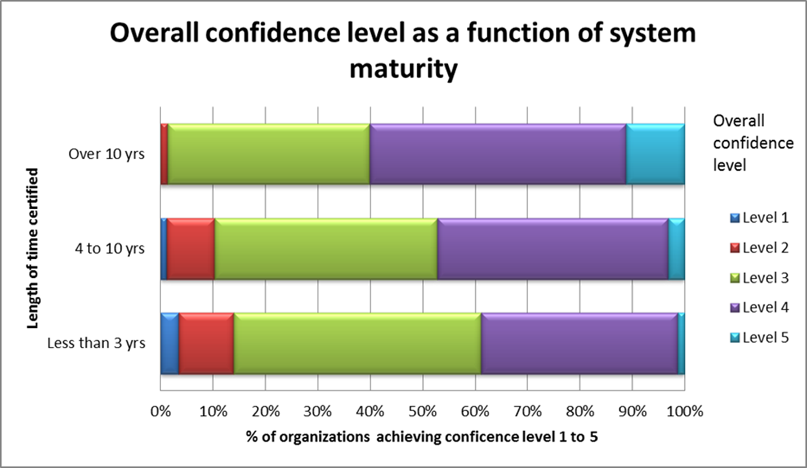
Some interesting correlations:
Longer-certified organizations demonstrated a higher level of confidence

Slide 28
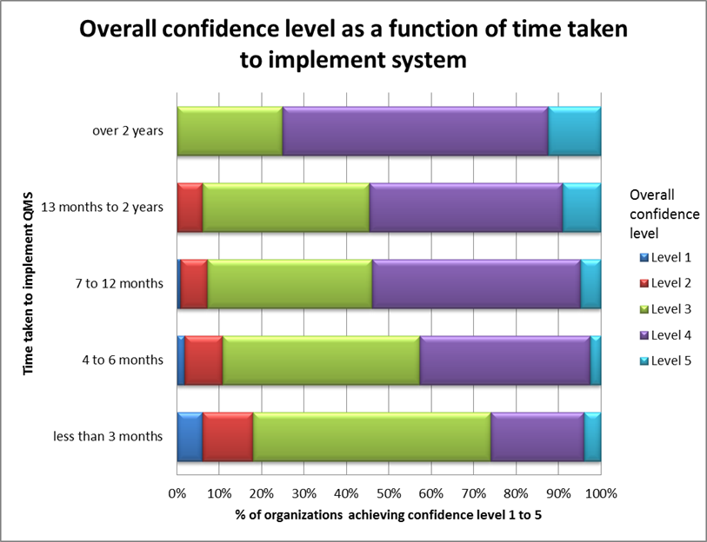
Some interesting correlations (2):
Organizations going for “quick implementation” performed worse

Slide 29
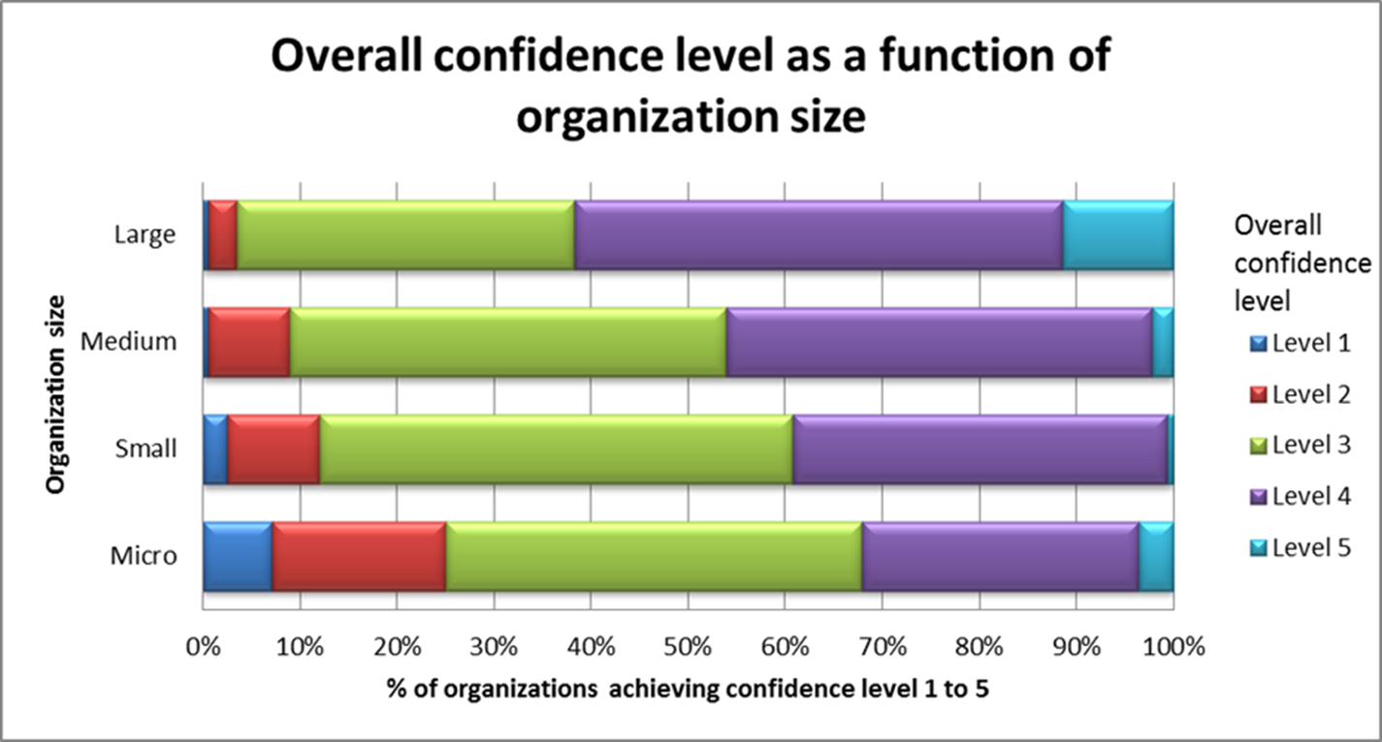
Some interesting correlations (3):
Large organizations* performed better than small* or micro*-organizations
(* as per European Commission 2003/361/EC)

Slide 30
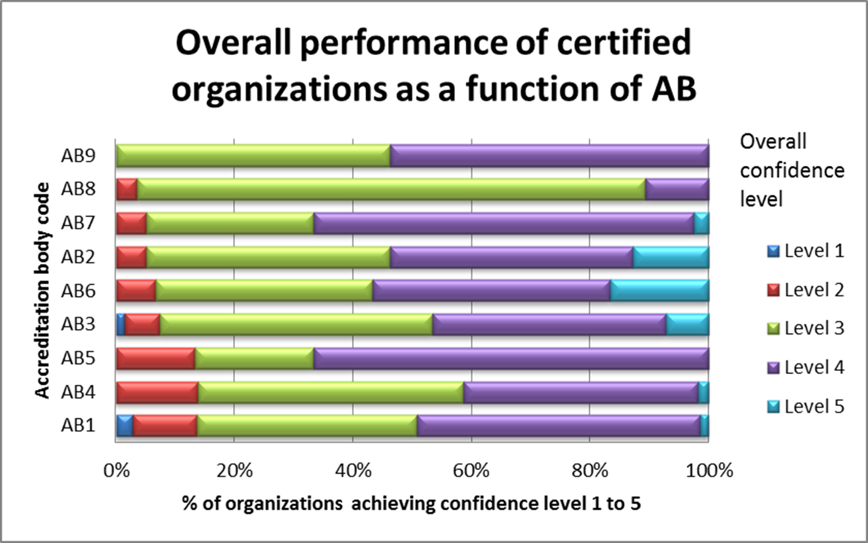
Some interesting correlations (4):
Variations in performance from one AB to another. (AB’s have been informed)

Slide 31
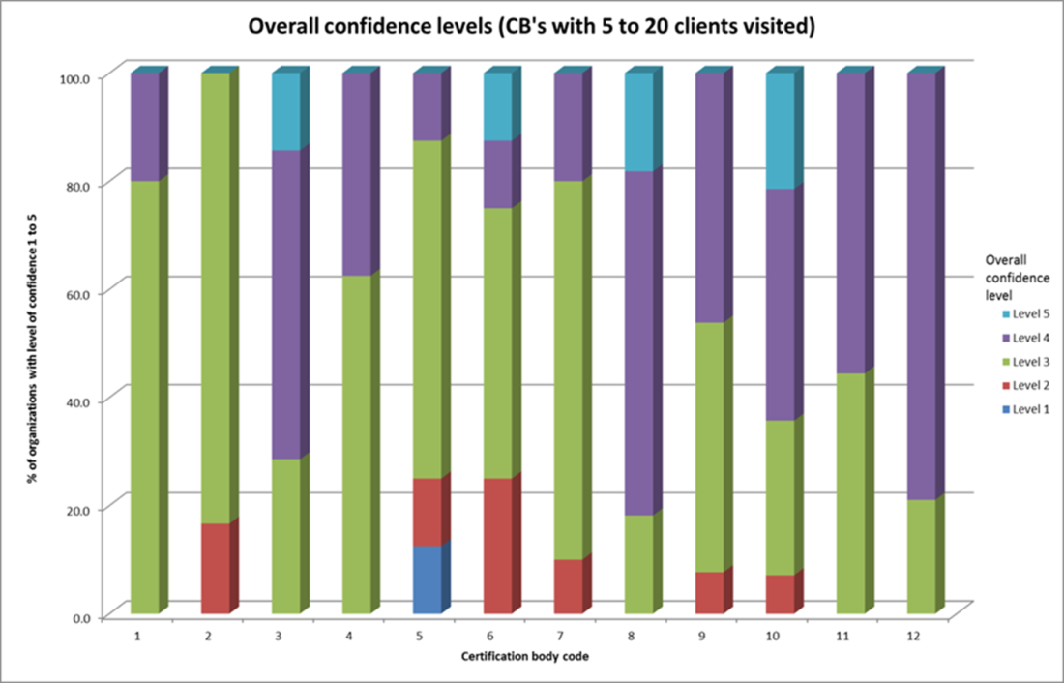
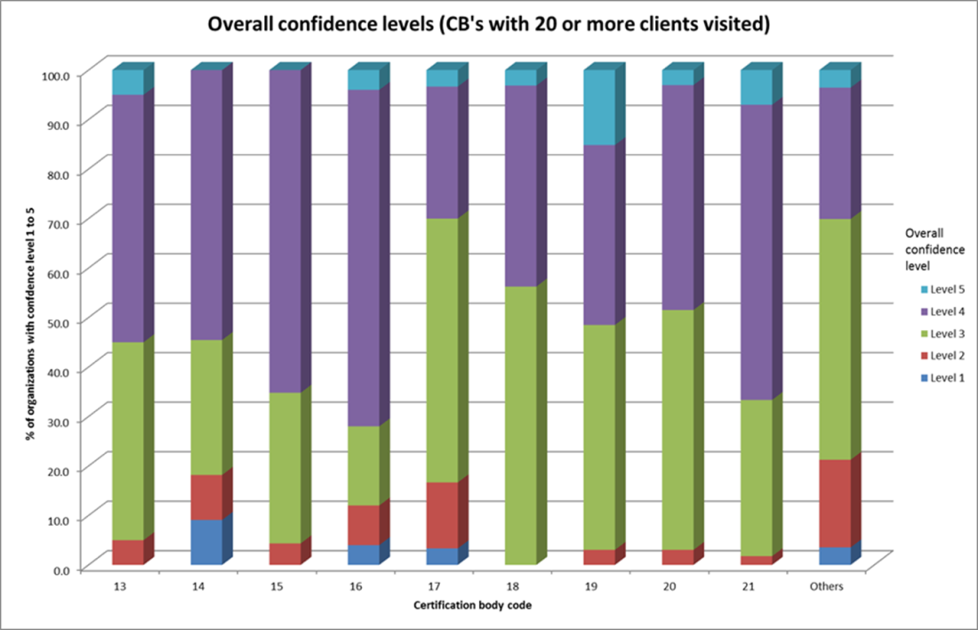
Some interesting correlations (5):
Variations in performance of different CB’s (CB’s have been informed)
*
*
*
*
*
Some CB’s have over 15% “questionable” results (Grades 1 or 2)
Very poor performance of “others” (60 CB’s with less than 5 certified clients visited each)

Slide 32
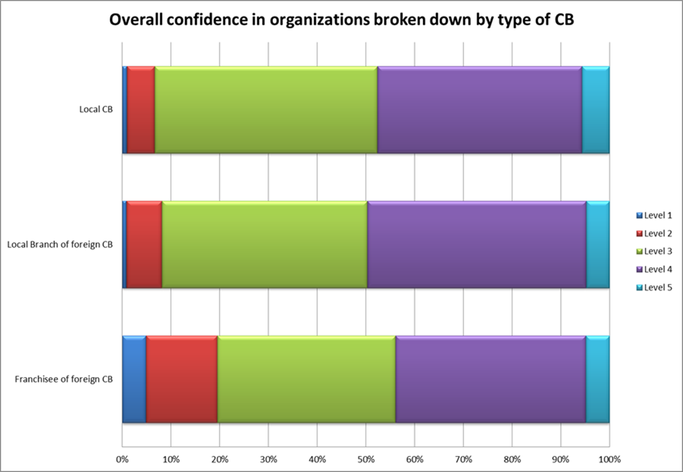
Some interesting correlations (6):
Concentration of “poor” results in CB franchisee operations (IAF Action Plan initiated)

Slide 33
Conclusions and recommendations

Slide 34
Conclusions (1)
Clear economic benefits to be derived from ISO 9001 implementation and certification
Overall, perceptions of accredited certification to ISO 9001 are good, though role of accreditation is not well understood.
Purchasers were generally satisfied with the performance of their ISO 9001-certified suppliers
Needs for greater harmonization among CB’s and AB’s regarding ways in which information about certified organizations is made available.

Slide 35
Conclusions (2)
A “market surveillance” methodology involving short (one-day) visits to certified organizations is effective in distinguishing between superior and unsatisfactory performance (as perceived by customers)
Overall, performance of the certified organizations was good, and demonstrated the effectiveness of the accredited certification process.
Small % of organizations (but large number) demonstrated unsatisfactory results.
need to avoid complacency and to drive further improvements in the accredited certification process.

Slide 36
Recommendations (1)
Project should be amply communicated (developed and developing countries), to demonstrate the benefits that accredited certification to ISO 9001 can bring.
For accredited certification to achieve its full potential, resources need to be made available for:
Campaign to increase awareness among purchasers
Implementation of an effective market surveillance programme
Development of a single, international directory of accredited certificates

Slide 37
Recommendations (2)
ISO and NSB’s need to promote greater awareness of:
ISO 10002:2004 “Quality management — Customer satisfaction — Guidelines for complaints handling in organizations”
ISO 10019:2005 “Guidelines for the selection of quality management system consultants and use of their services”
ISO 9004:2009 “Managing for the sustained success of an organization — A quality management approach”

Slide 38
Recommendations (3)
Methodologies developed during this project could be used as a basis for similar studies (by ISO, IAF, UNIDO and/or others). Examples:
Studies in other geographical regions (developing AND developed economies) to identify any trends
Projects focused on service sector and/or organizations with a business-to-consumer market
Projects specifically aimed at studying the effectiveness of ISO 9001 in SME’s
Similar projects adapting the methodology for other management systems, and/or laboratory accreditation

Slide 39
THANK YOU!
nhc@tcaglobal.org

