Slide 1
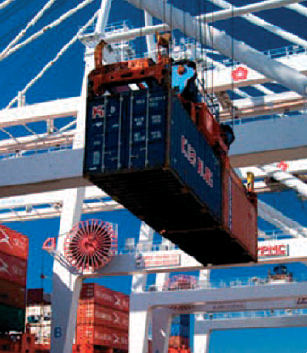
The International Laboratory Accreditation Cooperation (ILAC) The International Accreditation Forum (IAF)
Accreditation --
Facilitating Global Trade
by
Venkat Balakrishnan
ITU-UNIDO Regional Forum on Sustainable Conformity Assessment
Yangon, Myanmar, 25-27 November 2013

Slide 2
Accreditation in the TBT Agreement
“6.1.1 adequate and enduring technical competence of the relevant conformity assessment bodies in the exporting Member, so that confidence in the continued reliability of their conformity assessment results can exist; in this regard, verified compliance, for instance through accreditation, with relevant guides or recommendations issued by international standardizing bodies shall be taken into account as an indication of adequate technical competence;”

Slide 3
Accreditation to Support the Market
Accreditation Bodies
Accreditation service
Conformity assessment bodies
Conformity assessment bodies
Certification
Body
Certification
Body
Inspection
Body
Inspection
Body
Test
Lab
Test
Lab
Cal
Lab
Cal
Lab
Conformity Assessment Service
Conformity Assessment Service
Market
Conforming product/service
Demands for competent conformity assessment
Product/
service
Purchasers
Regulators
Requirements
Suppliers
Trade
Organizations
& Authorities
Demands for facilitating trade

Slide 4
ILAC and IAF
ILAC and IAF—global networks of conformity assessment accreditation bodies
Recognition of competent conformity assessment activities through global multi-lateral mutual recognition arrangements
Harmonization of conformity assessment practices
Promotion of accredited conformity assessment as an effective mechanism for providing confidence in goods and services

Slide 5
Global Vision
Tested, inspected or certified once, accepted everywhere'
“Accredited once, accepted everywhere”

Slide 6
Regional Cooperation Bodies
The IAF and ILAC Arrangements are structured to build on existing and developing regional MLAs/MRAs established around the world
The IAF MLA recognizes EA, PAC, IAAC
The ILAC MRA recognizes EA, APLAC, IAAC
European Cooperation
for
Accreditation
(EA)
Pacific Accreditation
Cooperation (PAC)
Inter-American
Accreditation Cooperation
(IAAC)
Asia Pacific Laboratory
Accreditation Cooperation
(APLAC)
Southern African
Development
Community Accreditation
(SADCA)
African Accreditation Cooperation (AFRAC)
Arab Accreditation Cooperation (ARAC)

Slide 7
Coverage of the ILAC MRA (September 2013)
ILAC MRA Signatories
ILAC Associate Members
ILAC Affiliate Members

Slide 8
Coverage of the IAF MLA (Sep 2013)
IAF MLA Signatories
IAF Members not yet Signatories

Slide 9
ILAC MRA & IAF MLA
The Arrangements, through peer evaluation, provide confidence that ABs are competent
ISO/IEC 17011
IAF-ILAC A series documents
The Arrangements provide confidence that accredited CABs operate to the same standard

Slide 10
ILAC MRA & IAF MLA
Signatories must recognize the certificates issued by CABs accredited by all other members of the Arrangements
This recognition and acceptance removes technical barriers to international trade (TBT) by eliminating the need for multiple certifications

Slide 11
Benefits of ILAC and IAF Accredited Conformity Assessment
Confidence in accredited conformity assessment results
Facilitation of cross border trade

Slide 12
USA Specifiers of the Arrangements
Consumer Product Safety Commission
Federal Highway Administration
U.S. Coast Guard
General Services Administration
Department of Defense
Nuclear Regulatory Commission
Food and Drug Administration
Environmental Protection Agency

Slide 13
Consumer Product Safety Commission
Statement by Scott Hey, program manager of the CPSC Office of Hazard Identification and Reduction on the benefits of the ILAC MRA:
“The MRA has had a tremendous impact on our group. With all the products from manufacturers around the world – cribs and bunk beds from China and the United Kingdom, bike helmets and baby walkers from Taiwan, China and Italy – knowing that they have all been through an accepted standard of testing from an accredited lab gives us a greater level of confidence in those products. It provides a sense of consistency in quality.”

Slide 14
U.S. Coast Guard
Statement by Kurt Heinz, chief, life saving and fire safety, U.S. Coast Guard on the benefit of the ILAC MRA:
“Obviously, avoiding duplicative tests saves a lot of time. A lot of the safety materials we use in ship construction, like the fire-resistant coatings we use on bulkheads and other areas, are manufactured in Europe and Asia, so being able to accept and depend on test results from labs in those countries makes sense. And, less time spent doing routine approval work translates into more time spent on policy and standard development – which is a good thing.”

Slide 15
Environmental Protection Agency
Statement by Eamon Monaghan, Program Integrity Lead, ENERGYSTAR on the reason for using the ILAC MRA:
“We didn’t have to develop and implement our own set of rules. Any kind of agency-specific rule creates costs or hassles for industry, and that was something we really wanted to avoid. We currently certify products in 65 categories, many of which are certified and tested overseas. Referencing the ILAC MRA took the EPA off the hook for developing a lot of criteria for labs or conducting our own lab oversight. And, by working with only ILAC signatories, we have the confidence that the labs have been appropriately assessed. We now recognize 27 ILAC-signatory accreditation bodies around the world.”

Slide 16
KORUS US-Korea Trade Agreement
KORUS ARTICLE 9.5: CONFORMITY ASSESSMENT PROCEDURES
3. Each Party shall accredit, approve, license, or otherwise recognize conformity assessment bodies in the territory of the other Party on terms no less favorable than those it accords to conformity assessment bodies in its territory.

Slide 17
Benefits for government and regulators
Flexible alternative to regulation
Efficient monitoring

Slide 18
Benefits for industry
Greater acceptance of products and services opening up markets
Avoiding the costs of multiple testing, inspection or certification
Efficient management of suppliers

Slide 19
Benefits for consumers
Public confidence in goods and services despite complex global marketplace
Reduces product failures

Slide 20
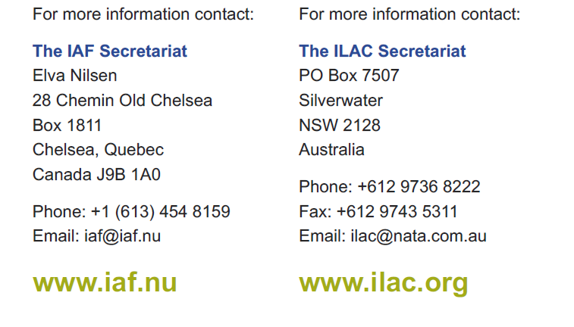
Contact Details

