Slide 1
ITU-UNIDO Forum on Sustainable Conformity Assessment for Asia-Pacific Region Yangon City, Republic of Union of Myanmar, 25-27 November 2013
Maldives experience: Strengthening Institutional Capacity on Conformity Assessment
Ouseph Padickakudi
Senior Programme Manager
O.Padickakudi@unido.org
On behalf of Mr. Nasih Jamaal, Maldives
Polytechnic

Slide 2
General Overview
Project Objective: Improve Standards, Metrology, Testing, and Quality (SMTQ) through implementation of internationally accepted:
metrology institutes (both legal and commercial)
standards development institutes
food safety testing facilities
product certification – primarily to assist exports
certification to Management System Standards (MSS)
Starting date: July 2013
Duration: Three years
Budget: € 944,680 from Norwegian Agency for Development (NORAD)
Counterparts:
Maldives: Maldives Standards and Metrology Centre (MSMC)
Maldives Food and Drug Authority (MFDA)

Slide 3
Achievements in Maldives (to date)
Capability built in the standards cell for adoption of standards and WO TBT Inquiry Point/Standards Information Centre strengthened
Detailed plan to control substandard and hazardous imported products developed and submitted
Legal and industrial metrology laboratory established, but not yet operational due to staff shortage in Maldives
National food testing laboratory of MFDA strengthened and accredited
Awareness created among personnel involved in fish harvesting about Good Hygiene Practices (GHP), and quality of fish products improved in the supply chain
Fifteen auditors trained on ISO 22000 and capacity built for certification and six fish processing units certified
Awareness created about OHSAS 18000 standard in Fish and Hospitality industry
Male fish handling facility of the airport certified for HACCP

Slide 4
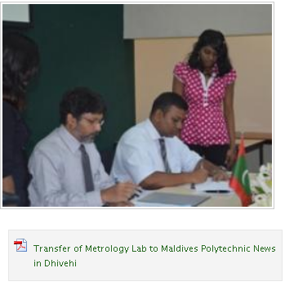
Work in Progress: Accreditation of Metrology Laboratories in Maldives
MOU between Polytechnic and MED was signed on 29th July 2012
February – June 2013 : Expert in Legal Metrology & Lab accreditation fielded to monitor overall progress and to develop procedures required for the compliance to ISO/IEC 17025, for its management requirement chapter and technical procedures that are required for technical requirement of ISO/IEC 17025
Experts’ technical advise has not yet resulted in application to accreditation body

Slide 5
Expected outcomes
For each of the countries involved in phase III the outcomes are similar:
The Maldives will have:
Food assessment facilities capable of identifying unsafe and unwanted foods
Quantity statements acceptable to all purchasers
A strategy to improve exports of fish through use of Management System Standards
Bhutan will have:
food assessment facilities capable of identifying unsafe and unwanted foods
quantity statements acceptable to all purchasers
certified products freely traded
a strategy to improve business and government through use of Management System Standards
Nepal will have:
food assessment facilities capable of identifying unsafe and unwanted foods
products supported by test certificates
certified products freely traded
training and certification capacity to improve business through use of Management System Standards

Slide 6
Maldives outputs activities and timeline
Output 1 (MFDA): published laws and regulations along with accredited testing capacity to detect residues, additives, pesticides and contaminants
Activities | Responsibility | Timeline
1.1 Finalize and publish a Food Safety Law for food produced, processed, or prepared in the Maldives, as well as food imported, according to the Codes Alimentarius Commission requirements | Ministry of Health UNIDO | 1st Year, Q2 Q3 Q4
1.2 Prepare and publish regulations based on CAC standards covering activities involved in producing, processing, preparing food for domestic use and export, as well as for food importers. Regulations concerning residues, additives, pesticides and contaminants. | MFDA UNIDO | 1st Year, Q4 2nd Year, Q1 Q2 Q3
1.3 Enhance food testing capability of MFDA through procurement of equipment / providing training | MFDA UNIDO | 2nd Year Q2 Q3 Q4 3rd Year Q1 Q2
1.4 Achieve re-accreditation | MFDA | 3rd Year Q1 Q2 Q3 Q4

Slide 7
Maldives outputs activities and timeline
Output 2 (Polytechnic and MSMA): Measuring Instruments used in the Maldives calibrated with international acceptance of calibration certificates and support for Management Systems in support of trade
Activities | Responsibility | Timeline
2.1 Complete update of Polytechnic metrology lab facilities | Polytechnic UNIDO | 1st Year, Q4 2nd Year Q1 Q2 Q3
2.2 Develop and make available training course for calibration inspectors | Polytechnic UNIDO | 2nd Year, Q2 Q3 Q4 3rd Year Q1 Q2 Q3
2.3 Policy Decision to ensure continuous availability of trained calibration inspectors in each Atoll | Ministry of Economic Development Ministry of Home Affairs MSMC | 1st Year Q2 Q3 Q4
2.4 Publish Standards Act | Ministry of Economic Development MSMC | 1st Year Q2 Q3 Q4

Slide 8
Maldives outputs activities and timeline
Activities | Responsibility | Timeline
2.5 Assess the market potential for MSS Certification as well as MSS Training | MSMC UNIDO | 1st Year, Q2 Q3 Q4
2.6 Policy decision to support MSS awareness/certification through a national CB, contract with a foreign CB, or no action | Ministry of Economic Development | 1st Year, Q2 Q3 Q4 2nd Year, Q3 Q4
2.7 Establish a national CB accredited to ISO/IEC 17021 or contract with a foreign CB | MSMC UNIDO | 1st Year Q2 Q3 Q4 3rd Year Q1 Q2 Q3 Q4

Slide 9
Budget
Outputs | NORAD | Co-funding (In-kind) |  |  | TOTAL
 |  | Govt. | Para-statal | Private
 | Euros (Thousands)
Output 1 Bhutan: BAFRA | 85 | 10 | 50 | 0 | 145
Output 2 Bhutan: BSB | 138 | 45 | 150 | 10 | 343
Output 1 Maldives: MFDA | 85 | 20 | 50 | 0 | 155
Output 2 Maldives: Polytech & MSMA | 35 | 50 | 50 | 10 | 145
Output 1 Nepal: DFTQC | 85 | 10 | 50 | 0 | 145
Output 2 Nepal: NBSM | 88 | 0 | 90 | 10 | 188
SUBTOTAL TECHNICAL ASSISTANCE | 516 | 135 | 440 | 30 | 1121
Project management | 320 | 15 | 132 | 0 | 467
PROJECT TOTAL BUDGET | 836 | 150 | 572 | 30 | 1588
Support costs | 108.68
GRAND TOTAL | 944.68 | 150 | 572 | 30 | 1696.68
Percentage | 55.7 | 8.8 | 33.7 | 1.8 | 100.0

Slide 10
UNIDO inputs
Recruitment of Part-time Technical Advisor (CTA), who will provide guidance on technical matters, especially in systems for laboratory and certification body accreditation
Recruitment of international and/or national experts and consultants required for the project
Procurement of all the equipment
Remuneration of the CTA and the experts and consultants recruited by UNIDO
Remuneration of the experts appointed for the evaluation of the project
Arrangement of all attachments and training outside of country and correspondent payment

Slide 11
Counterpart inputs
Each NSB will provide an office with secretarial support and IT connectivity for the CTA, the National Coordinator and international experts
Availability of limited transport
Each country will designate and provide a National Project Coordinator working in close cooperation with the CTA and national organizations
All involved organizations will identify and release the trainees, i.e. quality auditors, metrologists, inspection staff, laboratory technicians and managers. Such staff will be remunerated by their organizations
The government of Maldives will provide the means to renovate/move the metrology laboratories and install appropriate environment control equipment
The government of Maldives will be involved in finalizing laws, determining policy respecting certification to MSS and relating to personnel retention
Private sector bodies previously certified will provide their experience with the implementation of MSS

Slide 12
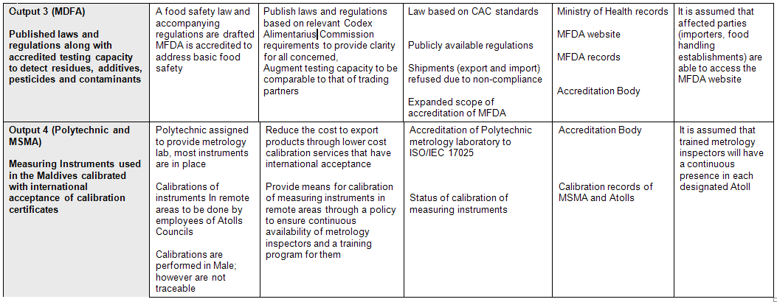
Logical framework (Maldives only)

Slide 13
Thank You
for your attention

