Slide 1
Joint ITU-UNIDO Forum on Sustainable Conformity Assessment for Asia-Pacific Region
Telecom Regulations, Policies & Conformity Assessment
PAKISTAN
(Yangon City, Republic of Union of Myanmar 25-27 November 2013)
Presented By: Umair Afzal
Senior Executive Strategy
umair.afzal@multinet.com.pk
Multinet Pakistan Private Limited
Connecting You to Pakistan and beyond…….

Slide 2
Contents of presentation
Multinet & Axiata Group
Contents
Telecom Landscape of Pakistan
Evolution of Telecom Sector
The Regulatory Body and Its Functions
Telecom Licenses Issued by the Regulator
Powers of the Regulator, Telecom Standards and Conformity
Type Approval, Testing & 3rd Party Technical Agencies
Type Approval Equipment Category
Type Approval Procedure
Registered Consultants
Conclusions and Recommendations

Slide 3
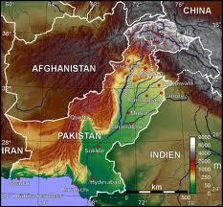
Geographical Location
Multinet & Axiata Group

Slide 4
Telecom Landscape of Pakistan
Multinet & Axiata Group
Total Population: 184.5 Million (Economic Survey of Pakistan 2013)
Revenues of the telecom sector during 2012 stood at USD 4 billion registering a growth of 13 percent over the same period last year.
Telecom sector contributes upto 2 percent of National GDP (2010-2011)
Pakistan is Connected with 4 Submarine Cables, SeaMeWe-3, SeaMeWe -4, IMEWE and TW-1 and 2 Landing stations
Pakistan telecom sector has emerged as the fastest growing sector across Asia in the recent years

Slide 5
Telecom Landscape of Pakistan
Multinet & Axiata Group
Pakistan has moved from the monopolized structure to a deregulated one.
Monopoly of PTCL on basic telephony has been abolished and new operators emerged on the telecom scene of Pakistan where competition has been introduced

Slide 6
Telecom Landscape of Pakistan
Multinet & Axiata Group
With a population of 179 million, Pakistan presents remarkable stats in the telecom sector
Teledensity Breakup | No. of Subscribers (millions) | Teledensity (%)
Annual Cellular Mobile Teledensity | 129.6 | 72.27%
Annual Fixed Local Loop Teledensity | 2.98 | 1.67%
Annual Wireless Local Loop Teledensity | 3.34 | 1.87%
Total Teledensity (%) |  | 75.77 %
Internet Penetration | No. of Subscribers (millions) | Penetration (%)
Internet Users | 19.8 | 15.27%
Mobile Internet Users | 15.7 | 12.11%
Broadband Subscribers | 2.8 | 2.16%

Slide 7
Teledensity (FLL & WLL)
Multinet & Axiata Group

Slide 8
Teledensity (Cellular & Total)
Multinet & Axiata Group

Slide 9
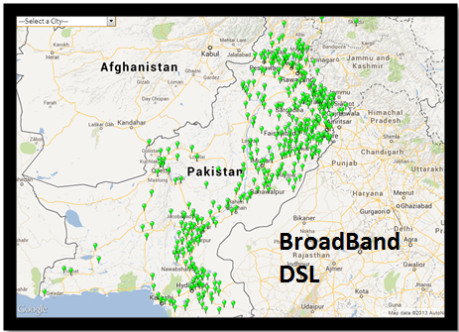
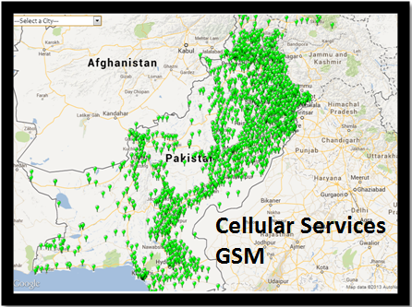
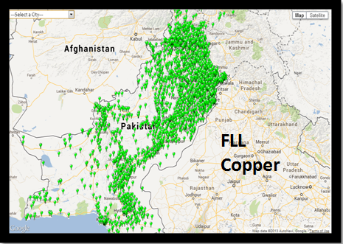
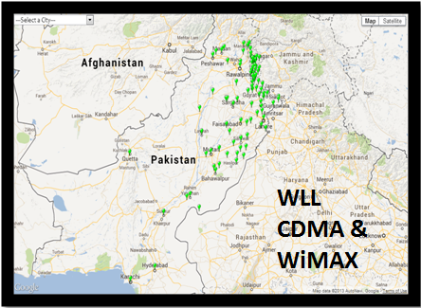

Slide 10
Evolution of Telecom Sector in Pakistan

Slide 11
Evolution of Telecom Sector in Pakistan
Multinet & Axiata Group
1947
Pakistan Posts & Telegraph Dept.
1962
Pakistan Telegraph & Telephone Dept
1991
Pakistan Telecommunication Corporation Act
1994
The Pakistan Telecommunication Ordinance
1996
Telecom Reorganization Act (PTA, PTCL, NTC, FAB)
1998
Mobile & Internet subsidiaries established
2000
Telecom Policy Finalized
2003
Telecom Deregulation Policy

Slide 12
Telecommunication Reorganization Act 1996
Multinet & Axiata Group
Telecom Reorganization Act 1996
Pakistan Telecommunication Limited Company (PTCL)
Pakistan Telecommunication Authority (PTA)
National Telecommunication Corporation (NTC)
Frequency Allocation Board (FAB)
Incumbent Telecom Service provider
- Carriers Carrier
- White Label Services
- Landline
- Wireless Broadband
- Broadband
- IPTV Smart TV
- Submarine Cable Landing s
Pakistan Telecommunication Regulatory Authority
Provider of ICT service to
- Federal Government,
- Armed Forces
- Defense Projects
- Provincial Govt.
- Govt. Institutions
Allocation of radio frequency spectrum
- to the Government
- providers of telecom services & Systems
- Radio and Television broadcasting operations,
- Public and private wireless operators
- others.

Slide 13
Telecommunication Reorganization Act 1996
Multinet & Axiata Group
Telecom Reorganization Act 1996
Pakistan Telecommunication Limited Company (PTCL)
Pakistan Telecommunication Authority (PTA)
National Telecommunication Corporation (NTC)
Frequency Allocation Board (FAB)
Pakistan Telecommunication Authority (PTA)
Incumbent Telecom Service provider
- Carriers Carrier
- White Label Services
- Landline
- Wireless Broadband
- Broadband
- IPTV Smart TV
- Submarine Cable Landing s
Pakistan Telecommunication Regulatory Authority
Provider of ICT service to
- Federal Government,
- Armed Forces
- Defense Projects
- Provincial Govt.
- Govt. Institutions
Allocation of radio frequency spectrum
- to the Government
- providers of telecom services & Systems
- Radio and Television broadcasting operations,
- Public and private wireless operators
- others.

Slide 14
Functions of Regulator - PTA
Multinet & Axiata Group
To regulate the establishment, operation and maintenance of telecommunication systems and provision of telecommunication services in Pakistan.
To promote and protect the interests of users of telecommunication services in Pakistan
To promote the availability of a wide range of high quality, efficient, cost effective and competitive telecommunication services throughout Pakistan.
To promote rapid modernization of telecommunication systems and telecommunication services.

Slide 15
Functions of Regulator - PTA
Multinet & Axiata Group
To investigate and adjudicate on complaints and claims made against licensees
To make recommendations to the Federal Government on policies with respect to international telecommunications

Slide 16
Telecom Licenses Issued by the Regulator

Slide 17
Telecom Licenses
Multinet & Axiata Group
Licenses
(2)
Cellular Mobile
(7)
Class VAS
(1)
Long Distance International (LDI)
Local Loop (LL)
(3)
Fixed Local Loop (FLL)
(4)
Wireless Local Loop (WLL)
Infrastructure
(5)
Infrastructure License
(6)
Tower License

Slide 18
Licenses Issued under PTA
Multinet & Axiata Group
Long Distance International (LDI)
License issued for the provision of end to end communication between points that are located in Pakistan with points that are located outside of Pakistan
Fixed Local Loop (FLL)
License issue for the provision of fixed line telecommunication services within a Telecom Region using medium excluding wireless.
Wireless Local Loop (WLL)
License issue for the provision of fixed line telecommunication services within a Telecom Region using mediums including wireless, with limited mobility.

Slide 19
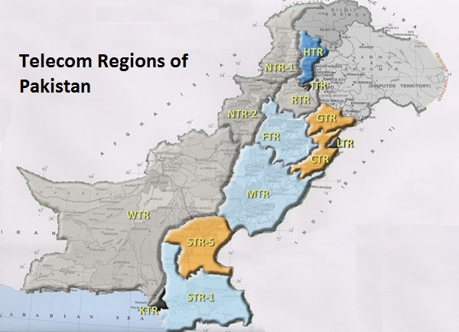
14 Telecom Regions of Pakistan
Multinet & Axiata Group

Slide 20
Licenses Issued under PTA
Multinet & Axiata Group
Infrastructure License
This License authorizes the licensee to establish and maintain the following Telecom Infrastructure Facilities to lease, rent out or sell end to end links to Telecom Operators licensed by Authority on mutually agreed terms strictly keeping in view their license
(a) Earth stations & Satellite Hub;
(b) Optic fiber cables;
(c) Radio communications links;
(d) Submarine cable landing centre
(e) Towers, poles, ducts and pits used in conjunction with other infrastructure facilities
(f) Such other Telecommunication infrastructure as the Authority may, by Regulation, require.

Slide 21
Licenses Issued under PTA
Multinet & Axiata Group
5. Tower License
This license authorizes a firm/ person to establish and maintain the following Telecom Infrastructure Facilities to lease, rent out or sell to Telecom Operators licensed/ registered by the Authority on mutually agreed terms strictly keeping in view their license/ license conditions
Cellular Mobile
Class VAS Licenses :
All class value added licensed and registered services can only be provided through mutual interconnects and marketing agreements with Local Loop Operators, Long Distance and International Operators, Infrastructure operators and Cellular Operators, with PTCL included.

Slide 22
Number of Operators under PTA
Multinet & Axiata Group
Total Operational Licenses | Number of Licenses Issued
LDI Licenses | 14
FLL Licenses | 17
WLL Licenses | 11
Infrastructure Licenses | 5
Infrastructure Tower Licenses | 8
International Landing Station | 2
Mobile Operators Licenses | 5
Integrated Licenses | 3

Slide 23
Powers of Regulator, Telecom Standards & Conformity

Slide 24
Powers of Authority
Multinet & Axiata Group
“Powers of Authority”
Chapter II of the Telecommunication Act of 1996 states PTA has the authority to
Prescribe standards for telecommunication equipment and terminal equipment,
- certify compliance of such equipment with prescribed standards, and
- issue approvals of terminal equipment and of approved installers under section 29
(h) Provide guidelines for, and determine, the terms of interconnection arrangements between licensees – Reference Interconnect Offer (RIO)
(i) Carry out inspections of telecommunication equipment and any premises owned or occupied by the licensees and summon any person for investigation and an enquiry

Slide 25
Reference Interconnect Offer - RIO
Multinet & Axiata Group
PTA has devised interconnection guidelines for each service to avoid anti-competitive practices by incumbents and Significant market powers(SMP’s)
Interconnection to domestic network is guaranteed so as to promote “fair” competition between incumbents and new operators (PTA Interconnection Guidelines, 2004)
SMP operators must submit to the PTA their Reference Interconnect Offer (RIO) within one month of gaining such status
Interconnection Terms are to be public unless determined confidential by the PTA

Slide 26
Reference Interconnect Offer - RIO
Multinet & Axiata Group
PTCL, the only fixed-line SMP, submitted its RIO in October 2003 (approved in May 2005).
Interconnect parties may adopt RIO as the default interconnection offer or negotiate alternative charges
Interconnection disputes are referred to the PTA for resolution under (Interconnection Dispute Resolution Regulations, September 2004)

Slide 27
Telecom Standards and Conformity
Multinet & Axiata Group
Section 29, Telecom Act 1996
Terminal equipment and approved installers.
(1) “No terminal equipment shall directly or indirectly be connected to a public switched network unless it has been approved by the Authority or an agency appointed by the Authority…”
(2) “The Authority may, by regulations, specify technical standards for terminal equipment and procedure for approving test equipment and for testing any terminal equipment and to certify that it complies with the relevant technical standards.”
“No person may install any telecommunication equipment as part of, or connect terminal equipment (other than by a plug-into-socket connection) to any public switched network except in accordance with regulations made by the Authority.”

Slide 28
Telecom Standards and Conformity
Multinet & Axiata Group
Section 29, Telecom Act 1996
(4) “The Authority shall maintain a register of all terminal equipment and installers thereof approved under this section and shall be open to public inspection.”

Slide 29
Recent Measure Taken by PTA
Multinet & Axiata Group
Telco's Asked to Start Rolling Out Biometric System for SIM Verification
http://propakistani.pk/2013/11/18/telcos-asked-to-start-rolling-out-biometric-system-for-sim-verification/ (ProPakistani Blog - 18, Nov 2013)
Legal International Traffic Increased by 8% During Last Month
http://propakistani.pk/2013/11/12/legal-international-traffic-increased-by-8-during-last-month-anusha-rehman/ (ProPakistani Blog - 12, Nov 2013)
PTA Blocks 200,000 IPs, Thousands of SIMs and Devices, to Control Grey Traffic
http://propakistani.pk/2013/11/11/pta-blocks-200000-ips-thousands-of-sims-and-devices-to-control-grey-traffic/ (ProPakistani Blog - 11, Nov 2013)
PTA Officers Visit Telco's to Confirm Blocking of Un-Verified SIMs
http://propakistani.pk/2013/10/28/pta-officers-visit-telco-to-confirm-blocking-of-un-verified-sims/ (ProPakistani Blog - 28, Oct 2013)

Slide 30
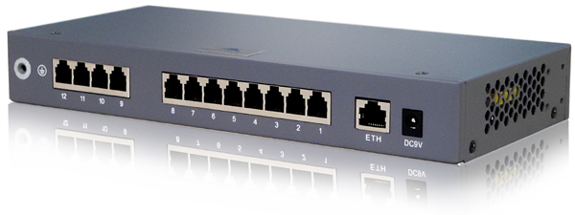
Type Approval, Testing & 3rd Party Technical Agencies
Type Approval Regulations, September 2004

Slide 31
Type Approval - Equipment Category
Multinet & Axiata Group
PTA accepts international telecom equipment standards and applies them equally to domestic and imported products
Type approval is required for specified equipment
Tests conducted by internationally accredited laboratories are accepted
Self-certified test results are unacceptable

Slide 32
Type Approval - Equipment Category
Multinet & Axiata Group
Sr. No | Type Approval Equipment Category
1 | Wireless Module
2 | VoIP Terminal Equipment
3 | Vehicle Security Devices
4 | Broadband Terminal Equipment
5 | PABX/IP-PBX
6 | Wireless Radio Trans/Receive
7 | Fixed Wireless Terminal Equipment (GSM Gateway, WLL sets, etc)
8 | RFID Equipment

Slide 33
Type Approval - Procedure
Multinet & Axiata Group
1. Type Approval Procedure
Type Approval request are to be made for particular model of the equipment with complete documents.
Demonstration of equipment, after completing all the requirements at PTA H/Qs Islamabad.
The applicant shall provide the following essential information:
List of Information Required For Type Approval
1 | Applicants Undertaking | 7 | User Guide/Manual
2 | Photographs of the Equipment | 8 | Set of Circuit Schematic and Functional Block Diagrams
3 | System Description | 9 | Authorization letter (If T.A required on his own name)
4 | Functional / Safety Test reports | 10 | Processing fee in Pak Rupees equivalent to amount US $ 100.
5 | Technical Data and Specifications | 11 | Sample(s) of the equipment
6 | EMC, EMI, Radio Test Reports | 12 | Cost of the equipment as per the quotation/invoice

Slide 34
Type Approval - Procedure
Multinet & Axiata Group
2. No Objection Certificate (NOC) for Import of Telecom Equipments - Procedure
PTA issues NOC for the import of Telecommunication equipment imported for Research & Development or Demonstration purposes.
Following documents are required in this regard:-
Documents required for NOC to import of Telecom equipment
1 | Purposes/Justification of the import of equipment
2 | Shipment documents. (AWB No, Commercial Invoice etc)
3 | Technical Literature of the equipment
4 | Authorization letter from company for whom the consignment being imported
5 | Any other relevant document required

Slide 35
NOC Criteria for Foreign Missions
Multinet & Axiata Group
NOC Issuance Criteria for Foreign Missions:
No foreign mission based in Pakistan is authorized to file its request directly to PTA and all such cases be forwarded through Ministry of the Foreign Affairs, GoP.
Classified equipment being imported by different Foreign Missions including High Commissions and Embassies for Armed Forces/Law Enforcement Agencies, will be cleared by concerned organization/agency for whom the equipments are being imported under intimation to PTA.
If the equipment is wireless equipment than the equipment shall only be released after getting valid frequency allocation from PTA/FAB.
Total time lead for Type Approval application and Issuance of NOC is two weeks after completion of all requirements.

Slide 36
PTA Approved 3rd Party Technical Agencies
Multinet & Axiata Group
PTA Accredited Test Laboratories
The Authority accept EMC/EMI, safety and functional Test Reports issued by a world renowned Laboratories.
The tests conducted by the international accredited laboratories are accepted for type approval.
PTA reserves the right to get any product retested if required.
Local manufacturers are recommended to get their equipment tested from Air-Weapon Complex (AWC) laboratories.

Slide 37
List of Registered Consultants
Multinet & Axiata Group
S# | Name | Company Name | Country | Expertise
1 | Robert Milne | Antelope Consulting International | UK | Numbering and QoS of NGNs
2 | Julian Ding | First Principles Consultancy | Malaysia | Competition Policy, convergence effects
3 | Adeel Najam | Frost and Sullivan | Singapore | Core Networks, Regulatory Issues
4 | Zeeshan Ahmed | Independent Consultant | Pakistan | Telecom Managed Services, NOC Development & Operations
5 | Sajjad Ahmad | MAXIM TELECOM (Pvt.) Ltd | USA | MPLS, NGN, GEPON, HFC, TRIPLE PLAY, Rural Telephony, VSAT, WIRELESS
6 | Malcolm Webb | MGF Webb | New Zealand | Telecommunications regulatory strategy and related commercial expertise
7 | Arturo Briceno | NERA Economic Consulting | USA | Universal service, costing telecom services
8 | Syed Abid Ali | Netsol Technologies | Pakistan | Six Sigma, Process Improvement, Quality of Service

Slide 38
List of Registered Consultants
Multinet & Axiata Group
S# | Name | Company Name | Country | Expertise
9 | Avais Kamal | Optiwave Technologies | Pakistan | Optiwave Technologies
10 | Dr. Jeffrey | Orbitage Consultancy | Malaysia | 3G/UMTS, GPRS, HSDPA
11 | Imran Maqsood | Pak Datacom Ltd | Pakistan | Satellite Communication, VSAT Planning/Management, Frequency/Bandwidth Management and Co-ordination
12 | Mr. Salman Ansari | SATC | Pakistan | IMS, IP base Technologies, Rural communications, E-Government Services
13 | Shaukat Javed | Shaukat Hayat Javed | Pakistan | Fiber Optic Transmission Networks, & Access Networks, Broadband Services, Rural Telephony, Integrated Solutions, Quality of Service
14 | Mr. Farman Ali | TEACH | Pakistan
15 | Maurie Dobbin | Tele Resources | Australia | Advisor on policy making

Slide 39
Conclusion

Slide 40
Conclusion
Multinet & Axiata Group
For the telecom sector, it can rightly be said that deregulation has proved fruitful
The technology is changing rapidly and its transfer to local markets is fast.
Consumers have wide variety of telecommunication services to choose from
Telecom rates have been greatly reduced and communication has become much easier for people using the latest technology at affordable prices
Liberalization of the telecom sector in Pakistan has attracted foreign direct investment, facilitated technological changes and generated employment opportunities

Slide 41
Barriers faced by Telecom sector - Ranking
Multinet & Axiata Group
Index of trade restrictions
Score | Extent of restrictiveness
0.00 | Does not restrict at all
0.25 | Somewhat restrictive
0.50 | Fairly restrictive
0.75 | Moderately restrictive
1 | Completely restrictive
Barriers | Ranks
 | 0.00 | 0.25 | 0.50 | 0.75 | 1.00
Licensing Procedure |  |  | ✓
Licensing Cost |  |  | ✓
Transparency in licensing procedure | ✓
Inter-connction agreements |  | ✓
Tarrif regulations |  |  |  |  | ✓
Anti-competitive rules | ✓
Equipment standards requirements |  |  | ✓
Pricing policy | ✓

Slide 42
Barriers faced by Telecom sector - Ranking
Multinet & Axiata Group
Government policy instability |  |  |  |  | ✓
Security situation of country |  |  |  | ✓
Corruption at govt level |  | ✓
Other regulatory constraints by govt |  |  |  | ✓
Difficultiy in finding reliable and | ✓
competent business partner
Bureaucratic red tape |  |  | ✓
Culture & language | ✓
Lack of competent work force | ✓
Source: Rahman, S. H., Khatri, S., & Brunner, H. P. (2012). Regional Integration and Economic Development in South Asia. Northampton: Edward Elgar.

Slide 43
Thank you for your patience

