Slide 1
ENISA and Cloud Certification
ITU Workshop on “Cloud Computing Standards – Today and the Future”
(Geneva, Switzerland 14 November 2014)
Dimitra Liveri
Security and Resilience of Communication Networks Officer
ENISA

Slide 2
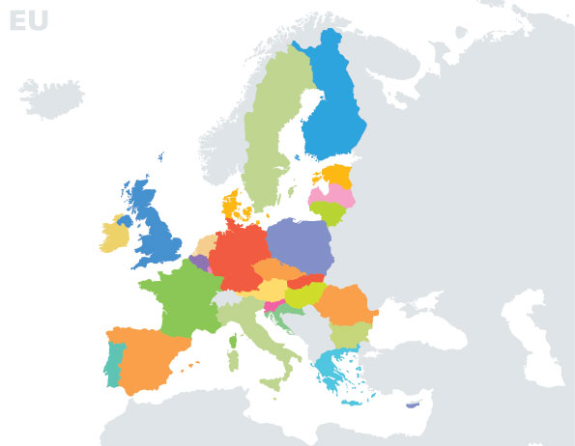
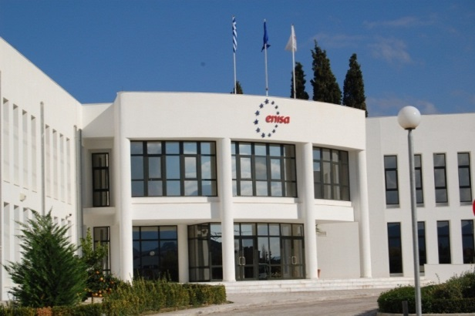
Securing Europe’s Information Society

Slide 3
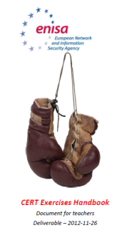
ENISA Activities
Policy
Implementation
Recommendations
Mobilising
Communities
Hands on

Slide 4
ENISA’s Cloud Security work
2009 Cloud computing risk assessment
2009 Cloud security Assurance framework
2011 Security and resilience of GovClouds
2012 Procure secure (Security in SLAs)
2013 Critical cloud computing
2013 Incident reporting for cloud computing
2013 Securely deploying GovClouds
2013 Support EU Cloud Strategy
Cloud Computing Schemes List (CCSL)
2014 Cloud Certification Meta-Framework (CCSM)
2014 Security frameworks for Gov Clouds
2014 Security guide for SMEs
…Ex post analysis for Cloud Incidents
http://www.enisa.europa.eu/activities/Resilience-and-CIIP/cloud-computing
Notes:
This is an overview of the work we did in the past and are doing.
Our early papers from 2009 are still widely downloaded and quoted.
They basically give an overview of the main risks and benefits when moving to the cloud.
Let me go over some of them quickly.
Put in about “ENISA’s work on Cloud Computing, but concentrating on how we have helped industry secure a developing business model (work with CSA, support for the EU Cloud strategy). Here we can stress the fact that we look for security solutions that are economically viable and provide a reasonable trade-off between opportunity and risk. This is ENISA supporting economic growth.”
All SecureCloud events are coorganized with CSA

Slide 5
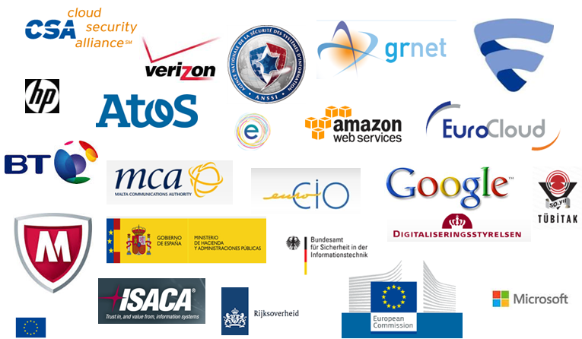
ENISA engages the community
Tackling Cloud Security issues together
Notes:
The ENISA working group setup in 2013, we bring together the private and public sector stakeholders, they provide expertise and feedback in all our Cloud Security studies.

Slide 6
The EU Cloud Strategy
“EU should not only be cloud-friendly, but also cloud–active”
The European Commission’s strategy
“Unleashing the potential of cloud computing in Europe”
Adopted on 27 September 2012, it is designed to speed up and increase the use of cloud computing across the economy
Cutting through the jungle of technical standards
“I am pleased that ETSI launched and steered the Cloud Standards Coordination (CSC) initiative in a fully transparent and open way for all stakeholders.”
Development of model “safe and fair” contract terms and conditions
“...ensuring technical security requirements are mapped onto certification, as ENISA is leading…”
“... we officially launch the platform for public sector cooperation with this "Cloud for Europe" initiative. This is an enormous step forward.…”
Neelie Kroes, European Commissioner for the Digital Agenda Oct 2013
A European Cloud Partnership to drive innovation and growth from the public sector
Notes:
Quote by Kroes – EU launched the strategy in 2012. ENISA had been pushing for cloud already since 2009.
ENISA supports the strategy because we believe that cloud computing can be more secure.
Kroes: “EU should not only be cloud-friendly, but also cloud–active”
Three key actions
Cutting down the jungle of standards
Development of model 'safe and fair' contract terms and conditions
Establishing a European Cloud Partnership
EU Cloud partnership
Leverage public sector procurement to create better cloud solutions
Based on common requirements (also security requirements)
Should set an example for the private sector also
International collaboration
Many issues are global, not EU only

Slide 7
ENISA and Cloud Certification
Cloud Certification Schemes List (CCSL)
List of existing certification schemes
Relevant for cloud computing customers
to provide potential customers with an objective overview of characteristics per scheme, and
to help the customers understand how the scheme works and if it is appropriate for their setting

Slide 8
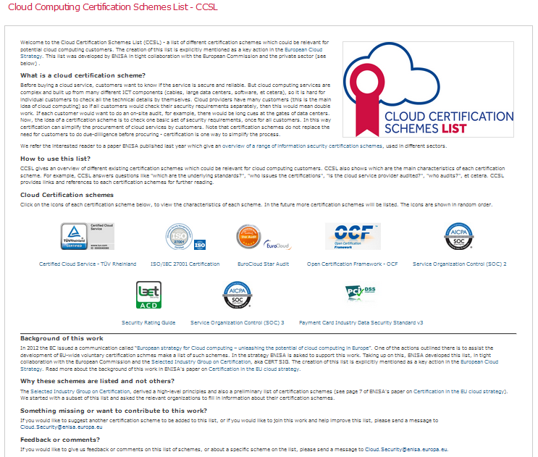
CCSL view

Slide 9
Cloud Certification Schemes Metaframework
Cloud Certification Schemes Metaframework (CCSM)
Metaframework based on existing certification schemes
Mapping detailed ICT security requirements of the public sector in the EU (11 countries but more will come),
Assist MSs map their requirements to the security controls and thus choose certification,
to provide more transparency to customers and support the use of certification in procurement.

Slide 10
CCSM view in a diagram

Slide 11
Thank you for your attention Dimitra Liveri: Dimitra.liveri@enisa.europa.eu For more information visit: http://www.enisa.europa.eu

