Slide 1
DMTF Cloud Standards
Cloud Management & OVF Update to ITU-T SG13

Slide 2
Disclaimer
The information in this presentation represents a snapshot of work in progress within the DMTF.
This information is subject to change. The Standard Specifications remain the normative reference for all information.
For additional information, see the Distributed Management Task Force (DMTF) Web site:
            www.dmtf.org
Cloud work at DMTF
  http://www.dmtf.org/standards/cloud
Work in Progress documents available at:
  http://www.dmtf.org/standards/wip

Slide 3
Contents
Management Cake
Cloud Management Work Group (CIMI)
Open Virtualization Format Work Group (OVF)
Cloud Auditing Data Federation Work Group (CADF)
Software Entitlement Work Group (SEWG)

Slide 4
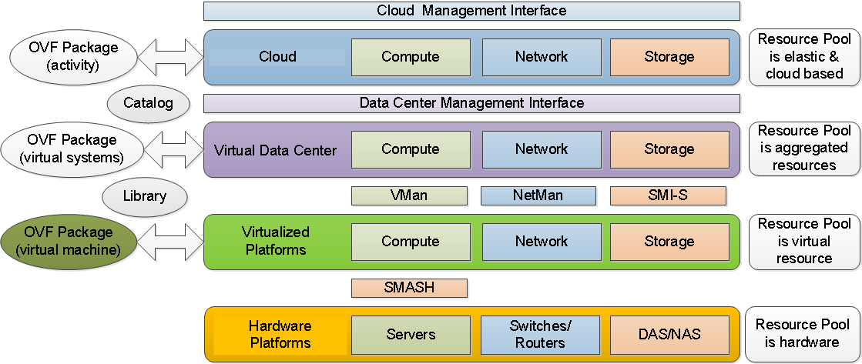
Management Cake

Slide 5
Cloud Management Work Group
Cloud Infrastructure Management Interface Model and RESTful HTTP-based Protocol (CIMI) DSP0263
  Version 1 approved at ISO
  Version 2 in development
Version 2 Work Items
  Collections architecture
  Common network model
    Work with NSM and OVF Work Groups
    Input from NFV folks
    Input from OpenStack
  Version 2.1 Work Items
    Use cases presented in “Cloud Infrastructure Management Interface Use Cases for CIMI 2Informational” DSP2042
Both DSP0263 v2 and DSP2042 available as work in progress

Slide 6
CIMI v2 Use Cases
  Business Continuity/Disaster Recovery Use Cases
  Realizing Business Continuity on a Machine
  Realizing Disaster Recovery on a Machine
  Service Level Objective Management Use Cases
  Introducing SLO Concepts in CIMI
  Assigning a Common SLO to a Machine in Multiple Clouds
  Auto-scaling Functionality
  Log and Metadata Management Use Cases
  Authorization Metadata Management
  Log Data Management
  Aligning Monitoring and Auditing with CADF
  Multi-cloud Management Use Cases
  Support for Multiple Operations in One Job

Slide 7
CIMI v2 Use Cases - continued
  Federation and Multi-brokering
  Controlling Resource Placement within a Cloud or across Clouds
  Extending an Existing Network to Multiple Clouds
  Creating an Inter-cloud Network
  Multi-cloud System Configuration
  Assigning a Common SLO to a Machine in Multiple clouds
  OVF Life Cycle - Import
  OVF Life Cycle - Export
  Resource Groups Management and Control Use Cases
  Support for Multiple Operations in One Job
  Auto-scaling Functionality
  Application Management and Orchestration Use Cases
  Enabling Application-level Orchestration and Management

Slide 8
OVF 2
Submitted to ANSI / INCITS for de jure standard
Follow on submission to ISO/IEC for international standard
Feature set
    Support for Network Port Profiles
    Scaling at deployment time
    Support for basic placement policies – including scoped placement
    Encryption of OVF packages
    Disk sharing at runtime
    Advanced device boot order
    Advanced data transfer to guest software
    Improved support for Internationalization - I18N
    Improved support of HASH functions
    Enhanced shutdown order control

Slide 9
OVF 3
OVF 3 is in development
Focus on network abstraction for cloud customer deployment
Focus on virtual network devices to address ETSI NFV use cases
Focus on shared information network model for with CIMI and Network Services Management

Slide 10
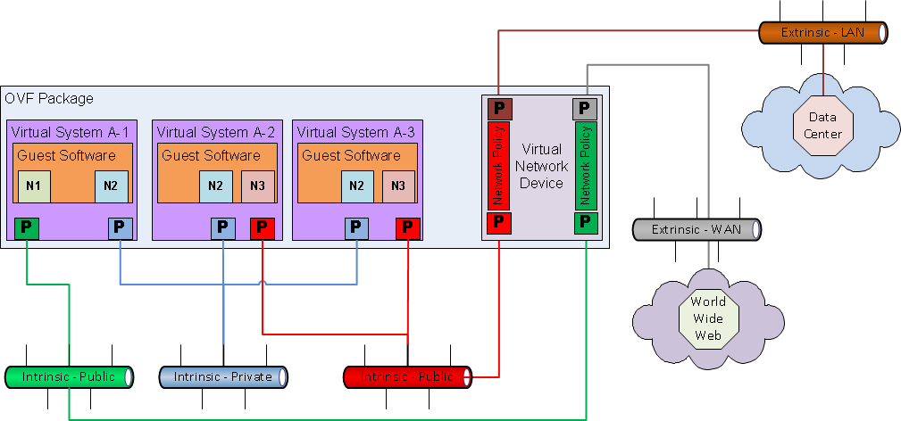
OVF and Virtual Network Devices

Slide 11
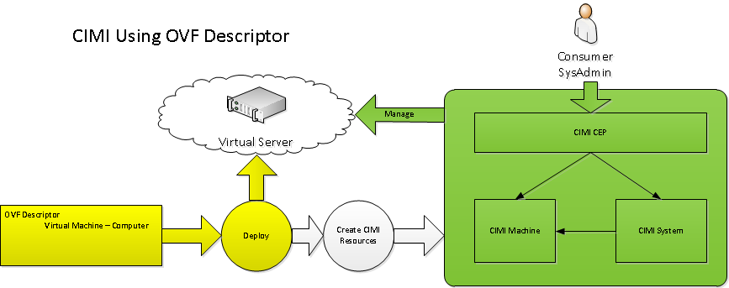
OVF and CIMI

Slide 12
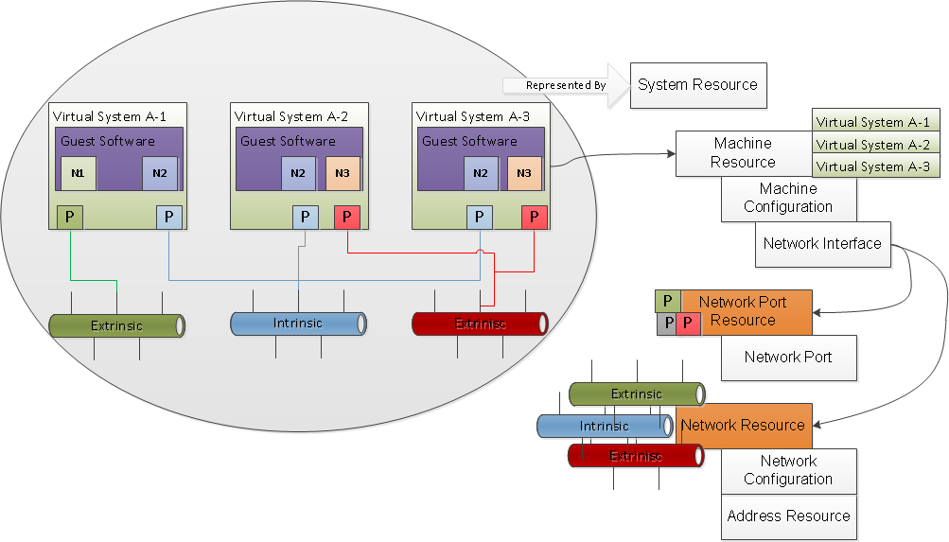
OVF Translation to CIMI Resources

Slide 13
Cloud Auditing Data Federation Work Group
Develop Standards for the Federation of Cloud Audit Data
  Specify Data Model with a Normative, Prescriptive Audit Event Data Format
    Deterministic values and fields (no Empty or Null fields)
  Along with Interface Definitions and a compatible Component and Interaction Model
    Supported by Granular Use Cases Covering Various Compliance Areas
Key Consumers / Audience
  Professionals Responsible for Certifying Compliance with IT, Industry, Government, Regional and Corporate Policies
    e.g. Auditors, Chief Compliance Officer (CCO), Chief Risk Officer (CRO), Chief Info. Sec. Officer (CISO), CIO, CFO, etc.
CADF Projects
  DSP0262 Data Format and Interface Definitions Specification
  DSP2038 OpenStack Model (CADF-OpenStack), A CADF Representation for OpenStack

Slide 14
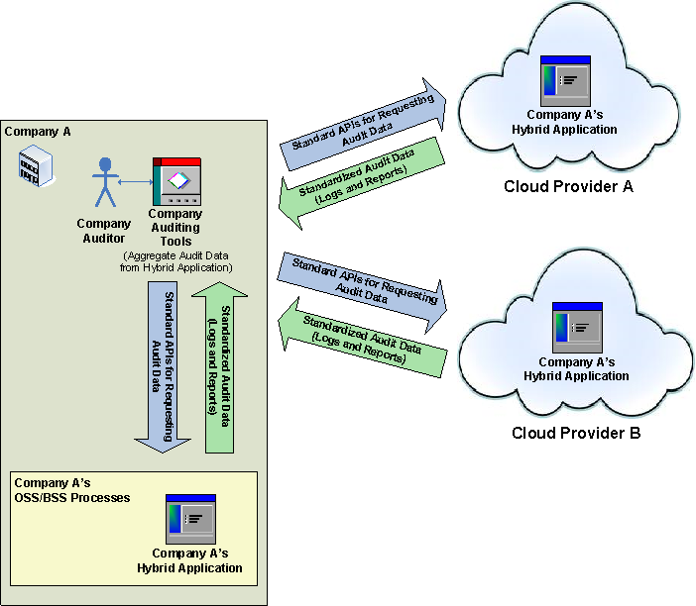
CADF – A Use Case
Aggregates Audit Data from
Hybrid Cloud Application
That Spans Multiple
(Cloud and Partner)
Deployments

Slide 15
Software Entitlement Work Group
List of Software Products whose entitlement metrics can be managed
Product - unit of acquisition, primary access point for manageability.
  Product Identification
  Entitlement Usage Metrics
  Events on a per Product basis
  For the key events in the product lifecycle, events and relevant statistics are accumulated
Software Entitlement Projects
  DSP1067 Software ID Tag Profile (work in progress release)
  DSP IS0301 Software Identification and Entitlement Metrics
Aligned with ISO/IEC 19770-3, Information technology — Software asset management — Part 3: Software entitlement tag

Slide 16
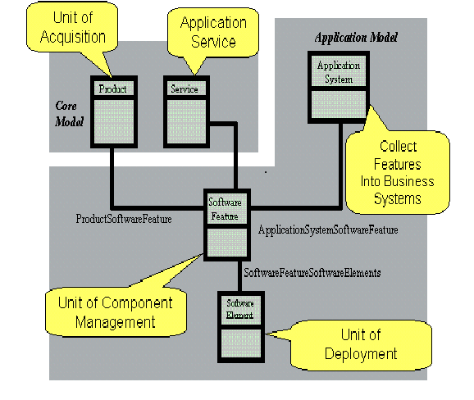
SE - Model

