Slide 1
Caller ID Spoofing, Egypt experience
ITU Workshop on “Caller ID Spoofing”
(Geneva, Switzerland, 2 June 2014)
Dr. Hosam Abd Elmaoula
NTRA
EGYPT

Slide 2
Content
Introduction
Definition of Spoofing
Types of Spoofing
Potential Impacts of Spoofing in Egypt
Methods of ID-Spoofing in Egypt
Operator Procedures
SIM box
Re-file
Consumer Procedures
Call Back
SIM Card
Applications mobile / website
OTT
Combating ID-Spoofing in Egypt
Recommendations

Slide 3
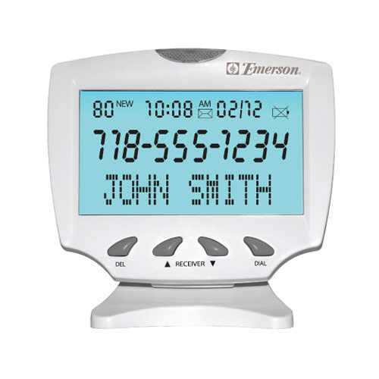
Spoofing
Spoofing is the act of one person pretending to be someone else

Slide 4
Types of Spoofing
Caller ID spoofing
Is when a telephone's caller ID displays a number that does not belong to the person calling.
IP Spoofing
A technique used to gain unauthorized access to computers.
URL Spoofing
A website shows another website.
E-mail Address Spoofing
A message coms from any e-mail address the sender chooses.

Slide 5
Impacts
Inability to provide accuracy of charging, mutual settlements and accounting.
Limiting the recipient ability to reject call attempts, which could have economic implications on the callee as well as the privacy.
Inability to stop automated telemarketing calls.
Callee deception, when he receives a call showing a local number, whereas the caller is outside of the callee country placed by international call.
Impersonation, where a caller or message source can impersonate a known entity to the user by spoofing it’s number.
Denial of services, route a huge number of calls to drop the services.

Slide 6
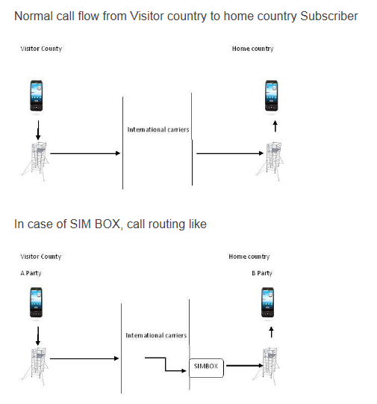
Methods of ID Spoofing in Egypt Operator procedures
SIM BOX

Slide 7
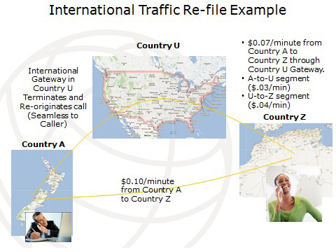
Methods of ID Spoofing in Egypt Operator procedures
Re-file occurs when the traffic is sent to a hub and then routed through a gateway that appears to re-originate the calls, so that they are not filed as “transit” traffic under international settlements.

Slide 8
Methods of ID Spoofing in Egypt Consumer procedures
Traditional Call Back
Step 1 – Registration
Web Registration - enter account number, PIN and phone number in the web form sonatelco.com
Mobile Registration - call the access number
Step 2 - Make Calls
Dial one of the callback access numbers provided in your panel.
Listen for at least 1 ring and hang up and wait for call back.
Pick up the hand set on the callback and listen for a 'BEEP'.
Enter in the destination number you wish to call follow by #. Example - 9654435676#

Slide 9
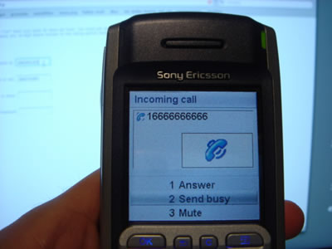
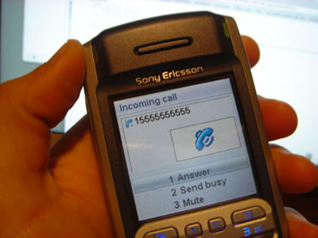
Methods of ID Spoofing in Egypt Consumer procedures
Advanced Call Back - SIM Card
All what explained in the previous technique can be done by inserting a very slim SIM Card in the handset
By using a SIM card you can make a call to anyone and hide or change your caller ID.

Slide 10
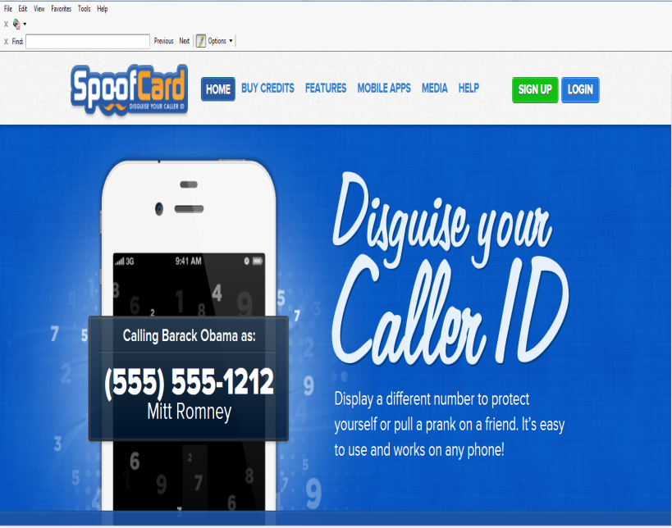
Methods of ID Spoofing in Egypt Consumer procedures
Applications Mobile / Website
( ex. one leg call)
Group spoofing
Disguise your number
Change your voice
Add background noise
http://www.spoofcard.com/?utm_source=pj&utm_medium=Affiliate&source=pjn&subid=7504

Slide 11
Methods of ID Spoofing in Egypt Consumer procedures
Over The Top (OTT)

Slide 12
Fighting ID-Spoofing in Egypt SIM BOX
Via Mobile
Test Call Generation (TCG)
Profiling
Group Killing
MSRN
TGT

Slide 13
Fighting ID-Spoofing in Egypt SIM BOX
Via Internet
Internet VoIP Filter (Operator Level /Country Level)
Detect and Stop/Throttle Bypassing IPs .

Slide 14
Fighting ID-Spoofing in Egypt
Re-file
Fighting RE-file by modifying the commercial deals with carriers.
Call Back and SIM card
Fighting Call Back and SIM card by blocking the ranges of the numbers and IPs.
OTT services
Fighting the implications of OTT services by regulations including well defined SLA.

Slide 15
Proposed Actions
To conduct studies to characterize possible types and ways of illegal ID spoofing.
To develop Recommendations on regulatory measures to assist MSs and Operating Agencies to combat ID spoofing.
To develop guides and bet practices, taking into account case studies from different regions of the world.

Slide 16
Thank You

