Slide 1
ITU Regional Standardization Forum for Asia Pacific Region Da Nang City, Vietnam 22 August 2016
Tools for preparing, submitting and tracking Proposals to WTSA-16
Xiaoya Yang
Head of WTSA Programmes Division, ITU-TSB
xiaoya.yang@itu.int

Slide 2
CPI overview
The Conference Proposals Interface (CPI):
Web-based tool for preparing/submitting proposals to WTSA-16.
Creates formatted proposals in any of the six official UN languages.
Ensures that the authoritative in-force provisions are used as the basis for proposals.

Slide 3
Preparing & submitting proposals using CPI
WTSA-12 proceedings
1
2
3
Create a “skeleton”
Indicate proposed changes
Submit proposal to WTSA-16
Modifications since WTSA-12 (e.g., updated Res.2, A.5, etc.)
“Skeleton” (selected provisions)
Proposal
WTSA-16
Reference text to be used (provisions): Resolutions, Recommendations, Opinions; Questions
Baseline texts
Baseline texts will be available to delegates from June 2016 through the Conference Proposals Interface (CPI) website.
These baseline texts should be used as the starting point for all suggested changes.

Slide 4
Types of change
MOD: Proposal to modify existing provision(s) (use "track changes"). E.g., addition, deletion or replacement of words or figures.
ADD: Proposal to add a new provision, i.e., a draft new WTSA Resolution, A-series Recommendation or Opinion (do not use "track changes.
SUP: Proposal to delete an existing Resolution, Recommendation or Opinion (do not use "track changes"). Reasons/rationale for deletion need to be given.
NOC: Proposal to maintain provision(s) without change (do not use "track changes"). Reasons/rationale for maintaining the text need to be given.
OTHER: Proposal on general matters no included above.

Slide 5
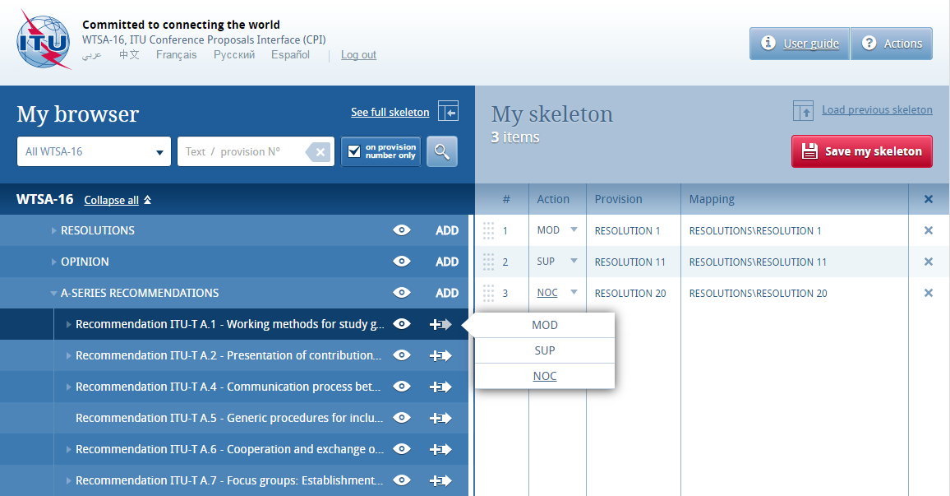
Conference Proposal Interface (CPI)
Baseline texts
Baseline texts will be available to delegates from June 2016 through the Conference Proposals Interface (CPI) website.
These baseline texts should be used as the starting point for all suggested changes.

Slide 6
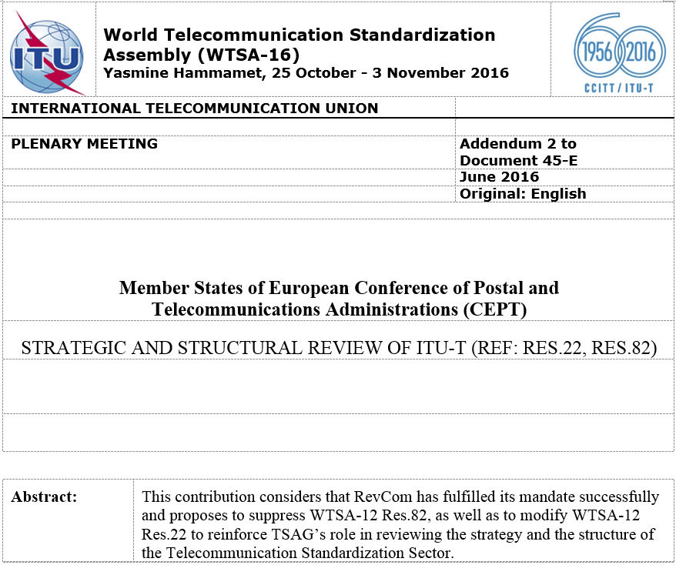
Anatomy of a Proposal - Header
- Document number (if known) and language; - date of submission; and - original language of submission.
Member(s) submitting proposal(s)
Proposal title
Description of background or content of this proposal (maximum 250 words).

Slide 7
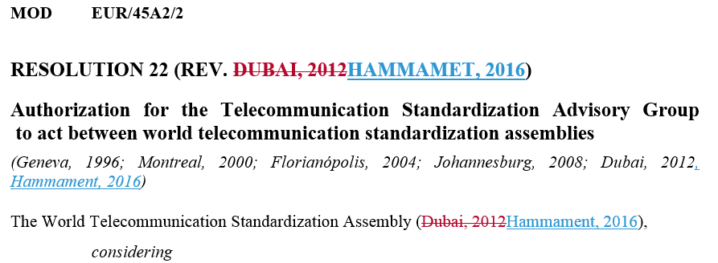
Presentation of MODs
- MOD: Action type “modify existing provision(s)”; - EUR: Submitter’s identifier, e.g., Member States of European Administrations; - /45A2: Document number, e.g., Document 45, Addendum 2;
- /2: Proposal number within in this document.
For MOD files, show changes in revision marks relative to a clearly identified, previously translated text. For Member Proposals, these should be existing Provisions.

Slide 8
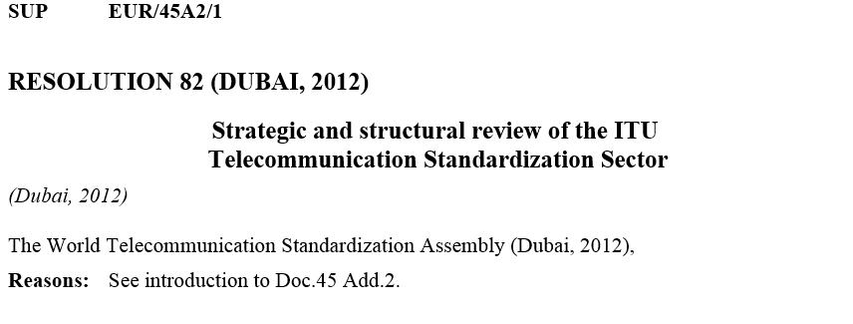
Presentation of ADDs, NOCs, SUPs
ADD, NOC and SUP Proposals should be clean text, and do not require the Provision content.
NOC and SUP Proposals include only the Provision title and a “Reasons” field.

Slide 9
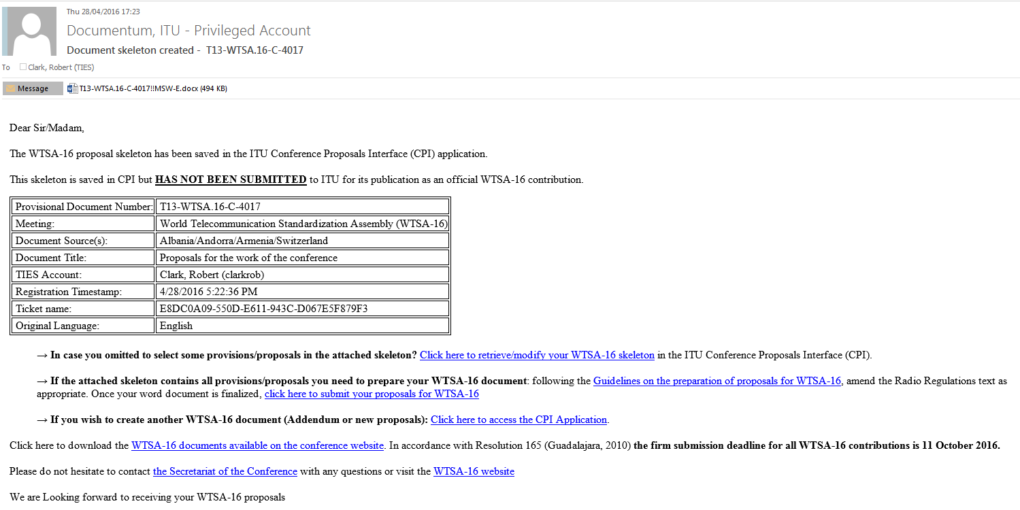
Email confirmation

Slide 10
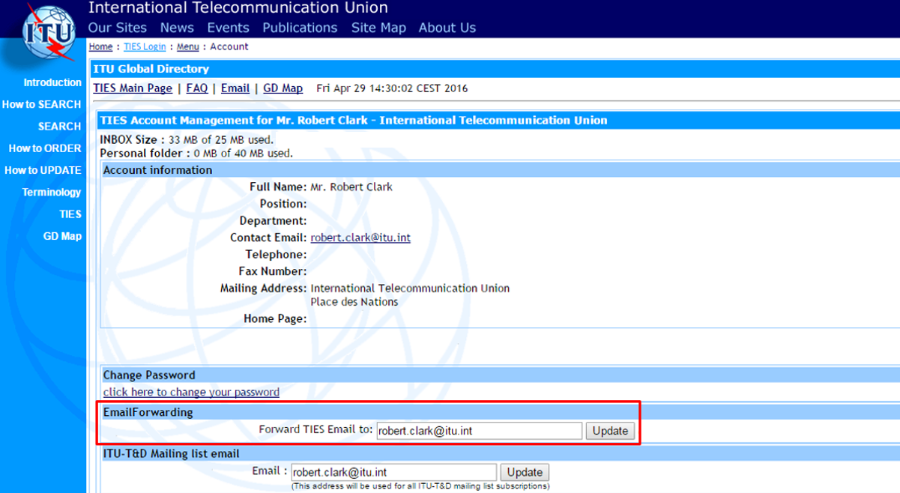
Setting TIES email forwarding
http://www.itu.int/online/mm/scripts/account

Slide 11
CPI Live demo
https://www.itu.int/net4/Proposals/CPI/WTSA16

Slide 12
Proposals Management System (PMS) web view
The PMS web view:
Web-based tool for delegates to identify and monitor Proposals
Ensures transparency from initial submission to final disposition
Tracks whole Contributions and individual Proposals

Slide 13
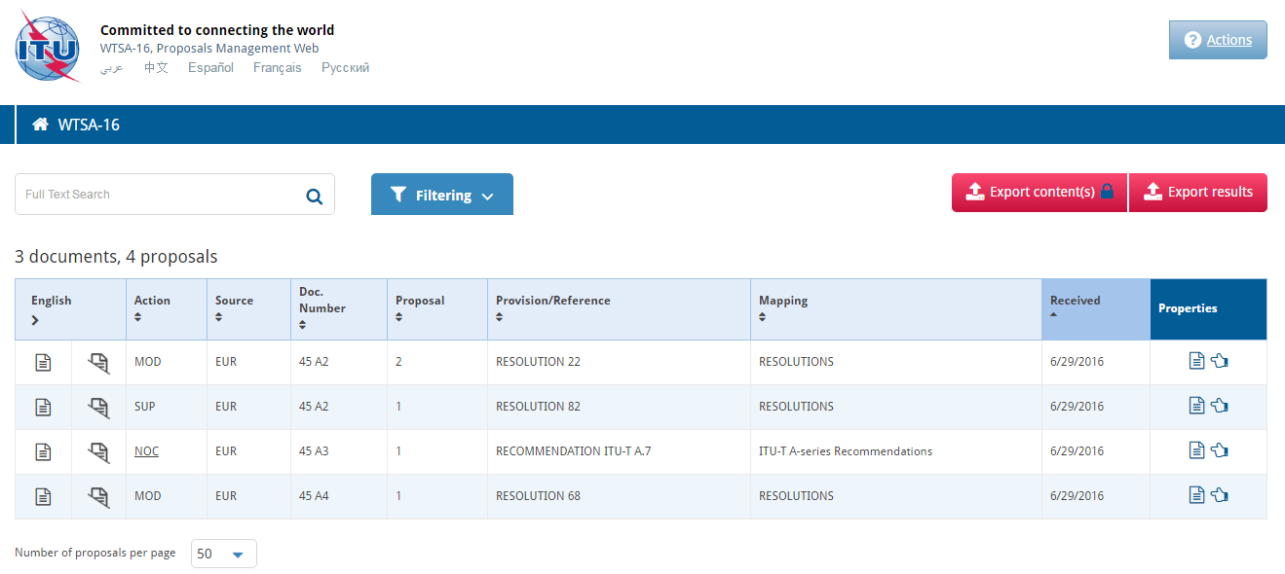
The Conference Proposals Interface (CPI):
Web-based tool for delegates to prepare/submit proposals to WTSA-16.
Ensures that the authoritative in-force provisions are used as the basis for proposals.
Creates formatted proposals in any of the six official UN languages.
Proposals Management Webpage
Complete Document (e.g., Doc.45 Add.2)
Specific Proposal, independent of its parent document (e.g., Doc.45 Add.2, Proposal 1)

Slide 14
Thank you
Any questions?
Rob Clark
ITU-T Study Groups Department (robert.clark@itu.int)
WTSA-16 Secretariat: wtsa-doc@itu.int

