Slide 1
ITU Regional Standardization Forum for Asia Pacific Region
Da Nang City, Vietnam
22 August 2016
Review of ITU-T Study Group Structure
Xiaoya Yang
Head of WTSA Programmes Division, ITU-TSB
xiaoya.yang@itu.int

Slide 2

Contents
Vision and Objectives of WTSA-16
Study Group Structure

Slide 3
Contents
Vision and Objectives of WTSA-16
Study Group Structure

Slide 4
Vision of WTSA-16 (1/2)
  Minimum Objective: Ready for 2020
  Expected message from WTSA 2016 re-structuring:
    Standard development platform: ready for 2020 and beyond
    ICT plays a crucial role in convergence, and so should ITU-T
    Valuable place for industry production and market developments
    Tactile awareness about the technology trend and market flows
    Enhance “Relevance” of ITU-T activities and value to Membership:
      Members, markets and businesses
      Balance of roles between developed and developing
      Clearer visibility on standards/technology targets
      Better coherence of Infrastructure

Slide 5

Vision of WTSA-16 (2/2)
Raise level of WTSA-16 and make this the best ever WTSA
Less inward-looking and procedure-focused
Make it interesting to the world outside ITU
Spice up plenary sessions with talks by renowned speakers on 5G, IoT, smart cities, video is the future, over-the-top services, digital financial services, optical fibre, trust/security/privacy, big data, e-health, connected car …
  Your suggestions welcome for speakers

Slide 6
Contents
Vision and Objectives of WTSA-16
Study Group Structure

Slide 7
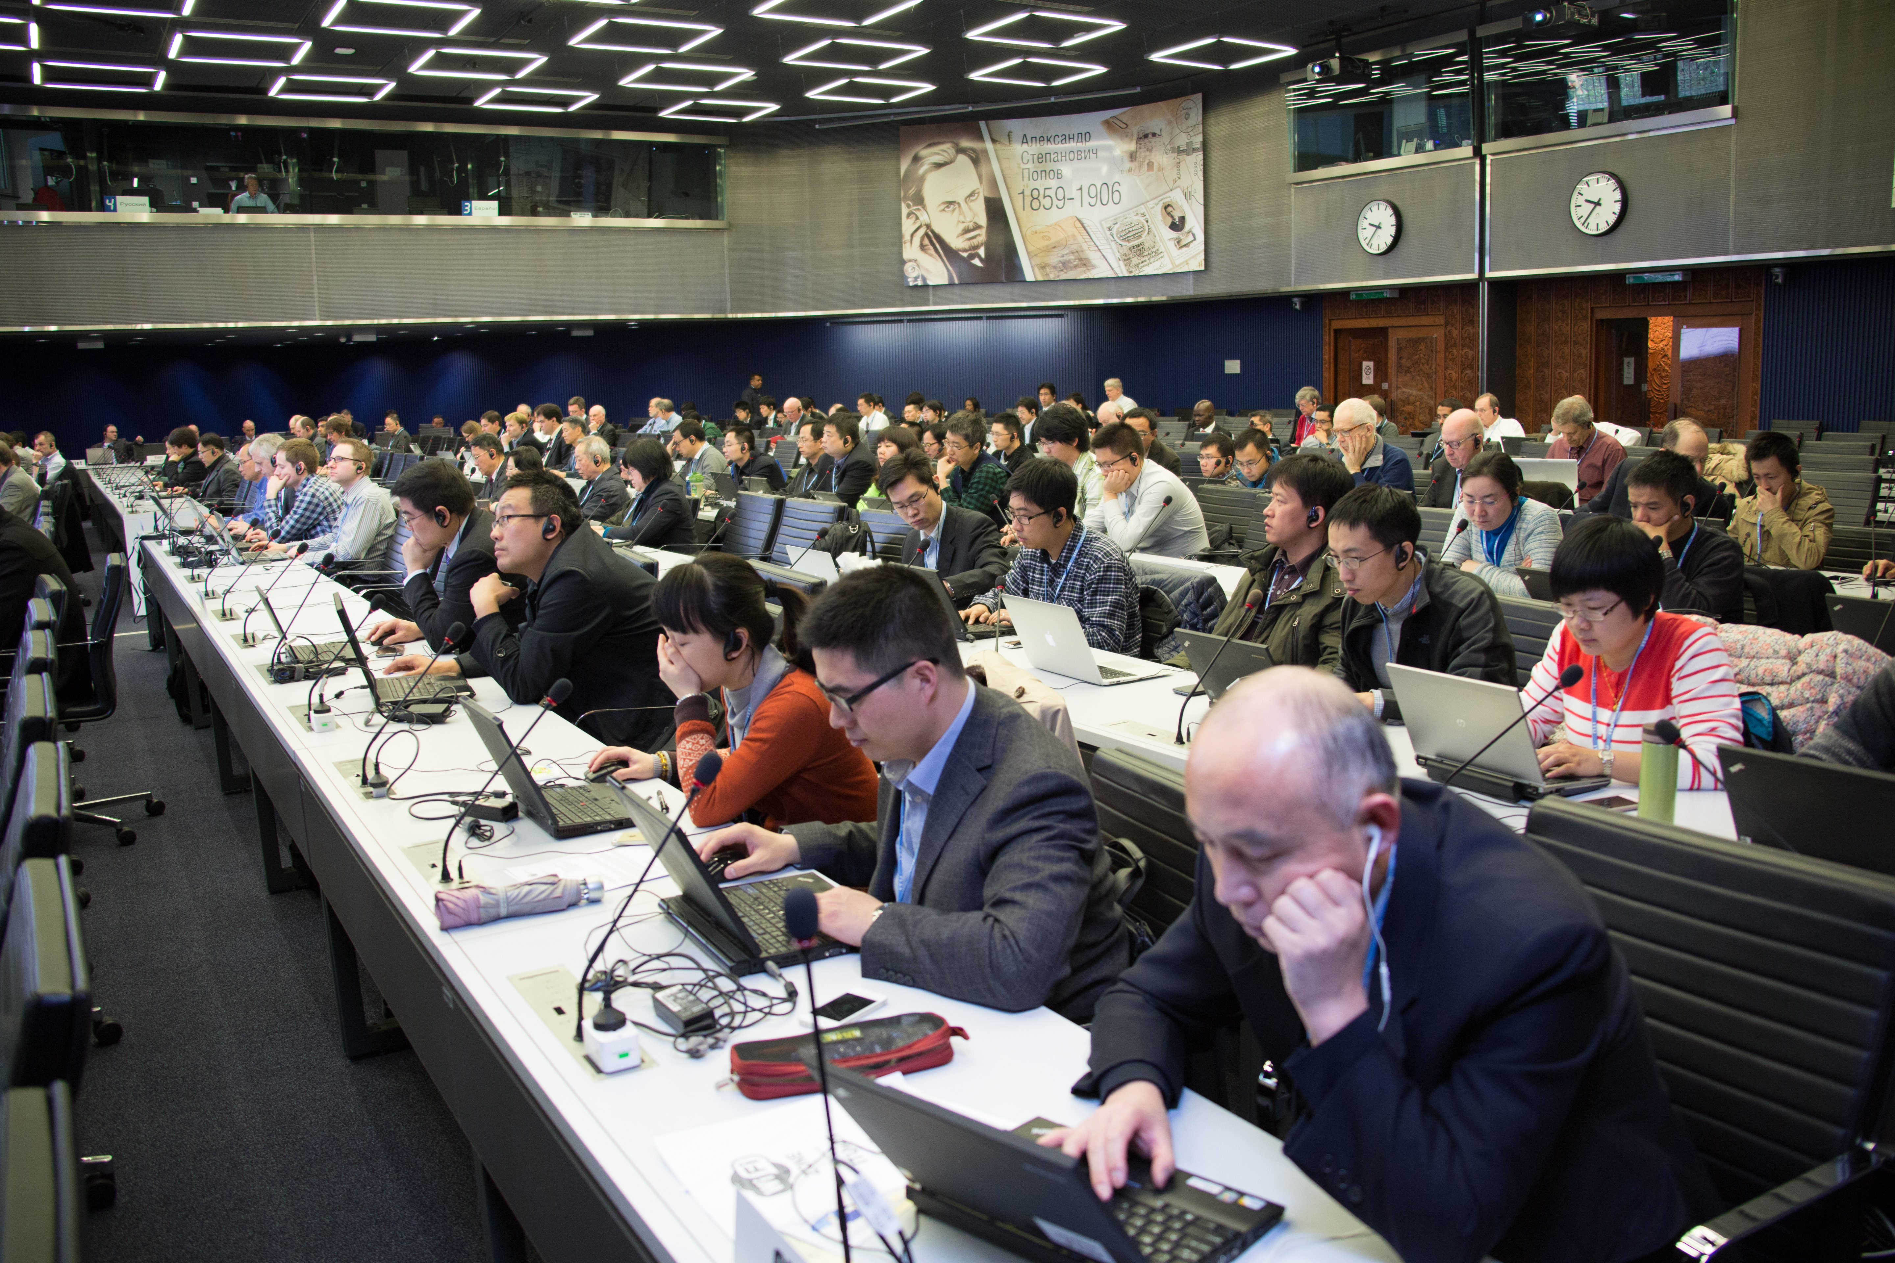
ITU-T current structure (1): ITU-T Eleven Study Groups
SG2 Operational aspects
SG3 Economic and policy issues
SG5 Environment and climate change
SG9 Broadband cable and TV
SG11 Protocols and test specifications
SG12 Performance, QoS and QoE
SG13 Future networks (incl. cloud)
SG15 Transport and access
SG16 Multimedia
SG17 Security
SG20 IoT & Smart Cities

Slide 8
ITU-T current structure (2): ITU-T Focus Groups
Augment the Study Group system
  Way to quickly react to ICT standardization needs
  Great flexibility of working methods
  Open to non-member participants
Current Focus Groups:
  5G/IMT-2020 Wireline
  Digital financial services
  Aviation applications of cloud computing for flight data monitoring
  Smart sustainable cities
  Bridging the gap: from innovation to standards
  Smart water management

Slide 9
Study Group Restructuring
At TSAG in February:
  No formal proposal from membership
  TSB Director’s food for thought
TSB Circular Letter 204, 8 March: hold on with submitting applications for chairmen/VC until TSAG July when study structure will have become clearer
No longer running: chairmen of ITU-T SG5, 9, 11, 16, 17
Table with term limits of chairmen/vice-chairmen: here

Slide 10
Study Group Structure: Functions and Elements
Equipped with functions and elements:
  Service and applications (Telecom media based and Cable based)
  Key Functions: Transport (very big), Control (small), Management (very small), QoS/QoE, Security and Environments/Energy
  Essential elements: Use cases, Requirements, Architectures, Mechanisms, Protocols, C&I, NNAI, and EPI (Economic and Policy Issues)
  Except “End user devices”
Enough # of Members: MS + SM (269) + Associates (144) + Academia (110)
Many tools: SG, FG, Workshop, Academia Events and Seminars
Good at “references” and “information”
Relatively weak at contribution to market & industry
“So far ITU-T is mainly working on building blocks, not so much on solutions, i.e. ITU-T Recommendations mainly address specific elements (protocols etc.), whilst implementations of products or even networks requires implementation of multiple Recommendations” – TD 419/TSAG, Feb 2016 -

Slide 11
Study Group Structure: Status of Relationships
EPI: Economic and Policy Issues
MM: Multi-Media
CATV: Cable TV
Id: Identification
Env: Environment
Eng: Energy
IoT/SC
Control
Management
MM
Requirements
Functions
Architectures
CATV
?
EPI
Security
Env
Eng
Number
(Id?)
QoS/QoE
?
?
Transport (being expanded)

Slide 12
Study Group Structure: Expected Model
Operational, EPI
Functions
Serv/App oriented Functions
Serv/App oriented Functions
Serv/App oriented Functions
Common Use Functions (Qos, Security etc)
Infrastructure Functions

Slide 13
Study Group Structure: recurring issues since WTSA-08
None of groups in favor to merge
Unsuccessful past merger proposals:
  SG2 + SG3
  SG11 + SG13
  SG9 + SG16
No agreement up to WTSA-12
Collocated meeting (not always possible):
  SG2 and SG3
  SG11 and SG13
  SG9 and SG16
Good to reduce # of SGs?
But what’s the value?
Impact for fulfilling Strategic Objectives
Ready for 2020
Enhance visibility and relevance

Slide 14
Study Group Structure: Classifying SGs
Possibly four categories of SG: Operational (Policy/Regulation), Commonly used functions, Service/Application oriented, and Infrastructure
SG 17
SG 20
SG 15
SG 3
SG 12
SG 16
SG 13
SG 2
SG 5
SG 9
SG 11
M
Operational
Common Used
Functions
Service
Application
Oriented
Infrastructure
M: Management

Slide 15
Study Group Structure: Mapping to the Model
Operational
Functions
(SG2, SG3)
Ser/App Functions (SG9)
Ser/App Functions (SG16)
Ser/App
Functions (SG20)
Common Functions (SG5, SG12, SG17)
Infrastructure Functions
(SG 11, SG13, SG15, WP2/2)*

Slide 16
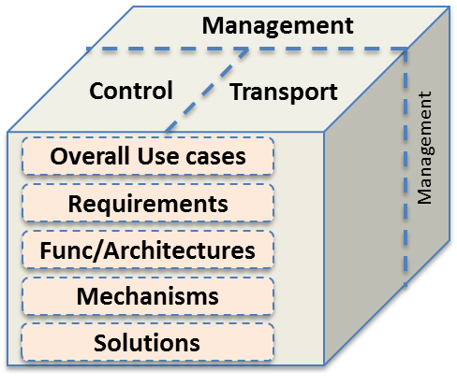
Study Group Structure: Strengthen Infrastructure
Management
Control
Transport
Overall Use cases
Management
Requirements
Func/Architectures
Mechanisms
Solutions
SG11 + SG13 + SG15 + WP2/2
SG X
(Access Infrastructure)
SG Y
(Core Infrastructure)
Further issues: C&I, Counterfeit, Outside Plant, Home networks

Slide 17
Study Group Structure: Possible way forward
CATV
MM
IoT/SC
EPI
QoS/QoE
Security
Env/Eng
Number
(Id?)
Further detailed arrangements among SGs should be followed

Slide 18
Study Group Structure: Meeting duration and frequency
Enhance Production: Dynamic, Flexible, Efficient, and Effective
Study Group
Study Group
8 (or 6) months
S W R…………R W S
S W R…………R W S
2 W or 10 D
2 W or 10 D
S: Study Group Plenary
W: Working Party Plenary
R: Rapporteur Group session/meeting
SG
SG
Could be 8 (or 6) months
W R…R S
W R…R S
1 W /5 D
1 W /5 D
R R
R W
R S
R R
3~5 D
3~5 D
3~5 D
3~5 D

Slide 19

www.itu.int

