Slide 1
ITU Regional Standardization Forum for Asia Pacific Region Da Nang City, Vietnam 22 August 2016
Guidelines for Drafting WTSA Resolutions
Xiaoya Yang
Head of WTSA Programmes Division, ITU-TSB
xiaoya.yang@itu.int

Slide 2
Agenda
Evolution of WTSA Resolutions
Analysis of WTSA-12 Resolutions/Opinion
Observation of WTSA-12 Resolutions/Opinion
Guidelines for drafting WTSA Resolutions

Slide 3
Evolution of WTSA Resolutions (1993-2012)
WTSA-yy | number of Resolutions | Breakout of Resolutions |  |  | number of A4-Pages
 |  | New (Res No.#) | revised | Suppressed/merged (Res No.# suppressed)
WTSC-93 | 21 | 21 (Res No. 1 – 21) | - | - | 59
WTSC-96 | 20 | 8 (Res No. 22-29) | 12 | 9 (Res No. 6, 8, 12-16, 19, 21) | 62
WTSA-00 | 21 | 11 (Res No. 31^{[1]} -41) | 10 | 10 (Res No. 3-5, 9-10, 23-25, 27-28) | 67
WTSA-04 | 31 | 14 (Res No. 42-55) | 17 | 4 (Res No. 36, 37, 39, 41) | 93
WTSA-08 | 49 | 21 (Res No. 56-76) | 28 | 3 (Res No. 42, 46, 51) | 139
WTSA-12 | 50 (+1) | 6 (Res No. 77-82; Op No. 1) | 44 | 5 (Res No. 17, 26, 53, 56, 63) | 187
^{[1]} Resolution Number 30 was never used.

Slide 4
50 WTSA-12 Resolutions
44 Revised, 6 New:
Res 77 - software defined network
Res 78 - e-health
Res 79 - e-waste
Res 80 - Acknowledge involvement of membership
Res 81 - Strengthening Collaboration
Res. 82 - Strategic and structural review of ITU-T
187 A4-pages
References:
160+ to other ITU Resolutions
28 to ITU Constitution
78 to ITU Convention
Notes:
Grayed one covered by other speakers.

Slide 5
WTSA-12 Opinion 1 (new)
“Practical application of network externality premium”
considering the progress achieved … those Member States concerned may wish to … possibly withdraw the reservations about Recommendation ITU-T D.156, Network externalities,
Member States to implement Recommendation ITU-T D.156,
Council to report on this subject to PP 2014

Slide 6
‘Rough’ Categories
ITU-T rules and procedures (12)
Collaboration and cooperation (6)
ITU-T administration (7)
Specific subjects (4)
Thematic topics (21 Res. + Op 1)

Slide 7
Category 1: rules and procedures (12)
Res 1 – ITU-T rules of procedures
Res 2 – ITU-T SG mandates
Res 22 – Authorization for TSAG to act between WTSAs
Res 31 – Admission of Associates in ITU-T
Res 33 – Guidelines for ITU-T strategic activities
Res 35 – Appointment and maximum term for Chairman and Vice-Chairman
Res 40 – Regulatory aspects of ITU-T work
Res 54 - Creation of and assistance to regional groups
Res 68 – evolving role of WTSA
Res 71 – academia membership
Res 74 – Admission of Sector Members from developing countries in ITU-T
Res 82 – review committee
Notes:
Grayed ones either only editorially changed, or covered by previous presentation.

Slide 8
Category 2: collaboration/cooperation (6)
Res 7 – ISO/IEC
Res 11 – UPU
Res 18 – ITU-R
Res 45 – Coordination of standardization work across ITU-T SGs and role of TSAG
Res 57 – Coordination/cooperation of ITU’s three Sectors
Res 81 – Strengthening Collaboration
Notes:
18, 38, 57 – only editorial changes

Slide 9
Category 3: administration (7)
Res 32 – Strengthening electronic working methods for ITU-T
Res 34 – Voluntary contributions
Res 43 – Regional preparations for WTSAs
Res 59 - Enhancing participation of telecommunication operators from developing countries
Res 66 – Technology Watch in TSB
Res 67 – Use in ITU-T of the languages of the Union on an equal footing
Res 80 - Acknowledging active involvement of the membership in developing ITU-T deliverables
Notes:
18, 38, 57 – only editorial changes

Slide 10
Category 4: Specific subjects (4)
Res 44 – Bridging Standardization Gap
Res 55 – Mainstreaming gender in ITU-T activities
Res 70 – Telecommunication/ICT accessibility for persons with disabilities
Res 75 – ITU-T’s contribution in implementing the WSIS outcomes
Notes:
44, 54 – covered in the other presentation on BSG
58 – only editorial change

Slide 11
Category 5: thematic topics(22)
SG2&3 (12):
Res 20 NNAI, 60 numbering, 61 number misuse, 65 Calling Party Number Delivery
Res 29 alternative calling procedures, 62 dispute settlement, Opinion 1
Res 47 ccTLD, 48 IDN, 49 ENUM, 64 IPv6
Res 69 non-discriminatory access to Internet
SG5: Res 72 EMF, 73 climate change, 79 e-waste
SG11: Res 76 – Conformity and Interoperability
SG13: Res 38 IMT, 77 SDN
SG16: Res 78 e-health
SG17 : Res 50 cybersecurity, 52 spam, 58 National CIRTs
Notes:
Grayed Resolutions on have editorial changes
76, 77 covered by other presentations.

Slide 12
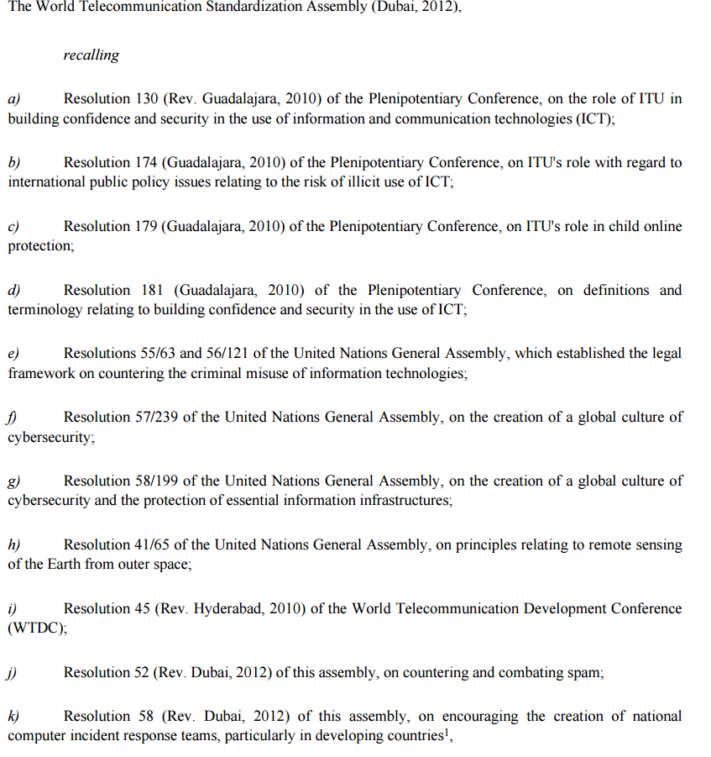
Observation 1: cross-reference

Slide 13
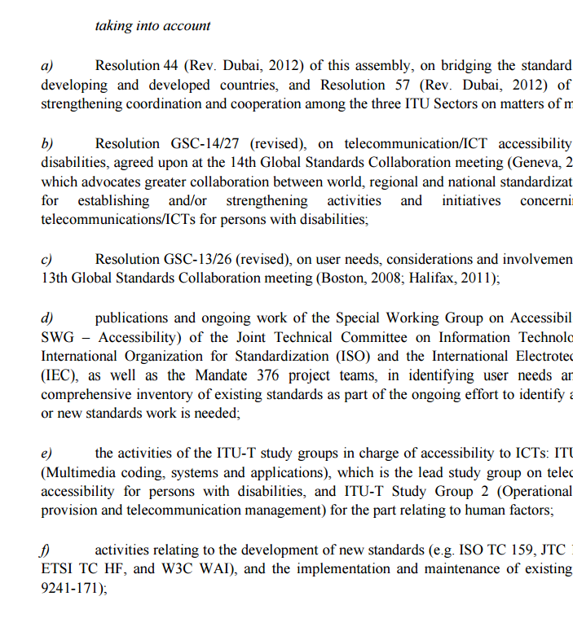
Observation 2: chronicle of events

Slide 14
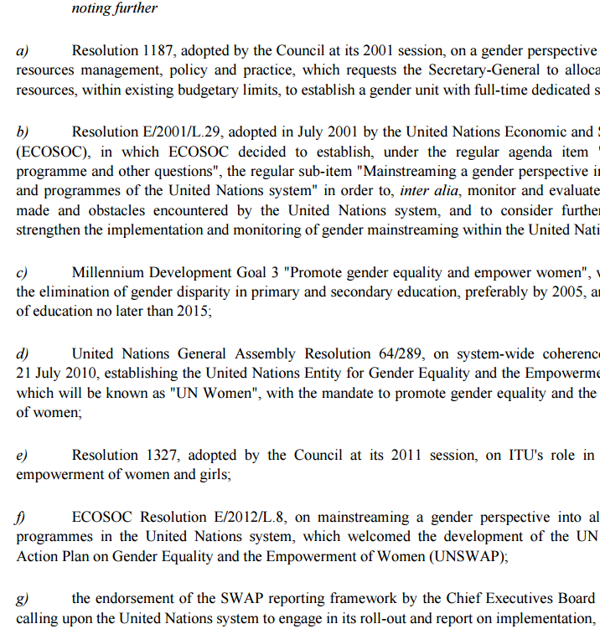
Observation 3: bibliography

Slide 15
Observation 4: Passive tense

Slide 16
Observation 5: no executive body

Slide 17
Observation 6: for membership action

Slide 18
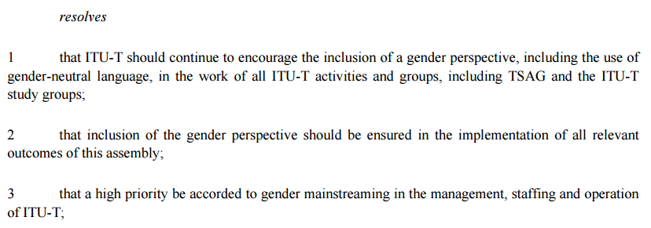
Observation 7: instruct ITU-T

Slide 19
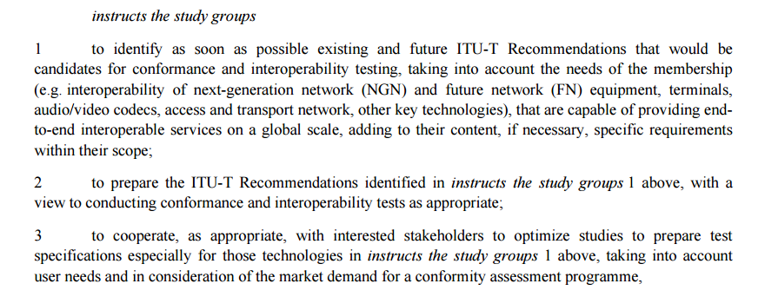
Observation 8: Instruct ITU-T SG(s)

Slide 20
Propose the following Guiding Principles
Each WTSA examines and suppresses obsolete Resolutions and parts thereof;
No editorial updates to dates/venues in WTSA Resolutions unless requested by contribution;
‘stand-alone/self-complete principle’;
One Resolution not to exceed four A4-pages;
The ‘preamble’ part not to exceed one A4-page;
‘minimum cross-reference principle’;
‘‘no repetition principle’;
When referencing to ITU CS/CV/GR, ‘stand-alone principle’ could overwrite ‘no repetition principle’;
‘no chronicle of events principle’;
‘no bibliography principle’;
bearing in mind that :
instruction given to ITU membership is non-binding;
instruction given to ITU-T SG will not serve much if not followed up by contributions to drive the work to progress;
The ‘operational’ part :
‘identified entity and specific action principle’;
‘measurable result principle’;
‘planning principle’;
‘report/expire principle’.

Slide 21
A Series Recommendations (1)
Recommendation ITU-T A.01- Working methods for study groups of the ITU Telecommunication Standardization Sector (ITU-T)
Recommendation ITU-T A.02 - Presentation of contributions to ITU-T
Recommendation ITU-T A.04 - Communication process between ITU-T and Forums and Consortia
Recommendation ITU-T A.05: Generic procedures for including references to documents of other organizations in ITU‑T Recommendations
Recommendation ITU-T A.06 - Cooperation and exchange of information between ITU-T and national and regional standards development organizations
Recommendation ITU-T A.07 - Focus groups: Establishment and working procedures
Recommendation ITU-T A.08 (10-2008) - Alternative Approval Process
Recommendation ITU-T A.11 - Publication of ITU-T Recommendations and WTSA proceedings

Slide 22
A Series Recommendations (2)
Recommendation ITU-T A.12 (10-2008) - Identification and layout of ITU-T Recommendations
Recommendation ITU-T A.13 (12-2007) - Supplements to ITU T Recommendations
Recommendation ITU-T A.23 (10-2000) - Collaboration with the International Organization for Standardization (ISO) and the International Electrotechnical Commission (IEC) on information technology
"Recommendation ITU-T A.23, Annex A (02-2010) - Guide for ITU-Tand ISO/IEC JTC 1 cooperation"
Recommendation ITU-T A.31 (10-2008) - Guidelines and coordination requirements for the organization of ITU-T workshops and seminars
A-Series Supplement 2 (06-2000) - Guidelines on interoperability experiments
A-Series Supplement 3 (07-2012) - IETF and ITU-T collaboration guidelines

Slide 23
ITU-T A-series Recommendations
Organization of ITU-T work
Under the responsibility of TSAG
Is it necessary for TSB staff to serve as ‘editor’ for A-series?
Rational: TSB is the primary implementer of A-series Recommendations
Consequence: Resolution 1/A.1 need to be revised

