Slide 1
ITU Regional Standardization Forum for Asia Pacific Region
Da Nang City, Vietnam
22 August 2016
WTSA-16 Overview
Xiaoya Yang
Head of WTSA Programmes Division, ITU-TSB
xiaoya.yang@itu.int

Slide 2
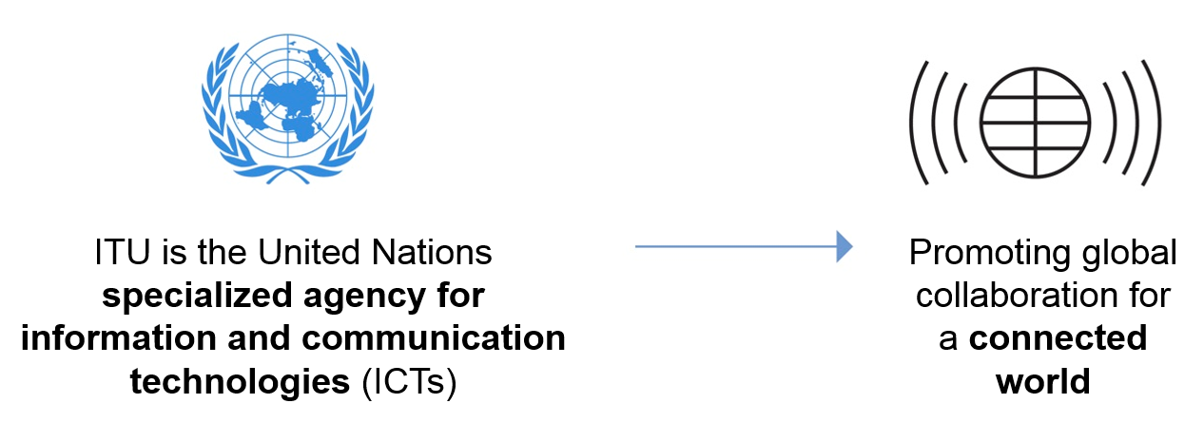

Who are we?
ITU is an International Public/Private/Academic Partnership

Slide 3


What do we do?
Allocation of global radio spectrum and satellite orbits
Bridging the digital divide
‘Committed to Connecting the World’
Establishing international standards

Slide 4
ITU Structure
General Secretariat
ITU-R
(Radiocommunication)
ITU Council
(48 MS)
ITU-D
(Development)
WRC & RA
WTDC
Plenipotentiary Conference
(193 MS)
ITU-T
(Standardization)
WTSA

Slide 5


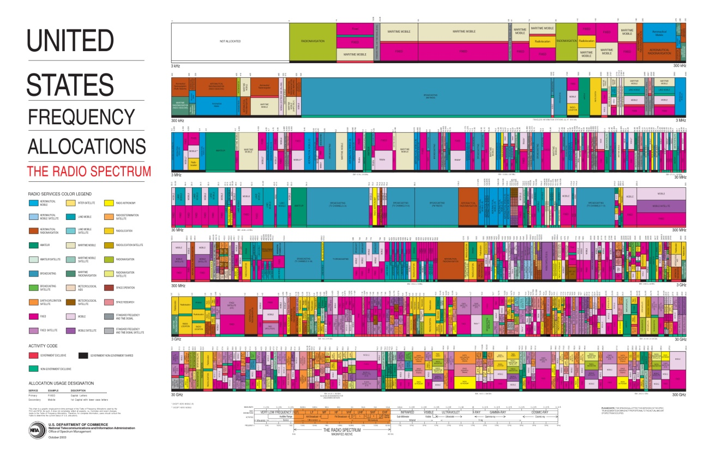

ITU allocates frequencies; satellite orbits
WTSA-16

Slide 6


ITU develops standards
WTSA-16
… and allocates numbers
WTSA-16 is about standards

Slide 7



ITU assists developing countries
WTSA-16
… in building up their ICT infrastructure

Slide 8
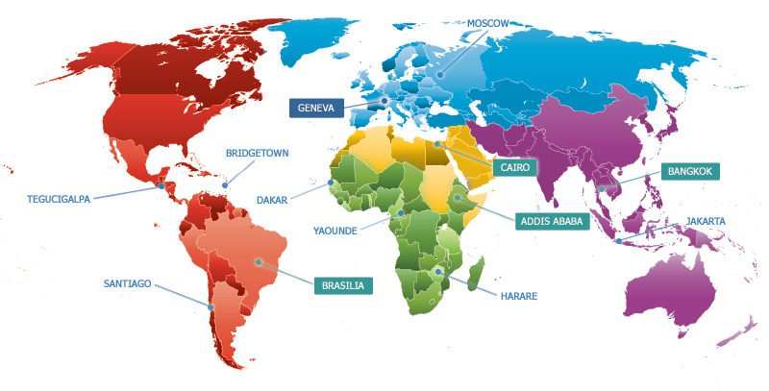
ITU’s Global Presence

Slide 9
ITU-T Objectives 2016-2019 (PP-14)
T.1 Develop non-discriminatory international standards (ITU-T Recommendations), in a timely manner, and foster interoperability and improved performance of equipment, networks, services and applications
T.2 Promote the active participation of the membership, in particular developing countries, in the definition and adoption of non-discriminatory international standards (ITU-T Recommendations) with a view to bridging the standardization gap
T.3 Ensure effective allocation and management of international telecommunication numbering, naming, addressing and identification resources in accordance with ITU-T Recommendations and procedures
T.4 Foster the acquisition and sharing of knowledge and know-how on the standardization activities of ITU-T
T.5 Extend and facilitate cooperation with international, regional and national standardization bodies

Slide 10
What is WTSA
World Telecommunications Standardization Assembly
Held every 4 years
Participants include:
  Membership: Member States, Sector Members, Associates, Academia
  ITU 5 Elected Officials
  ITU Staff (TSB, IS, C&P, RO Directors, Interpreters)
What is decided:
  Resolutions on Thematic areas, SG Mandate and Structure, and ITU-T Recommendations
  Resolutions and Recommendations on Working Methods, other administrative matters
  Elections of SG and TSAG Chairmen and Vice Chairmen
Who decides: in the Plenary by consensus as determined by the WTSA Chairman

Slide 11
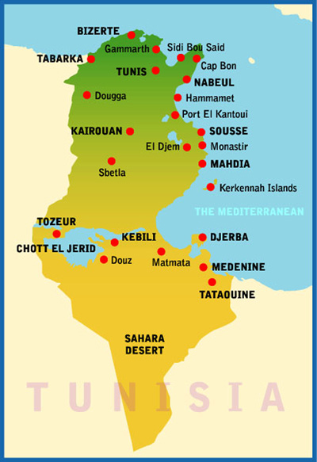
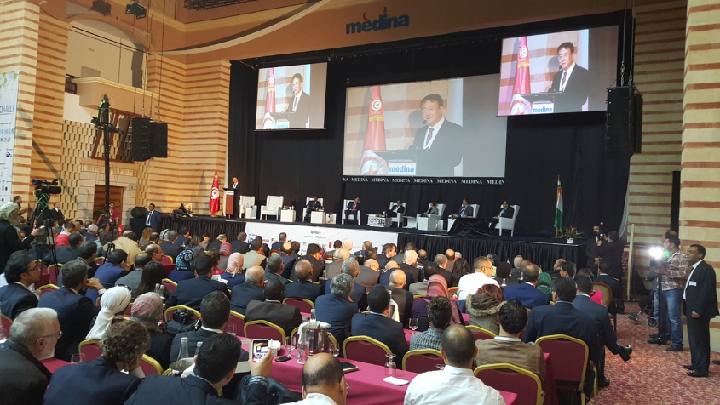
World Telecommunications Standardization Assembly WTSA-16
Dates: 25 October – 3 November 2016
  CxO Meeting 23 October
  Global Standards Symposium 24 October
  Chairmen Meeting 4 November
Location: Yasmine Hammamet, Tunisia
Venue: Medina Conference Center
Contribution Deadline: 26 September

Slide 12
Hot topics discussed at ITU-T
WTSA-16
5G (non-radio)
Internet of Things (for smart cities)
Security, Privacy and Trust
Transport, Access, Home
Optical fibre
Video coding, e-everything (e.g., e-health)
ICT and the environment
Digital Financial Service (e.g., Mobile money)
Global roaming, Over The Top
Bridging Gaps (standards, technology)
Connected vehicles

Slide 13
Vision of WTSA-16
WTSA-16
Make this the best ever WTSA
Less inward-looking and procedure-focused
Make it interesting to the world outside ITU
Invite renowned speakers on 5G, IoT, smart cities, video is the future, over-the-top services, digital financial services, optical fibre, trust/security/privacy, big data, e-health, connected car …

Slide 14
Global Standards Symposium
WTSA-16
A one-day event preceding every WTSA
The report of GSS is presented in the opening of WTSA by the GSS Chairman
GSS theme being considered
  Privacy and security
  Open source
  Sustainable development goals

Slide 15

Output: WTSA-16 Proceedings
WTSA-16
A ~450-page (electronic) book with updated Resolutions and Recommendations
Esp. :
  Resolution 1 – ITU-T rules of procedures
  Resolution 2 – ITU-T Study Group responsibility and mandates
  ITU-T A-series Recommendations - organization of ITU-T work

Slide 16
Expected number of participants
WTSA-16
WTSA-12: 705
WTSA-08: 769
WTSA-04: 405
WTSA-16
WTSA-12:
Member States: 607
Palestine: 1
ROA (operators) 20
SIO (manufactorers) 36
regional/other 20
regional telco orgs 9
other entities 9
UN agencies 1
universities 2

Slide 17
Committees (draft)
WTSA-16
Plenary
COM 1: Steering Committee
COM 2: Budget Committee
COM 3: Working Methods
  may have subgroups
COM 4: Work Programme
  may have subgroups
COM 5: Editorial Committee

Slide 18
Meetings
WTSA-16
From 9:30 – 12:30 and 14:30 – 17:30 (Fri: 9:00-12:00)
Half hour coffee breaks, 2-hour lunch break
Either one session, or two sessions in parallel (with the same services offered – webcasting, captioning, …)
Smaller meetings before 9:30, during lunch break, after 17:30
On weekend (Saturday, Sunday): smaller meetings

Slide 19
Time management plan (draft)
WTSA-16

Slide 20
Time management plan (draft)
WTSA-16

Slide 21
Rules and Procedures
WTSA-16
ITU’s General Rules of Conferences, Assemblies and Meetings apply
Consensus = no persistent objection from ITU Member State, as determined by Chairman
Vote Very rarely used in ITU, unlikely in WTSA-16
  in case if unavoidable, details (quorum, casting of vote, transfer of vote, etc) will be helped out by ITU Legal Unit on site

Slide 22

www.itu.int

