Slide 1
ITU Regional Standardization Forum for Asia Pacific Region Da Nang City, Vietnam 22 August 2016
Bridging the Standardization Gap at ITU
Xiaoya Yang
Head of WTSA Programmes Division, ITU-TSB
xiaoya.yang@itu.int

Slide 2
Background

Slide 3
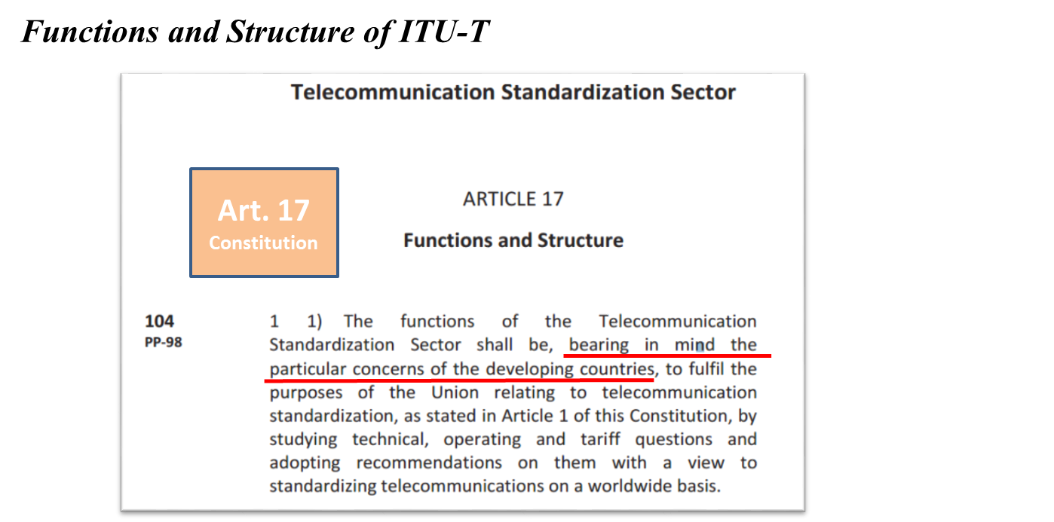
Art. 17 of the ITU Constitution cites “concerns of developing countries”

Slide 4
ITU Strategic Plan: BSG is a key strategic objective of ITU-T

Slide 5
Since 2002, ITU has a Resolution on BSG: Resolution 123 (PP-14)

Slide 6
Since 2004, ITU-T has a WTSA Resolution on BSG: Resolution 44 (WTSA-12)

Slide 7
ITU-T Mandate
Key elements of Resolution 44 Action Plan

Slide 8
A few words about WTSA-12 Resolution 44 & its Action Plan
Florianópolis, 2004 Johannesburg, 2008 Dubai, 2012

Slide 9
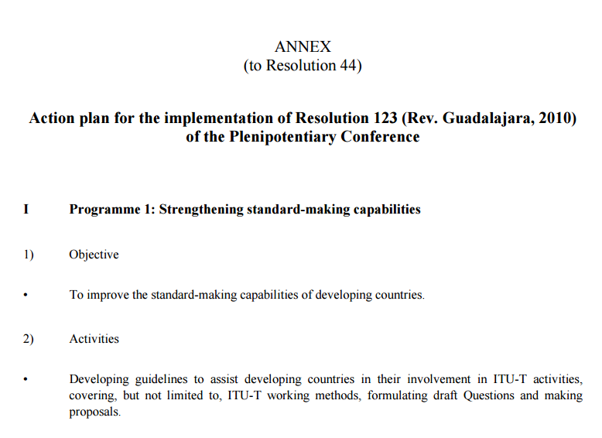
What WTSA-12 Resolution 44 contains:

Slide 10
BSG towards 2020: An enhanced value proposition

Slide 11
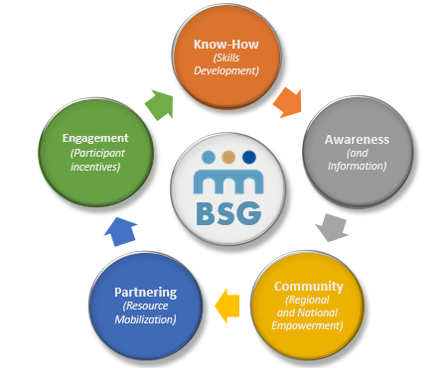
Bridging the Standardization Gap (BSG)

Slide 12
BSG Implementation
Applying the
BSG Action Plan

Slide 13
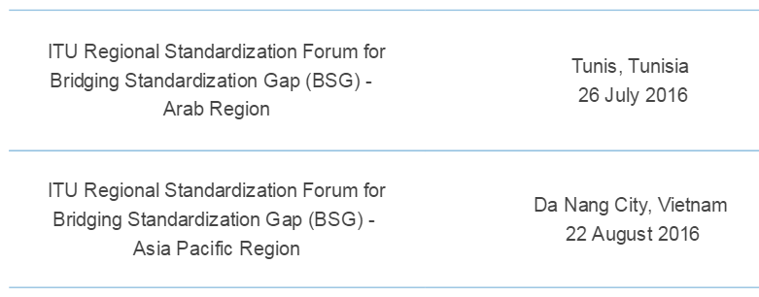
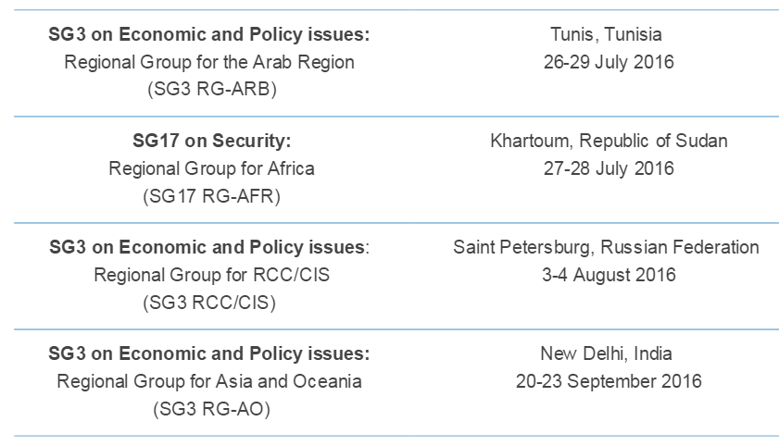
Community: Regional Group Meetings & Regional Forums

Slide 14
Know-How: Skills development for Study Group Delegates through hands-on sessions

Slide 15
Impact of BSG at the regional level:
An example from the African region (SG3RG-AFR)

Slide 16
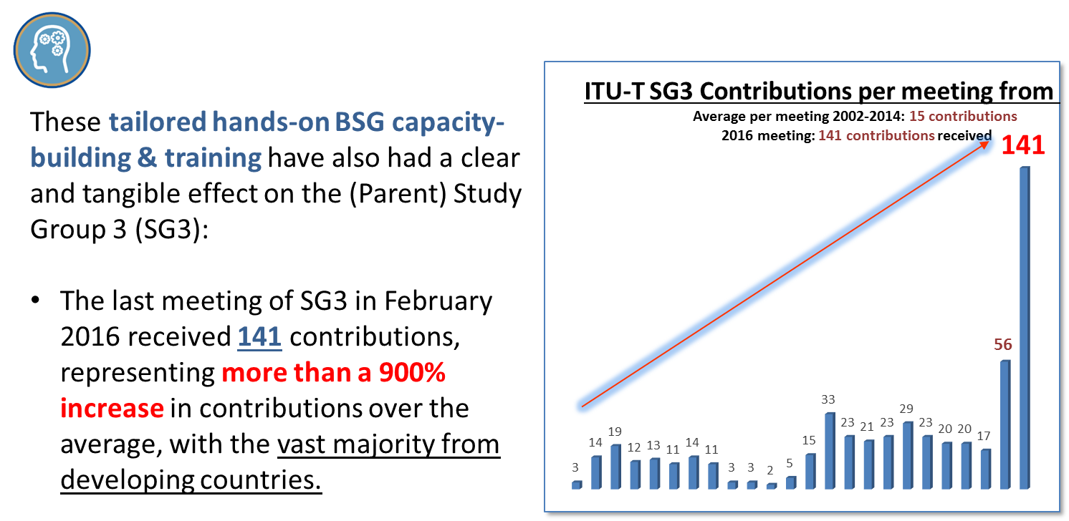
Impact of BSG at the global level: A case in point
Over 22% of these were submitted from the Asia-Pacific region!

Slide 17
ITU-T BSG Hands-On Sessions and Role-Play

Slide 18
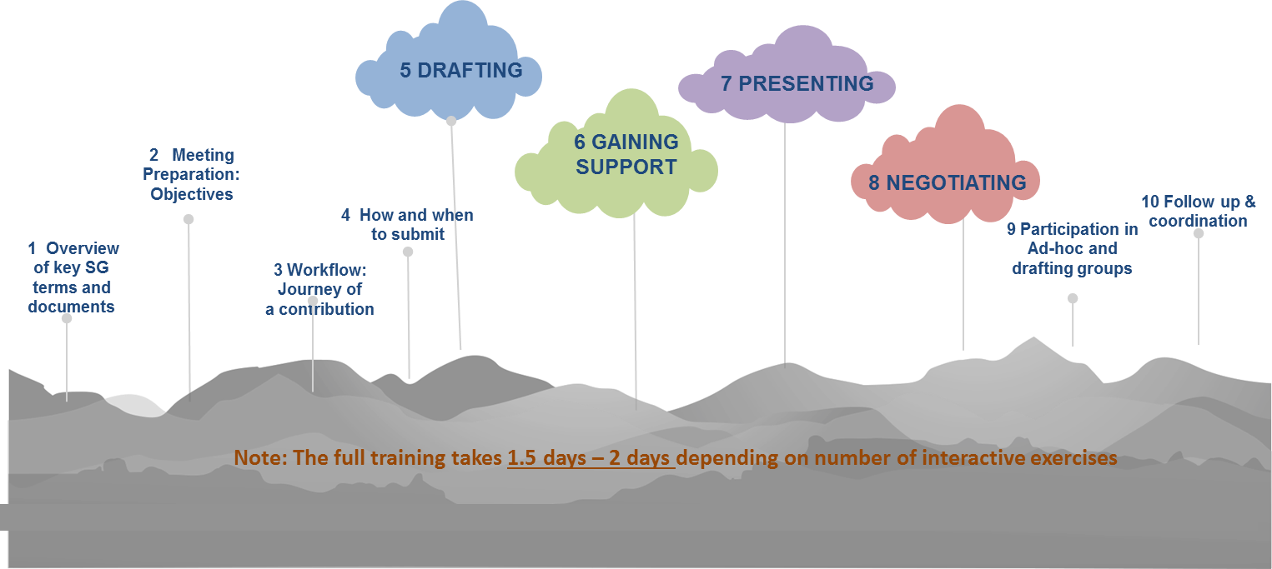
The Hands-on SG Effectiveness Training in 10 modules

Slide 19
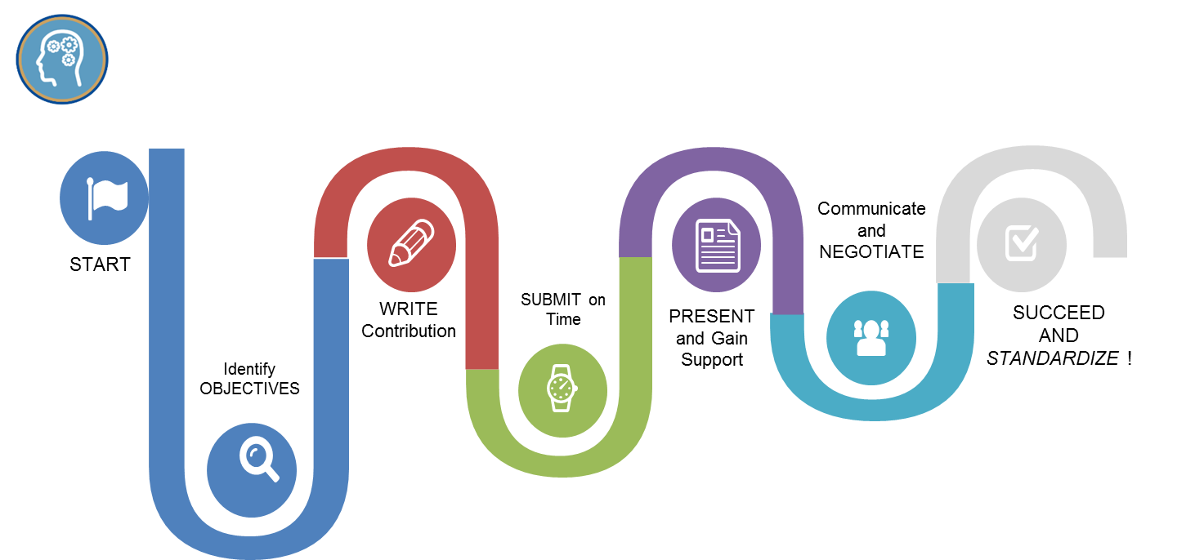
The winning ITU-T Standards Contribution Road Map

Slide 20
Hands-on sessions: Feedback from our BSG Alumni

Slide 21
Know-how: E-learning courses
Think about taking the ITU-T A.1 E-learning course and getting certified!
Link: https://academy.itu.int/index.php?option=com_joomdle&view=coursecategoryextended&cat_id=:&course_id=605:recommendation-itu-t-a-1-working-methods-of-itu-t-study-groups&Itemid=478&lang=en

Slide 22
Partnership Opportunities

Slide 23
Check out our new BSG website:
www.itu.int/go/bridging

