Slide 1
ITU Regional Standardization Forum for Asia Pacific Region Da Nang City, Vietnam 22 August 2016
TTA’s activities on bridging standardization gap Kihun Kim Principal Researcher, TTA (channel@tta.or.kr)

Slide 2
Contents
Who is TTA?
What is BSG?
Experiences and Activities of TTA
Observations?
Future Plan

Slide 3
Contents
Who is TTA?
What is BSG?
Experiences and Activities of TTA
Observations?
Future Plan

Slide 4
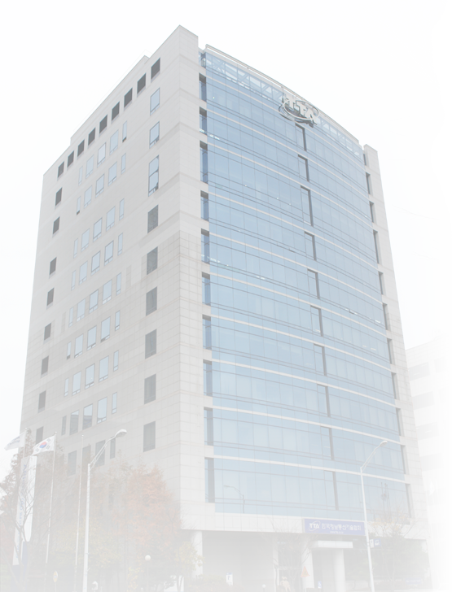
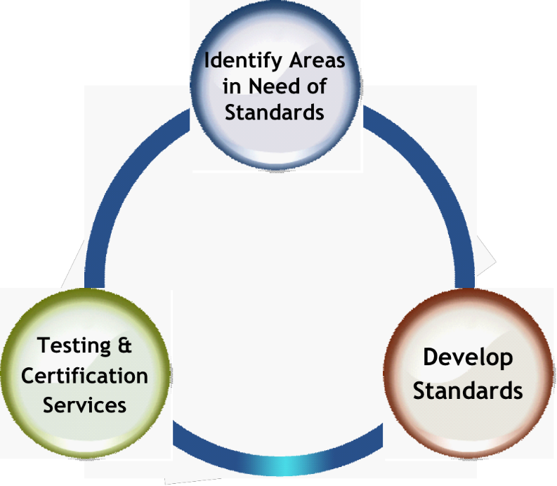
Who is TTA? : Telecom. Technology Association
Accredited standards developing & testing/ certification organization in ICT area
Planning and setting ICT standards
Testing and certifying ICT products
4

Slide 5
Who is TTA? : Structure
2 Divisions & 2 Laboratory &
1 Academia
Employees: 420
Board of Directors
Auditor
President
Technical Assembly
Examiner
TTA Academy
Standardization
Division
IT Testing &
Certification Laboratory
Software Testing &
Certification Laboratory
Management &
Service Division
Strategic Planning Dept.
Standards Promotion Dept.
Telecommunications
Convergence Dept.
Radio & Broadcasting Dept.
Information Technology Dept.
Testing & Certification Strategy
Planning Dept.
Network TCD
Broadcasting TCD
Mobile Communications TCD
Software Testing & Certification Dept.
Software Testing & Assessment Dept.
Information Security Assessment Dept.
Business Innovation Dept.
General Affairs Dept.
Information & Cooperation Dept.
5

Slide 6
Who is TTA? : Standardization Framework in Korea
ITU
Cooperation
ISO/IEC
ISO/IEC/JTC1
Delegation of
Authority for
Communications
Standard
Announcement
Delegation of
Authority for
Developing
Korean Standard
in IT area
Radio Research Agency
MSIP
Communications Standards Commission
KATS / MOTIE
Operational supervision
Industrial Standards Commission
suggesting draft
national standard
to be adopted
Operational supervision
MSIP
Korea ITU Committee
Information
Technology
Chemical
…
…
Secretariat
Service
Secretariat
Service
Proposal of
National Standards
Consignment of
KS promotion & sales
Telecommunications
Technology Association
한국정보통신기술협회
TTA
Korea Standards
Association
TTA Standardization Committees
Participation &
Proposal of Draft Standard
Promotion & Dissemination of
Standards
Promotion & Dissemination
Of KS
Manufacturers
Communication service
providers
Laboratories
Academia etc.
6
6

Slide 7
Who is TTA? : Testing and Certification Service
Software
Network
Broadcasting
Information Security
Products
Internet phone and
Communications
services quality
Mobile Phone Charger
Mobile Communication
7

Slide 8
Contents
Who is TTA?
What is BSG?
Experiences and Activities of TTA
Observations?
Future Plan
8

Slide 9
What is BSG? - Divide & Gap
(ICT/Digital) Divide(gap) has been widened between
Elderly people and Young people
Woman and Man
Urban and Rural area
People with disability and Non-People with disability
Large company and SME
Developing and Developed
Gap in standardization and has been also widened between
Large company and SME
Developed and Developing
9

Slide 10
What is BSG? – where the gap is originated?
<National level>
Rare recognition
Lack of legislation/policy
Lack of technology / expertise
- lack of R&D budget
(complex and complicated standard)
Lack of institutions
- R&D, SDO…
Lack of human resource
<Industry level>
Lack of industry
-> Resulting in low usage & adaptation of standards in implementing ICT service/product (standardization gap)
10

Slide 11
Contents
Who is TTA?
What is BSG?
Experiences and Activities of TTA
Observations?
Future Plan
11

Slide 12
Experiences and Activities of TTA – domestic level
Problem
Solution
Rare recognition
Latest tech. information dissemination
- ICT standard Weekly (weekly)
- Handbook of standards
- TTA Journal (bimonthly)
- Use of standard in ICT product/service
Holding workshop, training and seminar
- Std. technology w/s and seminar
- Special lecture on std. technology at univ.
- Training for fostering int’l standardization experts
Providing technical consultation
- Short term consultation on std. technology
- Customized consultation on implementation of std. technology (development of technology/ service based on standard)
Lack of technologies / expertise
Lack of human resource
12

Slide 13
Experiences and Activities of TTA – int’l level
Problem
Solution
Rare recognition
Collaboration program on BSG with developing countries in AP region
- Collaboration meeting on institutional/
procedural issue
Legislation framework of ICT standardization/conformity assessment system
Diagnosis on current standard setting process, and suggestions
Suggestions for topics for R&SD
Relationship between mandatory and voluntary standard
Guide for setting up standard developing body
Corresponding system to international standardization activities
∗ All the above topics include case studies of various foreign countries
- Technical workshop
- On site training
Lack of legislation/policy
Lack of institutional aspect
13

Slide 14
Experiences and Activities of TTA – others
ICT Collaboration Program with AfDB(African Development Bank)
Background/Objective
To enhance and strengthen ICT competence of African countries and to provide principal expertise and experience for developing human resource and implementing ICT infrastructure
Activities
Dispatching ICT experts to African countries for providing ICT policy and technical consultation
Holding ICT policy/technical workshop in African countries
Holding “On the Job Training” in Korea
Topics
ICT policy & regulation, Digital switchover, ICT equipment testing & conformance assessment, Cyber security, Broadband network, etc
14

Slide 15
Experiences and Activities of TTA – others
ICT Collaboration Program with IDB(Inter-American Development Bank)
Background/Objective
IDB has established a regional ICT training center which aims to increase the capacity of government officials to train on specific issues that foster investment and promotion of sustainable competition
The center planed to provide on-line and off-line training programs and it needed materials for the educations
Activities
Development of “textbook on standardization” for the education
Topics : e-Government, Standardization, Spectrum Management, Digital Switchover, Internet & Telecom regulation, Broadband & ICT economics, Capacity Building and Digital Literacy, Cybersecurity, Critical Infrastructure Protection, Satellite Communications, etc)
Participation in the education as an instructor
15

Slide 16
Contents
Who is TTA?
What is BSG?
Experiences and Activities of TTA
Observations?
Future Plan
16

Slide 17
Observations
Insufficiencies ;
Developing countries insufficient with:
Government Policy;
Government R&D budget;
Personnel in government and/or SDOs;
Standardization expert; and
Industry participation, etc.
in short, low level of recognition of its importance
17

Slide 18
Mandatory Standard vs. Voluntary Standard ;
Observations
No need for voluntary standard or no distinction
Mandatory standards (Technical Regulation) regulate the market
Need to consider the agreement of WTO/TBT and the era of liberalization of telecom. market
18

Slide 19
Observations
Conformity Assessment System ;
High interests on conformity assessment system, but lack of resources
Requirement for testing laboratory due to high dependency on import
Lack of expert, testing laboratory, technical regulation
Main reason which they have more interests in technical regulation than standards
19

Slide 20
Training or Consultation ;
Observations
Recognizing needs for training programs on:
Adopting international standards into national standards
Which international standards should be chosen
Which elements need to keep vs. which elements need to be modified
Relationship between technical regulation and standards
Any other considerations
Participating international standard meetings;
Introduction and working methods of ITU, APT, ETSI, IEEE, etc
Way to acquire information at SDOs’ websites, to draft and present contribution, and to convene a meeting, etc.
20

Slide 21
Contents
Who is TTA?
What is BSG?
Experiences and Activities of TTA
Observations?
Future Plan
21

Slide 22
Future Plan
Continue to collaborate AP countries as well as int’l & regional organizations (ITU, APT, AfDB, IDB) to enhance ICT (standardization) capabilities of AP countries
22

Slide 23
Thank you !
Contact information
Mail : channel@tta.or.kr
Phone : +82 31 724 0071

