Slide 1
ITU Regional Standardization Forum for Africa
Livingstone, Zambia 16-18 March 2016
QoS and QoE for Multimedia Services
Related Work in Q14/12
Christian Schmidmer, Joachim Pomy
OPTICOM GmbH Germany
cs@opticom.de, consultant@joachimpomy.de

Slide 2
Understanding, Testing and Optimizing
the Perceived Video Quality
of OTT VoD Streaming Services
Notes:
OTT video streaming, ABR, DASH are current buzzwords in the industry.
Probably everybody has already used YouTube, Netflix or Amazon Instant Video
Of course, these services come with new challenges on the measurement an monitoring side.
During my presentation I will explain why this is the case and
I will present PEVQ-S, which is OPTICOM‘s answer to this challenge.
PEVQ-S is based on existing standards and combines very low processing requirements with very high accuracy, which makes it the perfect tool
for applications like drive testing.

Slide 3
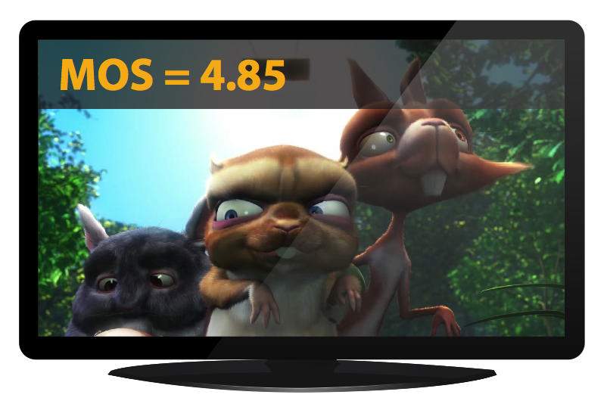




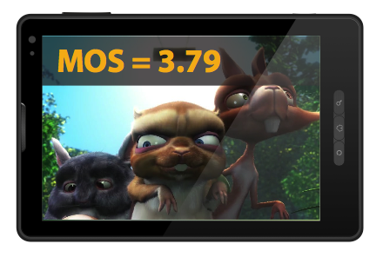

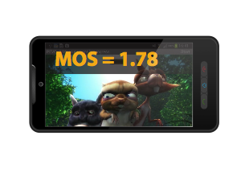
What is Different with Adaptive Streaming?
TCP (or TCP-like)-> No packet loss
Stalling effects (rebuffering)
Highly variable coding quality
Resolution changes
Long sequences
Many codecs
Many devices…
Conclusion:
Clear need for a new streaming video quality measurement technique
Notes:
TCP: Entire distorton classes are missing
Stalling gets less
Does not come for free, is exchanged for bitrate changes and resolution changes
To see those effects, long sequences are required
Closest are MM or Hybrid models from J.247 or J.343.x
For a better understnding of these effects let‘s have a look at how ABR works…

Slide 4



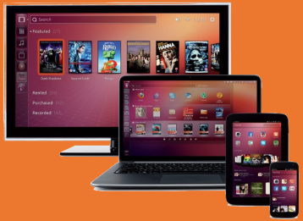

Adaptive Streaming Concept
Content
Encoder
IP Network
Clients / Player
CDN
650 Kbps
Cache
Cache
Cache
1.1 Mbps
Cache
Cache
3.5 Mbps
HTTP Streaming
Server
650 Kbps
1.1 Mbps
3.5 Mbps
Master
(Reference)
Chunk Files
(Transcoded)
Received
Media Bitstream
Video Codec
Network Capacity
(Re-) buffering
Content Quality
Media Stream Quality
Transmission Quality
Presentation Quality
Notes:
Content is uploaded.
As soon as content is uploaded, it will be transcoded into several lower quality versions with different bitrates (around ten versions, some 100 kBit/s up to >10Mbit/s).
Lower bitrates typically have lower resolutions as well.
Encoding happens exactly once. After that, all segments requested by the player are an exact copy
Network: No direct impact of the on video quality just delayed delivery of data.
Amount if delay depends on traffic. The delay however has an impact on the player behavior.
The player‘s biggest worry is that it‘s input buffer runs low and the viewer sees stalled images.
2s segments
The player monitors ist input buffer and requests low bitrates (=low quality) if the buffer level is low, high bitrates (high quality) if the buffer level is high.
This is still a bit opportunistic and not forseeable network delays may lead to stalling/rebuffering.
In a simple world, the segment bitrate information would be sufficient to estimate video quality. But reality is never simple…
Something far more complex is needed to cope with the requirements of different codecs, sudden bitrate changes, content dependencies, devices…
For such purposes, FR methods are clearly unrivalled.
Of course since I am presenting this, our proposed solution will be based on PEVQ ☺ / J.247 and J.343.xxx
And the good news is that you can have PEVQ accuracy with extremly low processing requirements. So how does that trick work?
Before we look into that, remember:
Chunk files are encoded once
The network does not modify the bitstreams
At the player we have a sequence of video chunks selected from the chunk files

Slide 5
PEVQ Structure
Reference
Degraded
Screen Size
Alignment
Computational Cost
High
Perceptual Model
Calculate Indicators per Frame
Modelling of Temporal Effects
Low
PEVQ-S
Database
Indicator Combination
Frames
Indicators
MOS
Notes:
PEVQ explained…
High accuracy!!!!
Screen size modeling by mapping is suboptimal, but sufficient and advantagous here
PEVQ can be nicely cut into a computational expensive and computational cheap part
If we precalculate the indicators once and store them in a database, we can recalculate the MOS as often as we like in almost no time, even for 4k videos
Our trick for PEVQ-S is to precalculate all indicators for all frames and all datarates on the server

Slide 6
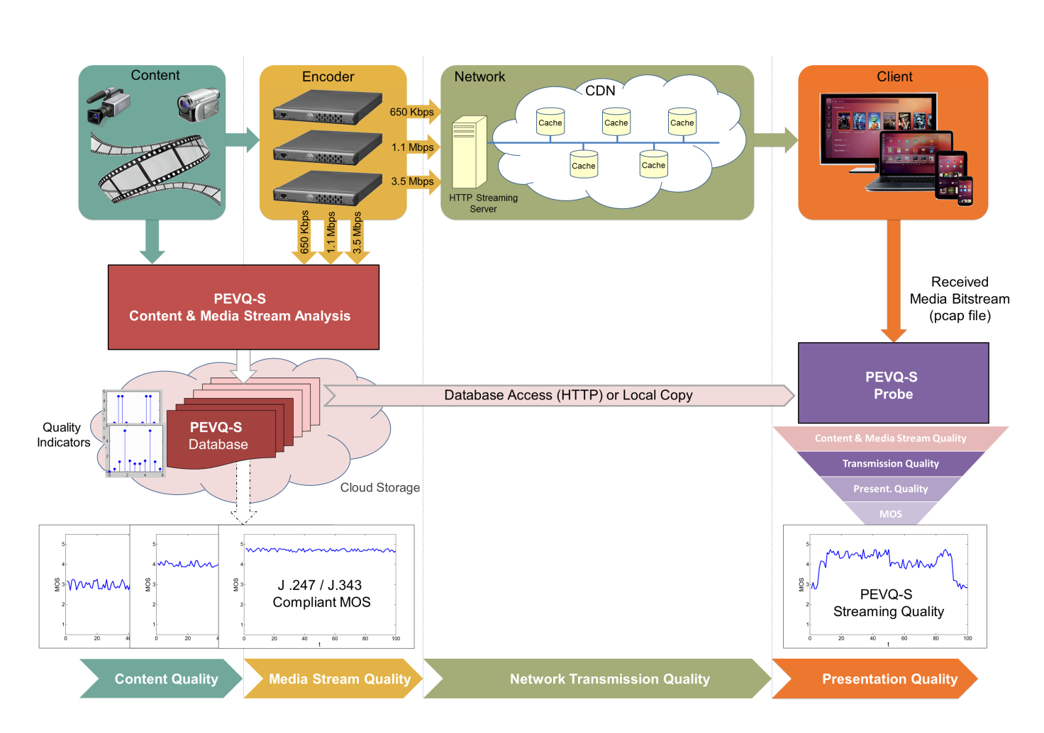
PEVQ-S in the Chain

Slide 7
Supported Services/Platforms
Notes:
Explaination of current state of PEVQ-S development

Slide 8
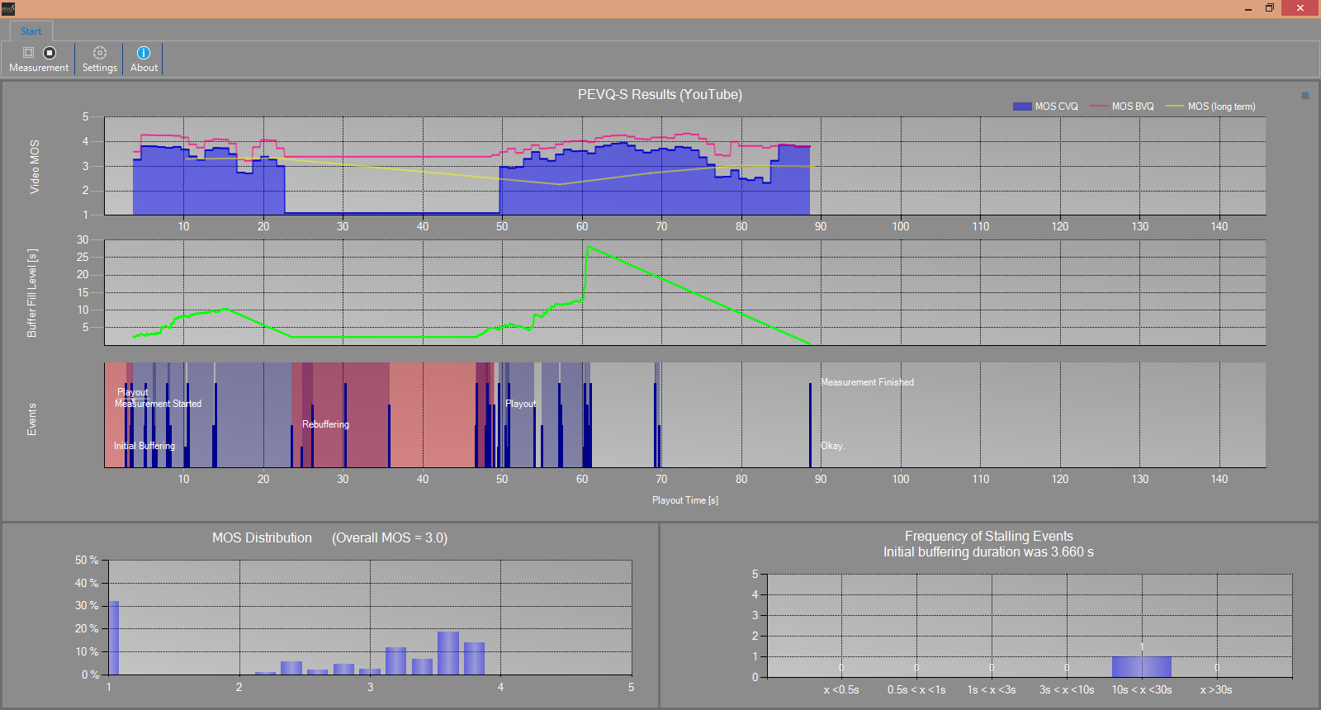
PEVQ-S Measurement
Notes:
Screen shot from our demo program which we use to visualize the measurement results
Top three diagrams, X axis is time, then explain bottom to top
Finally Stalling then MOS Histogram

Slide 9
Benchmarking VoD Streaming Services
Are data rates, considerably higher, or at least above the maximum video bit rate, a good enough prospect to achieve good video quality?
Stress testing of AIV using PEVQ-S
16 Mbit/s ADSL (copper)
32 Mbit/s ADSL (copper)
150 seconds video containing quality levels up to 1080p at a bit rate of 10 Mbit/s
Notes:
Due to the lack of standardized video quality measurement metrics for HTTP-based adaptive video streaming, most network operators’ best effort was optimizing for bandwidth, i.e. maximizing downstream data rates, minimizing initial buffering and re-buffering effects. The working assumption was that data rates, considerably higher, or at least above the maximum video bit rate should be a good enough prospect to achieve good video quality.
Is this assumption really true?
Testing how the three different CDNs used by AIV behave on two different ADSL lines.

Slide 10
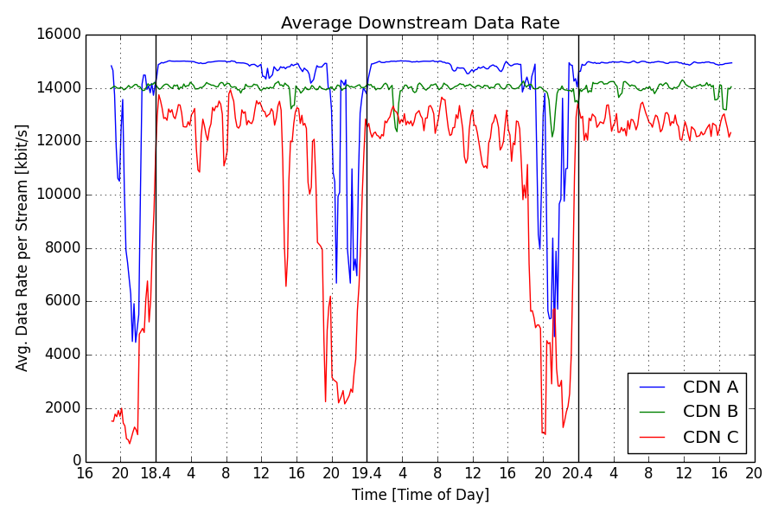
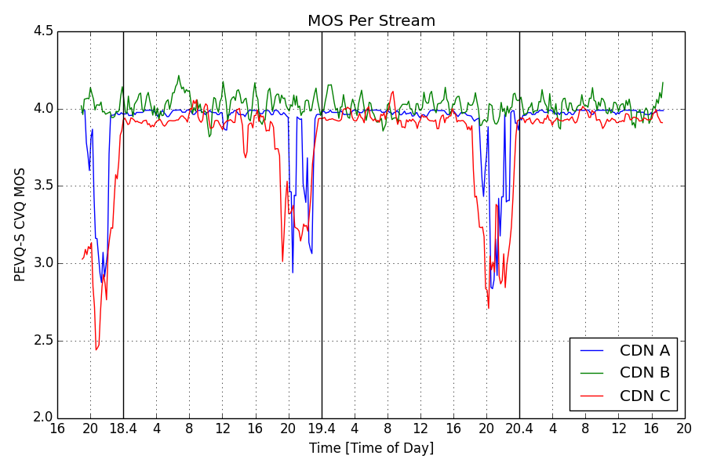
AIV over 16Mbit/s ADSL
Notes:
Explaination about the two plots
-> Different CDNs behave differently for a same provider. 1) The instantaneous bitrate is highly variable 2) Some have prime time effects others dont have them.
-> The fastest is simply not the best, constant rate CDN (CDN B) seem to have better average MOS then the other two.
Claim: PEVQ-S can give us inside into the OTT server ifrastructure from video quality point of view

Slide 11
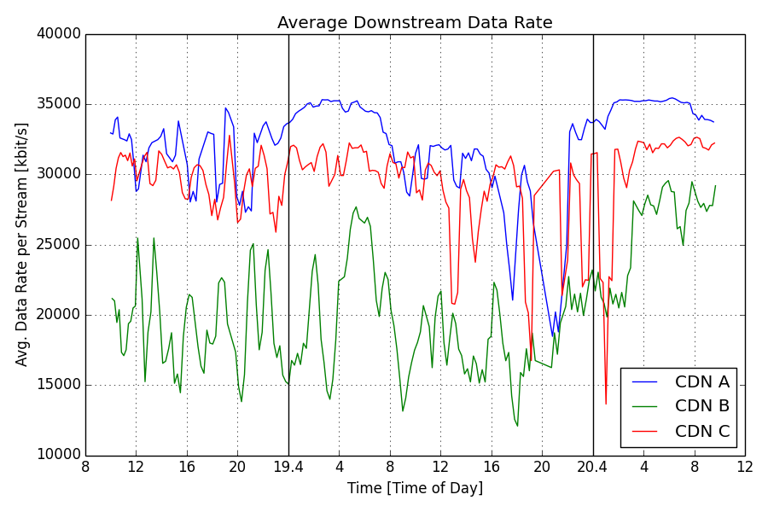
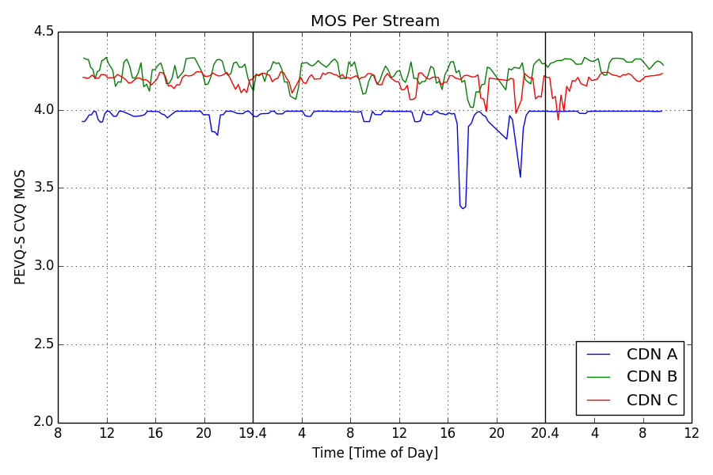
AIV over 32Mbit/s ADSL
Notes:
Different CDNs may have different behavior for different ISPs. CDN B which was in the constant datarate state for 16Mbit/s ADSL seem to be quite varying in here, also it cant simply deliver as fast as the internet speed. However, this seem to have little effect on the quality it delivers to the end user, the quality seems quite good despite its slowness.
Of course we found the reason why the blue CDN provides inferior video quality….

Slide 12
Conclusions
Clear need for a streaming video quality measurement technique for highly variable bitrates and resolutions as well as longer than 10s streaming sessions
Currently, no standardized subjective and objective VQM standard exists for ABR video streaming for the above setting
PEVQ-S is proposed to resolve this shortcoming, based on advancing existing standards, while maintaining maximum backward-compatibility and validated accuracy
PEVQ-S is suited to evaluate different OTT quality layers:
Content, Media Stream, Transmission and Presentation Quality

Slide 13








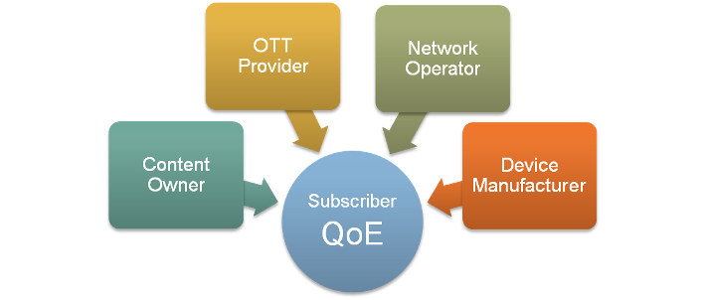







Players Involved in OTT QoE Rivalry
Notes:
Content Owners who want to extend their revenue stream by marketing their Movie and TV serial productions over new VoD channels;
OTT Providers like Netflix, Hulu, who compete with one another for new business models of online video offerings, but also compete with Content Owners setting up OTT services themselves
The incumbent Network Operators like providing transport infrastructure, but also hosting their own VoD offerings (BBC iPlayer, Telekom Entertain).
Manufacturers of end-user devices like connected and Smart-TVs, Set-top-Boxes, PCs, Tablets and Smartphones, as well as operating and standard software vendors (Microsoft, Adobe, Apple), who provide the user-interface to the viewer.

Slide 14
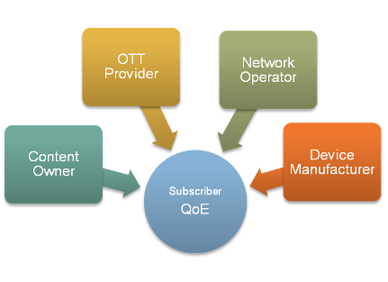
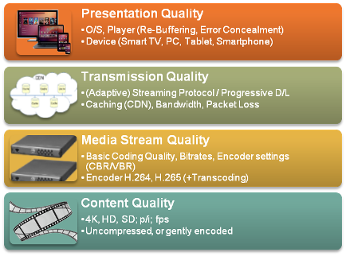
Stakeholders‘ Different Quality Views
Stakeholders for OTT QoE…
…and related quality layers
Notes:
Different stakeholders have a different view of the quality. And keeping in view the need of each stake holder the QoE in OTT can have different layers.
For example content owner wants to give the best content quality, which is characterized by the content resolution bitrate and framerate.
OTT provider wants to gives the best media stream quality for any given throughput of the network.
Network providers want to optimize the network throughput, ensuring minimum packetloss rate to avoid retransmissions and ensure a reliable delivery of media packets.
For device manufacturers, besides the screen size and other device hardware, the most important thing is what kind of adaptation logic, and buffer size is employed.
A modern QoE models needs to accommodate these four quality aspects in a unified framework.

Slide 15
Q.14/12
Development of parametric models and tools for audiovisual and multimedia quality measurement purposes
Rapporteurs Mr J. Gustafsson and Mr A. Raake
Purpose of the Question

Slide 16
Purpose of the Question
Work on parametric models and tools for multimedia quality assessment
2012, Q.14/12 successfully standardized the new P.120X-series of recommendations on parametric quality monitoring of UDP-based video streaming services
New standards P.1201, P.1202, P.1201.1, P.1201.2, and P.1202.1

Slide 17
Selected Topics
Q14/12 main work item is right now
P.NATS
  Parametric non-intrusive assessment of TCP-based multimedia streaming quality, considering adaptive streaming

Slide 18
P.NATS Track 1
Seven candidate models have been submitted for P.NATS Phase 1 of Track 1
  Ericsson
  T-Labs
  Huawei
  Netscout
  Swissqual
  OPTICOM
  NTT
Validation databases are in the process of being created

Slide 19
P.NATS Track 2
Targeting full-reference short term video quality module
  to replace the corresponding module of a track 1 model resulting in a P.NATS full-reference model

Slide 20
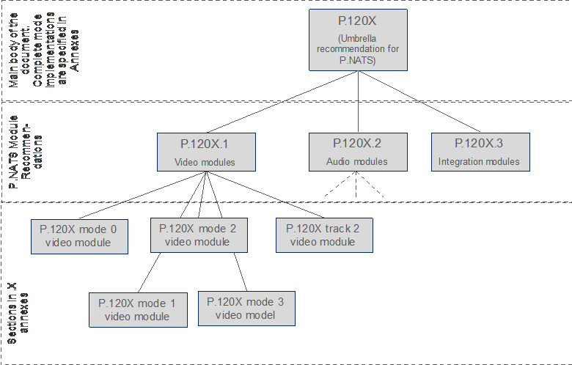

Slide 21
Wiki for P.NATS work item in Q.14/12
Parametric non-intrusive assessment of TCP-based
multimedia streaming quality, considering adaptive streaming
starting page of the P.NATS Wiki:
https://extranet.itu.int/ITU-T/2013-2016/sg12/pnats/Wiki/Home.aspx

Slide 22
P.ENATS
New work item, P.ENATS was proposed,
  will focus on the assessment of encrypted audiovisual streams

Slide 23
VQEG Adaptive Streaming project (AVHD-AS)
Validate objective methods for the assessment of adaptive bitrate streaming services like YouTube, Netflix, Hulu or Amazon Instant Video from an end users perspective.
Video only - audio will be excluded from all sequences
Audio-visual integration is subject of a different VQEG project.
Targeted scenarios include, but are not limited to
  streaming of video sequences over fixed and mobile networks,
    focus on consumer entertainment
The objective models are meant to be applied to sequences of up to 5 min duration
  The models should be based on general perceptual concepts
    not be depending on specific protocols which may change very often

Slide 24
Any questions ?
Contact:
Consultant@joachimpomy.de

