Slide 1
ITU Regional Standardization Forum for Africa Livingstone, Zambia 16-18 March 2016
Discovery of the new Recommendation
ITU-T G.1028:
End-to-end QoS for voice on Mobile networks 4G (VoLTE) Vincent BARRIAC, R&D, Orange Labs, Vincent.barriac@orange.com

Slide 2
Brief Reminder
G.1028 Is the number assigned after its approval further the Project of Recommendation previously
Known as "G.VoLTE“.
Three Years span between the idea and the adoption
March 2013: proposal for Launching a study question (Contributions C 074 and 076) and Acceptance for inclution into the Program of the question 11/12 ("Performance interworking and traffic management for Next Generation Networks")
November 2013: the first items of shared Knowledge (Contribution C 127) and decision to launch drafting G.VoLTE
September 2014: the first version of G.VoLTE (Contribution C 189)
May 2015: Second Version of G.VoLTE (Contribution C 241)
January 2016: Submission Of G.VoLTE for consent of the Study Commission 12 (contribution C 288, evolved to TD 873 rev 1 after session amendments and entry In the Accelerated Approval Procedure (AAP)
1-28 February 2016: Last reading for Comments (1 Comment received from Ericsson)
15 March 2016: adoption of G.1028
A lot of external standards ITU-T are refered In G?1028:
3GPP: Definitions and Specifications of mobile networks and services
IETF: Associated IMS protocol aspects VOLTE services
GSMA: Definition of the VoLTE service from the mobile operator standpoint

Slide 3
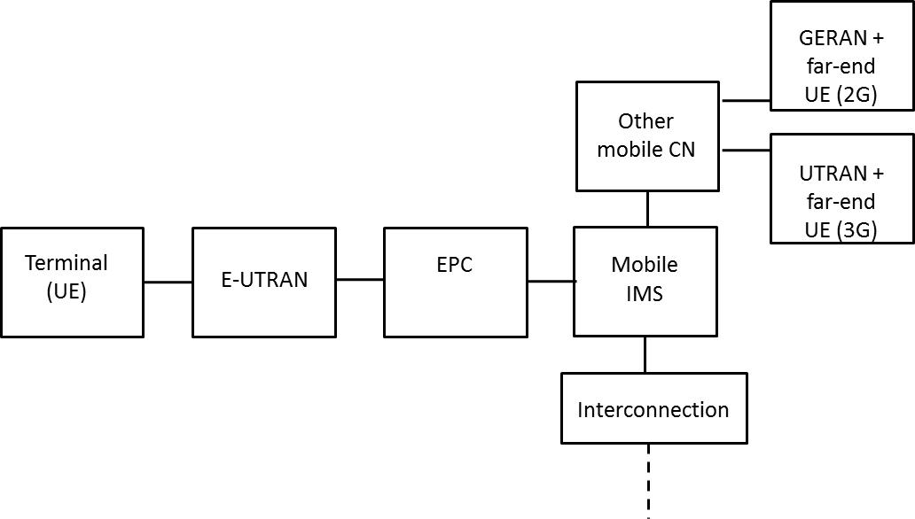
Basic Notions of the VoLTE service
Chapters 6 and 7
The VoLTE presupposes the use of the following elements
- Access Network 4G (E-UTRAN)
Compatible terminals
Core Network associated to the 4G (EPC) and connected to e-UTRAN by an eNodeB
Platform IMS and use of the Signalling Protocol SIP
Interconnection with the global Circuit

Slide 4
Basic Notions of the VoLTE service (continued)
Chapters 6 and 7
The mechanisms considered as optional but taken into consideration in G.1028:
RoHC
TTI bundling
DTX, DRX
SPS
Preconditions The SIP
Classification Of QOS (Use Of QCI)
5 for SIP
1 for the Voice in real time
Coding Audio In AMR or AMR WB, with support of the TrFO
Functionalities for future versions of G.1028
SRVCC
VoWiFi
ViLTE ?
QCI | Flow Rate Guaranteed | Priority | Delay budget | Rate of loss allowed | Example Of Service
1 | Yes | 2 | 100 Ms | 10⁻² | Votes
5 | Non | 1 | 100 Ms | 10⁻⁶ | IMS signaling

Slide 5
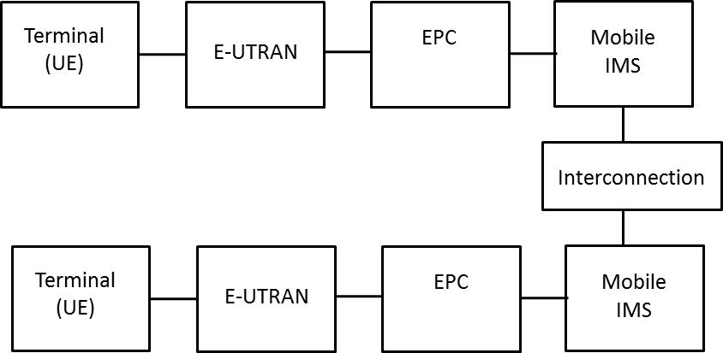
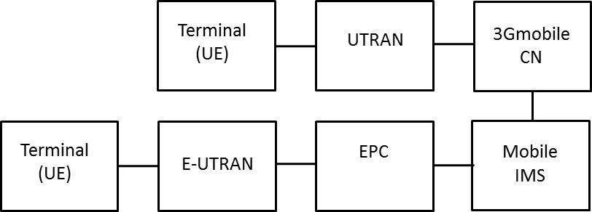
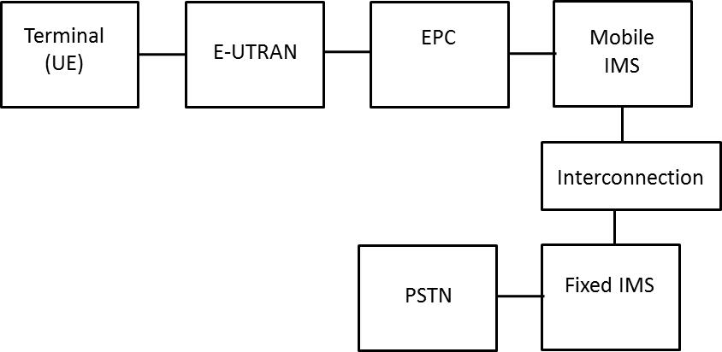
Call Cases Considered In G.1028
Chapters 7.1 to 7.4
LTE-LTE
-With and Without Roaming
LTE-3G
LTE-RTC

Slide 6
Identification of Main Degradations of Perceived Quality
Chapter 8
Annex 1
Family 1: Difficulties related to delivering services
Registration (IMS/SIP)
Call Establishment
Call End l (more or less desired)
Family 2: Difficulties related to the Audio Contents of the Service (Similar To the other mobile services)
Frequency Contents (Coding, Distortions)
Interruptions and Cut offs
Delay, Difficulties of interactivity
Background noise
Impact of the use of the VoLTE on the other elements that are not dealt with in G.1028
QoS of services of data
Lifetime of the Battery

Slide 7
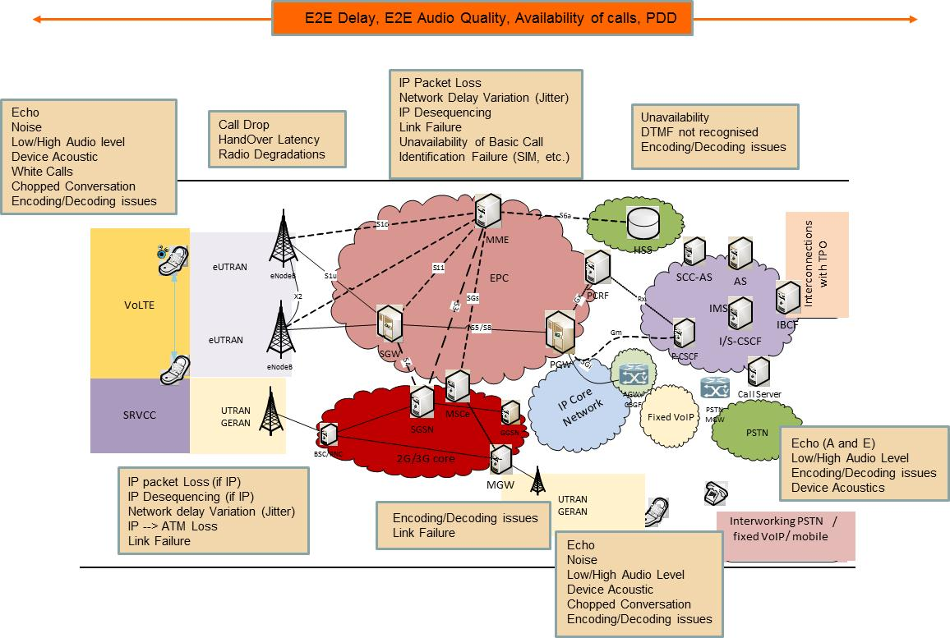
Identification of Main Degradations of Perceived Quality
Chapter 8

Slide 8
Selection of QoS indicators (1/2)
Name | Definition | Fitted IP Metric
Rate of Success of Recording | Proportion of Recording Attempts for successful VoLTE service | The rate of success of registration may be estimated at the level IMS, on the basis of meter readings at the level of the P-CSCF = 1 - IRA (See IETF RFC 6076)
Availability of service | Availability of end to end expressed in terms of capabilities to establish calls from and to a VoLTE client, | Network Efficiency Rate (NER) Measurement of the capabilities of the Network, from the standpoint of the service platform to convey the VoLTE client calls. For the SIP Protocol, NER = SEER (See IETF RFC 6076)
Time of establishment of call after Numbering (PDD) | Length (expressed in seconds) between the end of the dialing by caller and the feedback of the ringing tone or a recorded announcement , | Time for the establishment of SIP session Time Interval between a caller sending message INVITE with SDP and his receiving a message (180 or 200) in return. = SRD (See IETF RFC 6076)
Chapter 9

Slide 9
Selection Of indicators Of QoS (2/2)
Name | Definition | Metric IP Box
Voice Quality (MOS-LQ) | Speech Quality (See Itu-T P.10/G.100. The objective measurement is possible with the help of the models ITU-T p.862 or P.863 | Index Of Network Quality (ITU-T G.107, p.564) Rate Of Loss of IP Packages (See IPLR In Itu-T Y.1540): points of measurement at different points In the Transmission chain.
Delay of mouth to ear | The required time for a speech signal to be conveyed from the mouth of a speaker to the ear of an auditor, | Transmission time for IP Packages (See IPTD In Itu-T Y.1540) Transmisison Time In loop (RTT) Approximately the double of the delay, can be measured using the RTCP.
Rate Of Interrupted Calls | Continuity of service expressed In terms of the capabilities to maintain the Calls up to their normal end . | Rate of completeness of a session Can be estimated at the level IMS, on the basis of meter readings at the level of the P-CSCF SCR = (See IETF RFC 6076)
Bandwidth Of the speech signal( NB, WB Or SWB) | Measurement of the Spectrum used (expressed in the form of a Window on the scale of Hz). | Statistics on the Codecs Information pertaining to the Selection of codec (AMR Or AMR WB) and the debit rate, as well as evolvement (based on SIP messages).
Chapter 9

Slide 10
A few Objectives for Quality
Tables 3 to 6
G.1028 does not set imperative objectives
Nevertheless, on the basis of the existing knowledge , a budget of degradation is Proposed
For each of the retained indicators
For each link of the transmission chain ( terminal, e-UTRAN, EPS, IMS, Interconnection), as well as for the set.
A few examples :
Indicator | Call type | The overall budget | Specific budget
Availability | 4G-4G or 4G-fixed | 99%
 | 4G-3G | 98%
PDD | 4G-4G | 3.5 s (4 S If interconnection)
 | 4G-3G | 4.5 s
 | CSFB | 6 s
MOS-LQOSW | 4G-4G | 4 (AMR-WB And TrFO)
 | 4G-3G | 3.8 (AMR WB and TrFO)
 | 4G-RTC | 3.1 (AMR)
Transmission time | All | 400 ms | Device : 190 ms (emission + reception) E-UTRAN: 80 ms EPS: 50 ms
Rate of dropped calls | 4G-4G And 4G-RTC | 2% | RTC = 0%
 | 4G-3G | 3%

Slide 11
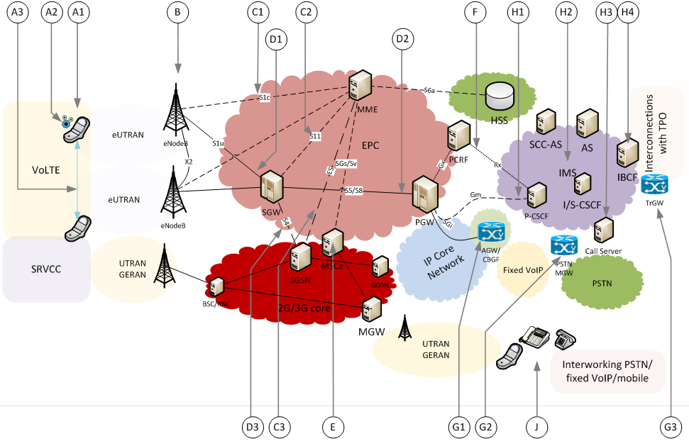
Strategy of Measurement and Supervision
Chapters 10.1 and 10.2
Several measurements points are possible
AT the Ends, Where the client accesses the service (points A and J)
Where we can access the transmitted signal , generally at the demarcation points between sections of Network (Points B, D, E And G)
Where we have an end to end service vision from the point of View of signalling ( points C, F And H, But Also E).
The Complementary Approaches
For the establishment of troubleshooting
For the supervision In Time Real
For the Characterization And the correction of Faults

Slide 12
Link with the ecosystem of ITU-T standards
Chapter 10.3
Besides, several indicators that are not Specific To the VoLTE, are already defined
E.800: Availability, the time to access the service
E.804: Rate of premature hold down
P.10/G.100: Voice quality , delay, frequency Distortion
Y.1540: Metrics of IP transport
The evaluation Of Voice Quality is the subject of many useful recommendations
The Parametric :models p.564 ( measure), G.107 (Planning)
The model Based Signal: p.863, p.563
Some thresholds of acceptability of the existing standards are applicable to the VoLTE
G.114 for the values of delay
G.109 for the fator R (G.107)
Y.1541 for the metrics of IP transport

