Slide 1
ITU Regional Standardization Forum for Africa
Livingstone, Zambia 16-18 March 2016
Session 1 :
Methods and Tools for the evaluation of the QoS/QoE of the Fixed and Mobile Internet
- Study Case Morocco-
Hassan TALIB,
Vice-Chair ITU-T SG 12, Head DCT ANRT
Talib@anrt.ma // Htalib@ties.itu.int

Slide 2
Plan of the presentation
Introduction: background of QoS/QoE…
The Internet service at Morocco
Evaluation of the QoS of the fixed Internet
Evaluation of the QoS of the Mobile Internet 3G and 4G
  Mobile Internet on PC
  Mobile Internet on Smartphones
  FTP or HTTP measures
Measured indicators (Definitions)
Platform of Measurement Servers
  Evaluation of the QoE of the Internet
  Conclusions and Recommendations
Livingstone, Zambia, 15-18 March 2016

Slide 3
Background for the Follow-up of the QoS/QoE at ANRT
Device QoE Portal: QoE and downloaded applications
Adoption of a communication strategy (Publication)
An international regulatory framework (standards):
Itu-T: Series E, G, P, Y, QoS Handbook, ...
Regional: ETSI (series EG), IEEE,…
A national regulatory framework:
- Remits
QoS Obligations for operators
A benchmark of best practices and a technological watch
The ANRT exerts a regular monitoring of the QoS/QoE
Feedback on uses
Complaints,
Press,
Associations of consumers,
…
Analysis of the data received from operators in terms of performance, KPIS
The field measures (campaigns) carried out by ANRT and QoE measures

Slide 4
Background for the follow-up of the QoS
Establishment of a global device for receipt of KPIS of operators: all networks and all services
Complete model of operational KPI data according to the frequencies of fixed sending
Elaboration of agreed reference documents by all the actors managing the field measures of the QoS
Mastered outsourcing of measures and use of results by the operators

Slide 5
Plan of the presentation
Introduction: background of QoS/QoE…
The Internet service at Morocco
Evaluation of the QoS of the fixed Internet
Evaluation of the QoS of the Mobile Internet 3G and 4G
  Mobile Internet on PC,
  Mobile Internet on Smartphones
  FTP or HTTP measures
Measured indicators (Definitions)
Platform of Measurement Servers
  Evaluation of the QoE of the Internet
  Conclusions and Recommendations
Livingstone, Zambia, 15-18 March 2016

Slide 6
The fixed and mobile Internet Services 3G and 4G in Morocco
Three global operators : Itissalat Al-Maghrib (Morocco Telecom), Medi Telecom (Méditel) and Wana Corporate (INWI):
  Fixed (national and international);
  Mobile: 2G (GSM and CDMA), 3G (UMTS and CDMA 2000) and 4G LTE,
Fixed Internet: ADSL and FTTX (coupled offers: Tripleplay).
Mobile Internet: 3G (marketed since March 2007) and 4G (marketed since June 2015).
Internet Marketing: telecom operators (licenses) or service providers (declarations).
Livingstone, Zambia, 15-18 March 2016

Slide 7
The Internet service at Morocco
Mobile telephony: park and traffic
The park of the mobile subscribers has experienced a very strong evolution since 1999. The penetration rate has reached more than 127% at the end of 2015.
The traffic for outgoing voices of the Mobile has exceeded 52 billion minutes in 2015, registering a growth of more than 9% compared to 2014.
Livingstone, Zambia, 15-18 March 2016

Slide 8
The Internet service at Morocco
Average usage and mobile ARPM
The ARPM "Average Revenue per Minute" Mobile has evolved from 1.27 DHHT/min at the end of 2008 to 0.27 DHHT/min at the end of 2015 recording a decrease of 78.7%.
For the prepaid Mobile, this indicator is about 0.26 DHHT/min while it is 0.29 DHHT/min for the Postpaid.
The average monthly outgoing use per mobile client is appreciated from 43 to 101 minutes/client/month, or a growth of almost 135% between 2008 and 2015.
Livingstone, Zambia, 15-18 March 2016

Slide 9
The Internet service at Morocco
The Internet: Park and penetration
The Internet Park has experienced a sustained growth during the last five years.
This growth is mainly due to the development of mobile Internet offers.
On nearly 14.5 million Internet subscribers, more than 92% use the mobile connections versus 7.8% for the fixed ADSL access.
Livingstone, Zambia, 15-18 March 2016

Slide 10
The Internet service At the Morocco
Invoice monthly Internet by client
On the period 2008-2015: the monthly invoice on average per Internet subscriber has registered a decline of 84%.
At the end of 2015, the monthly invoice on average per Internet subscriber has reached 24 DHHT/month/customer. For the mobile Internet, this invoice is about 17 DHHT/month/client while it is 94 DHHT/month/client for the ADSL.
Livingstone, Zambia, 15-18 March 2016

Slide 11
The Internet service At the Morocco
International bandwidth and domain names
Evolution of the number of domain names ".ma "
The park of the domain names in " .ma" continues to grow in reaching 59138 accounts at the end of 2015, or a growth of almost 8.6% compared to the end of 2014.
The domain names created directly under the extension " .ma « prevail over (89.6%).
The total number of providers".ma" is 33 at the end of December 2015, of whom 04 were refisteredin the course of the 4Th Quarter 2015.
The international Internet Bandwidth has stabilized at 450 000 Mbps in 2015.
Livingstone, Zambia, 15-18 March 2016

Slide 12
Plan of the presentation
Introduction: background of QoS/QoE…
The Internet service at Morocco
Evaluation of the QoS of the fixed Internet
Evaluation of the QoS of the Mobile Internet 3G and 4G
  Mobile Internet on PC,
  Mobile Internet on Smartphones
  FTP or HTTP measures
Measured indicators (Definitions)
Platform of Measurement Servers
  Evaluation of the QoE of the Internet
  Conclusions and Recommendations
Livingstone, Zambia, 15-18 March 2016

Slide 13
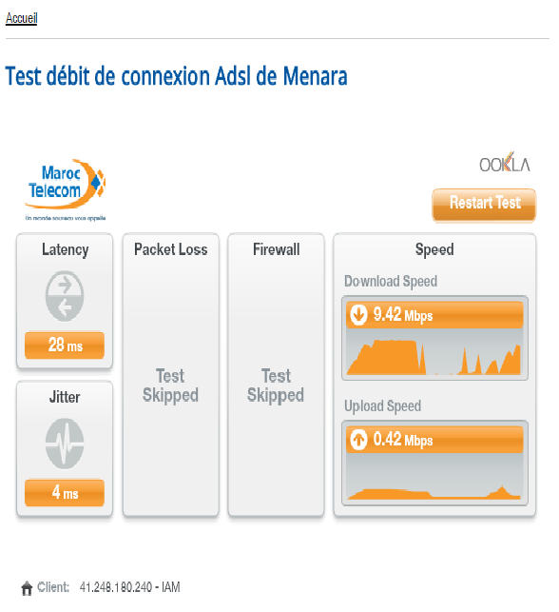
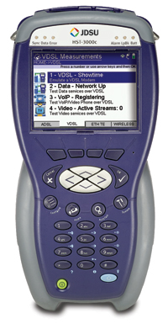
QoS of The Internet on The xDSL
Measurement device for the qualification and eligibility of the xDSL line: Length, diameter of the line (caliber ), crosstalk (tele-crosstalk), LOSSES, …
Interface of the test for speed ADSL on the site Menara : The heart of the network
Livingstone, Zambia, 15-18 March 2016

Slide 14
QoS of the Internet on the xDSL
Through the device of qualification of the line we measure the qualities of electrical transmission of the ADSL line between the equipment of the client and the connection point of the fixed network (DSLAM/MSAN):
Upward speed /Downward speed, ( Current /contractual rising and upward speeds the test device and the DSLAM/MSAN)
Maximum Upward speed /Maximum downward speed (Maximal speed upward and downward that can withstand the ADSL line)
Capacity (% use) of The line upwardly and downwardly
Estimated length of the line.
Livingstone, Zambia, 15-18 March 2016

Slide 15
QoS of the Internet on the xDSL
By connecting to the Web site Menara (measures the quality of the ADSL Internet access between the customer equipment and the MenaraTest Server ):
Actual upward speed/actual downward speed
Latency ( deadlines) and Jitter (jitter),
Recorded debit/theoretical and marketed debit.
Livingstone, Zambia, 15-18 March 2016

Slide 16
Plan of the presentation
Introduction: background of QoS/QoE…
The Internet service at Morocco
Evaluation of the QoS of the fixed Internet
Evaluation of the QoS of the Mobile Internet 3G and 4G
  Mobile Internet on PC,
  Mobile Internet on Smartphones
  FTP or HTTP measures
Measured indicators (Definitions)
Platform of Measurement Servers
  Evaluation of the QoE of the Internet
  Conclusions and Recommendations
Livingstone, Zambia, 15-18 March 2016

Slide 17


QoS of The Internet Mobile
Methodology of the Evaluation of the Quality of Services QoS Data for the 3G networks (UMTS or CDMA 2000 on PC or SP ) is perfectly valid and adapted the mobile and broadband networks:
4G ( ),
Wifi Outdoor (offloading ),…
Livingstone, Zambia, 15-18 March 2016

Slide 18
QoS of The Internet Mobile
Types and conditions of the QoS Measurements :
  Mobile Internet on PC: USB dongles (Prepaid Or Post-Paid) on Computers for UMTS, CDMA-2000 or LTE.
  Mobile Internet on Smartphones: SIM/3G or 4G for Subscribers on SP/tablets only for the UMTS or LTE.
  The measurements in FTP or HTTP modes: to carry out on the files tailored for measurements (Up/Dw):
    For the networks 3G uplink: =U=1Mb and downlink=D=5MB.
    For the networks 4G Uplink: =U=250MB And Downlink=D=1GB.
Livingstone, Zambia, 15-18 March 2016

Slide 19
QoS Of The Internet Mobile
Types and conditions of the QoS measurements :
  Evaluation of the QoS ≠ Evaluation of the Coverage.
  Measurement should be performed only on areas declared covered by all the relevant operators together : Exercise of the geographic sample and the mapping for Coverage.
  The exercise of Mapping for Coverage should be conducted in accordance with quarter details instead of being conducted per town.
Livingstone, Zambia, 15-18 March 2016

Slide 20
QoS Of The Mobile Internet -Measurements Tools
Measurement Tools (Precautions)
  Terminal Equipement (PC, SP and dongles/USB) , The criteria sf Choices :
    Choose among the most used manufactured models on the National market
    Providing measurement performances that do not restrain the higher measured speed rates in any case. For PCs(OS, firewalls, antivirus,…) and for terminals (Twindowsize, MTU, CPU , RAM,…).
Livingstone, Zambia, 15-18 March 2016

Slide 21
QoS Of The Internet Mobile - Tools Of The measures
Measurement Tools (precautions)
  Profiles of subscriptions used:
    Post-paid or prepaid.
    Beware of speed Downgrading if the downloaded volume reaches the thresholds.
    The tests on the SP must be done in forced mode 3G or 3G/4G and not in dual (avoid confusing GPRS and EDGE).
    For each operator (a server and a link) only one measurement is to performed at the same time.
Livingstone, Zambia, 15-18 March 2016

Slide 22
QoS of The Mobile Internet Mobile - MeasurementTools
Measurement Tools
  Application of Softwares (Agents installed in the terminals : PC and SP):
    At each data connection , the application provides information enabling the automatic calculation of all the indicators of QoS of the connection (level of fields, SC, failures, success,…) as well as the GPS position.
    The application allows you to store automatically and directly all results (indicators) in a server that centralizes the preparation of reports required in the framework of dedicated portal.
Livingstone, Zambia, 15-18 March 2016

Slide 23
Plan of the presentation
Introduction: background of QoS/QoE…
The Internet service at Morocco
Evaluation of the QoS of the fixed Internet
Evaluation of the QoS of the Mobile Internet 3G and 4G
  Mobile Internet on PC,
  Mobile Internet on Smartphones
  FTP or HTTP measures
Measured indicators (Definitions)
Platform of Measurement Servers
  Evaluation of the QoE of the Internet
  Conclusions and Recommendations
Livingstone, Zambia, 15-18 March 2016

Slide 24
QoS Of the mobile Internet
For each type of measurement, what indicators are relevant?
  Jitter, time limit, flow, losses of data,…?
  Pragmatic goals (by survey of satisfaction) pertaining to the users experience : Measure the accessibility (rate and time of connection), the reliability and the speed (flow of transmission and reception).
  Transformation of these elements in ten (10) Indicators:
Livingstone, Zambia, 15-18 March 2016

Slide 25
QoS Of The Mobile Internet
List Of the ten (10) Measured Indicators :
  The rate of successful connections: A connection is successful if it is established in a period of less than 1 minute. The rate of successful connections is calculated on the basis of the set of measures carried out.
  The rate of successful connections in a period of less than 10 seconds: The rate of successful connections in a period of less than 10 seconds is calculated on the basis of the set of measures carried out.
  The rate of files of U Mo sent in a period of less than 2 minutes: A file is considered sent if the file is sent in full in a DMAX deadline and if its content is correct. The rate is calculated on the basis of the total number of files sent.
  The rate of files of Mo received within a period of less than 5 minutes: A file is considered to be received if the file is received in full and if its content is correct. The rate is calculated on the basis of the total number of files downloaded.
Livingstone, Zambia, 15-18 March 2016

Slide 26
QoS Of The Internet Mobile
List Of the ten Measured Indicators :
  The speed of data reached for 90% of the U Mo files sent: This indicator corresponds to the percentile to 90% of the files sent.
  The speed of data reached for 50% of U Mo files sent: This indicator corresponds to the percentile to 50% of the files sent.
  The flow of data reached for 10% of U Mo files sent: This indicator corresponds to the percentile to 10% of the files sent.
Livingstone, Zambia, 15-18 March 2016

Slide 27
QoS Of The Mobile Internet
.
List Of the ten Measured Indicators :
-The speed of data reached for 90% of the U Mo files received: This indicator corresponds to the percentile to 90% of the files to be downloaded.
-The speed of data reached for 50% of U Mo files received: This indicator corresponds to the percentile to 50% of the files to be downloaded.
-The flow of data reached for 10% of U Mo files received: This indicator corresponds to the percentile to 10% of the files to be downloaded.
Livingstone, Zambia, 15-18 March 2016

Slide 28
QoS of the Mobile Internet
Measured Indicators:
  Important Details:
  The speed for 3G or 4G networks is the one shared between the users. The actual speed rate (operated) is always less than the theoretical speed rate (marketed). It is technological dimension.
  But, this speed is measurable for all operators through the same device.
Livingstone, Zambia, 15-18 March 2016

Slide 29
QoS Of The Mobile Internet
Additional indicator: TUDC
  The Rates of use of the contractual speed (TUDC) corresponds to the ratio between the speed used (observed) to the contractual speed(marketed) by the relevant operator . This report is expressed in percentage.
An actual
Example for a
Mobile Network:
Livingstone, Zambia, 15-18 March 2016

Slide 30
Plan of the presentation
Introduction: background of QoS/QoE…
The Internet service at Morocco
Evaluation of the QoS of the fixed Internet
Evaluation of the QoS of the Mobile Internet 3G and 4G
  Mobile Internet on PC,
  Mobile Internet on Smartphones
  FTP or HTTP measures
Measured indicators (Definitions)
Platform of Measurement Servers
  Evaluation of the QoE of the Internet
  Conclusions and Recommendations
Livingstone, Zambia, 15-18 March 2016

Slide 31
Platform Measurement Servers
Platform Measurement Servers for the Internet QoS for fixed or mobile networks?
  Measuring the performance of an Internet network , is measuring the QoS of a connection through this network between a terminal and a data server.
  Several external factors can affect one of the segments of the path of test. Hence the controversy the results of measures by the relevant operator .
  Options to set aside:
    Measures with a server installed abroad;
    Install the server in the operator’s premises.
Livingstone, Zambia, 15-18 March 2016

Slide 32
Platform Measurement Servers
Platform Measurement Servers:
  Problem: Lack of server (in the host premises), at national level, connected to all networks at the same time by a capacity greater than the supply of the highest speed!!!
  Solution: The design of a platform of measurement servers in the premises of the regulator. The capacities of the links are greater than the measured speed (example 10Mb/s for measuring 7,2MB/s and 20Mb/s for measuring 14.4Mb/s and 120MB/s for measuring the 4G).
Livingstone, Zambia, 15-18 March 2016

Slide 33
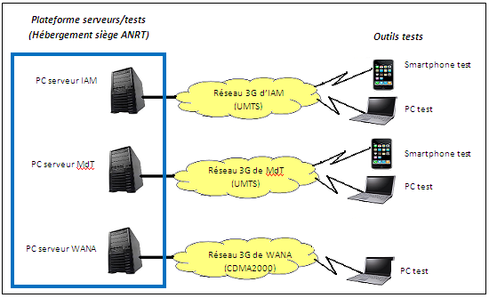
Platform Measurement Servers
Platform Servers:
All files tests (U and D) are installed in each server in the platform connected by FO to the networks of operators.
Livingstone, Zambia, 15-18 March 2016

Slide 34
Plan of the presentation
Introduction: background of QoS/QoE…
The Internet service at Morocco
Evaluation of the QoS of the fixed Internet
Evaluation of the QoS of the Mobile Internet 3G and 4G
  Mobile Internet on PC,
  Mobile Internet on Smartphones
  FTP or HTTP measures
Measured indicators (Definitions)
Platform of Measurement Servers
  Evaluation of the QoE of the Internet
  Conclusions and Recommendations
Livingstone, Zambia, 15-18 March 2016

Slide 35
Evaluation of the QoE Of the mobile Internet
The Solution enables users (Smartphones/tablet more than 40 million) to participate in the evaluation of the QoE and download a mobile application that will be used to forward, in a transparent way, information and data on the QoE to the ANRT. This device should enable us to achieve :
The collection and the calculation of indicators of the QoE of various services on a continuous basis;
The active tests of end-to-end connections;
The supervision of QoE parameters from the premises of ANRT ;
The Provision of the reports on QoE in a dynamic way;
The extension for supplementing with new data or new reports.
Compliance with the three basic principles:
Consent of users;
Observance of the regulation of personal data;
Transparent Application and no impact on the user ( neither on the account nor on the Device: battery or performance).
Livingstone, Zambia, 15-18 March 2016

Slide 36
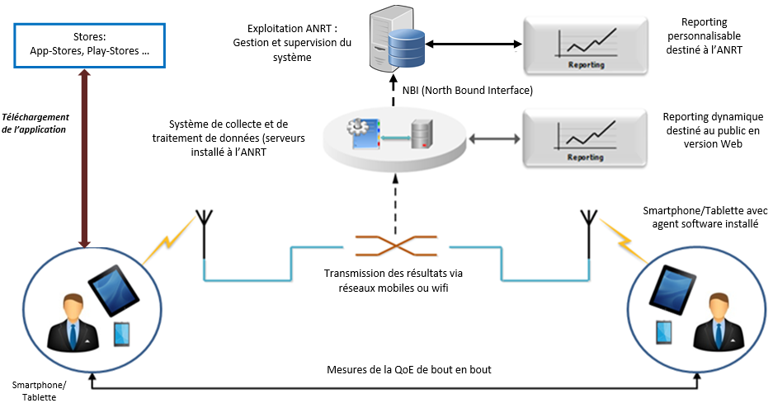
Evaluation of the QoE Of the mobile Internet
The solution of the evaluation of the QoE Is composed of the following three elements:
Mobile Application :
It is downloadable free of charge from a portal on the Web site of the ANRT and on the different sites of applications at least on App-Stores and Play-Stores and enabling to perform automatic and continuous measurements of the QoE. Transparent Application and no impact on the user (neither on the account nor on the device).
System for the collection and processing of data (ANRT): This System is installed in the premise of ANRT (the Data Server) and it enables the collection and automatic processing of the results of measures as well as the calculation of the QoE indicators .
System of Reporting (ANRT): It must include a user interface allowing the visualization of the QoE indicators as well as a powerful tool for producing reports. The Results must be, after processing, in the form of reports Including the results of Performance per operator, the geographical coordinates and the network parameters Including coverage (2G, 3G and 4G…), dashboards as well as graphics.
Livingstone, Zambia, 15-18 March 2016

Slide 37
Evaluation of the QoE Of the mobile Internet
The Solution enables to evaluate the QoE of Mobile networks of Telecommunications in accordance with the following services:
The QoE of the services of the 2Th Generation networks (2G) :
The Voice 2G;
The service of the SMS messaging;
The QoE of the services of the 3Th Generation networks (3G: UMTS/HSPA/HSPA+):
The Voice 3G;
The data 3G on Smartphones/tablets.
The QoE of the services of the 4Th Generation networks (4g/LTE):
The Voice 4G (Future utilization);
The data 4G on Smartphones/tablets.
Livingstone, Zambia, 15-18 March 2016

Slide 38
Evaluation of the QoE Of the mobile Internet
Voice Service 2G, 3G and 4G:
Time of establishment of call (second);
Failure Rate (%);
Cut-off rate (%);
Call Duration per cut off (minute);
Success Rate (%);
SMS Service:
Rates of not received SMS;
Rate of received SMS;
Duration of SMS receipt ;
Service Data 3G and 4G:
Rate of successful connections;
Average speed in Up-Link;
Average speed in Down-Link;
Peak speed in Up-Link;
Peak speed in Down-Link;
Loading time of the Web pages.
Coverage
Unavailability of the network;
Time to access the service per operator and per (type of service);
Availability of the service per operator and per (type of service);
Identification of areas with no data coverage per operator.
Livingstone, Zambia, 15-18 March 2016

Slide 39
Plan of the presentation
Introduction: background of QoS/QoE…
The Internet service at Morocco
Evaluation of the QoS of the fixed Internet
Evaluation of the QoS of the Mobile Internet 3G and 4G
  Mobile Internet on PC,
  Mobile Internet on Smartphones
  FTP or HTTP measures
Measured indicators (Definitions)
Platform of Measurement Servers
  Evaluation of the QoE of the Internet
  Conclusions and Recommendations
Livingstone, Zambia, 15-18 March 2016

Slide 40
Conclusions and Recommendations
Recommendation N°1
  Permanent consultation with the operators on the methodology at the upstream level. Adoption of a concerted and a reference approach for the follow-up.
  Adoption of a framework (protocol) of measures for the evaluation of the QoS/QoE.
  None of the operators is informed on the sites of the QoS measurements QoS; nor on the period.
Livingstone, Zambia, 15-18 March 2016

Slide 41
Conclusions and Recommendations
Recommendation N°2
  Achieve a significant number of blank measurements QoS/QoE , with the same tools as those used in the actual campaigns of measures and preferably in the presence of the representatives of the operators concerned by the measures (marginalize or eliminate any potential controversy of operators).
Livingstone, Zambia, 15-18 March 2016

Slide 42
Conclusions and Recommendations
  Recommendation N°3
  The measurements for operators: positive use of the results by the operators (use of the platform servers for tests//financing campaigns by the operators).
  Recommendation N°4
  Release the results (comparative), adopt a communication strategy and envisage sanctions for defects as the last resort.
Livingstone, Zambia, 15-18 March 2016

Slide 43
Conclusions and Recommendations
  Recommendation No. 4 (continued)
  Publication of the results of measures:
The first Voice campaign on a large sample (30 Cities and crowded facilities airports, tourist centers…).
1Er Quarter of the year
The second similar campaign to the first one and based on the same sample broadly.
4Th Quarter of The Year
Communicating Results
to the operators
Timeline of 5 to 6 months for
The Correction of defects
Identified by the ANRT
(Publication of the Results and communication)
Livingstone, Zambia, 15-18 March 2016

Slide 44
Thank you for your attention
Questions/Answers
Talib@anrt.ma // Htalib@ties.itu.int
Livingstone, Zambia, 15-18 March 2016

