Slide 1
ITU Regional Standardization Forum for Africa Livingstone, Zambia 16-18 March 2016
ITU-T SG5 Activities
A special focus on L.1440: Methodology for environmental impact assessment of information and communication technologies at city level
Ahmed Zeddam
Chairman, ITU-T SG5
(Orange, France)

Slide 2
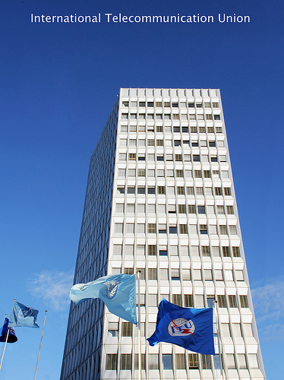
ITU
UN specialized agency for ICTs
unique public/private partnership
ITU is committed to connecting all the world's people
Members:
193 Member States (Governments and regulatory bodies)
Over 700 Private Sector (Sector Members and Associates)
Over 90 Academia
Notes:
As you may know, the International Telecommunication Union (ITU) is the UN specialized agency responsible for Information and Communications Technologies (ICTs).
ITU allocates global radio spectrum and satellite orbits, develop the technical standards that ensure networks and technologies seamlessly interconnect, and strive to improve access to ICTs to underserved communities worldwide.
ITU is committed to connecting all the world's people – wherever they live and whatever their means. Through our work, we protect and support everyone's fundamental right to communicate.
Today, ICTs underpin everything we do. They help manage and control emergency services, water supplies, power networks and food distribution chains. They support health care, education, government services, financial markets, transportation systems and environmental management. And they allow people to communicate with colleagues, friends and family anytime, and almost anywhere.
With the help of our cross-sectional membership, ITU brings the benefits of modern communication technologies to people everywhere in an efficient, safe, easy and affordable manner.
With regard to the membership, ITU is unique among UN agencies in having both public and private sector. So in addition to our 193 Member States, ITU membership includes ICT regulators, some 89 leading academic institutions and some 700 private companies.
In an increasingly interconnected world, ITU is the single global organization embracing all players in this dynamic and fast-growing sector.
ITU has three main areas of activity organized in ‘Sectors’ which work through conferences and meetings.
ITU three sectors are:
ITU-R (Radiocommunication) plays a vital role in the global management of the radio-frequency spectrum and satellite orbits - limited natural resources which are increasingly in demand from a large and growing number of services such as fixed, mobile, broadcasting, amateur, space research, emergency telecommunications, meteorology, global positioning systems, environmental monitoring and communication services - that ensure safety of life on land, at sea and in the skies.
ITU-D (Development) The core mission of the Telecommunication Development Sector (ITU-D) is to foster international cooperation and solidarity in the delivery of technical assistance and in the creation, development and improvement of telecommunication/ICT equipment and networks in developing countries.
ITU-T (Standardization) assembles experts from around the world to develop international standards known as ITU-T Recommendations which act as defining elements in the global infrastructure of information and communication technologies (ICTs). Standards are critical to the interoperability of ICTs and whether we exchange voice, video or data messages, standards enable global communications by ensuring that countries’ ICT networks and devices are speaking the same language.
The coordination of all ITU activities is ensured by the General Secretariat. The mission of the General Secretariat is to provide high-quality and efficient services to the membership of the Union.
In my presentation, I am going to focus on the standardization work of ITU only.

Slide 3
Importance of global standards
Drive competitiveness, for individual businesses and world economy;
Lower prices;
Reduce technical barriers;
Foster interoperability;
Manufacturers, network operators and consumers;
Reduce negative impacts on the environment.
Work with us!
Notes:
As part of its mandate, ITU-T develops international “green” standards to promote innovative solutions to tackle e-waste, combat climate change and promote environmental sustainability using ICTs.
ITU-T Recommendations are beneficial to:
Drive competitiveness, for individual businesses and world economy
Lower prices
Reduce technical barriers
Foster interoperability
Manufacturers, network operators and consumers
Reduce negative impacts on the environment (including e-waste)
Through its Recommendations, ITU-T facilitate the development, transfer and diffusion of clean and green technologies, including access to modern energy, energy efficiency and ideas for renewable sources.

Slide 4
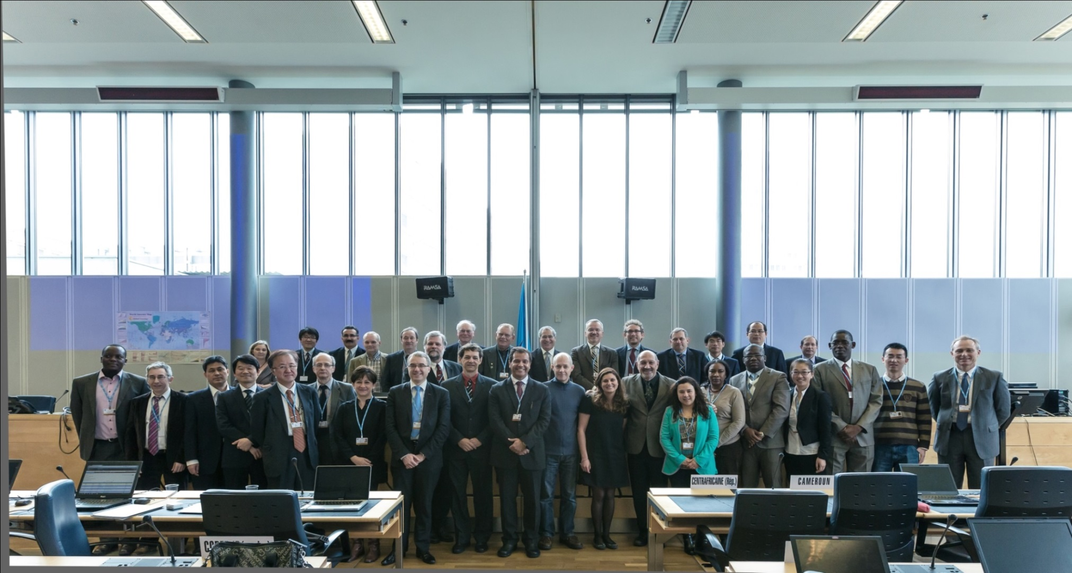
What ITU Does to Shape Smart Sustainable Cities
ITU-T Study Group 5 Environment and Climate Change
Focus Group on Smart Sustainable Cities
Focus Group on Smart Water Management
Research and Development
Notes:
ITU has taken a leadership position to bring the multitude of technologies that target urban problems into the forefront. ITU is working on standards for a multitude of technologies that can target urban problems, including intelligent transport that can be applied to make city streets safer and cleaner; smart water and smart grid to create greater efficiency in these vital utilities; faster broadband technologies to ensure equitable access; cloud computing that offers to power many future applications.
ITU Study Groups assemble experts from around the world to produce international standards, which we call Recommendations, and which enable many of these applications.

Slide 5
Methodology on Cities
Standards are vital to shape Smart Sustainable Cities
Q17/5 - Energy efficiency for the ICT sector and harmonization of environmental standards
Q18/5 - Methodologies for the assessment of environmental impact of ICT

Slide 6
ITU-T SG5
“Environment and climate change”
SG5 develops international standards (ITU-T Recommendations) that address ICT’s relationship with electromagnetic effects and climate change.
Q 12 Terminology
WP1/5
Damage prevention and safety
WP2/5
Electromagnetic fields: emission, immunity and human exposure
WP3/5
ICT and climate change
5 Questions
6 Questions
7 Questions
Study Group 5 offers the ideal platform for climate change stakeholders
Notes:
Kindly note that WP3 has 8 question if we count the new Question of Gilbert.
Paolo comments but actually in the web are 6…. 17,18,19,21,22 and 23

Slide 7
Working Party 3 – ICTs and Climate Change
Q 13/5 - Environmental impact reduction including e-waste
Q 14/5 - Setting up a low cost sustainable telecommunication infrastructure for rural communications in developing countries
Q 15/5 - ICTs and adaptation to the effects of climate change
Q 16/5 - Leveraging and enhancing the ICT Environmental sustainability
Q 17/5 - Energy efficiency for the ICT sector and harmonization of environmental standards
Q 18/5 - Methodologies for the assessment of environmental impact of ICT
Q 19/5 - Power feeding systems
Notes:
ITU-T Study Group 5
Working Party 3 “ICT and Climate Change”
Continuing and expanding the work of ITU-T Focus Group on ICT and CC
Next meeting of SG5 will be held on 29 January- 7 February 2013, Geneva, Switzerland
Next meeting of WP3 will be held on 8-12 October 2012, Geneva, Switzerland
All ITU-T study groups to examine impact of standards on climate change
Work areas:
Q 17/5 - Energy efficiency for ICT equipment and climate change standards harmonization
Q 18/5 - Methodology of environmental impact assessment of ICT
Q 19/5 - Power feeding systems
Q 21/5 - Environmental protection and recycling of ICT equipment/facilities
Q 22/5 - Setting up a low cost sustainable telecommunication infrastructure for rural communications in developing countries
Q 23/5 - Using ICTs to enable countries to adapt to climate change

Slide 8
Methodologies for ICT in Cities
ITU-T Study Group 5, Question 18
General principles on
How to evaluate the environmental impact of ICTs in cities, or other urban areas with a focus on GHG emissions
How to assess the impacts of the use of ICTs in cities to reduce the GHG emissions of other sectors
Approval expected in 2013
Notes:
They will be presented by Jean-Manuel Canet in more detail.
Common set of methodologies for the assessment of ICT carbon footprint
Without, it will be impossible to provide meaningful comparisons
Helps to establish the business case to go green
Scope includes: goods, networks, services, organizations, projects, cities and countries
L.1400 Overview and general principles of methodologies for assessing the environmental impact of information and communication technologies
L.1410 Environmental impact of ICT goods, networks and services
L.1420 Environmental impact of ICT in organizations
L.1430 Environmental impact of ICT projects
Environmental impact of ICT in cities (consent expected in 2013)
Environmental impact of ICT in countries (consent expected in 2014)
Developed in cooperation with UNFCCC Secretariat, EC, and over 40 organizations etc..
Environmental impact of ICT in cities (consent expected in 2013)
It is expected that this Recommendation will cover the following aspects:
aggregation of impacts at cities level of ICT goods, networks and services
aggregation of impacts at cities level of ICT organizations
Impacts of ICT projects in cities, for instance in the construction sector, the energy sector, the transport sector

Slide 9
Development of ITU-T methodologies : a cooperative effort
Mitigation purposes : Methodologies related to the assessment of footprint
Adaptation purposes : framework, best practices, adapting infrastructure

Slide 10
ITU-T Energy and carbon footprint methodologies (1/2)
L.1400- Overview and general principles
https://www.itu.int/rec/T-REC-L.1400
L.1410 - Environmental impact of ICT goods, networks and services
2 Parts : cover first order and second order effects of ICT
Revision 1 in force prepared jointly with ETSI
https://www.itu.int/rec/T-REC-L.1410
L.1420 - Environmental impact of ICT in organisations, published
Includes 3 scopes of ISO 14064-1
Covers both ICT sector organisations and ICT in other organisations
https://www.itu.int/rec/T-REC-L.1420

Slide 11
ITU-T Energy and carbon footprints methodologies (2/2)
L.1430 Environmental impact of ICT projects
a complement to ISO standard ISO 14064-2 and the Project Protocol of the Greenhouse Gas Protocol (GHG Protocol)
it provides guidance for the application of a specific methodology to assess the environmental impact of information and communication technology (ICT) greenhouse gas (GHG) and energy project
https://www.itu.int/rec/T-REC-L.1430
L.1440 Environmental impact of ICT in cities
Part I relates to the first order effects from the use of ICT goods and networks in a city´s organizations and households.
Part II relates to the first and second order effects from ICT projects and services applied in the city.
https://www.itu.int/rec/T-REC-L.1440

Slide 12
General principles
Relevance
Select GHG sources, data and methods appropriate to the assessment of the GHG emissions of ICT activities and organizations.
Completeness
Include all specified GHG emissions that provide a material contribution to the assessment of GHG emissions arising from products.
Consistency
Enable meaningful comparisons in GHG-related information.
Accuracy
Reduce bias and uncertainties as far as practicable.
Transparency
The organization shall disclose the information sufficiently to allow a third party to make decisions with confidence.

Slide 13
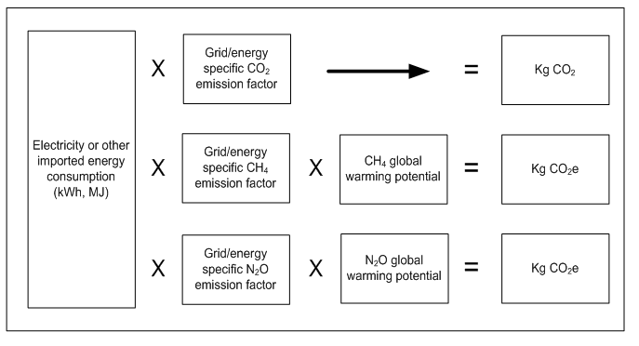
Quantification methodologies
GWP factors for GHG taken from IPCC Time frame of 100 years

Slide 14
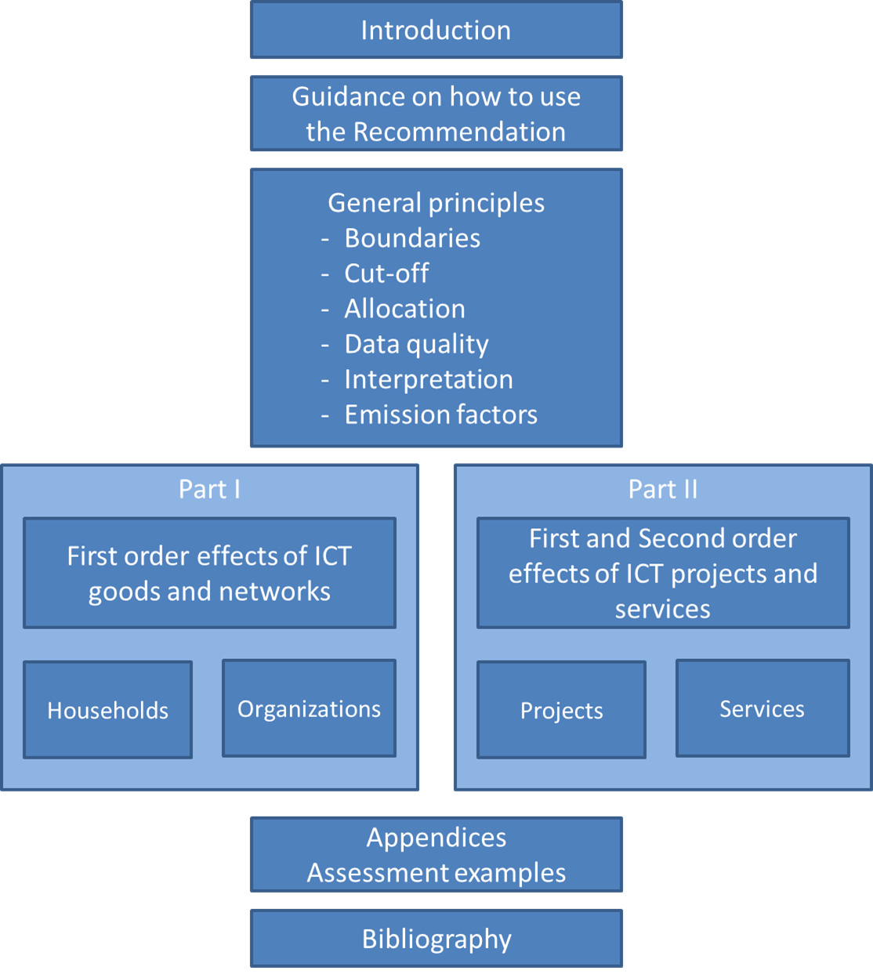
L.1440 structure

Slide 15
GHG Emissions in a city : example of results
Yearly city level life cycle GHG emissions related to ICT goods in all households, city with 77 500 inhabitants, Italy
source : Appendix I, L.1440

Slide 16
Thanks for your attention

