Slide 1
ITU Regional Standardization Forum for Africa Livingstone, Zambia 16-18 March 2016
Using ICTs in Adaptation to Climate Change Effects; Status of work of Q15 of SG5 Nevine Tewfik, Head of Research, Studies and Policies - IR division
ntewfik@mcit.gov.eg
MCIT- Egypt

Slide 2
B. Q15/5 Main study areas
Studying how ICTs can be effective in enabling countries to better adapt to climate change;
Studying how the telecommunications infrastructure and associated ICT can be resilient to the effects of climate change;
Producing Recommendations;
Collecting, sharing and disseminating information and best practices. Studying how ICTs can be effective in enabling countries to better adapt to climate change;
Studying how the telecommunications infrastructure and associated ICT can be resilient to the effects of climate change;
Studying how ICTs can be used in verticals to adapt to climate change effects;
Issuing recommendations, collecting, sharing and disseminating information and best practices and producing supplements.

Slide 3
Q15/5 and Goal 13 of the SDGs
Take urgent action to combat climate change and its impacts
Goal 13 is related to goals
G12- G14- G15
13.A
Implement the United Nations Framework Convention on Climate Change
13.B
Promote mechanisms for raising capacity for effective climate change-related
13.3 Improve education, awareness-raising
on climate change mitigation,
and early warning
13.1- Strengthen resilience and adaptive capacity to climate-related hazards and natural disasters
13.2 - Integrate climate change measures into national policies

Slide 4
The Building Bloc of ICTs in SDGs
Social Media
connect people to people across the globe.
Internet of things
Enables digital
services that allow
individuals to
monitor events and
trends important to
their well- being
Mobile devices
allow people to stay connected
and take advantage of ICT
solutions anywhere and anytime
Cloud computing
Facilitates data sharing, providing people with access to information anytime and anywhere.
Connectivity
Connectivity provides unprecedented opportunities to improve livelihoods as it connects people to markets
Power
Access to affordable,
reliable, sustainable and modern energy
enables the use of
ICT solutions in
developing areas.
Digital services
connect people to
information and allow people
to engage, share and
transact, regardless
of location.
3D printing
enables the production of objects such as tools and spare parts on demand from any location.
Smart Systems
generate sciences
By automating work,
responding to
events that
impact that work
And optimizing the use
Of resources.
Analytics
The combination of vast amounts of accessible high-quality, real-time data and today’s data visualization and analytics technology

Slide 5
Technology Uses by Sector
Technology use in environmental protection: protect the planet from degradation for present and future generations (G12, G13, G14, G15).
LIVELIHOODS AGRICULTURE
HEALTH
EDUCATION
WAHS &
POWER
INFRASTRUCTURE
DISASTER
GOVERNANCE
ENVIRONMENTAL PROTECTON
SOCIAL MEDIA
DIGITAL SERVICES
ANALYTICS
provide opportunities to engage people in discussions
provide the means for individuals and
institutions to engage in commerce
electronically (including carbon credit
provide capabilities needed to produce snapshots, analyze trends and make projections about changes in our environment, their impact and the probability that mitigation plans will be successful. Analytics also inform law enforcement activities focused on environmental protection
concerning environmental protection issues, advocate for change and take collective action.
trading), resulting in a reduction of emissions associated with a reduction in transport and warehousing needs. They also can provide early warning of impending natural disasters.
SMART SYSTEMS
such as building, transportation and grid management systems, provide the means to optimize the use of natural resources and reduce
CLOUD COMPUTING
provides the capability to bring together and deliver high-quality,
environmental impacts.
timely information and services needed to protect our environment -
SATELLITES, UAVs & THE INTERNET OF THINGS
3D PRINTING
anytime, anywhere.
opportunities to
such as remote sensors, weather stations and RFID tags, generate rich sets of
eliminate much of the cost and the negative environmental impacts of supply chains that move products ine ciently
highly accurate georeferenced digital data about the earth: soil; vegetation; water bodies and levels; atmosphere; weather; storms; earthquakes and
from producer to consumer locations
MOBILE DEVICES CONNECTIVITY
volcanic activity; settlements; transport routes and more.
allow individuals to access information connects individuals,
concerning the environment, participate conservationists and
POWER
in electronic commerce, take an active government agencies to
role in discussing environmental issues, environmental protection
monitor adherence to conservation information and services.
solutions provide the energy needed to power ICT equipment.
targets and alert law enforcement to illegal activity such as poaching or lack of adherence to water rationing.
Source: SDG ICT Playbook 2015 (Nethope, Intel, CRS, MS, CDW)

Slide 6
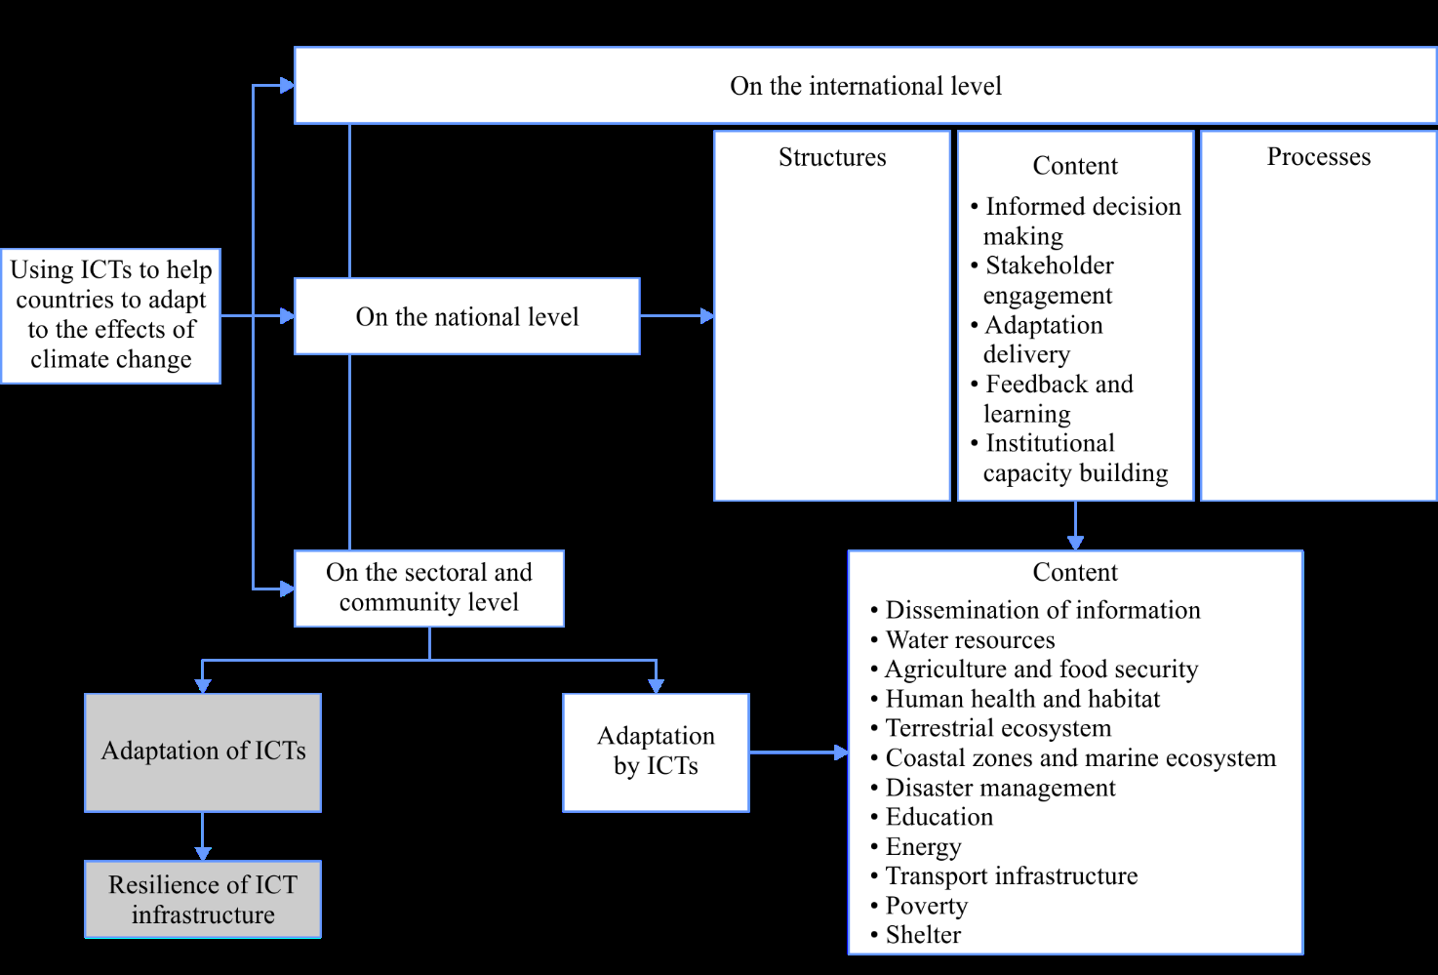
Recommendation ITU-T L.1500 - Framework for information and communication technologies (ICTs) and adaptation to the effects of climate change. L1500 Recommendation

Slide 7
Approved Recommendations and work in process
Recommendation L. 1503 Information and communication technologies for climate change adaptation in cities
(consented)
Recommendation on the use of ICTs in the adaptation of the agricultural sector (in process)
- Supplement on Adaptation (in process)
- Supplement on best practices in the adaptation of the ICT Infrastructure to the effects of climate change (in process)
- Three supplements on smart water 14, 15 and 16
Recommendation ITU- T L.1502
Recommendation ITU-T L.1501 - on how countries can utilize ICTs to adapt to the effects of climate change
Recommendation ITU-T L.1500 - Framework for information and communication technologies (ICTs) and adaptation to the effects of climate

Slide 8
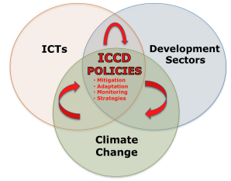
ITU- T L. 1501 Best practices on how countries can utilize ICTs to adapt to the effects of climate change
ITU-T L.1501 provides the multi-level framework for ICTs integration in Climate Change adaptation for countries to integrate ICTs into their national climate change adaptation strategies
Three main components of the framework:
Content: policy development
Structure: institutional arrangements
Design and implementation of coherent Process
Checklist of Indicators
To assist countries ensure that they meet the necessary requirements for the adoption and the implementation of the framework for ICTs and climate change adaptation
To assist countries ensure that they keep a record of the possible trends linked to climate change

Slide 9
L. 1502 Adapting information and communication technology infrastructure to the effects of climate change
Information and Communication Technologies (ICTs) can be part of the solution to climate change by, for example, helping countries adapt to the effects of climate change. At the same time, ICT equipment and infrastructure are themselves exposed to the effects of climate change and therefore need to be both robust and resilient.
ICT Sector
Adaptation
Resilience Attributes:
Robustness, self-organization, learning, scale, rapidity, redundancy, flexibility and diversity
CLIMATE CHANGE
Extreme events
(short term)
+
Chronic trends
(long term)
IMPACTS
ADAPTIVE ACTIONS

Slide 10
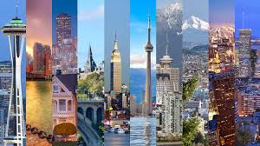
ITU- T L. 1503 Information and communication technologies for climate change adaptation in cities
The Recommendation is aimed at a broad audience of stakeholders interested in ICTs, climate change adaptation, and Smart Sustainable Cities, including city decision makers and planners. Urban stakeholders, including mayors and city planners, are invited to consider novel approaches to sustainability by integrating the use of ICTs in their climate change adaptation strategies and policies. The following are the key steps:
Assess climate change risks
and vulnerabilities
Develop an action plan
Identify the role of ICTs and
infrastructure in the adaption plan
Implement adaptation actions
Monitor and evaluate adaptation
actions using ICT

Slide 11
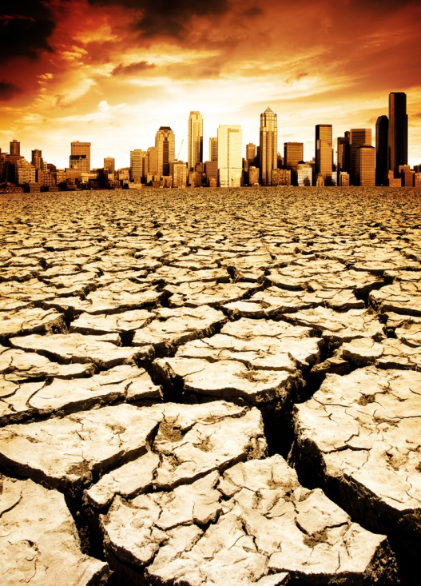
L. Supp 14, 15 and 16 on Smart Water
L. Supp 14 identifies gaps on standardization for Smart Water Management (SWM), taking related ICT standardization activities currently undertaken by the various standards developing organizations (SDOs) and forums into consideration
L. Supp 15 illustrates the different technologies for sensing water quality indicators, in addition to early warning systems. The Supplement also demonstrates most commonly measured water parameters and associated sensing technologies.
L. Supp 16 provides municipalities, decision-makers and interested stakeholders with an overview of the main technical aspects that need to be considered to effectively design and implement smart water management in cities. This Supplement provides a general overview of the requirements for water sensing and early warning systems.

Slide 12
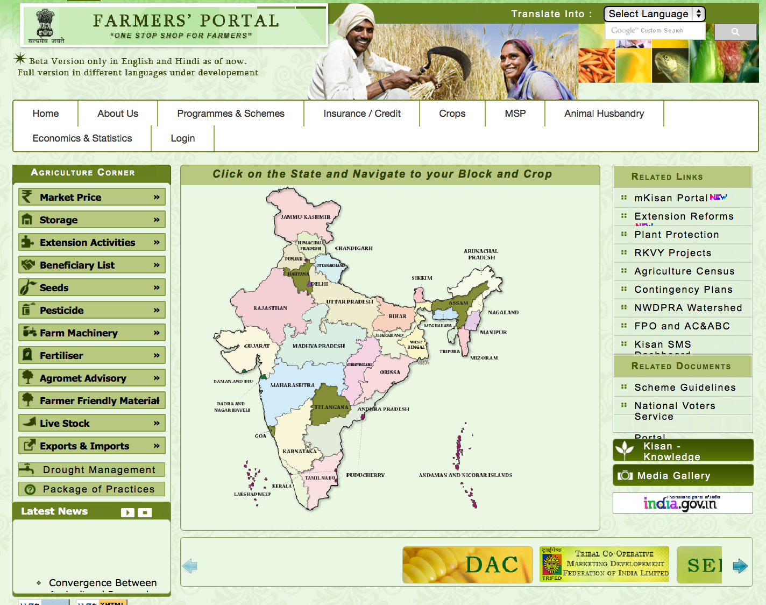
Draft Recommendation on the Use of ICTs in the adaptation of the agricultural sector to CC
The Recommendation aims to explore the potential of ICT in supporting the agricultural sector in the event of climate change.
It offers useful information to decision makers concerning areas of possible adaptive action using ICTs in the events of climate change in both developing and developed countries.
ICT can aid small farmers to exploit their resources and mitigate the impact climate change has on their livelihood

Slide 13
Potential areas of Work in Adaptation
Knowledge Sharing in Agriculture Sector using ICT
Best practices of Crowd Sourcing in Agriculture Sector using ICT
Best practices of Customization/ Personalisation of information in Agriculture Sector using ICT
Best practices of Farmer-to-Farmer interaction for community practices in Agriculture Sector using ICT
Best practices of R&D with involvement of farmers, intermediaries in research & academic activities in Agriculture Sector using ICT
Best practices of integration of advisory services with other activities like input supply, testing, support services in Agriculture Sector using ICT
Best practices of Multi-media portals/ two-way information flow, one stop centres for various operations in Agriculture Sector using ICT
Best practices of Micro-irrigation, micro-land management etc. in Agriculture Sector using ICT
Best practices of use of GIS application in Agriculture Sector using ICT
Best practices of forecasting, Agro-met advisories, Drought relief management information on basis of location, time and to lowest area granularity in Agriculture Sector using ICT
Best practices of Market information in Agriculture Sector using ICT
Best practices of Weather based insurance in Agriculture Sector using ICT

Slide 14
Thank You

