Slide 1
MTN ZAMBIA NETWORK PERFORMANCE QOS Presentation

Slide 2
Executive Summary – Network performance management
Mobile communication has been in existence since 1990s in Zambia regulated by CAZ the predecessor of ZICTA.
During this period of CAZ the performance metrics where not monitored and the QOS was basically a preserve of the operator.
ZICTA introduced QOS measures that ensures that operators achieved proactively KPIs and they have installed monitoring equipment to achieve this objective.
MTN Zambia limited has responded positively to this challenge since customer experience is a major objective for the institution and working with ZICTA has helped us to meet this objective seeing the regulator as independent eye for MTN.

Slide 3
Challenges in service provision
The major challenges for degraded service;
Backup battery and fuel thefts
Grid Availability
Road construction impacting underground fiber
Power outage impacting leased fiber from Zesco

Slide 4
Highlights
In order to ensure that we maintain the high network availability despite power challenges we quickly offloaded the passive network to a tower company whose only responsibility is ensure that we have power 24/7.
Invested in network optimization tools and outsourced the operations of the network so that we can provide oversight on network KPIs so that we have two layered service delivery i.e. within MTN and the managed service vendor.
Independent benchmarking are carried out periodically to monitor QOS not only locally but with the best in industry.

Slide 5
IHS-MTN Network Availability per Day
Very fast improvement in the availability in the first month after closing

Slide 6
TCH Availability - December 2015
7th Dec 2015
Fiber failure between Chililabombwe OSN and Kabundi OSN which impacted 14 BTS sites. Duet to the vandalized fiber Outage duration: 2hrs
11th / 12th Dec 2015
All provinces affected by the national wide power blackout.
22nd / 23rd Dec 2015
All provinces affected by the national wide power blackout except Southern Province.
KSM BSC failure-187 sites impacted. Zesco Fiber protection Route / Microwave Backbone were impacted that National Power blackout Outage duration: 2hrs 50min

Slide 7
2G&3G COVERAGE
All towns generally measured good 2G coverage samples (Rxlev >-90dBm) above 95%.
The samples were a mixture of GSM900 and DCS1800 cells
General improvement in 3G coverage KPI (RSCP >-95dBm) recorded after optimization

Slide 8
2G&3G QUALITY
After the 2G Frequency Replanning project the 2G quality (RxQual <=4) improved across all major towns.
The 3G quality (Ec/Io >-14dB was mostly improved in Kitwe, Lusaka, Chingola and Ndola.

Slide 9
2G&3G CSSR
The measured 2G CSSR was improved the most in Livingstone, Kitwe and Solwezi after optimization of poor areas.
For 3G CSSR Kitwe, Lusaka, Mufulira and Solwezi had most improvement.
Notable improvement in the other towns was recorded after some optimization works.

Slide 10
2G&3G HANDOVER SUCCESS RATE
The 2G handover success rate had the least improvement in Ndola due to the city’s topology. Optimization will continues using the collected DT samples and OSS based KPIs.
Livingstone HOSR improved with the new site.
The 3G handover success rate was 100% in all major towns.
Ndola and Kitwe were optimized to get further improvement.

Slide 11
2G CALL DROP & 3G THROUGHPUT
The 2G call drop rate was optimized in Lusaka, Ndola and Chingola to less than 1%. This was a direct consequence of the Frequency Optimization and other RF works.
The 3G call drop rate was excellent, at 0% in all the towns after optimization.

Slide 12
2G CALL DROP & 3G THROUGHPUT
The inter RAT HO from 3G to 2G measured 100% in the towns tested after optimization.
The 3G throughputs KPI (HSDPA throughput > 1Mbps) were improved mostly in Ndola, and Solwezi.
The average speeds for all the towns is approx 6133kbps with highest recorded speeds in Luanshya, Kabwe and Livingstone.
Attached are measured hotspot speeds for Lusaka.

Slide 13
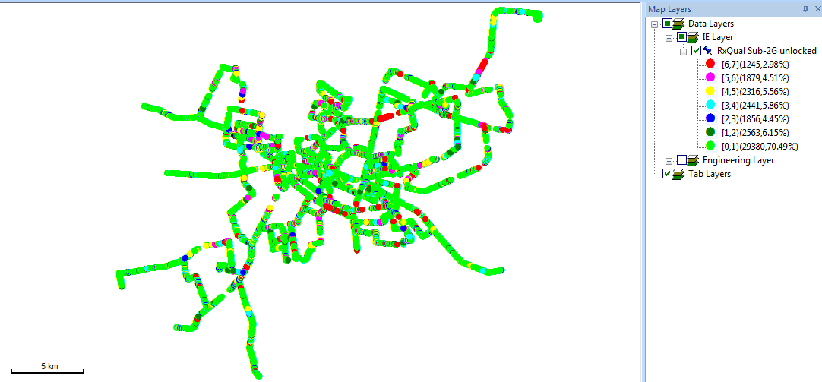
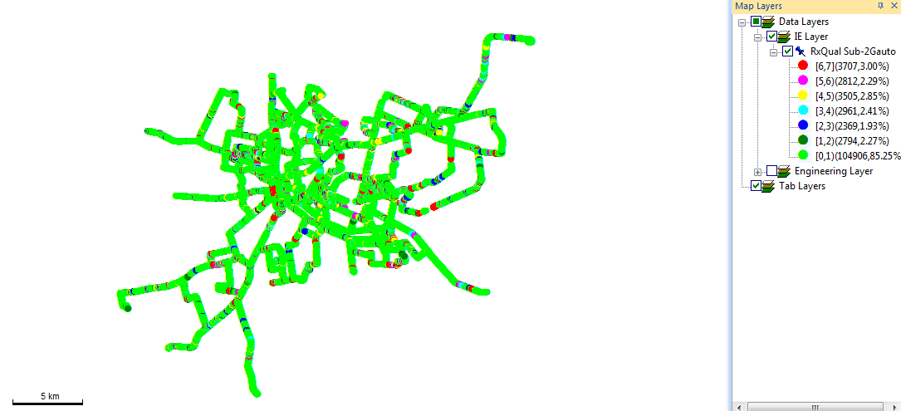
Lusaka DT Quality – GSM
Before
After
In Lusaka the GSMauto RxQual has improved. The best samples (RxQual 0,1) increased from 70.49% to 85.25% while Total RxQual > 5 has increased from 92.5 to 94.7%. The most improvement is in the GSM 900 spectrum

Slide 14
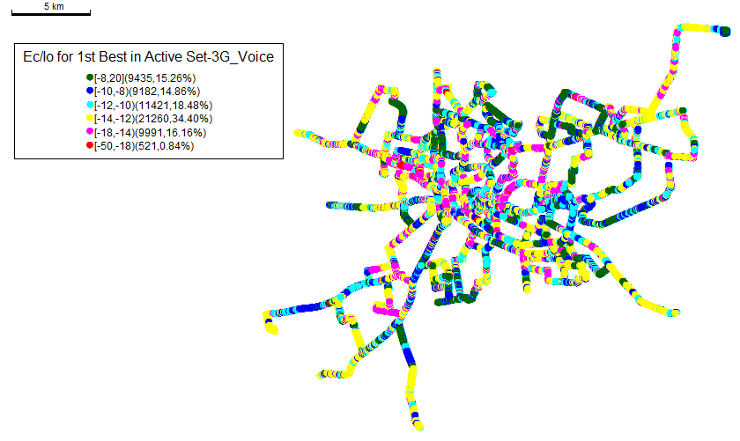
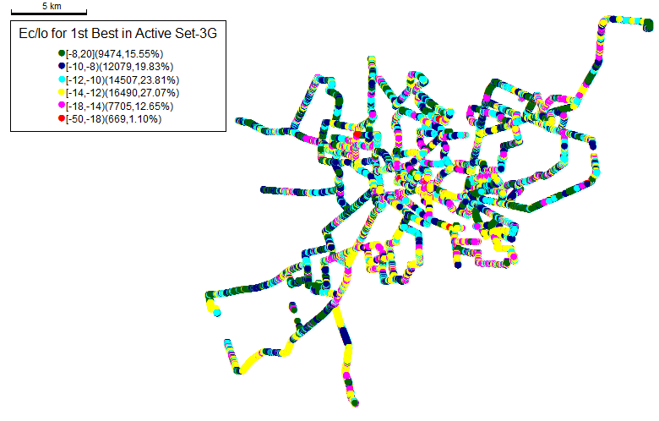
Lusaka City – 3G Quality (Ec/Io)
Quality – Ec/Io before
Quality – Ec/Io after
The 3G quality improved with the over 200 F2 cells introduced into the network. The EFD feature also contributed to reducing the loading on cells. Good quality samples increased from 82% to 86%
IBS / Lamp site, Split antenna, 3rd & 4th Carrier solutions should be considered for hot spot areas where the users and load continues to rise.

Slide 15
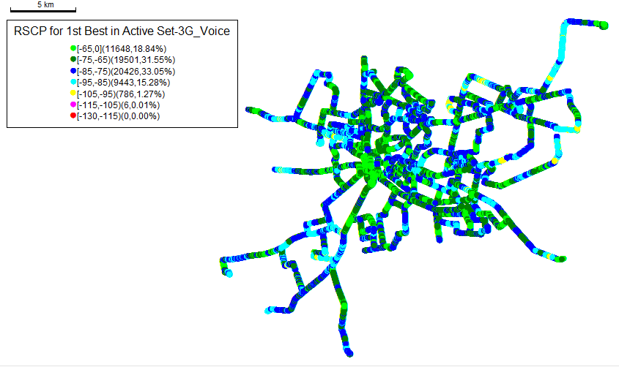
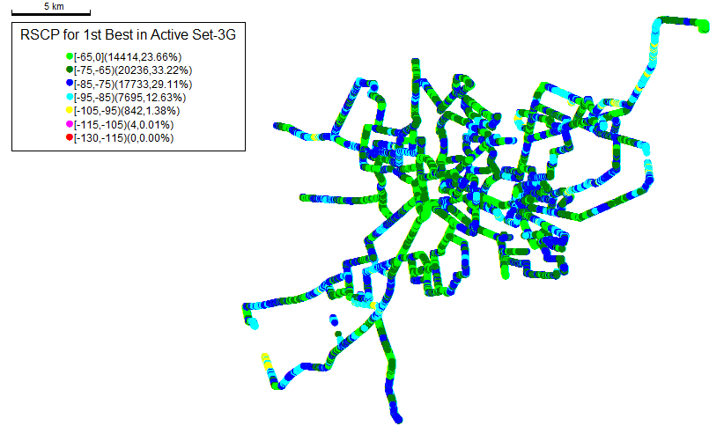
Lusaka City – 3G Coverage (RSCP)
Coverage– RSCP before
Coverage – RSCP after
The 3G coverage in Lusaka City is good. The before and after sample (RSCP >-95dBm) averaged around 98.7%.
There were 2 additional sites in H1 2015 that improved the coverage in the Makeni and Salama park areas

Slide 16
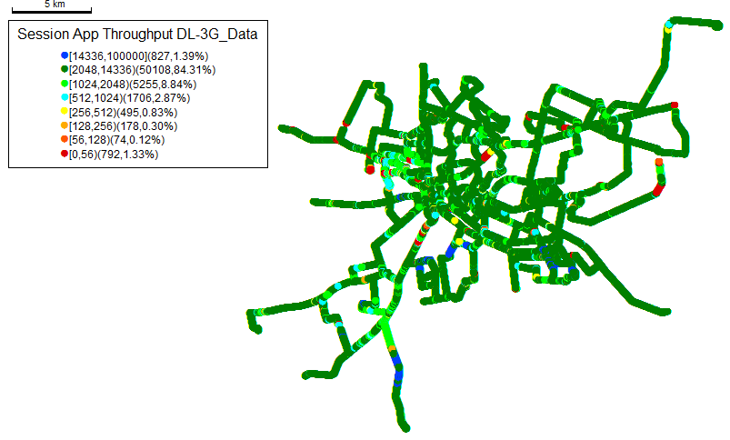
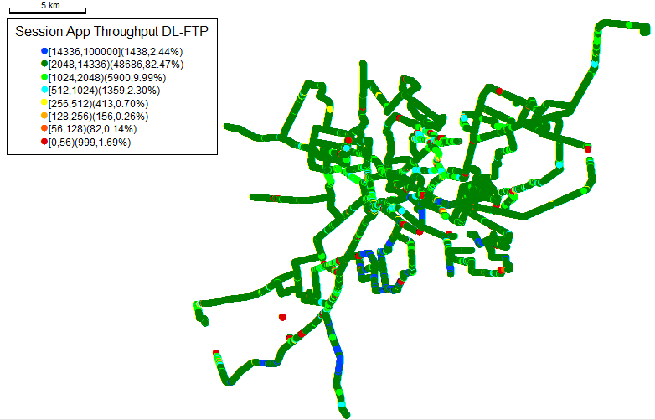
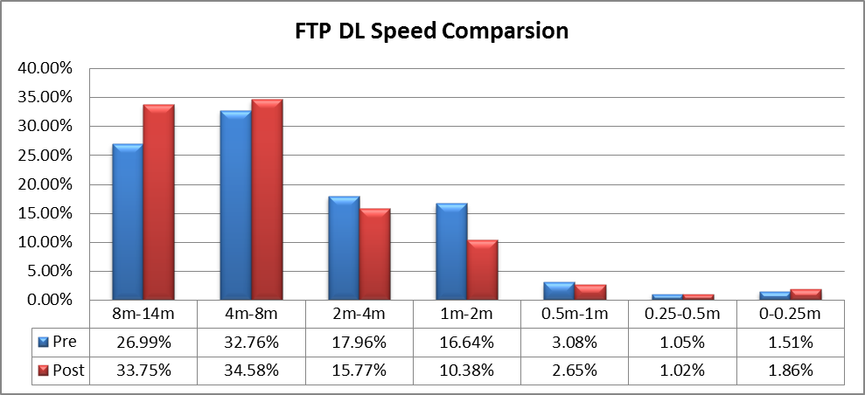
Lusaka City – HSDPA Throughput
Throughput plot -- before
Throughput plot - after
3
1
The Lusaka average HSDPA throughput are good averaging around 5.715Mbps with about 95% samples >1Mbps for before and after drives
The throughput above 14Mbps increased in the after drives following the new F2 cells, EFD and DC HSDPA features introduced in the network.

Slide 17
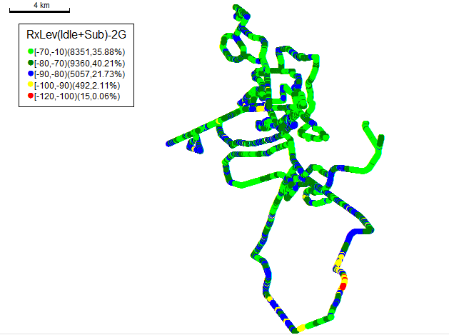
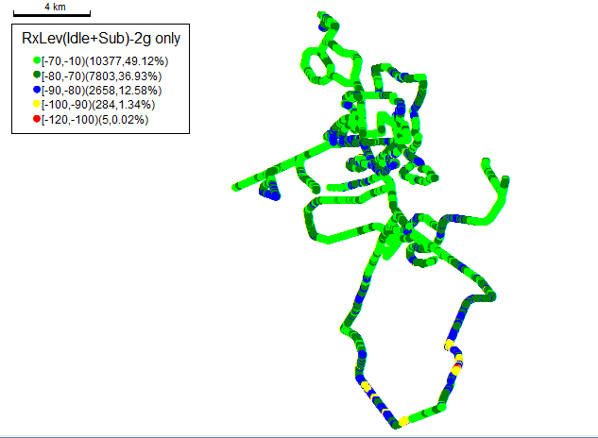
Ndola DT Coverage Plots – GSM
Before
After
Ndola 2G coverage on the GSM 900 is generally good. New T3499_ZM3470_NDOLA LIME has improved coverage
Up to 98.63% samples in Lusaka measured better than -90dBm therefore no major challenge with coverage.

Slide 18
Summary
When you work with the regulator as a partner in customer experience the subscribers benefit from good QOS.
MTN always views ZICTA as a partner in QOS and currently we are engaging them on spectrum to ensure that the services we offer and the best in the industry.

Slide 19
THANKYOU

