Slide 1
ITU Regional Standardization Forum for Africa Livingstone, Zambia 16-18 March 2016
Mobile Broadband QoS- The case of a University Hall of Residence Kwame Baah-Acheamfuor, National Communications Authority kwame.baah-acheamfuor@nca.org.gh

Slide 2
Outline
Objectives
Parameters
Methodology
Findings
Conclusions

Slide 3
Objectives
In pursuance of obligations of the 3G Cellular Mobile Licence of Telecommunication Operators and National Broadband Policy targets, the consumer perspective of the quality of data services are tested to ensure the compliance of Operators to the obligations on service quality to the user.

Slide 4
Parameters
Data Access Time (DAT)
Data Access Success Rate (DASR)
Data Drop Rate (DDR)
Throughput

Slide 5
Data Access Time (DAT)
Data Access Time is a measure of the time lapse in activating a PDP Context for data service.
– Moment PDP Accept message is received,
– Moment PDP Request message is sent,
Data Access Time should be less than five seconds (<5secs) in 100% of cases

Slide 6
Data Drop Rate (DDR)
Data Drop Rate is the probability to drop in connection to public server without end user’s intervention
Data Drop Rate should be equal or less than one per cent (1%).

Slide 7
Data Access Success Rate (DASR)
Data Drop Rate is the probability to drop in connection to public server without end user’s intervention
Data Access Success Rate should be equal or better than ninety five percent (95%)

Slide 8
Throughput
Throughput is the rate of data transfer.
As per the QoS Regulations and National Broadband Policy the minimum data transfer rate for 90% of data connections should be 1.00 Mbps

Slide 9
FINDINGS

Slide 10
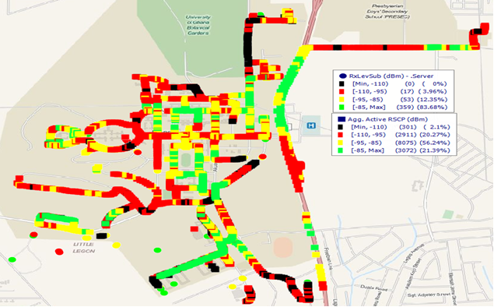
Operator A Coverage

Slide 11
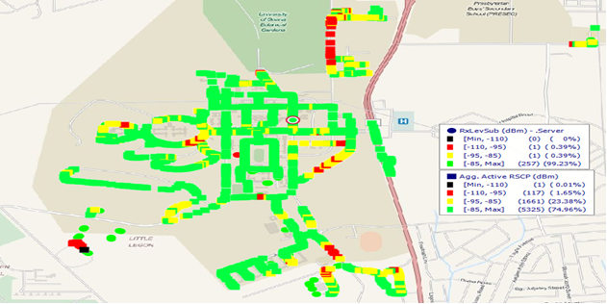
Operator B Coverage

Slide 12
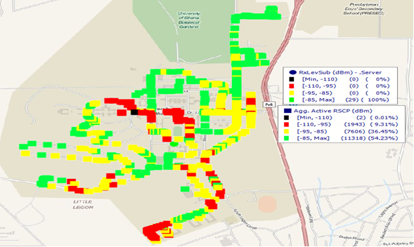
Operator C Coverage

Slide 13
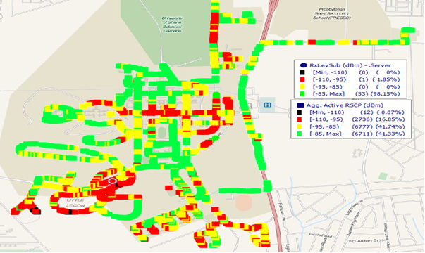
Operator D Coverage

Slide 14
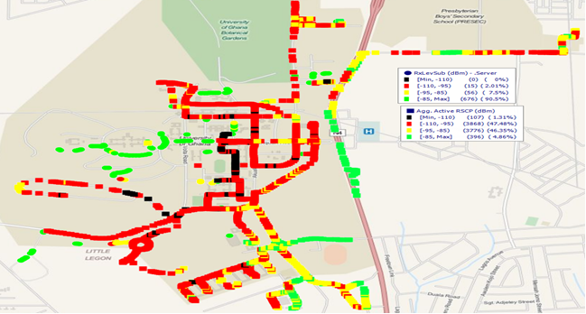
Operator E Coverage

Slide 15
Findings on Parameters
Parameter | Threshold | A | B | C | D | E
DAT | >5 seconds | 2.14 | 1.64 | 1.94 | 2.36 | 3.376
DASR | ≥95% | 100 | 100 | 100 | 94.59 | 83.33
DDR | ≤1% | 0 | 0 | 0 | 0 | 0
Throughput | ≥1Mbps | 1.92 | 1.882 | 2.064 | 2.507 | 0.03

Slide 16
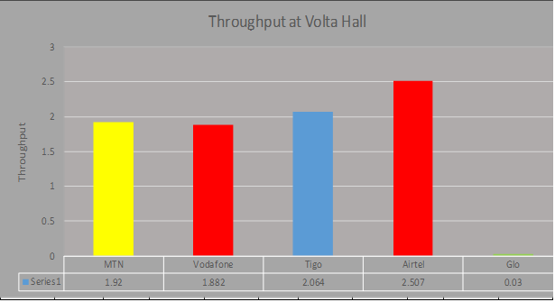
Throughputs

Slide 17
Questions for further Studies
Does good coverage influence Data Access Time?
Does bad coverage influence Data Access Setup Rate?
Does good coverage guarantee better Throughputs?

