Slide 1
ITU Regional Standardization Forum for Africa Livingstone, Zambia 16-18 March 2016
Zambia QoS Overview Mbulo Collins Mbulo, Monitoring & Compliance Engineer - QoS, ZICTA cmbulo@zicta.zm

Slide 2
Presentation Lay-out
Introduction
Background Information and Definitions
Zambia QoS equipment lay-out
Zambia QoS measurement Method
Going Forward – Opportunities, Challenges
Conclusion

Slide 3
Introduction
The Zambia Information and Communication Technologies Authority (ZICTA) since 2009
ICT Act 2009,
ECT Act 2009,
Postal Services Act 2009
Initially Communications Authority of Zambia (CAZ): 1994 - 2009
Telecommunications Act 1994
Radiocommunications Act 1994

Slide 4
Background Information
In discussing QoS; it is always important to understand the relevant terms and definitions, thus need for definitions

Slide 5
Definition of QoS – end to end
As per ITU-T Recommendation E.800, quality of service is:
“Totality of characteristics of a telecommunications service that bear on its ability to satisfy stated and implied needs of the user of the service.”

Slide 6
Four view points of QoS – ITU-T Rec G.1000

Slide 7
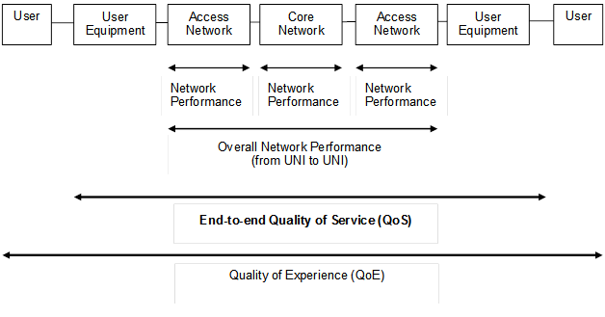
ITU-T E.804 End to End QoS/QoE
QoE is subjective by nature. Employing an objective method to find subjective verdict

Slide 8
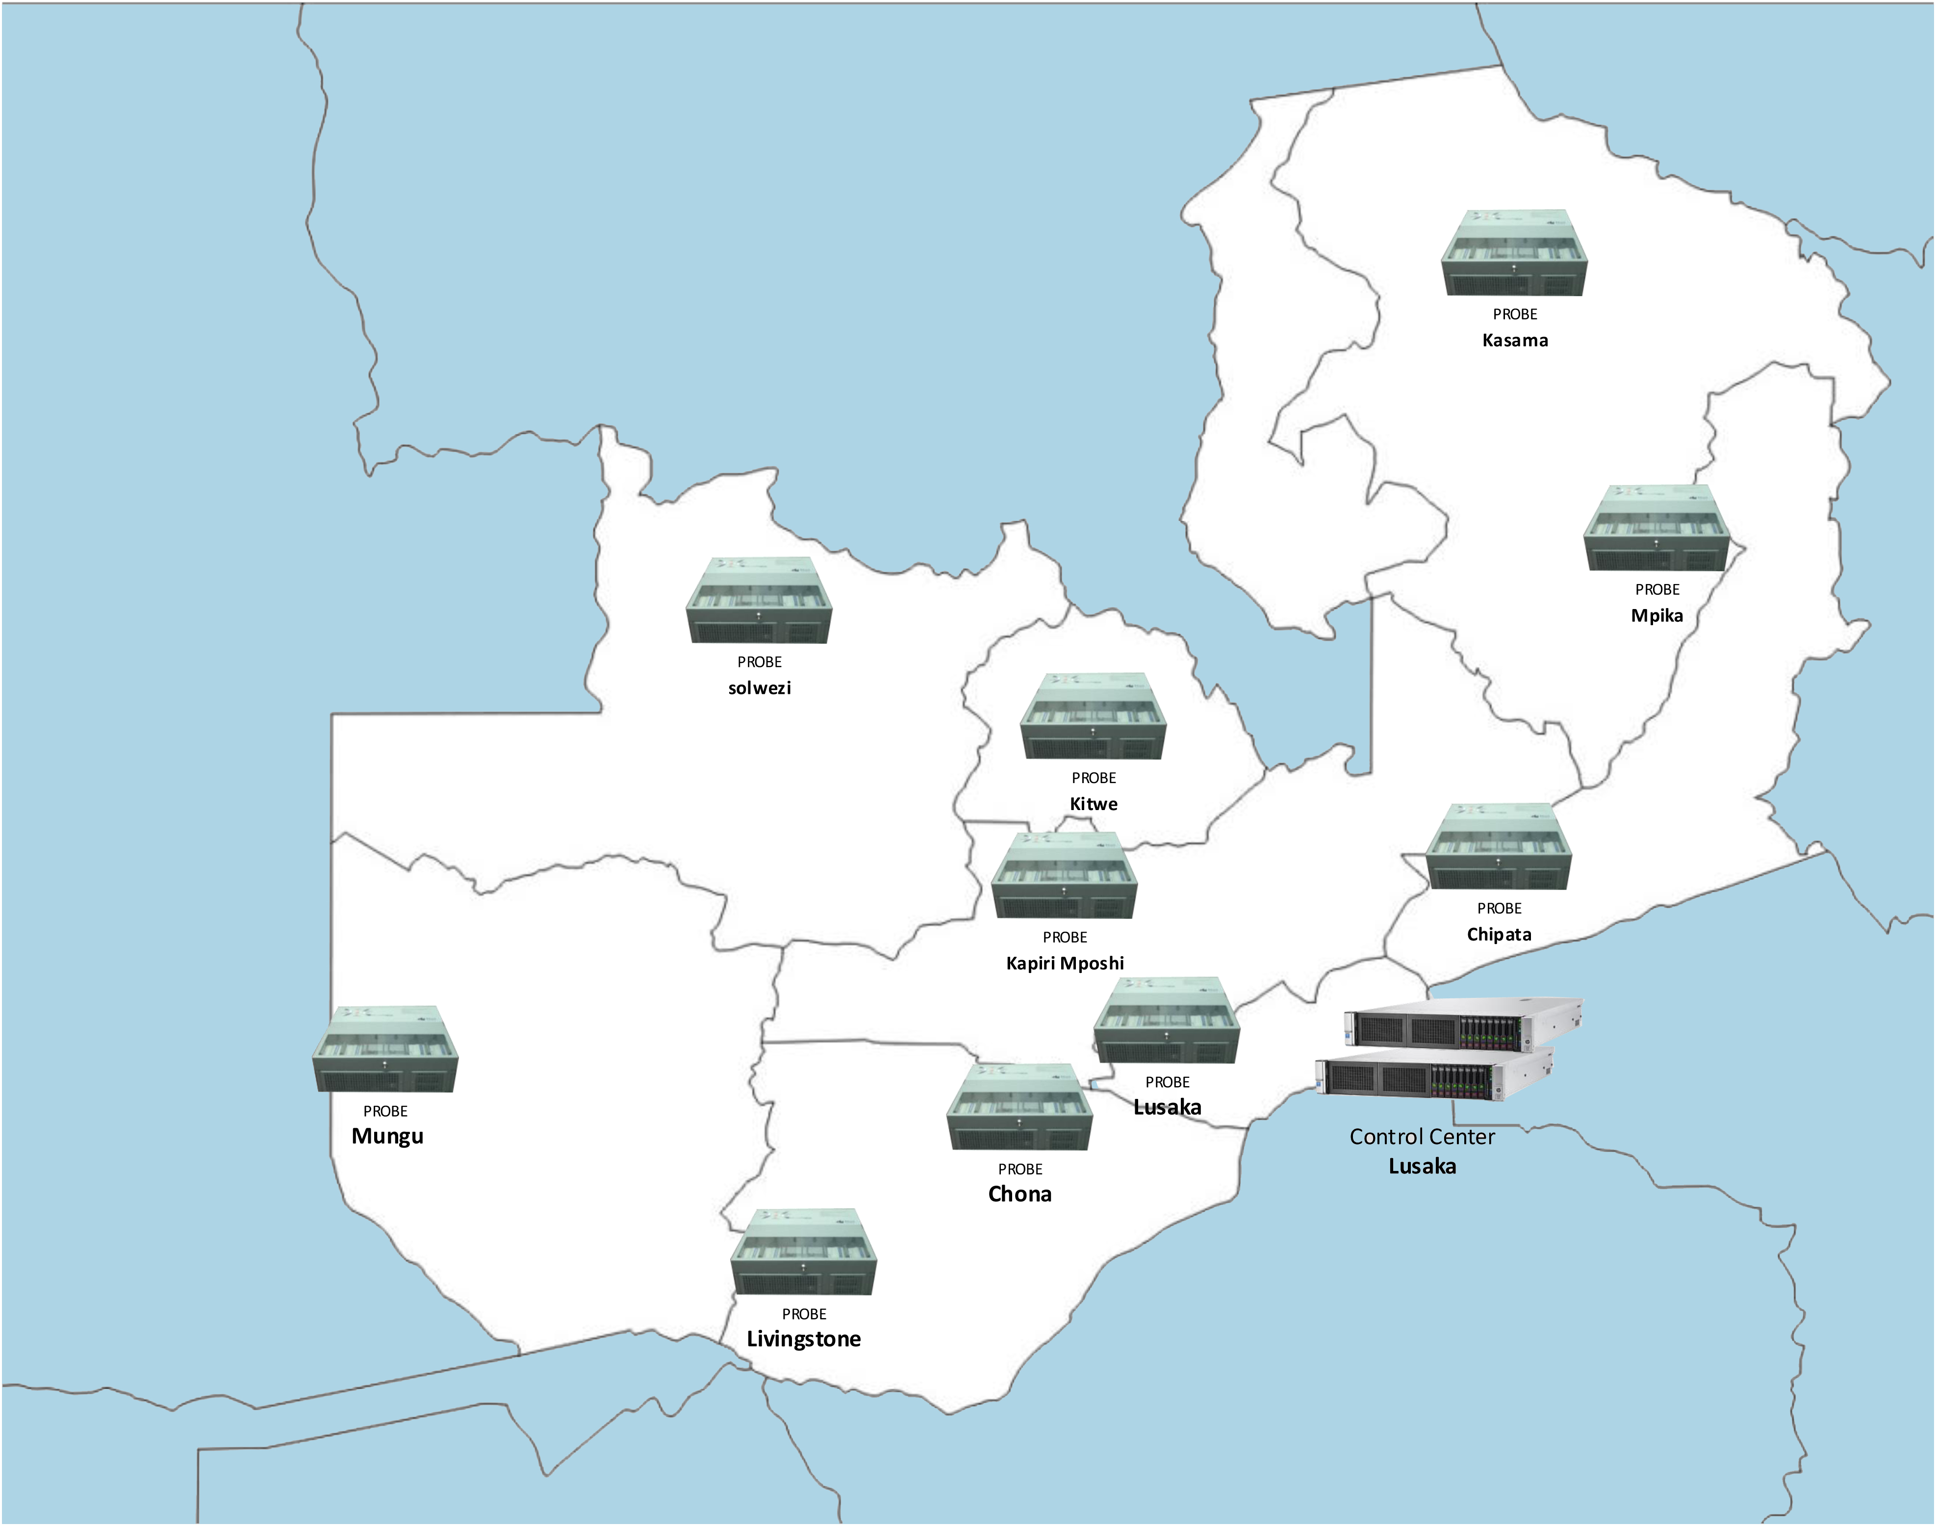
The Zambian Case – QoS Network Layout
Fixed Network Consists:
10 fixed Monitoring units across the provinces
These carry out tests 24/7

Slide 9
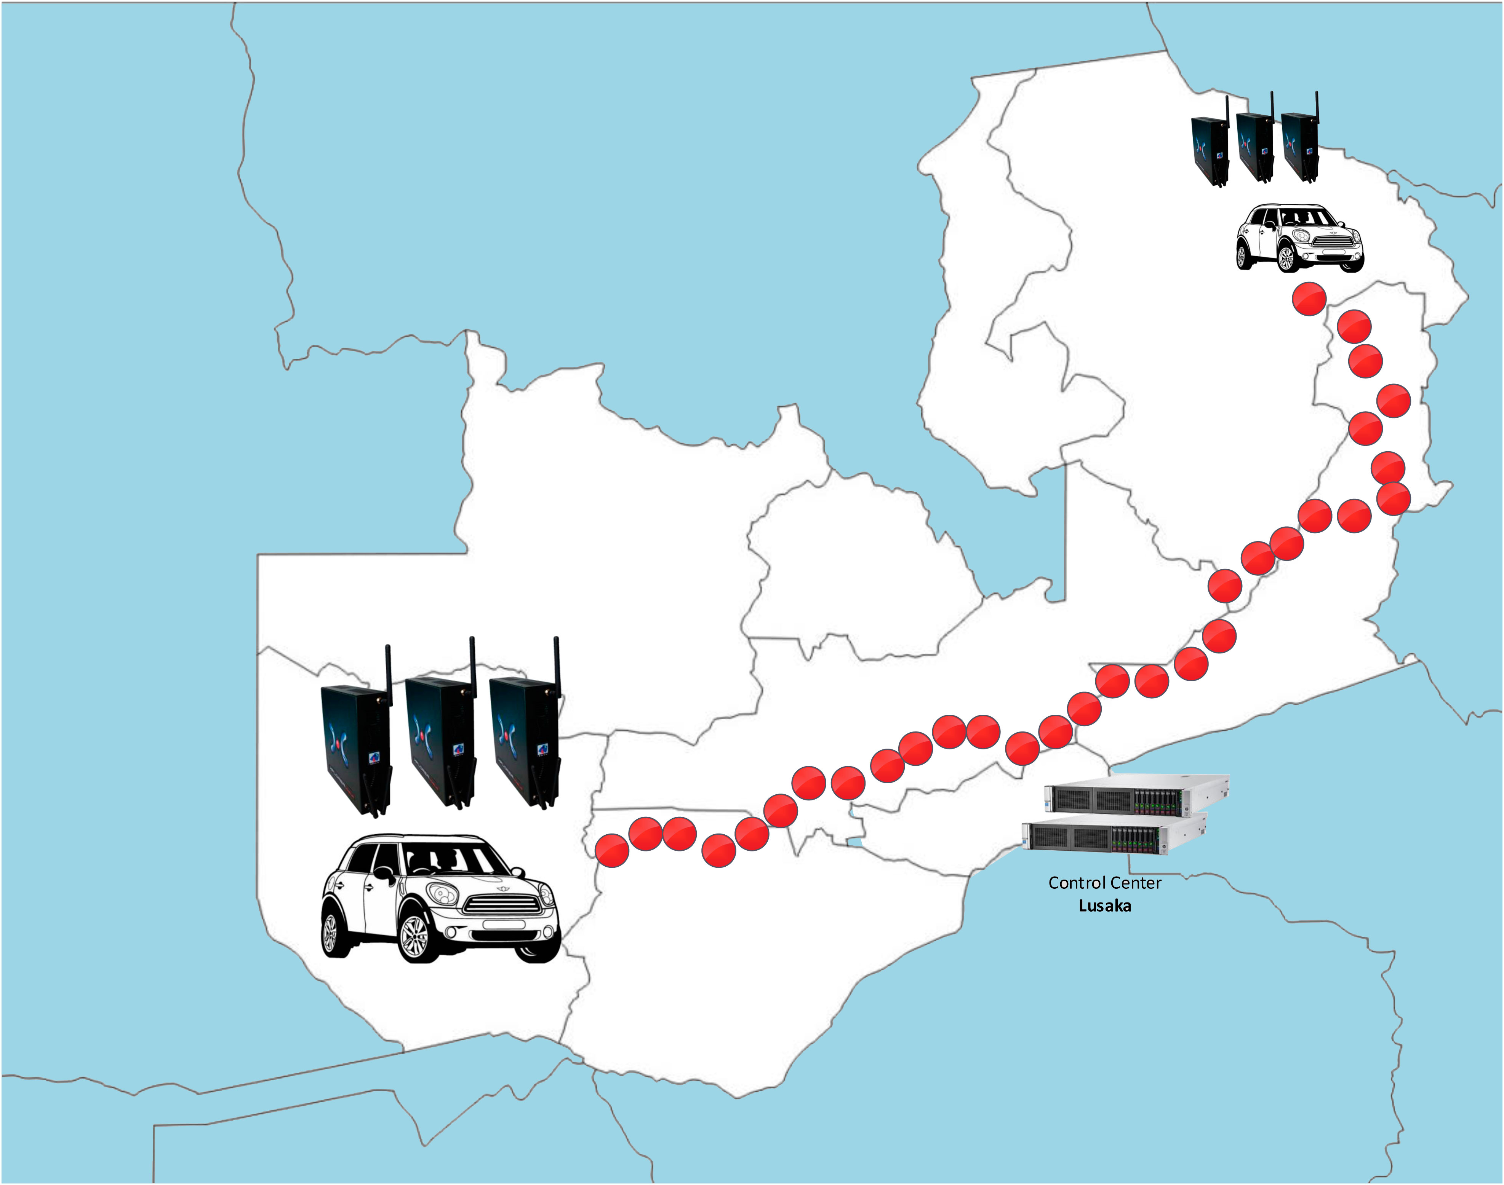
The Zambian Case – QoS Network Layout
Mobile Part:
12 mobile micro monitoring units – used to carryout drive tests
ETSI TS 102 250-4, among other standards

Slide 10
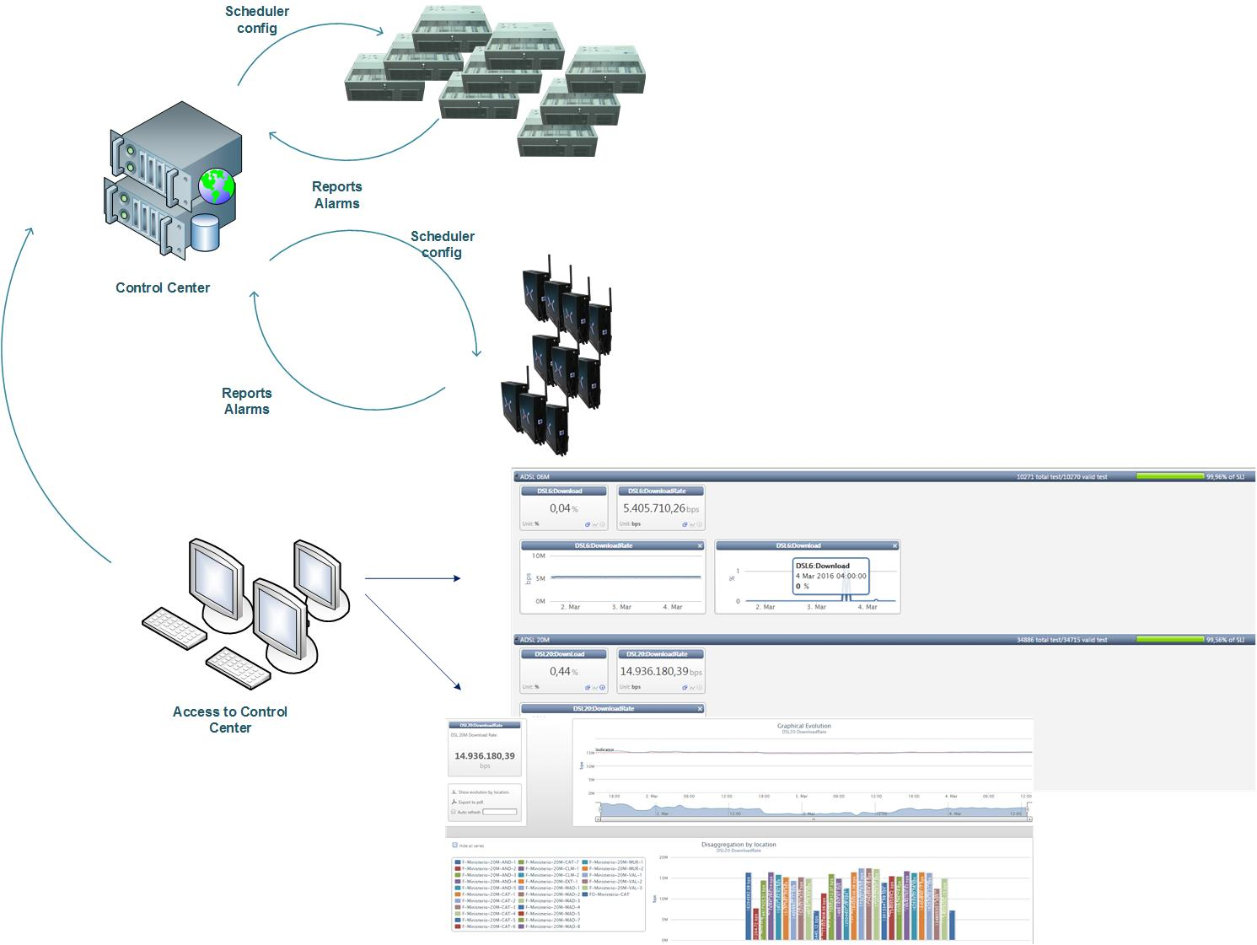
NETWORK LAY OUT

Slide 11
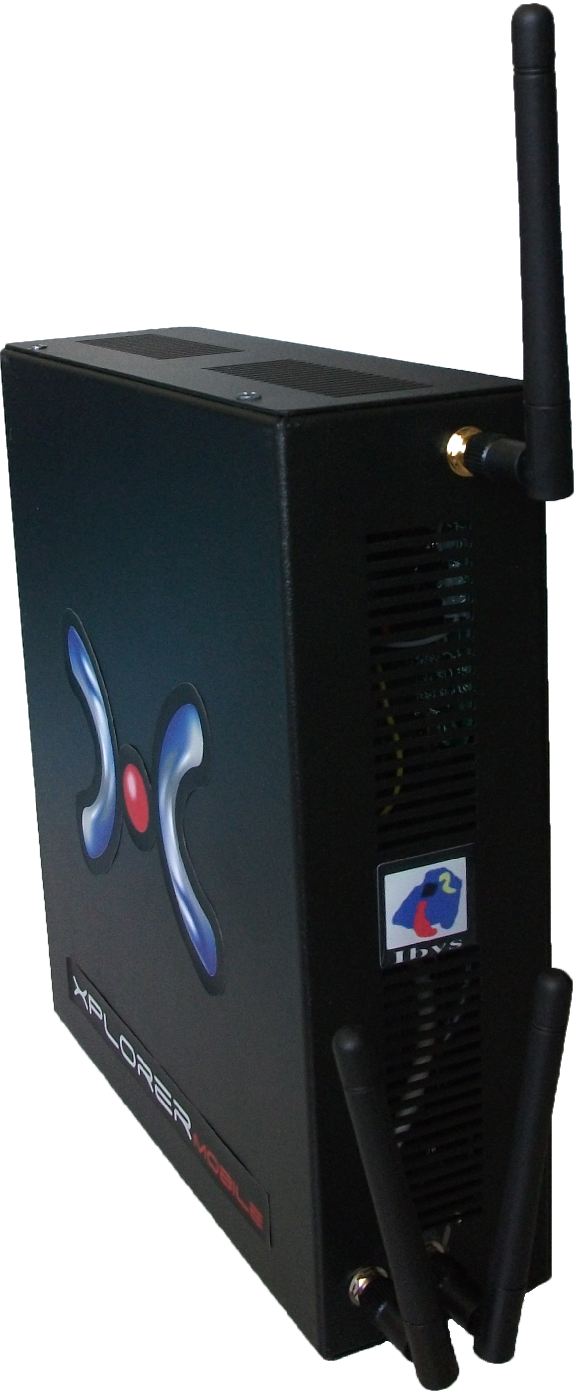
The Equipment
The equipment being used is Xplorer QoS of Ibys Technologies, Spain
General specifications
WMIX-N26006 Motherboard
Intel® ATOM™ D2550 1.86GHz processor
Intel® NM10 Express Chipset
Support for DDR3 1066/1333/1600 MHz SO-DIMMs. Note : DDR3 1333MHz and DDR3 160 MHz SO-DIMMs operate at 1066MHz Only.
Dual display: VGA / LVDS, 3rd display via PCI-Express x1 graphic card
Expansion slots
2x Gigabit Ethernet LAN1: Realtek 8111E LAN2: Realtek 8111E
2x RS232 serial ports
1x SATA
6x USB ports
1x PCI-Express x1
Internal HDD – 500GB
Operating System: Windows XP Embedded with SP3.
12V DC Input @ 8A
AC/DC transformer included, 100-240v~, 2A, 50-60Hz
External dimensions: 220x200x65mm
Fanless, noiseless.
Control by RF using embedded interface or through onboard LAN.
One external antenna for internal control network connection.
One or two external test antennas with optional attenuation.
Supports different test interfaces (test-devices): wireless modems, wireless dongles, LTE modules, smartphones and LAN interfaces. Optional onboard GPS for drive test.
Supports VoWifi/Wifi VoIP/VoWLAN
Internal LAN interface for Fixed broadband tests (if required)
Size 9x20x22 cm.
Weight 2 kg approx.
Main features:
Equipped with 2 Test Wireless Modems (Siemens, 2G/2.5G/3G/3.5G) for Voice and Data tests.
Equipped with 2 Sierra or Huawei wireless USB Dongles (2G/3G/3.5/4G) for data tests only
Besides, the backplane of the box comes with several ports for LAN, Audio, PC, Mouse, etc. The box can be connected to 12VDC or 220 VAC.
Also LAN/xDSL tests can be performed if needed.
Note: versions “a” to “c” comes with two test devices (test-interfaces), but they can be ordered with 1 test device as well.
Note: All versions come with one extra wireless modem for remote (radio) communication with the Server.

Slide 12
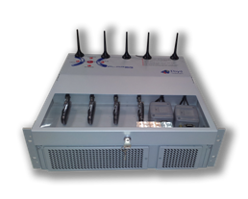
The Equipment
The equipment being used is Xplorer QoS of Ibys Technologies, Spain
General specifications:
Processor type Intel® Core i7/i5 Processor
Processor speed 2,4 GHz
Number of processors 1 processor
L2 Cache Memory Built-in Processor
Chipset Intel® C216 /Q77 chipset
Standard memory 4GB Two DIMM sockets support 1333/1600 DDR3-SDRAM
Internal Units 2 SATA 500 GB 3,5" hard disk without hot connection
Hard disk speed 7.200 rpm
Flexible disk drive USB only
Optical drives DVD-ROM and DVD-RW
Chassis type 3U Rack
Chipset Intel® C216 /Q77 chipset
Network Interface Integrated server adapter HP NC362i Gigabit double-port
External I/O ports RJ-45 (Ethernet) : Realtek 1 ports for 10/100 network interfaces; 1 port ;VGA - 1; USB - 6 totally: (2) back, (6) internal optional
Expansion slots Expansion slots: 4 PCI x16
Power supply Common, high efficiency of 250W / 12VDC
Power connections req 115V/60Hz, 220V/50Hz or and/or 12VDC
Operating systems Microsoft® Windows® Embedded
Dimensions 44,80 x 45 x 13,5 cm
Weight 12 kg
Main features:
Up to eight/six test interfaces
2G-2.5G-3G-3.5G-4G/LTE tests
LAN, WIMAX, PSTN, xDSL, etc. tests
Up to 6-8 Simultaneous tests
Multi-technology test capability
Manual / scheduled tests
Commercial Handsets
Industrial Test Mobiles
Wired & wireless connections for external communication (i.e. with a Centralized Control Unit)
Capability for Real time (or post) visualization of results
Very easy access to phone slots
Ready to be mounted on a car or truck
12VDC and/or 220VAC
Rack mountable

Slide 13
Zambia: Basis for QoS monitoring/measurement & enforcement
The QoS framework is based on:
The ICT & ECT Acts of Parliament - 2009
Drawing from the available international standards, ZICTA, in full consultation with the 3 MNOs, drew and published QoS guidelines 2010 – these stipulate the Zambian QoS standards in summary and explain measurement method for each parameter

Slide 14
Why Measure QoS/Performance?
Consider the stakeholders:
The Consumers – Improved QoS: Value for money
The Mobile Network Operators – Improved QoS: retain customers, business advantage, more profits and
The Sector Regulatory Authority – Improved QoS: Protect both MNO and Consumer
Government – Improved QoS: Consumers consuming a lot, means more revenue through taxes
ALL THE STAKEHOLDERS DESIRE IMPROVED NETWORK QUALITY – COMMON GOAL: good quality networks
How then can we achieve good quality networks? Unless our goal is measurable
GENERAL: Whatever your goal, acronym S M A R T objectives demand Measurable objectives! How else will you know if you are on track or not?

Slide 15
Engaging Stakeholders: National Standardization Process
ICT Steering Committee
National Secretariat
Technical Committee 2
Technical Committee 3
Technical Committee 4
Technical Committee 5
Technical Committee 1
ZICTA and ZABS
TC3: QoS, QoE and Interconnection

Slide 16
Zambia: Currently Parameters for Quarterly & On-demand Reports
SMS delivery time
SMS success rate
Voice call set up time
Voice call success rate
Dropped Call Rate
Data set up success rate (2G and 3G) 4G
Dropped data sessions (2G, 3G) 4G
Average data speeds (2G, 3G)
MOS Voice Quality: PESQ … pending upgrade to POLQA

Slide 17
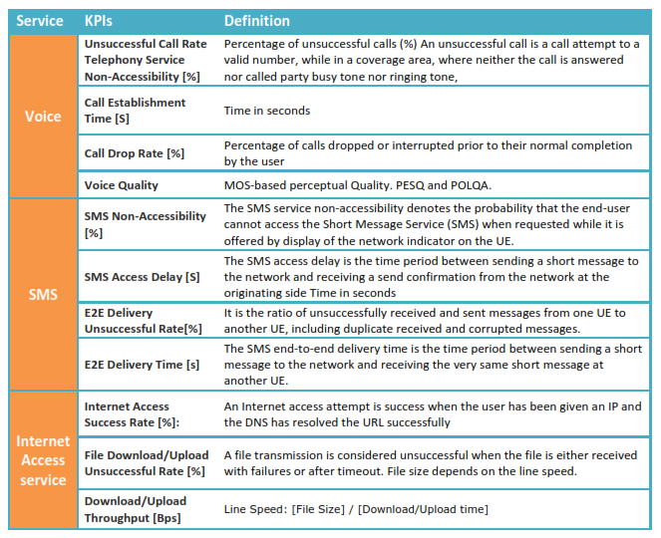

Slide 18
QoS Measurement Methods
Active (Intrusive)
Is where equipment is active on the network i.e. part of the traffic
Mean Opinion Score/Expert Panel
ITU T Rec E.803, among others
Passive (Non intrusive)
Direct from MNO core network
Submission from MNOs
Usually quarterly reports requested

Slide 19
Requirements for QoS Measurements: ETSI TS 102 250-4: General Aspects
All tests are based on emulation of a typical customer using services provided in a Public Mobile Network (PMN).
All of the services to be tested (see TS 102 250-2 [3]) can be emulated by the Mobile QoS Test-equipment (MQT) which can be installed in a vehicle, can be carried around by a pedestrian or is installed for semi-stationary use (e.g. office
environment).
Test scenarios need to distinguish the following principal user cases.
1) user-to-user services (typically telephony);
2) store-and-forward services (e.g. SMS);
3) information services (e.g. accessing the internet or FTP download);
4) push services.

Slide 20
QoS Simplicity has made it Complex
In QoS/QoE our main interest is to view the network as perceived by the consumer. i.e. outside view
All the 4 perspectives of QoS benefit more when they view it from the consumer’s stand-point
The simplicity of the consumers’ view brings confusion with Network Performance & other network KPIs: Don’t confuse NP with QoS, let alone QoE
Why? – maybe because the people discussing it actually know what goes on in a communication network; which the consumer sees as a “black-box” ????

Slide 21
Trending to data QoS?
Growing importance of ICT as driver of economic development, in all sectors of the economy
To facilitate smooth exploitation of cloud computing services, e-services (government, health, education), etc
Note also that QoS parameters trend towards concentrating on data services

Slide 22
Importance of QoS data availability to stakeholders
The importance of evaluating and ‘knowing’ how good our networks are performing cannot be over-emphasized
As such, it is eminent that all regulatory bodies, MNOs that may have underplayed this function have no option but to attach prominence going forward.
This is the bed-rock of the ‘future’ networks/life

Slide 23
Challenges
To have common view-point with MNOs
Sample Size: To have clear-cut definition needed …
Perhaps SG12 work has focused more on the measurement methods (which is very important) only – we need emphasis/clarity on the statistics too … how to apply those statistics formulae and graphs ???

Slide 24
Going Forward - Opportunities
To achieve increased participation of all stakeholders in entire process
To start continuous publishing of results – where consumers can easily access and utilise valid results
As data services take prominence, plan to reduce significantly SMS tests to concentrate on data services
To participate/initiate actively in a SG12 question on the statistics (sample size) and what numbers can be defined as fair and acceptable to all stake holders in specified scenarios

Slide 25
CONCLUSION: Disclaimer - QoS is NOT about Sanctions!
The objectives of activities done related to QoS/QoE, such as monitoring and reporting by regulator/MNO, meetings etc is to;
Deliver the best possible experience to the consumer
The consumer will have a great experience
The network operator gains loyalty – retain/get new customers – more profits
Government receives more taxes
This points to the proposed QoSphere!

Slide 26
End
Thank You

