Slide 1
ITU Regional Standardization Forum for Africa Livingstone, Zambia 16-18 March 2016
Developing EPR Guidelines for Sustainable E-waste Management Hoda Shakra, Unit manager, Green ICT program- IR division
hshakra@mcit.gov.eg
MCIT- Egypt

Slide 2
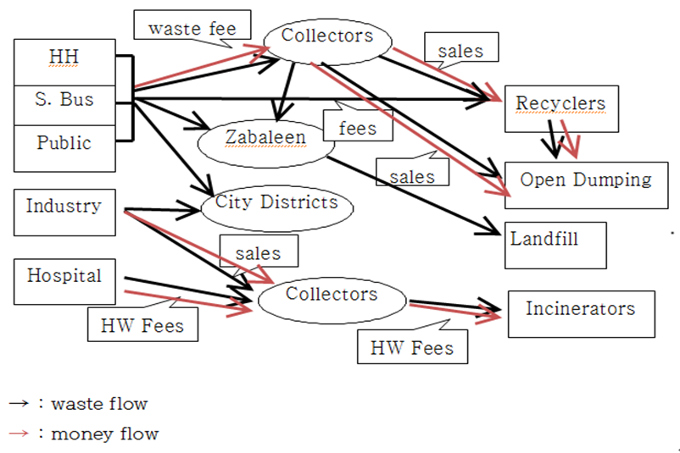
A. Current E-waste management policies and practices
1. Waste Flows in Egypt

Slide 3
A. Current E-waste management policies and practices
2. Status
- 95.21 million mobile subscriber with 110.95 % penetration rate
- 27.25 Million internet user with 31.71% penetration rate
- 190,000-290,000 laptops and 8000-15,000 desktops imported per year with total weight 1000 tons
- 6.8 million EoL mobile phone in 2015 and it will reach 10.5 million in 2020
- 1.29 Million EoL PCs in 2015 and it will reach 1.46 by 2020
-0.33 million LCD in 2015 and it will reach 0.67 by 2020
- Management Activates: collection & pre-processing(sorting, refurbishing, dismantling, shredding)
- The informal sector plays a significant role specially in collection
- ITG is the formal recycling business with capacity 200 tons/month sourced from public and private organizations through bids
- No overall integrated environmental policy regarding WEEE
- The legal framework includes restrictions on imports of WEEE
-National Green ICT initiative since 2010 (MCIT, MoE, NGOs, Private sector, International Organization)

Slide 4
A. Current E-waste management policies and practices
3. Challenges
Lack of appropriate legislation
Lack of accreditation system for e-waste for private sector participation.
The absence of effective take-back schemes
Lack of qualified skills and professionals.
lack of appropriate infrastructure and technology for recycling
Lack of awareness about the threats and opportunities of the E-waste recycling.
The lack of willing of consumers to give out their E-waste for free or affordable prices.

Slide 5
A. Current E-waste management policies and practices
3. Challenges
The high cost of the machinery used in recycling.
The lack of incentive mechanism for tack back models
No specific entity that is responsible for managing E-waste recycling in Egypt.
No environmental obligation on Egypt at the international level, Egypt is not on the Annex1 country in Kyoto protocol

Slide 6
B.EPR policy demands of Egyptian government
1. Changing environment: e-waste is becoming a national issue
Consumption of EEE is showing a steady increasing trend
The volume of e-waste is also showing an ever increasing trend already with a large amount of accumulation beyond the capacity of current recycling business
2. The matured market condition
Enough markets and traders for the transactions of used e-goods, though most of the activities are informal
Emerging recycling companies
Well established company like International Technology Group(ITG) may be the first sign of formal WEEE collection and recycling
3. Public sectors ,NGOs, private sector are prepared
National Green ICT initiative and National Green ICT steering committee

Slide 7
B.EPR policy demands of Egyptian government
4. EPR as the best alternative
Challenges and requirements for Egyptian government to establish a formal and efficient e-waste recycling system are summarized as (1) preparing legal basis, (2)
constructing infra structures, (3) introducing a sustainable assistance system
The EPR mechanism is a good initiative for transiting to a shared responsibility
EPR is to provide subsidies and assistances to private recycling business to enable them to enjoy profits
EPR system can provide subsidy to recycling business which government cannot afford
EPR changes the sole responsibility system for waste by local government to shared ones among consumers, producers, and center and local governments
EPR can be used as an effective mean to draw people’s participation
Take-back system promotes sharing of collection roles among producers and consumers(residents) through various incentive mechanisms prepared by producers
Resistance from the producers will not be at the level to be worried
The financial burden imposed on domestic manufacturing industries will be relatively small compared to the advantage or benefit accrued to all the stakeholders

Slide 8
C.EPR best practices
1. EPR in Europe
WEEE Directive (2002), RoHS Directive (2002), and REACH Regulation (2006)
European waste legislation currently gives a global framework for the implementation of EPR
Number of countries adopting EPR is increasing covering 28 EU member states, Asian countries, and United states
EPR policies have been designed and implemented in a very heterogeneous manner across Europe with a large variety of implementation models
The examples of implementation models are Take-back requirements, Deposit/refund, Advance disposal fees, Material taxes, Upstream combination tax/subsidy.
An EPR policy is characterized by: (1) the shifting of responsibility (physically and/or economically; fully or partially) upstream toward the producer and away from municipalities; and (2) the provision of incentives to producers to take into account environmental considerations when designing their products

Slide 9
C.EPR best practices
2. EPR in Asian countries
 | Japan | South Korea | China
Law | Home Appliance Recycling System (1998) | Waste Deposit-Refund System (1992–2002); Producer Responsibility Recycling System (2003–2007); Act for Resource Recycling of E-waste | Law on Waste Household Electrical Device Collection, Utilization and Management (under review)
Targeted products | TVs, refrigerators, washing machines, air conditioners | Washing machines, TVs, air conditioners, refrigerators, PCs, audio, mobile phones, printers, copiers, faxes all E-goods in 2015 | TVs, refrigerators, washing machines, air conditioners, PCs

Slide 10
C.EPR best practices
2. EPR in Asian countries
 |  | Japan | South Korea | China
Role of Stakeholders | Consumers | Mandatory cooperation on collection ⇒ Retailers (upon replacement purchase), local government, collection companies | Cooperation on collection ⇒ Retailers (upon replacement purchase), local government, collection companies | Cooperation on collection via retailer, local government and collection contractor channels
 | Local governments | Collect E-wastes from consumer and transport to designated exchange; also collect illegally dumped appliances | Collect E-wastes from consumer and transport to designated exchange; also collect illegally dumped appliances | Collection and transport to storage yards
 | Producers | Mandatory collection via retailers; setup of designated exchange | Achievement of mandatory collection/ recycling targets; construction of collection centers and recycling plants | No physical obligation
 | Recyclers | Recycling by producer- designated contractors | Recycling via producer consignment | Voluntary collection from storage yards and recycling
 | Collection companies | Voluntary collection; distribution as used goods/parts (including exporting) | Voluntary collection; distribution (including exporting) as used goods (including parts); | Voluntary collection from storage yards and recycling

Slide 11
C.EPR best practices
2. EPR in Asian countries
Stakeholders | Japan |  | Korea |  | China
 | Collection cost | Recycling cost | Collection cost | Recycling cost | Collection cost | Recycling cost
Consumer | Total cost | Partial cost | Almost not | Almost not | Almost not | Almost not
Local government | Illegal dumping collection cost | Almost not | Illegal dumping collection cost | Almost not | Unclear | Almost not
Producer | Mainly physical obligation | Mainly physical obligation | Total cost (financial and physical obligation) | Total cost (financial and physical obligation) | Almost not | Almost not

Slide 12
D. Adequateness of Asian and European versions of EPR in Egypt
The Asian version can easily be applied to Egypt without much change. Producers can be assigned the recycling duties like in Korea and China
Precautionary duties as well as recycling duties can be assigned to producers without severe
resistance from the producers. Japanese version does not seem to be appropriate for Egypt,
since assigning most of financial burden to consumers may raise much resistance from the
consumers who cannot afford the increased price
Decision of target rate of recycling requires some caution
The decision of recycling volume in advance needs estimation of sales volume and statistics
about recycling quantity which may cause difficulty in Egypt where most recycling activities are performed in hidden, informal
The European version may better suit to Egypt which require producers to pay subsidy for the
quantity recycled by recycling business
This system does not need pre estimation of recycling duties. Take-back system can be easily introduced in Egypt

Slide 13
D. Alternatives options in designing EPR
1. Type of EPR
There are two different types for implementing producers responsibility system. The one imposing only financial burden and the other assigning physical burden
For this there are two possible alternatives; Deposit and refund system and imposing recycling subsidies.
producers are given obligated recycling quantity in advance in proportion of sales volume
2. Producers responsible
Generally manufacturers and importers are included
Sometimes sellers are also included

Slide 14
IV.
D. Alternatives options in designing EPR
3. Scope of items subject to EPR
In the first stage scope of items are to be minimized for the easy start up
The candidates are home appliances such as Refrigerator, TV, Washer, and PC, Monitor, Printer, Mobil Phones
4. Scope of Duties
Two kinds of duties can be assigned to producers
The first is precautionary duties that include restriction of the use of hazardous substances
The latter is recycling duties which include establishing a take-back system
5. Complying recycling duties
For physical duty producers are given options; self-recycling, entrust, and joint compliance

Slide 15
D. Alternatives options in designing EPR
6. Subsidies
Subsidies or assistance is provided only to qualified recycling
In order to be qualified recycling, recycling must be undertaken by recyclers with permit complying with recycling standards and procedures
7. Administration of EPR system
Organizational arrangement is needed for the implementation works
There must be government organization in charge of identifying producers, checking their
reports to decide sales volume, obligation quantity, supervising recycling business, check
the recycled quantity claimed, paying subsidies and imposing penalties

Slide 16
E. Supplementary measures in designing EPR
Review of existing laws and Developing an Egypt WEEE Directive is needed.
Survey on the status of E-waste generation and management.
Establishing an efficient collection system with motivated by commercial profits.
Develop Measures for strict monitoring and regulations for illegal dumping and free riders for the successful adoption of EPR.
Develop Education and public campaign.
Develop National R&D system developing higher valued recycling (up-cycling)

Slide 17
Thank you

