Slide 1
ITU Regional Standardization Forum
For Arab Region
SESSION 1
10:30-11:05
Introduction to ITU-T Standardization Process

Slide 2
Objective :
To provide an introduction to the ITU, the ITU-T standardization process, the work of study groups, the roles of secretariat and Members respectively.

Slide 3
The International Telecommunications Union
ITU is the United Nations specialized agency for information and communication technologies – ICTs.
ITU is committed to connecting all the world's people by :
Allocating global radio spectrum and satellite orbits,
Developing the technical standards,
Sriving to improve access to ICTs to underserved communities worldwide.
The ITU is lead by the Plenipotentiary Conference (PP) that meets every 4 years.
ITU action is organized through three sectors of activities
- THe RADIOCOMMUNICATIONS sector (ITU-R)
The STANDARDIZATION sector (ITU-T)
The DEVELOPMENT sector (ITU-D)

Slide 4
ITU-T working structure
The World Telecommunications Standardization Assemly (WTSA) : Meets every four years and sets the overall direction and structure for ITU-T:
Defines the general policy for the Sector,
Establishes the study groups and approve their work program,
Appoints the WG chairmen and vice-chairmen.
Telecommunication Standardization Advisory Group
- Reviews priorities, programs, operations, financial matters and strategies
- follows up on the accomplishments of the work program,
- restructures and establishes ITU-T study groups, provides them with guidelines
- advises the Director of the (TSB), and produces organization and working procedures.
The Study Groups
The Workshops and Seminars
The Technology Watch
identifies emerging technologies, with a view to identifying work items able to lead to new ITU-T Recommendation

Slide 5
TSAG - Telecommunication Standardization Advisory Group
Roles :
make the ITU-T the most attractive place to come to do standards work in an increasingly dynamic environment of ICTs.
Establish ITU-T working methods to streamline approval procedures for new international standards.

Slide 6
THE ITU-T
STANDARDIZATION PROCESS

Slide 7
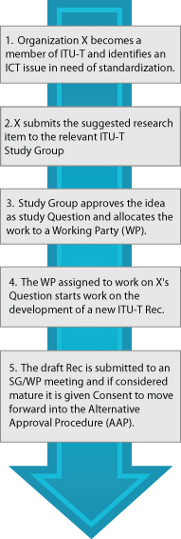
ITU-T STANDARDS ELABORATION PROCESS

Slide 8
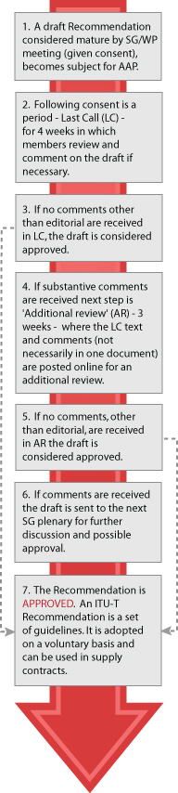
ITU-T STANDARDS APPROUVAL PROCESS

Slide 9
ITU-T Study Groups
ITU-T Study Group 2 - Operational aspects of service provision and telecommunications management
ITU-T Study Group 3 - Tariff and accounting principles including related telecommunication economic and policy issues
ITU-T SG5: Environment and climate change​
ITU-T SG9: Broadband cable and TV
ITU-T SG11: Protocols and test specifications
ITU-T SG12: Performance, QoS and QoE
ITU-T SG13: Future networks including cloud computing, mobile and next-generation networks
ITU-T SG15: Networks, Technologies and Infrastructures for Transport, Access and Home
ITU-T SG16: Multimedia
ITU-T SG17: Security
ITU-T SG20: IoT and its applications including smart cities and communities (SC&C)

Slide 10
ITU-T leadership position holders (As defined in the work Programme)
SG16 |  |  | Vice-chairman | Mohannad | El-Megharbel | Egypt (Arab Republic of)
SG17 |  |  | Vice-chairman | Khalid | Belhoul | United Arab Emirates
SG17 |  |  | Vice-chairman | Mohamed M. K. | Elhaj | Sudan (Republic of the)
SG17 RG-AFR |  |  | Vice-chairman | Mohamed M. K. | Elhaj | Sudan (Republic of the)
SG20 |  |  | Chairman | Nasser Saleh | Al Marzouqi | United Arab Emirates
SG20 |  |  | Vice-chairman | Abdurahman | M. Al Hassan | Saudi Arabia (Kingdom of)
WP1/20 |  |  | Co-vice-chairman | Abdurahman | M. Al Hassan | Saudi Arabia (Kingdom of)
WP2/20 |  |  | Co-vice-chairman | Ramy Ahmed | Fathy | Egypt (Arab Republic of)
RevCom |  |  | Vice-chairman | Musab | Abdullah | Bahrain (Kingdom of)

Slide 11
NATIONAL STANDARDIZATION SECRETARIAT
An evidence : A weak contribution of developing countries to the standardization activities.
An ITU‑T ambitious effort : Bridging the Standardization Gap (BSG)
BSG Objectives : to assist developing countries in establishing a National Standardization Secretariat to coordinate standardization activi ties and participation in ITU‑T study groups.
Potential roles of NSS:
Consolidate interest in ICT standardization
Coordinate among a national government and its industry players,
Simplify technical issues on the basis of unified and coordinated understandings
Promote coordination between national public and private sectors.
Increase effectiveness, avoid conflicting positions in the same or in different ITU‑T study groups,
improve awareness regarding exchange of information with ITU-T,
Assist national dissemination of information from the ITU to appropriate national experts
Provide a number of ITU-T-related functions such as preparation for international meetings, development and submission of contributions, etc…

Slide 12
../..

