Slide 1
ITU Activities in Digital Financial Services
ITU Regional Standardization Forum for Asia-Pacific
(Jakarta, Indonesia, 27-28 October 2015)
Vijay Mauree
Programme Coordinator, TSB
ITU

Slide 2
I. Mobile Banking v/s Digital Financial Services
MOBILE BANKING
Banking services delivered through a mobile phone. Need a bank account.
Digital Financial Services
The use of ICTs and non-bank retail channels to extend the delivery of financial services to unbanked.
    Bank account not needed.
    Use of agents for cash in and cash out.
    Use mobile handsets and other digital means for transactions

Slide 3
II. Digital Financial Services – Key Concepts
OTC
(over the
Counter)
transactions
may use just
the mobile
wallet
account of an
agent for
transfers or
payments
with cash
Mobile money
- a closed electronic
credit system;
usually with interfaces
to banking systems
Mobile Payments
- a transaction system
operated via
a mobile phone
with bank interfaces
Mobile Banking
- all bank transactions
& financial instruments
from a mobile
phone
Mobile Wallet (mWallet) accessed from handset, stores account, checks ID, handles encrypted transactions; held on M-DFS server

Slide 4
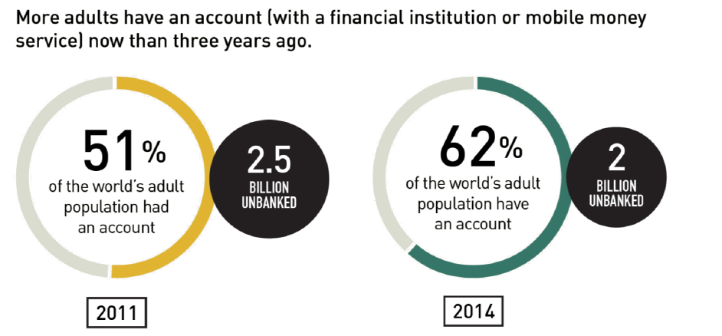
III. Digital Financial Services and Financial Inclusion
1.6 billion have a
mobile phone
Source: FINDEX 2014

Slide 5
IV. Mobile Money Market Situation: Overview
NUMBER OF LIVE MOBILE MONEY SERVICES FOR THE UNBANKED BY REGION - 2014
Source: GSMA

Slide 6
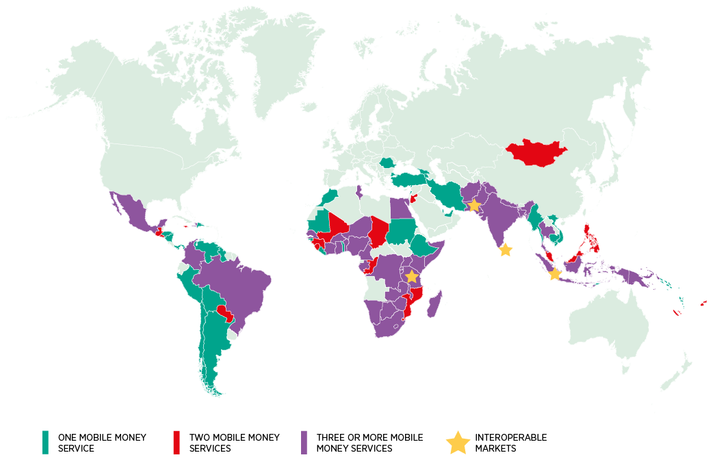




IV. Mobile Money Market Situation: Interoperability
56 markets have 2 or more live services.
38 markets have 3 or more live services.
In 2014, MNOs implemented A2A interoperability in three markets
    Pakistan
    Sri Lanka
    Tanzania
  following in the footsteps of MNOs in Indonesia.
MNO: Mobile Network Operator
A2A: Agent to Agent
Source: GSMA Survey of Mobile Money Adoption in 89 Countries, 2014
Source: GSMA Survey of Mobile Money Adoption in 89 Countries

Slide 7
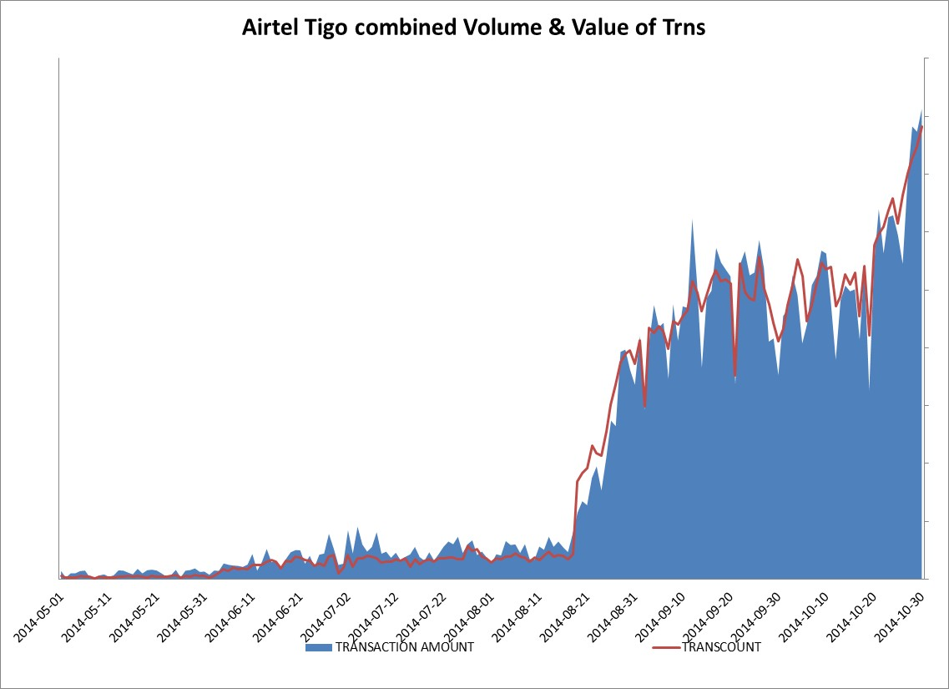
IV. Mobile Money Market Situation: Tanzania
Source: Millicom

Slide 8
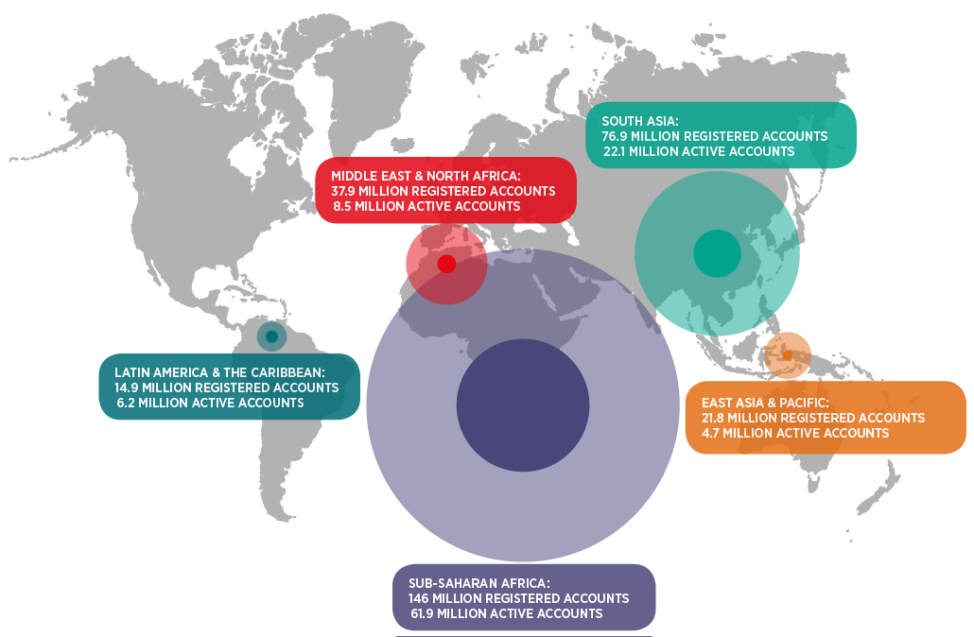
V. Mobile Money Accounts : Active Accounts
299m
registered accounts
(203m in 2013)
103m
active accounts
(61m in 2013)
    21 services now have more than 1 million active accounts.
    5 services have more than 5 million active mobile money accounts.
    16 countries are now home to more mobile money accounts than bank accounts.
Source: GSMA Survey of Mobile Money Adoption in 89 Countries
Notes:
An active mobile money account is a mobile money account that has been used to conduct at least one transaction during a the past 90 days.
There are more registered mobile money accounts than bank accounts in Burundi, Cameroon, the Democratic Republic of the Congo, the Republic of Congo, Gabon, Guinea, Kenya, Lesotho, Madagascar, Paraguay, Rwanda, Swaziland, Tanzania, Uganda, Zambia and Zimbabwe.

Slide 9
VI. Account Penetration: Top 10 Markets
Cote d’Ivoire
Kenya
Lesotho
Namibia
Paraguay
Rwanda
Swaziland
Tanzania
Uganda
Zimbabwe
- In alphabetical order.
Both banks and non-banks are allowed to issue mobile money (or equivalent) and to use agents for cash-in and cash-out operations, and
There is sustainable, market-driven approach to interoperability.
Source: GSMA Survey of Mobile Money Adoption in 89 Countries, 2014

Slide 10
VII. Critical Success Factors
Interoperability
Regulatory Dialogue
Consumer Protection
Competition
Security Issues
User Friendliness

Slide 11
VIII. ITU FG DFS
  GOAL: Recommend a standardization roadmap for interoperable digital financial services for financial inclusion.
  Objectives
  Identify the technology trends in digital financial services
  Describe the ecosystem for digital financial services.
  Identify successful use cases for implementation of secure digital financial services.
  Study the best practices related to policies, regulatory frameworks, consumer and fraud protection, business models and ecosystems for digital financial services.
  Suggest new work items for ITU-T Study Groups

Slide 12
ITU-T Focus Group Digital Financial Services (FG DFS)
VIII. ITU FG DFS
Duration: 2 years
Open to all stakeholders
1st Meeting: Geneva, 5th December 2014.
    97 participants, 25 countries
2nd Meeting: Washington DC, 21st April 2015.
    78 participants, 23 countries
3rd Meeting: 30 Sept – 2 October 2015, Malaysia
4th Meeting:
  15-16 December 2015, ITU, Geneva
  14 December: Workshop on Digital Financial Services and Financial Inclusion
www.itu.int/en/ITU-T/focusgroups/dfs/

Slide 13

























Stakeholders
VIII. ITU FG DFS
Better Than Cash
Alliance
Notes:
Multistakeholder Concept – participation from diverse group
International Organizations
Central Banks
Telecom Regulators
Mobile Money Operators
Payment Service Providers
DFS Platform Providers
Standards Development Bodies

Slide 14
VIII. ITU FG DFS – Regulatory Dialogue
AML + KYC
Settlement
Payment licenses
Micro loans
Deposit
  Insurance
    Licensing
    Costs
    Network Integrity
    QoS
    SIM Registration
Telecom Regulator
Financial Services Regulator
Open Access Dispute Res.
Pricing
Competition
Security
Taxation

Slide 15
Four Working Groups Have Been Established to Lead the Focus Group’s Efforts
VIII. ITU FG DFS
Main areas of work
Interoperability
Consumer Experience & Protection
Technology, Innovation & Competition
DFS Ecosystem

Slide 16
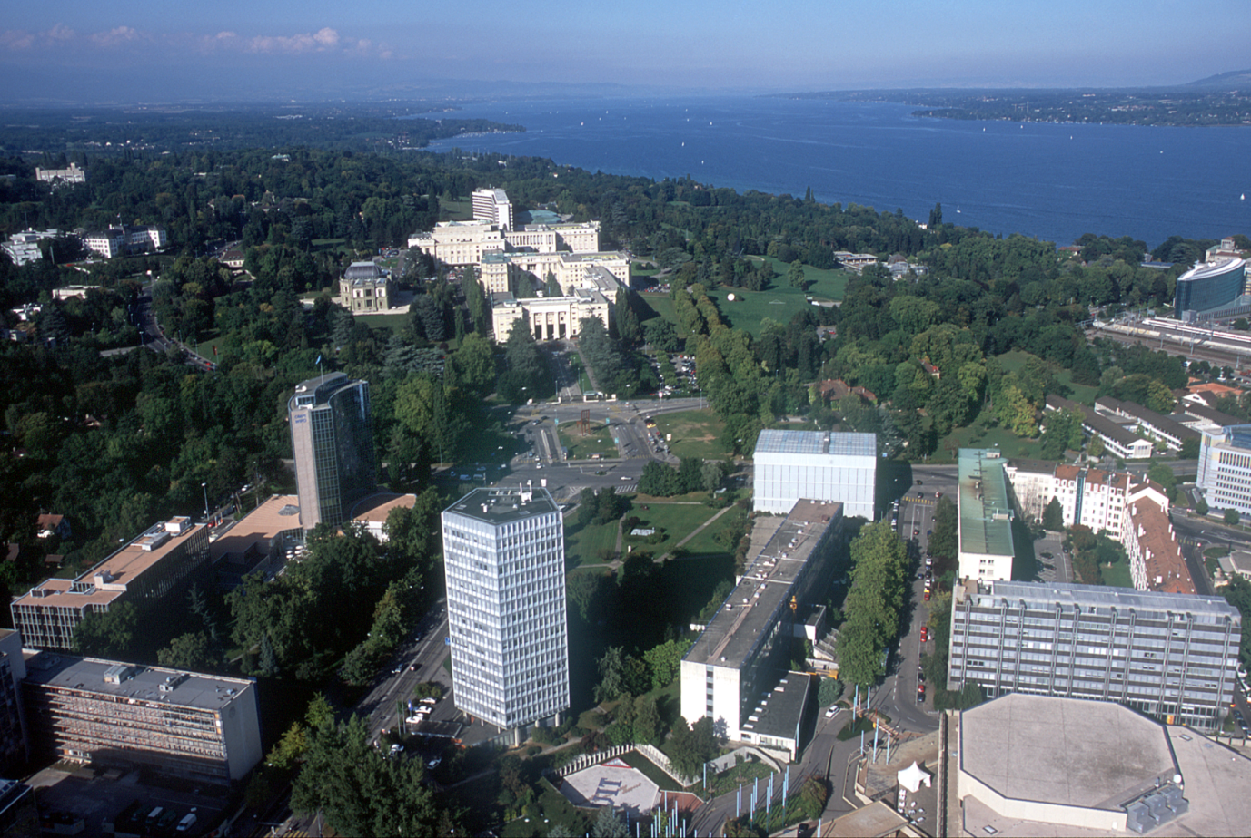
THANK YOU
www.itu.int/en/ITU-T/focusgroups/dfs/.

Slide 17
Working Group Tasks
DFS Ecosystem
  Obtain, review and leverage existing documents on global digital financial service specifications, standards, guidelines (including SG2 in TSAG-TD 158), etc. Some 65 documents related to DFS have been reviewed
  Describe definitions of terminology and taxonomy for digital financial services
  Describe the ecosystem for digital financial services in developed and developing countries and the respective roles and responsibilities of the stakeholders in the ecosystem
  Identify key elements of the ecosystem necessary for financial inclusion
  Establish liaisons and relationships with other working groups; determine need for future ITU-T actions
Interoperability
  develop a working definition of interoperability for digital financial services,
  undertake stocktaking of successful / unsuccessful initiatives for interoperability,
  develop a descriptive paper (which will include amongst others; a definition of interoperability, use cases, and discuss the layers and dimensions of interoperability identified by the working group) and
  develop a toolkit for interoperability.

Slide 18
Working Group Tasks
Technology, Innovation and Competition
  Six workstreams have been established
    Review of DFS Platforms
    Collect handset specifications in use in developing markets
    Collect handset types in use in developing markets
    Security for DFS
    Big data
    Competition Issues
Consumer Experience and Protection
  Develop guidelines for consumer protection for DFS
  Develop guidelines for quality of service in DFS.

