Slide 1
ITU Regional Standardization Forum for Asia-Pacific (Jakarta, Indonesia, 27-28 October 2015)
TELECOMMUNICATION EQUIPMENT CONFORMITY ASSESSMENT IN INDONESIA
Mochamad Hadiyana (hadiyana@postel.go.id),
Deputy Director for QoS and Standardization Cooperation, MCIT Indonesia

Slide 2
Outline of Presentation
Certification Overview
Legal Framework
Conformity Assessment Bodies
Certification Type and Procedure
Certification Label
Post Market Surveillance
Challenges

Slide 3
Certification Overview
Strict “ex-ante regulation”
(ensuring network interoperability, prevention of radio interference, ensuring public safety uniform government certification)
the 3rd party conformity assessment(Government)-led mandatory certification system
Level of harmfulness
Single System
Certification

Slide 4
Legal Framework
Government Regulation Number 50 Year 2000 concerning Telecommunication Provision
Article74:
Minister issues certificate of type approval for telecommunication equipment fulfilling technical requirement based on test report.
Telecommunication equipment testing conducted by accredited test house designated by Minister.
Article 75:
Minister may enter into mutual recognitions of technical requirement implementation aspect of telecommunication equipment with other country.
The mutual recognitions follow prevailing provisions.
Notes:
Government Regulation Number 50 Year 2000 concerning Telecommunication Provision Article 74 stipulates that Minister issues certificate of type approval for telecommunication equipment fulfilling technical requirement based on test report. And only accredited test houses designated by Minister may test telecommunication equipment which will be marketed in Indonesia.
Article 75 of the Government Regulation also stipulates that Minister may enter into mutual recognitions of technical requirement implementation aspect of telecommunication equipment with other country. And, the mutual recognitions must follow prevailing provisions.

Slide 5
Conformity Assessment Bodies
NATIONAL ACCREDITATION COMMITTEE (KAN)
(ISO/IEC 17011)
ACCREDITATION OF
CERTIFICATION
BODY
LABS
ACCREDITATION
INSPECTION
BODY
CERTIFICATION
TESTING/CALLIBRATION
LABS
ISO/IEC 17025
MEDICAL LAB.
ISO 15189
INSPECTION
IBODY
(ISO/IEC 17020)
CERTIFICATION BODY
BSN Guide 401-2000 (ISO/IEC Guide 65)
Pedoman BSN 1001
KAN Guide
801 -2004
ISO/IEC 17024
ISO/IEC 17021
Pedoman KAN 901
CB for
PERSONNEL
LSSM, LSSML, LPPHPL,
LSSMKP (+ ISO/TS 22003),
LSPRO,
LVLK
CB for Organic
CB for HACCP
CB for Ekolabel
Test/Callibration
Report
Inspection
Certificate
Personnel
Certificate
SNI ISO 9001,
SNI ISO 14001,
PHPL,
SNI ISO22000
SPPT SNI,
LK
ORGANIC
HACCP
ECOLABEL
Standard,
Methode
Standard
Standard, Requirement
Personel/
Profession
Industry

Slide 6
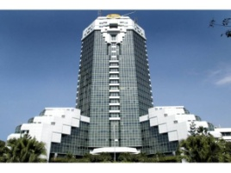
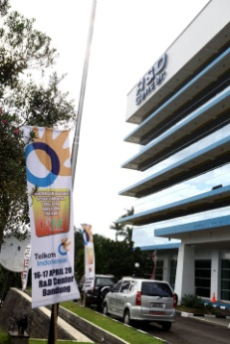
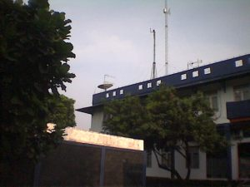
Conformity assessment Bodies
CAB for Certification
Through Ministerial Regulation Number 29 Year 2009 (revised by Number 18 Year 2014) concerning Certification of Telecommunication Equipment, Minister delegates the certification function to Director of Standardization of Directorate General of SDPPI
Director of Standardization accept interconnectivity/interoperability test report from 2 domestic testing laboratories
CAB for Testing
Balai Besar Pengujian Perangkat Telekomunikasi
IDEC of PT Telkom

Slide 7
Certification Type and Procedure
Type
Certification of Conformity (CoC)
(3rd Party certification)
: Equipments causing radio interference or harmful effects on networks or end-user safety
Ex) cell phone, Wi-Fi devices, PSTN terminals
1) Application by supplies
2) Testing by designated test lab
3) Review by certification body
4) Issue of certificate
Procedure
Testing in designated testing lab
Supplier
Apply for Certification
Assessment
Issuance of certificate
Market
In-house testing
Notes:
7

Slide 8
Certification Label
Certification labels are required for every single equipment marketed in Indonesia.
Manufacturer is responsible to produce the label and affixed it into the equipment.
Label must prominently display two components of information: number of certificate and PLG.ID number (application identity number) which can be obtained from the certificate.
Size of label is depending on the size of the equipment and it shall be visible by bare eyes.
In any case that the equipment is not possible to affix the label, the appearance of label in manual book and product packaging is allowable.
Markings and lettering can be of any size or color.

Slide 9
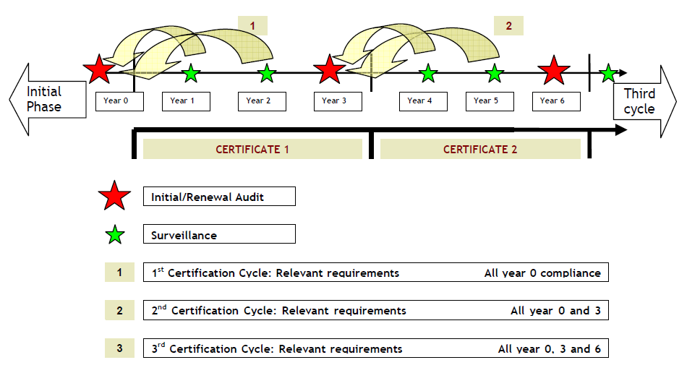
Post Market Surveillance
Post Market Surveillance Principle

Slide 10
Post Market Surveillance
Post Market Surveillance Framework
Overall MS Framework | Testing | Enforcement
Indonesia has MS program for telecommunications equipment. Minister of Communication and Information Technology has issued a ministerial decree concerning post market surveillance in March 2012 The RA and/or CB have the mandate to carry out MS activities. The RA has legal authority to take action when non-compliant equipment is identified. | Indonesia has tested equipment for MS purposes since 2013. It tested for major parameter of technical requirements. However, it does not test equipment for electrical safety, EMC and SAR compliance with a reason that local CBs do not have testing capabilities for electrical safety, EMC and SAR measurements. Testing samples criteria: the manufacturer’s history of compliance; whether the sample comes from a new applicant; new technology; popularity; significant price difference; and potential harm/impact to network or people due to non-compliance 2) Sample size The number of samples to be audited by the RA/CB in a given year is 3 units. | Action taken for non-compliance ranges from:1) request for correctional measures from the supplier/manufacturer, to 2) suspension or revocation of certification or 3) recall of equipment. Further, legal action would include fine not more than Rp. 200 Million (US$ 16,667) or a jail term of not more than 2 years or both.

Slide 11
Challenges
Lack of Resources
Lack of test labs
There are only 2 designated labs with limited scope of testing capability
The test labs concentrated in West Java
There is no designated first party labs
Lack of skilled human resources
Lack of human resource
Lack of technical training
Lack of suitable technical documents
Limited access to standards and their testing methods
Notes:
Although mutual recognition regime creates procedures that facilitate opportunities for mutual learning, technical assistance, and regulatory exchange, Indonesia found obstacles to enter into MRA. Firstly, assessment of mutual compatibility between national system of governance involves a (often highly) political process. Establishment of MRA MoU can be a costly and time consuming process. Secondly, achieving mutual recognition has much more stringent requirements than most standard type approvals. Beside that, testing using foreign technical regulation require high cost training, thus domestic testing laboratories tend to avoid MRA. And, examining the validity of test report is difficult. Tracing the original type approval can be a concern although this can be avoided if thorough documentation is utilized

Slide 12
Challenges
Obstacle to Enter Into MRA
Although mutual recognition regime creates procedures that facilitate opportunities for mutual learning, technical assistance, and regulatory exchange, Indonesia found obstacle to enter into MRA
Assessment of mutual compatibility between national system of governance involves a (often highly) political process
Establishment of MRA MoU can be a costly and time consuming process
Achieving Mutual Recognition has much more stringent requirements than most standard type approvals
Lack of conformity assessment infrastructure – CABs, technical regulation, accreditation body, etc
Testing using foreign technical regulation require high cost training
Domestic testing laboratories tend to avoid MRA
Low priority in work plan to implement
Examining the validity of test report is difficult
Tracing the original type approval can be a concern although this can be avoided if thorough documentation is utilized
Notes:
Although mutual recognition regime creates procedures that facilitate opportunities for mutual learning, technical assistance, and regulatory exchange, Indonesia found obstacles to enter into MRA. Firstly, assessment of mutual compatibility between national system of governance involves a (often highly) political process. Establishment of MRA MoU can be a costly and time consuming process. Secondly, achieving mutual recognition has much more stringent requirements than most standard type approvals. Beside that, testing using foreign technical regulation require high cost training, thus domestic testing laboratories tend to avoid MRA. And, examining the validity of test report is difficult. Tracing the original type approval can be a concern although this can be avoided if thorough documentation is utilized

Slide 13
Challenges
Possible Solution
Designate first party testing labs
Establish regional testing labs
Recruit suitable human resources for testing and certification
Increase participation in technical training, on the job training, on the job experience
Based on Ministerial Decree concerning Certification, our current equipment type approval process does allow for recognition of foreign test report and conformity assessment without having to formally engage on ATRC MRA.
Entering into bilateral MRA with very crucial scope (EMC, electrical safety, green ICT)
Establishing joint committee with other countries in case there is no MRA

Slide 14
Thank You

