Slide 1
ITU Regional Standardization Forum for Asia-Pacific Region
Conformance and Interoperability: Regional Assessment Studies
27-28 October 2015
Jakarta, Indonesia,
Sameer Sharma
Senior Advisor, ITU Regional Office, Bangkok
Notes:
1

Slide 3
WTDC-14 outcomes on C&I
The Dubai Declaration recognized that conformance and interoperability of telecommunication/ ICT equipment and systems can increase market opportunities and reliability and encourage global integration and trade.
Resolution 47 was amended, reaffirming the importance of collaboration and coordination between the three ITU Bureaux in implementing the ITU C&I programme.

Slide 4
WTDC-14 outcomes on C&I
Study Group Question 4/2, mandate:
“Studies of various issues related to conformance and interoperability are to be reported, and among others the description of the technical, legislative and regulatory framework that would be needed to implement appropriate C&I programmes by developing countries. Specifically, the following outputs are envisaged:
a) Harmonized Guidelines on technical, legal and regulatory aspects of C&I Regime;
b) Feasibility studies regarding establishment of laboratories in different C&I Domains;
c) Guidance on the framework and procedures to establish MRA;
d) C&I Regimes, case studies established at national, regional or global levels;
e) Development of a methodology for assessing the situation of C&I regimes in place in the regions (or sub regions);
f) Experience sharing and case studies reports on C&I programmes implementation.”

Slide 5
WTDC-14 outcomes on C&I
Outcomes of Objective 2, Output 2.2 of the Dubai Action Plan, focusing on the following issues:
a) Educating technicians, policy-makers and businesses on the importance of C&I procedures and testing, mobilizing the resources required to implement regional and national C&I programmes, in cooperation with other relevant regional and international organizations;
b) Providing assistance to developing countries in the establishment of national, regional or subregional C&I programmes, and conducting assessment studies for facilitating the establishment of common conformance and interoperability regimes at national, regional and subregional level;
c) Preparing guidelines on this process which outline the technical and human resources required and the international standards to be applied.

Slide 6
In-country C&I Test Lab
To encourage Member States to establish their own National C&I Test Laboratories. The ITU can provide the necessary Technical Assistance upon request from Member States.
The implementation of a Mutual Recognition Agreement (MRA) in the region may take time. A possible approach would be to start deploying In-Country (national) C&I Test Labs in Member States in order to build capacity and know how in the area of instrumentation, lab management, quality and instrumentation purchasing process (quality and instrumentation maintenance)
This may lead to Member States developing these National C&I Test Labs becoming references for their respective technology (domain) testing area in the Region.

Slide 7
Selection Criterions for National C&I Lab
Notes:
Table may be used as a guide for the selection of the technology (domain) testing area for the National C&I Labs. The Table provides indicative office floor requirements and cost factors.

Slide 8
C&I Regional Assessement Studies
C&I infrastructure in regions/sub-regions/countries are being assessed
Analysis of the status in the regions are being conducted
Looking for promoting regional agreements about possible locations for resources (Labs), agreements and testing capabilities
Close collaboration with regional experts in addressing capacity building activities, accreditation and type approval testing.
Moving forward to establishing regional test centers and/or MRAs as appropriate

Slide 9
C&I Regional Assessment Studies
Roadmap
Conformity Assessment Bodies will contribute with an orderly telecom apparatus market place
Once standards and procedures are in place, test labs and/or MRAs can approve equipment for compliance
Sharing test labs resources and using same procedures amongst countries and regions, lowers overall costs while continues addressing regional priorities
Setup of a robust framework (base on international procedures – ITU, ISO, IAF, ILAC, etc.) needed for trust and confidence in test results and among test labs

Slide 10

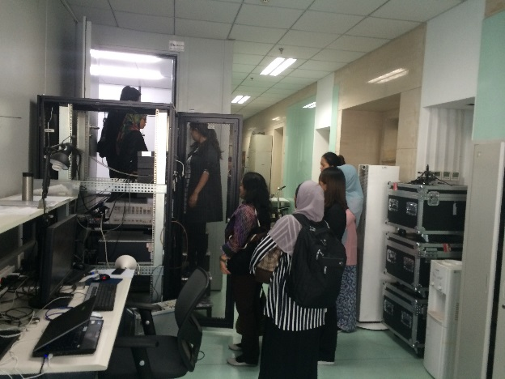
China Telecommunication Technology Labs(CTTL)
China Telecommunication Technology Labs (CTTL), founded in 1981, was named under the authorization of the Ministry of Information and Industry Technology (MIIT) and the State General Administration for Quality Supervision, Inspection, and Quarantine (AQSIQ).
Current CTTL is administrated by China Academy of Information and Communication Technology (CAICT).
CTTL is a leading high-tech laboratory on the combined missions of information communication technology development, information communication product standards and test methods research, telecommunication metrology standards and methods research, products inspection, verification and technical assessment as well as testing instruments methodology and evaluation of communication software.

Slide 11
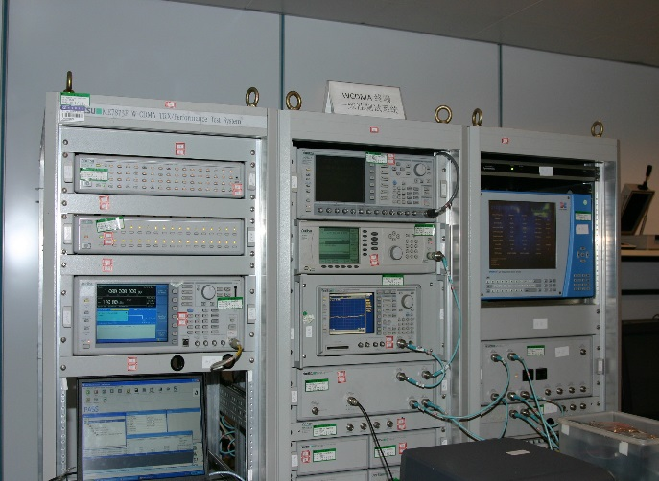
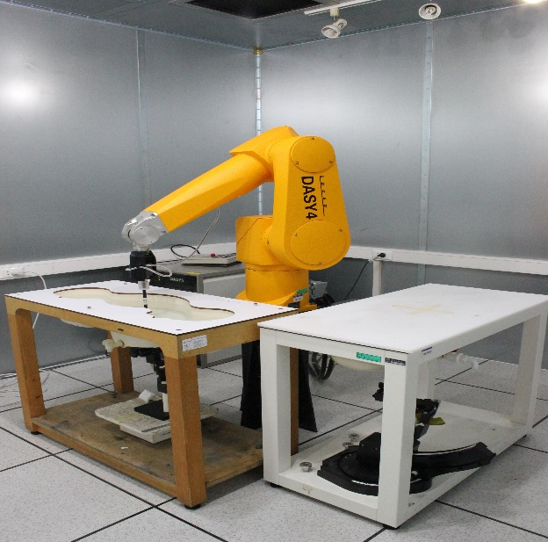
China Telecommunication Technology Labs (CTTL)
The development strategy of CTTL is located in the field of electronic information communication industry, based on the research of telecommunications engineering technology with also related fundamental theory, guided by the national and international telecommunication markets demand. CTTL provides comprehensive services and support to the government departments, network operators, product designers and manufacturers.
The main task of CTTL includes researching on the electronic communication information technology, setting the relevant standards, carrying out the technical feasibility and the standards compliance technology experiment and test.

Slide 12
China Telecommunication Technology Labs(CTTL)
CTTL has established its quality system according to the ISO/IEC 17025 and achieved successfully accreditation certificates both from the China National Accreditation Service for Conformity Assessment (CNAS) and foreign accreditation bodies (e.g. DakkS, Germany).
The Accredited scope of the laboratories covers various electronic information communication products including all kinds of telecommunication terminals, accessing equipment, transmission equipment, exchange, IP network equipment, multi-media communication equipment, gateway, server, electronic chips, automobile electronics, cable, power supply equipment as well as their reliability, seismic, energy conservation and environmental protection, hazardous substances testing, electrical safety and electromagnetic compatibility (EMC).
CTTL has become an advanced national base in large scale with integrated function for electronic information communication equipment testing and inspection as well as metrology and calibration of measuring instruments, providing open services to manufacturers and other clients both nationwide and worldwide. CTTL is a designating test laboratory for implementation of APEC-TEL-MRA and also the location of the Secretariat for APEC TEL MRA Working Group in China.

Slide 13
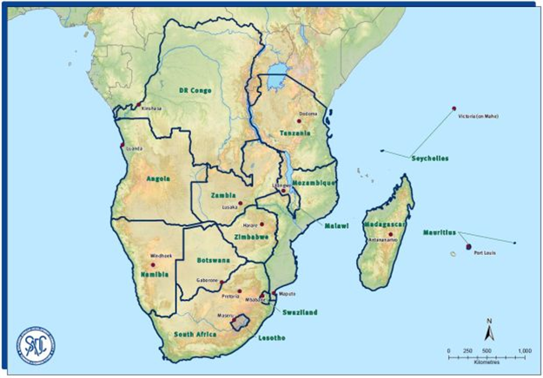
C&I Regional Assessment Studies
Calendar
Assessment Study for SADC Region completed 2014)
  The results of the Assessment Study have been presented during the Subregional Workshop for SADC (Southern African Development Community), 13-15 October 2014, Livingstone (Zambia)
Final Report
Survey Findings
Outcomes of the Workshop for SADC, Livingstone, Zambia, 13-15 Oct, 2014
  Recommendations: In Country C&I Test Lab
  Criteria for selecting countries for establishing regional test centres
  Proposed plan for a SADC framework MRA
  Media ​statement on the meeting of SADC Ministers Responsible for Communications, Postal and ICTs. Mangochi, Malawi,​ 21 November 2014​​

Slide 14

Assessment Study for Maghreb countries
Mauritania, Morocco, Algeria, Tunisia, Libya (completed 2014)
The results of the assessment study have been presented during the Subregional Workshop for Maghreb Countries, Tunis 9-11 Dec 2014
  Assessment Study for AMS (Caribbean) conducted in 2014, Assessment Studies for AMS (Central America) and AFR (EAC countries) are being conducted during 2015
Final Report
Survey Findings
Outcomes of the workshop for Maghreb, Tunis 9-11 December 2014
    Recommendations: In Country C&I Test Lab
    Criteria for selecting countries for establishing regional test centres
    Proposed plan for a Maghreb framework MRA

Slide 15
Follow-up of Assessment Study for Maghreb
Joint declaration signed between ITU Regional Office of Cairo and UMA the Secretariat General of the Arab Maghreb Union (UMA) for collaboration and support to Maghreb countries for establishing a common MRA
First meeting of C&I Expert Committee for Maghreb, Rabat (Morocco), 23-25 November 2015

Slide 16
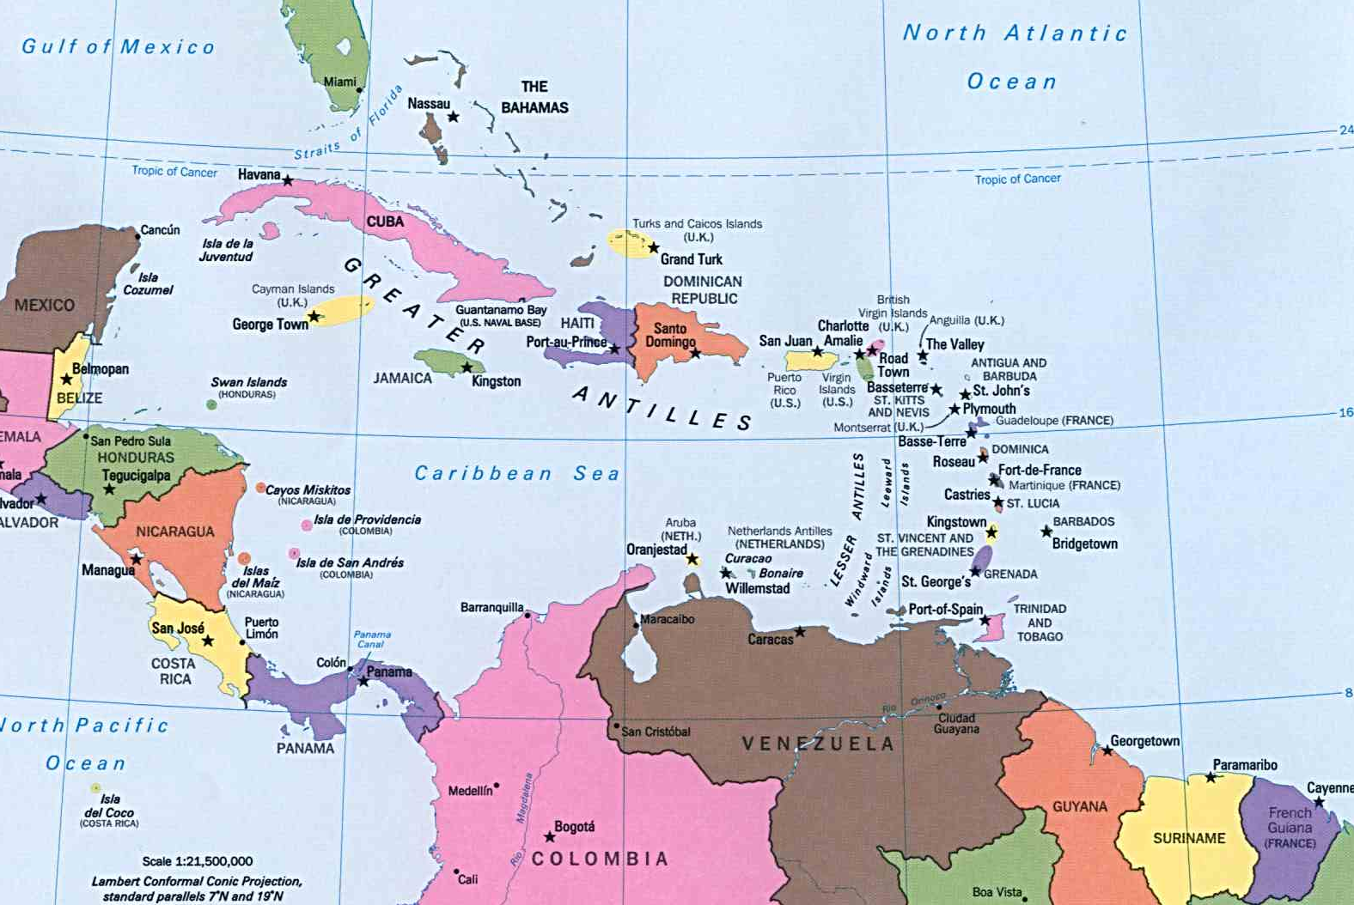
Assessment Studies for the Caribbean
  The results of the first assessment were presented during the ITU C&I Workshop for Caribbean (2-4 December 2014, in St. Augustine, Trinidad and Tobago)
Assessment Study on C&I for the Caribbean
Report
Outcomes

Slide 17
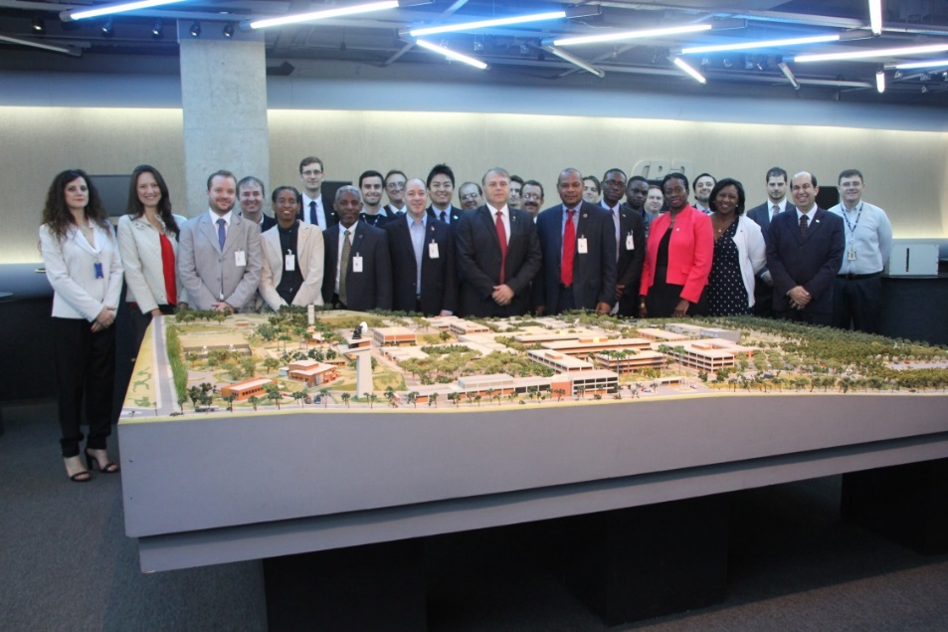
Follow-up of Assessment Study for the Caribbean
  As one of the results of the assessment and workshop held for the Caribbean was the cooperation between an ITU Academia member, CPqD with Caribbean countries in regard to homologation and testing procedures. A high level Caribbean mission visited the laboratories of the CPqD in Campinas, Brazil, during the C&I training for the region in June 2015

Slide 18
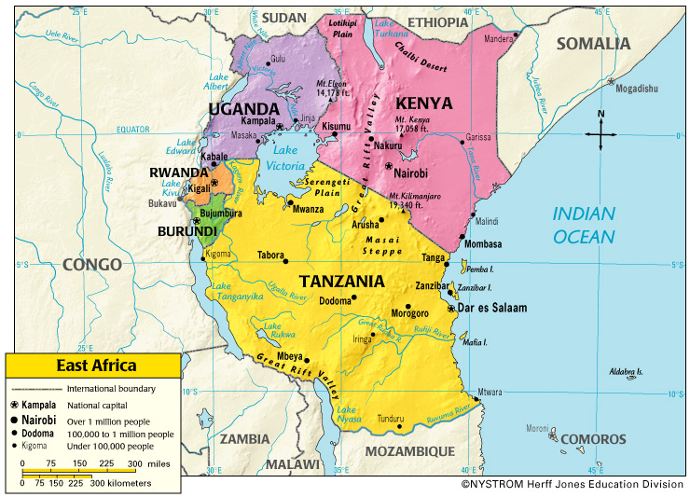
Assessment Studies for EAC countries:
The East African Community (EAC) is the regional intergovernmental organization of the Republics of Burundi, Kenya, Rwanda, the United Republic of Tanzania, and the Republic of Uganda, with its headquarters in Arusha, Tanzania. (ongoing 2015)
The results of the assessment study were presented during the Subregional Workshop for EAC countries, Nairobi 21-23 October 2015

Slide 19
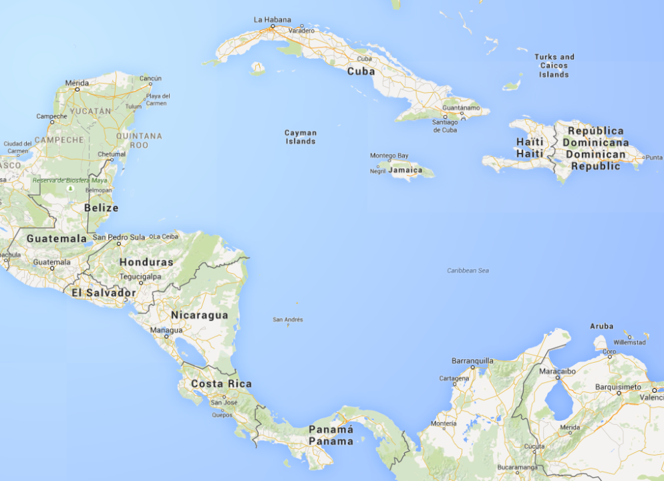
Assessment Studies
Assessment Studies for Central America
The results of the first assessment will be presented during the ITU C&I Workshop for Central America Managua, Nicaragua, 10-12 November 2015
Costa Rica
El Salvador
Guatemala
Honduras
Nicaragua
Panama
Dominican Republic
+
Cuba

Slide 20
Other C&I Related activities in the Americas region
The ITU Americas Regional Office is supporting ITU C&I Initiative by promoting discussion opportunities in regional fora and events:
Regional Standardization Forum
A whole Session will be dedicated to ITU C&I Initiative
Event was orgnised on 21 September 2015 at CITEL Headquarters in Washington D.C., United States
2. ITU Workshop on Strategic Broadband Infrastructure for development for the Americas
Jointly organized with the Brazilian Regulator, it will take place from 26 to 29 October 2015, in Sao Paulo, Brazil, during the FUTURECOM Exposition

Slide 21
ITU : I Thank U

