Slide 1
ITU Regional Standardization Forum for Asia-Pacific (Jakarta, Indonesia, 27-28 October 2015)
Pushing the Regional Cooperation and Development of EMC Compliance Testing – CAICT
Pengfei Qu (Phil), qupengfei@caict.ac.cn
Chief Engineer of EMC Lab, CTTL-Terminals
China Academy of Information and Communications Technology (CAICT)

Slide 2
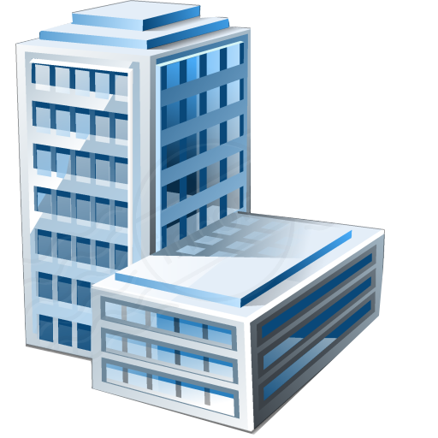
CAICT Profile
Founded in 1957
2400+ employees
A research institute of MIIT, PRC
Headquarters in Beijing
Branches
Government decision support
Change from CATR to CAICT in 2014
Secretariat of ITU Working Committee in China
Shanghai
Chongqing
Shenzhen
Guangzhou
Baoding
Consulting
Special national program
Supervision support
Test & Cert.
C&I Testing Center in Asia- Pacific Region
Centre of Excellence
Notes:
1. The only one national institute on information and communications, especially on telecommunications.
2. Over 8 locations in Beijing, 5 branches all over China. Three branches have similar business scope as the headquarters, there are in Shanghai (east of China), Chongqing (west of China) and Shenzhen (south of China). Other two branches locate in Guangzhou and Baoding, which have special research and business on intelligent city and seismic resistance.
3. For example, our institute drafted the well-known internet plus policy in China.

Slide 3
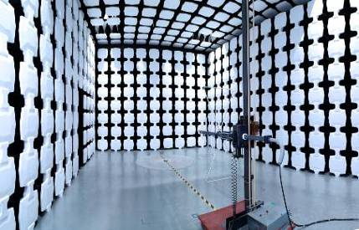
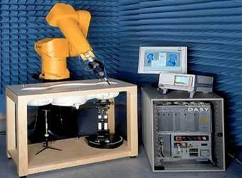
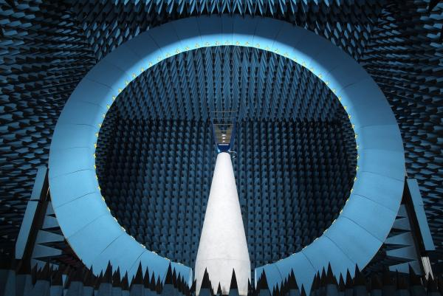
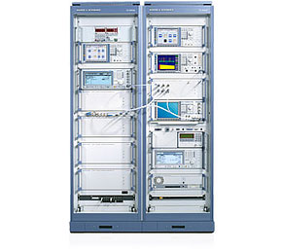
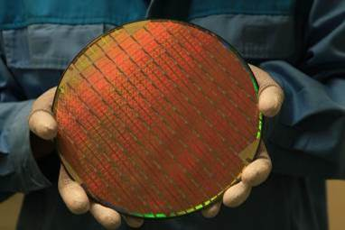
CAICT Profile – CTTL
CTTL – Brand of CAICT’s testing labs
Labs in 6 cities (13 locations)
Over 1000 employees, over 190 senior engineers
Using same ISO 17025 quality system
China Telecommunication Technology Labs
Some featured labs
EMC SAR OTA RF/Protocol IC/SOC APP&IFS

Slide 4
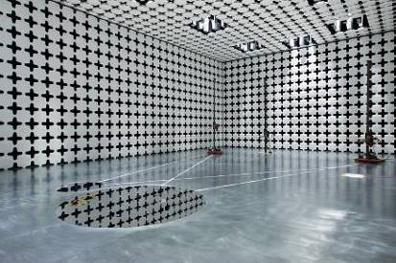
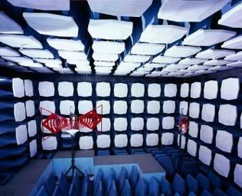
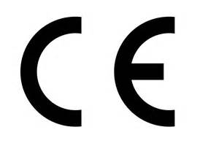
CAICT Profile – EMC Labs
Establishing EMC labs since 1999
7 Labs in
4 Cities
9 chambers
Incl.
10m SAC
60+
Employees
ISO 17025
Accredited

Slide 5
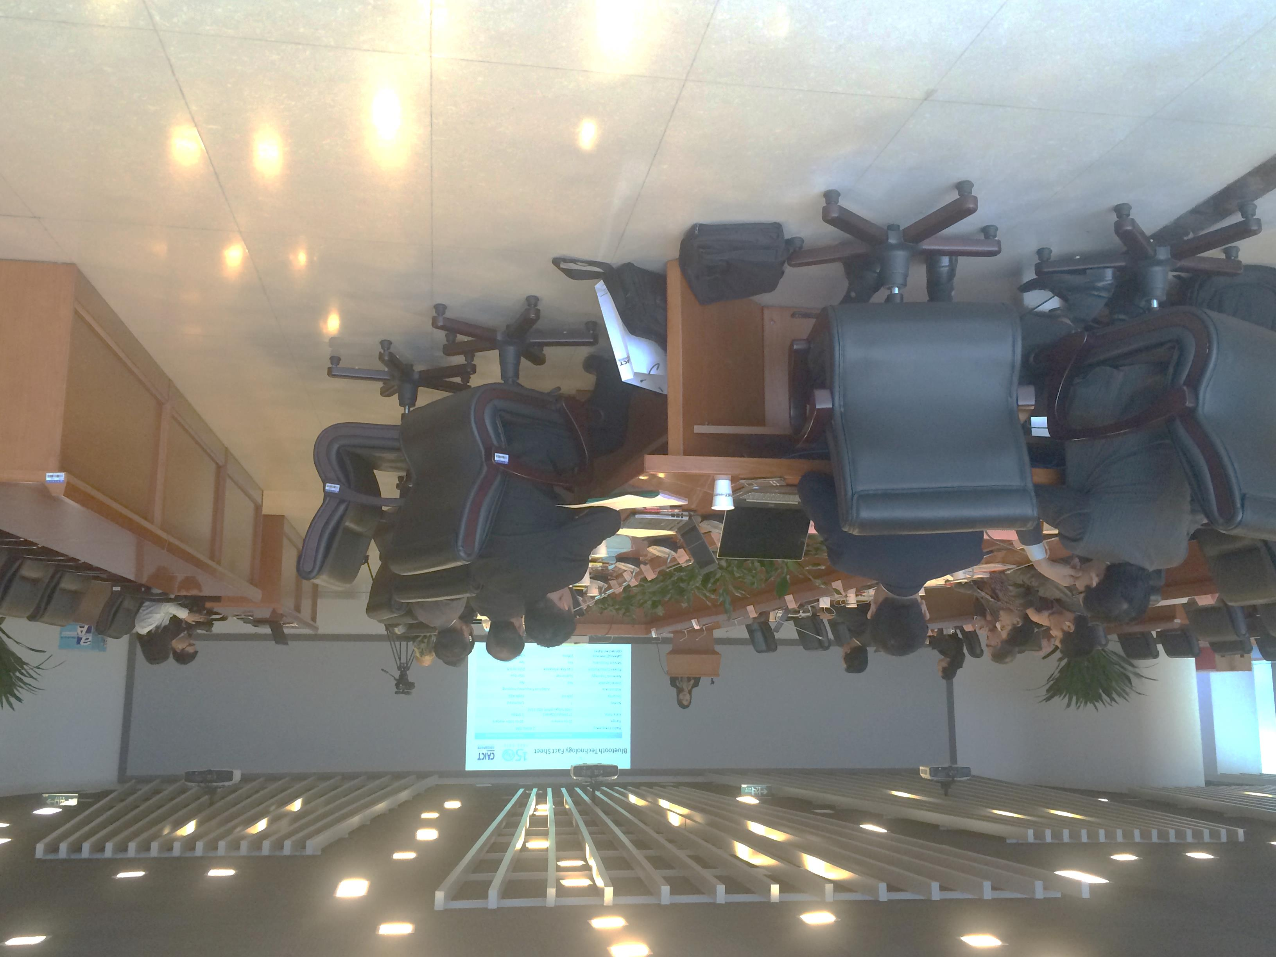
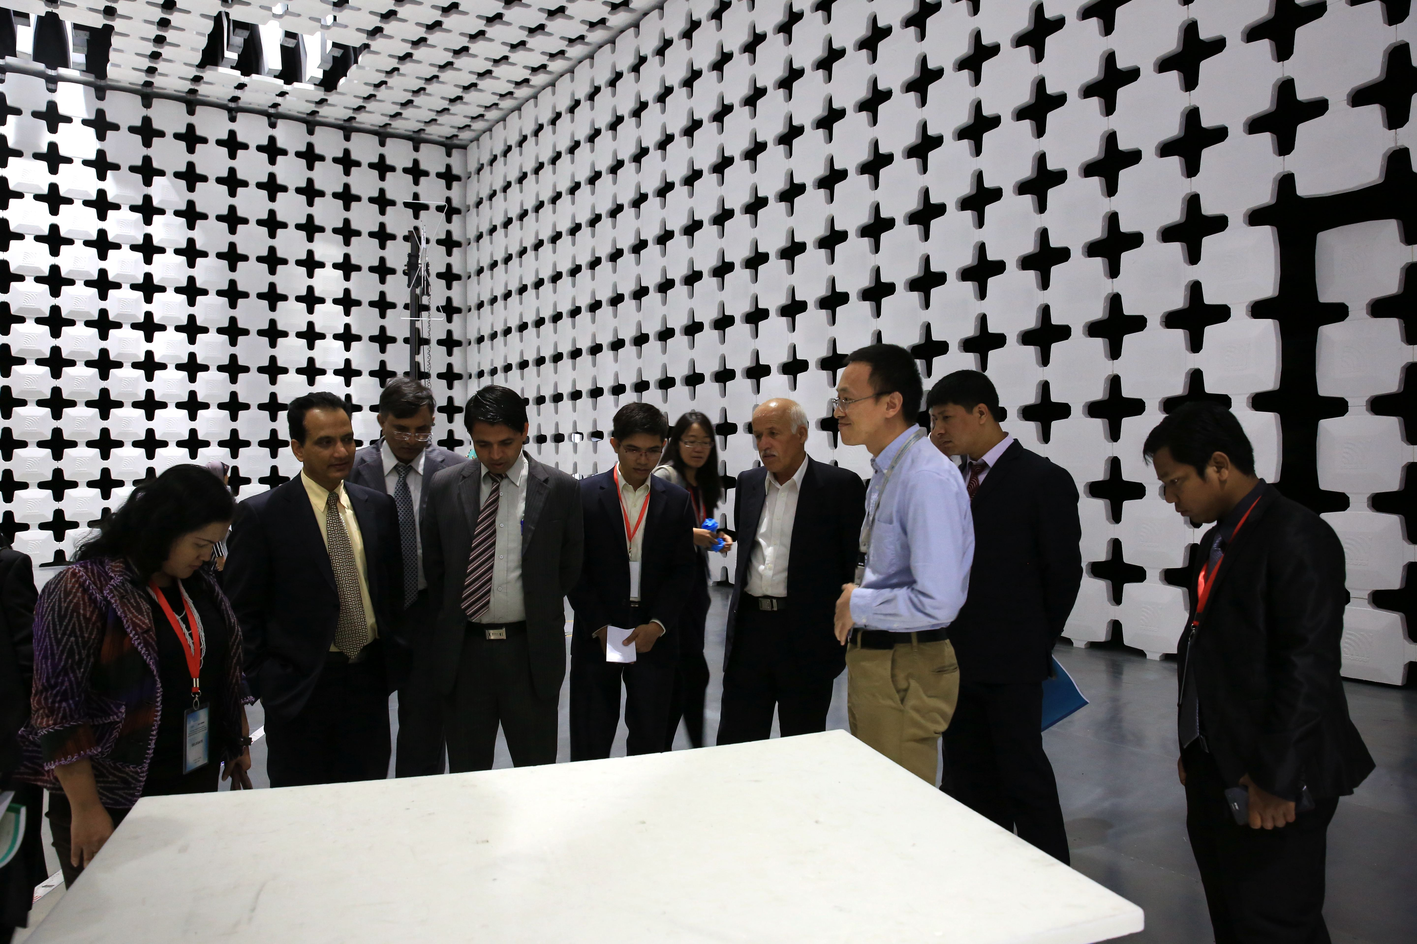
Proposals for pushing regional EMC cooperation
Support ITU standardization work
Information sharing (regular / telephone / online meetings, mail list, instant message group,…)
Inter-lab or round robin comparison tests
System calibration and site validations
Test scope complementation
Share training course
ITU Asia-Pacific Centre of Excellence Training
Notes:
Develop more ITU standards for ITU C&I program.

Slide 6
EMC Conformity Assessment Overview
Assurance of conformity to specific requirements
Conformity
1 Manufacturer Initiative
Better quality, services..
4 Final User Initiative
Problems, Disputes
2 Government Initiative
EM Environment, Safety
CE/FCC/CCC..
3 Industry Initiative
C&I
GCF/PTCRB…

Slide 7
EMC Conformity Assessment Overview
Conformity Assessment Architecture
Country/Region B
Country/Region A
MRA
Government
Laws/Directives
Cert. Body
Impl. Rules
Testing Labs
Standards
Manufacturers
Government
Laws/Directives
Cert. Body
Impl. Rules
Testing Labs
Standards
Manufacturers
Accreditation
Body
Accreditation
Body
Open or signed
Open or signed
Standardization
Body
Standardization
Body
International standardization bodies and manufacturers are the foundation and initiative.
Notes:
Note:
In some cases, the government may not be a part of this structure. In other cases, the government may manage the certification directly.
Some certification bodies may accept reports from foreign labs without MRA.

Slide 8
EMC Standardization Organization Overview
International EMC Standardization Organizations
IEC
ITU
ISO
IEEE
3GPP
TC77
SC-A
SC-B
SC-C
ITU-R
SGs
…
TC22
SCs
…
CISPR
CIS/A
CIS/B
CIS/D
CIS/F
CIS/H
CIS/I
ITU-T
SGs
…
Other TCs
SCs
…
Regional EMC Standardization Organizations
CEN CENELEC ETSI ANSI
National/Industry/Company EMC Standardization Organizations
Other TCs
Notes:
In most cases, the compliance means conformity to a specific standards. This page reviews the main EMC standardization organizations.
TC22: ISO 11452 series, ISO 7637, ISO 10605 series.
Tracing these standards is important and very time/money consuming.

Slide 9
Key points of establishing an EMC lab
Steps of establishing an EMC lab
Plan
Industry, Budget
Start Building Test Sites
Purchasing Instruments
Setup Quality System
System Integration
Validating Test Sites
Training
Complete SOPs
Audit
Got Accreditation
Commercial Operation

Slide 10
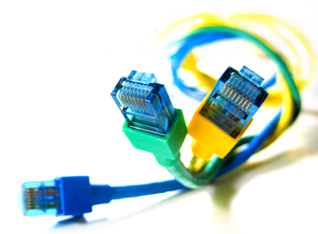
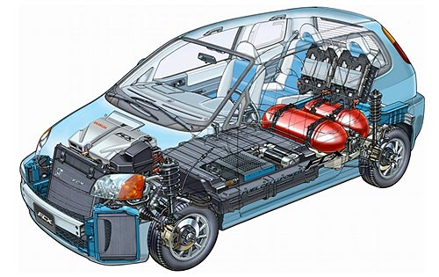
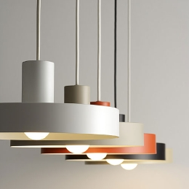
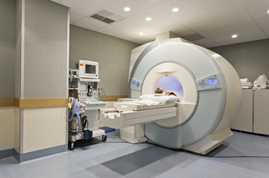
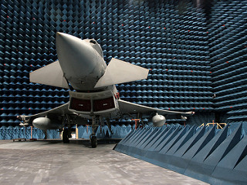
Key points of establishing an EMC Lab
Which industry will you consider?
Investment
Lab flexibility
Notes:
First decision is which industry will you concern.
Of course we will choose telecommunication industry,
EMC characteristics for each industry
IT or consumer electronics. Wireless communication need some call boxes;
2) Household appliance
3) Luminaire industries
4) Automobile: If you want to test some components
If you want to test a car, you will need the chassis dynomometer
5) Military / defense industries
6) Medical devices
7) Train (power consideration)
8) Electricity (power consideration)

Slide 11
Key points of establishing an EMC Lab
Small EUT, lower test level, single phase, no backup
Cost estimation for a communication EMC Lab
Test Item | Facilities | Basic Coverage (Asset in k€ ) | Full Coverage (Asset in k€ )
Radiated emission | 3m/10m chamber, ant-mast Receiver, antennas, pre-amp | 635 | 1630
Conducted emission | Shielded room, AMN and ISNs Receiver | 128 | 185
Harmonic Current, Flicker | Power source, power analyzer | 50 | 86
Radiated immunity | 3m FAR, antenna, SGs, AMPs, Field probes, power meter/probe. | 567 | 817
Conducted Immunity | Shielded Room, all-in-1 equipment or (SIG, AMP, CDNS, power meter) | 64 | 114
EFT, Surge, Dips, PFM | EFT/Surge GEN, Power source, ESD Gun, H-antenna, oscilloscope | 93 | 114
Additional for wired tests | Call simulators, Ethernet tester | 114 | 142
Additional for wireless tests | Cellular call box, audio analyzer, call box for SRD technologies | 257 | 500
Assets of CTTL EMC BJ
main lab: 8.8 million €
1651or 1908 | 3588
Notes:
Note: Building/house rent cost is not included.

Slide 12
Key points of establishing an EMC Lab
Important technical documents required by ISO 17025
Procedures
Practical implementation of a standard in the lab
In most cases, one procedure for each generic standard is enough. The procedure of product standard may refer to these generic procedures
Some product category may need specific procedure
Measurement uncertainties
Necessary for all EMI measurements
Inclusion in test report as required by most standards
Better to be lower than Ucispr
Future: may affect the limits.
Reference documents: CISPR 16-4-2, UKAS LAB 34

Slide 13
Key points of establishing an EMC Lab
Important technical documents required by ISO 17025
Measurement traceability
Choose ISO 17025 accredited calibration labs
Understanding principle of calibration (key parameters tracing up to national or international standard/organization, review of calibration report)
Prepare traceability chart for audit
Instrument based
Intermediate check
Verify calibration status between calibration intervals (1 year typically)
Need procedures and verification reports as well

Slide 14
Key points of establishing an EMC Lab
What kinds of chamber will you consider?
Conventional: OATS, SAC, FAR, TEM
Good news for ICT products
CISPR 32 allows the use of FAR as alternative choice of SAC
CISPR 35 will be published in 2016:
Adopted low-cost TEM waveguide and reverberation chamber as the alternative test site as the conventional FAR.
Bad news for all products affected by CISPR
CISPR 16 will limit the size of EUT
Quiet zone/test volume is not as important as before
EUT size(3m distance): within 1.5m(diameter)*1.5m(height)
EUT size(10m distance): within 5m (diameter)*3m (height)
Don’t waste money on unnecessary test volume!
Notes:
If you have enough budget, please choose SAC. The SAC is still the most popular one, especially for FCC.

Slide 15
Key points of establishing an EMC Lab
How do you know a test site is qualified?
OATS/SAC
Emission:
30MHz-1GHz: NSA (per CISPR 16-1-4, ANSI C63.4)
>1GHz: Svswr (per CISPR 16-1-4)
Immunity: FU (per IEC 61000-4-3)
FAR
Emission: FS-NSA (per CISPR 16-1-4)
Immunity: FU (per IEC 61000-4-3, IEC 61000-4-22)
Shielded Room and all chambers with shielded enclosure
Shielding effectiveness (per EN 50147, IEEE 299, GB/T 12190)
Special calibrated instruments required!

Slide 16
Key points of establishing an EMC Lab
How do you know your EMC test system works properly?
Emission Measurement
Inter-lab comparison, proficiency testing / measurement audit
System verification (comb gen, golden sample, ..)
Immunity test
System verification
Remain instruments’ traceability
Perform calibration in time
Intermediate checks

Slide 17
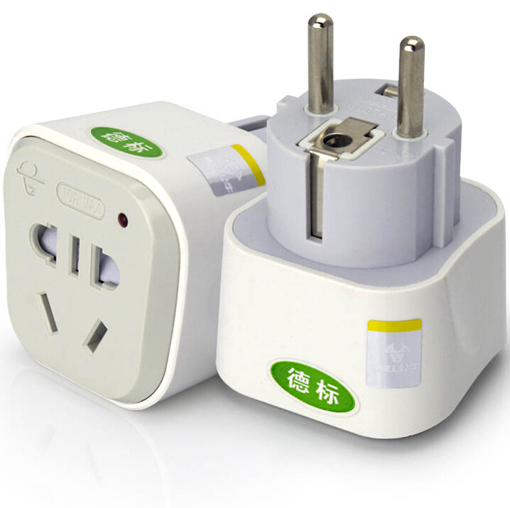
Key points of establishing an EMC Lab
How do you consider your power distribution system?
Current
Consider the max power consumption of potential EUT
Voltage and frequency
EUT
Local
International:
110V/120V/220V/230V/240V, 50Hz/60Hz
Programmable power supply preferred
Instruments: voltage stabilized source preferred
Separate the equipment/EUT power supplies
Try not to use a socket converter
Notes:
Aircraft EMC: 400Hz AC required.

Slide 18
Key points of establishing an EMC Lab
Some radiated test issues
Let the SAC and FAR close to each other. Share radiated immunity test system.
Choose antenna mast support tilting function to reduce the measurement uncertainty and meet FCC requirements
Reserve more space below turntable:
AMN for mains
VHF LISN for other cables
Put some ancillary equipment right below the turntable

Slide 19
Key points of establishing an EMC Lab
Some methods to improve efficiency
Dual antenna masts
For broad bands sweeping, using two antennas
In the same band, test two polarizations at the same time
NOTE: Consider them in site validation
Using latest Time-Domain test receiver
Using multi-tone immunity test system
Antennas should be bought in pairs
For backup during calibration (oversea..)

Slide 20
Key points of establishing an EMC Lab
Some additional customized features:
Reserve spaces/waveguides for future connection from the turntable to the control room
Reserve a video socket (e.g. VGA) from chamber to receiver
Engineers can see the results when they modify the EUT or test setup on extended displays (projector or LCDs) inside the chamber
Install access control system on all doors to improve the confidential level
Notes:
Your never know what kinds of cable of your next EUT and what kind of protocol it runs.

Slide 21
Key points of establishing an EMC Lab
Cautions of using some instruments/tests:
Pre-amplifier: Easily damaged by the transient interference when plugging into a socket or ESD
Turntable: Weekly or monthly maintenance recommended
In-situ tests
UPS/stabilized voltage supply preferred either in the lab or in-situ test
Good cooling and ventilation facility for racks and amplifiers
Keep enough space for heat dissipation
Antennas: all antennas should be handled carefully
Avoid overloading of receiver, spectrum analyzer, pre-amplifier: estimate and make good preparations.
Notes:
Antenna: Check the mechanical connection of the resonant elements.

Slide 22
Q&A
Pushing the Regional Cooperation and Development of EMC Compliance Testing – CAICT
qupengfei@caict.ac.cn
+86 10 62304633 ext 2031

