Slide 1
ITU Regional Standardization Forum for Asia-Pacific
(Jakarta, Indonesia, 27-28 October 2015)
BBPPT LABORATORY ROAD
Dodik SUDIYONO,
Technical Facilities Division, BBPPT,
DG SDPPI, MCIT
dodi002@kominfo.go.id
Notes:
Thank you very much
In this opportunity I would like to delivery the presentation in the ITU Regional Standarisation Forum for Asia-Pacific
With the title BBPPT Laboratory Road
Let me Introduce myself
My name is Dodik Sudiyono you can call me dodi as in email
I responsible for the Technical laboratory facility in BBPPT since 2012, it almost 3 year 8 month

Slide 2
Overview of BBPPT
ESTABLISHED BY THE NAME OF TELECOMMUNICATION DEVICE TESTING CENTER ON MAY 17th 1999 BASED ON MINISTRY OF TRANSPORTATION REGULATION NO.62 YEAR 1998 CONCERNING THE STRUCTURE AND ORGANIZATION OF TELECOMMUNICATION AND DEVICE TESTING CENTER
ORGANIZATIONAL STRUCTURE CHANGES, FROM DIRECTORATE GENERAL OF POST AND TELECOMMUNICATIONS UNDER THE DEPARTMENT OF TRANSPORTATION TO BE THE DEPARTMENT OF COMMUNICATION AND INFORMATION IN 2005, TELECOMMUNICATION DEVICE TESTING CENTER UNDER THE DEPARTMENT OF COMMUNICATIONS AND INFORMATION.
IN 2007, BASED ON MINISTER OF COMMUNICATION AND INFORMATION REGULATION NO.20/PER/M.KOMINFO/4/2007 CONCERNING THE ORGANIZATION AND WORK PROCEDURES OF CENTER OF TELECOMMUNICATION AND DEVICE TESTING CENTER,
  TESTING DEVICES TELECOMMUNICATIONS CENTER INCREASE THE STATUS TO BE EXAMINATION GATER OF TELECOMMUNICATION EQUIPMENT.
Notes:
May be some audience already know about BBPPT
I try to recall again about BBPPT as Test House
ESTABLISHED BY THE NAME OF TELECOMMUNICATION DEVICE TESTING CENTER ON MAY 17th 1999 BASED ON MINISTRY OF TRANSPORTATION REGULATION NO.62 YEAR 1998 CONCERNING THE STRUCTURE AND ORGANIZATION OF TELECOMMUNICATION AND DEVICE TESTING CENTER
ORGANIZATIONAL STRUCTURE CHANGES, FROM DIRECTORATE GENERAL OF POST AND TELECOMMUNICATIONS UNDER THE DEPARTMENT OF TRANSPORTATION TO BE THE DEPARTMENT OF COMMUNICATION AND INFORMATION IN 2005,
After that
TELECOMMUNICATION DEVICE TESTING CENTER UNDER THE DEPARTMENT OF COMMUNICATIONS AND INFORMATION.
IN 2007, BASED ON MINISTER OF COMMUNICATION AND INFORMATION REGULATION NO.20/PER/M.KOMINFO/4/2007 CONCERNING THE ORGANIZATION AND WORK PROCEDURES OF CENTER OF TELECOMMUNICATION AND DEVICE TESTING CENTER,
TESTING DEVICES TELECOMMUNICATIONS CENTER INCREASE THE STATUS TO BE EXAMINATION GATER OF TELECOMMUNICATION EQUIPMENT.

Slide 3
Legal Framework Implementing Conformance Test
LAW OF REPUBLIC INDONESIA NO. 36/1999 CONCERNING TELECOMMUNICATIONS (ARTICLE 32 SECTION 1 & 2)
GOVERNMENT REGULATION NO.50/2000 CONCERNING TELEKOMUNICATIONS PROVISION (ARTICLE 74)
  Article74:
    Minister issues certificate of type approval for telecommunication equipment fulfilling technical requirement based on test report.
    Telecommunication equipment testing conducted by accredited test house designated by Minister.
GOVERNMENT REGULATION NO.07/2009 CONCERNING PRICES OF STATE REVENUE THAT APPLY TO DEPARTMENT OF COMMUNICATION AND INFORMATION TECHNOLOGY (Jo pp NO.76/2010 REGARDING AMANDEMENTS TO REGULATION NO.07/2009)
REGULATION OF THE MINISTER AND COMMUNICATION AND INFORMATION NO. 29/PER/M.KOMINFO/9/2008 CONCERNING CERTIFICATION OF TELECOMMUNICATION EQUIPMENT AND DEVICES (ARTICLE 14 – 24)
STRENGTEN REGULATION OF THE MINISTER COMMUNICATION AND INFORMATION NO.18/2014 CONCERNING CERTIFICATION OF TELECOMMUNICATION EQUIPMENT AND DEVICES (ARTICLE 7 – 16)
Notes:
Legal Framework Implementing Conformance Test
LAW OF REPUBLIC INDONESIA NO. 36/1999 CONCERNING TELECOMMUNICATIONS (ARTICLE 32 SECTION 1 & 2)
GOVERNMENT REGULATION NO.50/2000 CONCERNING TELEKOMUNICATIONS PROVISION (ARTICLE 74)
Article74:
Minister issues certificate of type approval for telecommunication equipment fulfilling technical requirement based on test report.
Telecommunication equipment testing conducted by accredited test house designated by Minister.
GOVERNMENT REGULATION NO.07/2009 CONCERNING PRICES OF STATE REVENUE THAT APPLY TO DEPARTMENT OF COMMUNICATION AND INFORMATION TECHNOLOGY (Jo pp NO.76/2010 REGARDING AMANDEMENTS TO REGULATION NO.07/2009)
REGULATION OF THE MINISTER AND COMMUNICATION AND INFORMATION NO. 29/PER/M.KOMINFO/9/2008 CONCERNING CERTIFICATION OF TELECOMMUNICATION EQUIPMENT AND DEVICES (ARTICLE 14 – 24)
STRENGTEN REGULATION OF THE MINISTER COMMUNICATION AND INFORMATION NO.18/2014 CONCERNING CERTIFICATION OF TELECOMMUNICATION EQUIPMENT AND DEVICES (ARTICLE 7 – 16)

Slide 4
Purpose Conformance Test
BASED ON TELECOMMUNICATION REGULATION MENTIONED THAT TELECOMMUNICATION EQUIPMENT WHICH WILL BE TRADED, MADE, BUILT UP, AND LEASED AND USED IN INDONESIA REGION IS COMPULSORY TO BE MATCH WITH TECNICAL REQUIREMENT AND COMPULSORY TO BE TESTED TO GET CERTIFICATION
TO BE ABLE TO PROTECT AND MAINTAIN TELECOMMUNICATION TOOL/DEVICES QUALITY AND ENSURE THAT TELECOMMUNICATION DEVICE WHICH IS USED REALLY ACCORDANCE BY TECHNICAL REQUIREMENTS.
ENSURE THE CONNECTIVITY AND INTEROPERABILITY ON TELECOMMUNICATION NETWORK TO PROTECT THE CONSUMENS.
Notes:
Summary on the previous legal framework regarding of the telecommunication device is intended of the Purpose Conformance Test
BASED ON TELECOMMUNICATION REGULATION MENTIONED THAT TELECOMMUNICATION EQUIPMENT WHICH WILL BE TRADED, MADE, BUILT UP, AND LEASED AND USED IN INDONESIA REGION IS COMPULSORY TO BE MATCH WITH TECNICAL REQUIREMENT AND COMPULSORY TO BE TESTED TO GET CERTIFICATION
TO BE ABLE TO PROTECT AND MAINTAIN TELECOMMUNICATION TOOL/DEVICES QUALITY AND ENSURE THAT TELECOMMUNICATION DEVICE WHICH IS USED REALLY ACCORDANCE BY TECHNICAL REQUIREMENTS.
ENSURE THE CONNECTIVITY AND INTEROPERABILITY ON TELECOMMUNICATION NETWORK TO PROTECT THE CONSUMENS.
With the legal authority

Slide 5
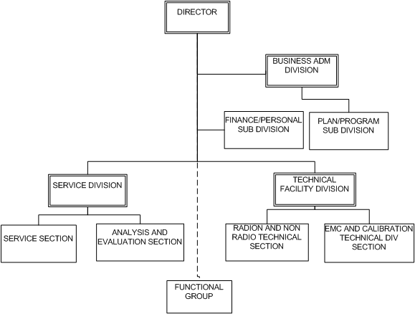
Organization Structure Based on Ministerial Decree
Notes:
BBPPT organization based on Ministerial Decree is
The top leader in Director, director assist by 3 division Business Administration Division, Customer Service Division and Technical Facility Division
Then I am responsible for technical facility division
Under my divison there are 2 section, namely
Radio and non radio Technical Section, and
EMC and Calibration Technical Section
The core ot this organization is functional group as the examiner or executing the Testing

Slide 6
ITU’s highest decision making bodies
WTSA-08 Resolution 76 :
  “Studies related to conformance and interoperability testing, assistance to developing countries, and a possible future ITU mark programme”
WTDC-14 Resolution 47
  “Enhancement of knowledge and effective application of ITU Recommendations in developing countries, including conformance and interoperability testing of systems manufactured on the basis of ITU Recommendations“
ITU Plenipotentiary Conference (PP-10) Resolution 177
ITU council decisions
Notes:
Adapted From the ITU Information Session on Conformity and Interoperability address
WTSA-08 Resolution 76 :
the needs of Developing countries for conformance and interoperability
Conformity is first step to increase the probability of interoperability
Indentification of Labs able to carry out tests accortding to the ITU-T recommendations requriremen, and training program
Voluntary-based ITU program promoting compliance to ITU-T Recommendation and possible creating of an ITU MARK
WTDC Resolution 47 :
Enhance of knowledge and effective application of ITU recommendation in developing countries, including conformance and interoperability testing of system manufactured on the basis of ITU recommendation
Pada dasarnya mendukung WTSA 2008 Res 76(Essentially supporting and endorsing WTSA 2008 Resolution 76)
ITU Plenipotentiary Conference (PP-10) Resolution 177
ALSO Reiterated essence of WTSA 2008 Resolution 76
Added : Invites Sector Member to :
Populate the pilot conformity database according to procedure and criteria adopted by ITU-T
Paricipate in ITU facilitated interoperability events
Endorsement Resolution 76, Resolution 47 and decisions of Council-09
-conformity & interoperability (C&I) programme to be implemented in pararel and without any delay
-parallel development of a long-term business plan in consultation with each region
-assist developing countries in establishing regional or subregional conformity and interoperability centres
-studies in view to introducing the use of ITU Mark for a possible future ITU Mark program

Slide 7
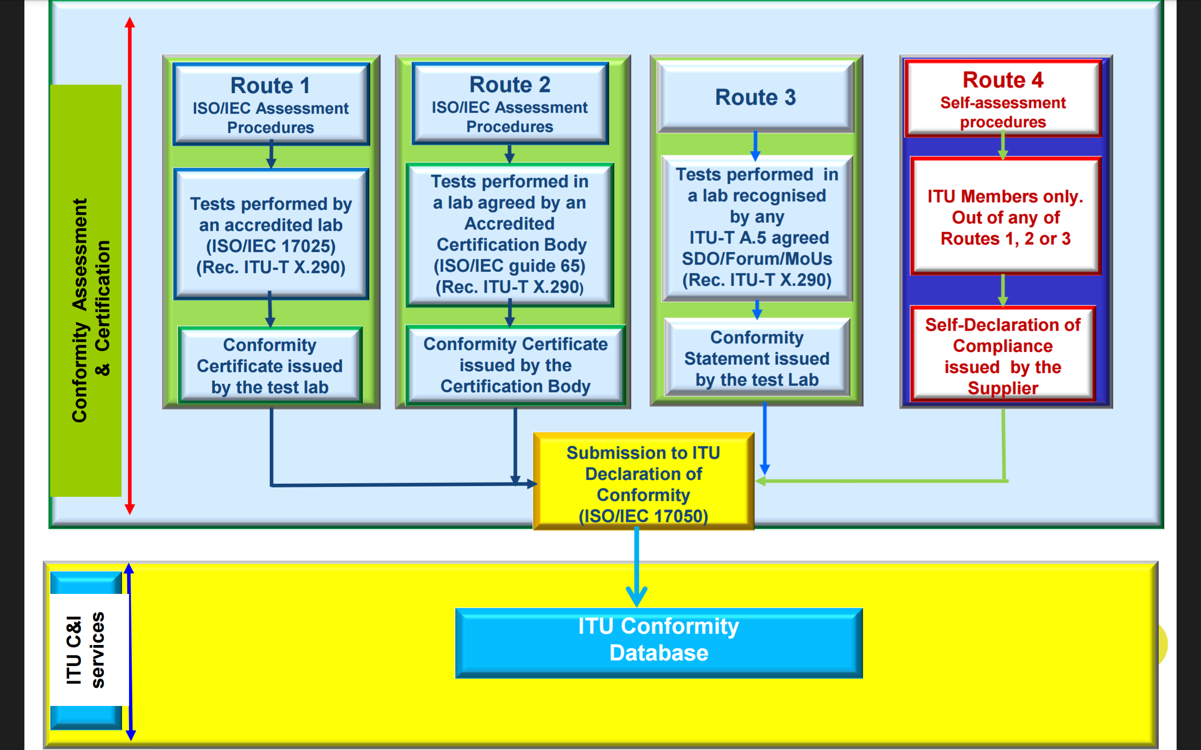
Implementation of the ITU Conformity
Notes:
Summary of those decision is NEED of conformance to Standard, because
Conformity key to increase the probability of interoperability
Standardization Developing Organization to consider conformity and interoperability issues
Improve quality of standard to increase quality of services/experience
Increase market opportunity
Reduce cost for operator, service provider, end user
So that conformance testing is an important step to demonstrate that the telecommunication equipment meet its specific requirement
Conformance testing is performed by testing laboratories
In order to ensure that the testing laboratories are competent to perform their task
The testing laboratories have tobe accreditate to meet ISO/IEC 17025
As shown in the Route 1 : Performed by an accredited Laboratory ISO 17025

Slide 8
BBPPT Quality Management System
QUALITY MANAGEMENT SYSTEM BASED ON ISO/IEC 17025:2008
ACCREDITED BY THE NATIONAL ACCREDITATION COMMITE (KAN) REGISTERED NUMBER LP-112-IDN (Conformance Test)
ACCREDITED BY THE NATIONAL ACCREDITATION COMMITE (KAN) REGISTERED NUMBER LK-137-IDN (Calibration)
BBPPT
KAN
APLAC
ILAC
Notes:
BBPPT Quality Management System
QUALITY MANAGEMENT SYSTEM BASED ON ISO/IEC 17025:2008
ACCREDITED BY THE NATIONAL ACCREDITATION COMMITE (KAN) REGISTERED NUMBER LP-112-IDN (Conformance Test)
ACCREDITED BY THE NATIONAL ACCREDITATION COMMITE (KAN) REGISTERED NUMBER LK-137-IDN (Calibration)
BBPPT have accredited ISO 17025 Since 2004,

Slide 9
Laboratory Accreditation Cooperation
ILAC
EA
APLAC
IAAC
SADCA
EA European co-operation for Accreditation
APLAC Asia Pacific Laboratory Accreditation Cooperation
IAAC Inter-American Accreditation Cooperation
SADCA Southern African Accreditation Cooperation
Komite Akreditasi Nasional –
The Accreditation Body of Indonesia (KAN)
Notes:
Picture of Laboratory Accreditation Cooperation
ILAC → APLAC → Accreditation Body of Indonesia (KAN)

Slide 10
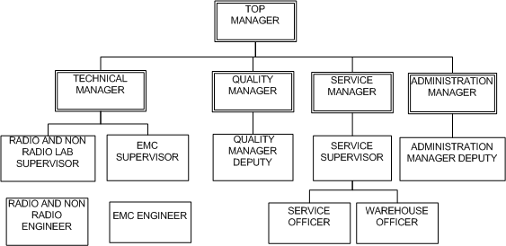
BBPPT Organization Structure Based on
ISO/IEC 17025
Notes:
BPPT Organization Structure based on ISO/IEC 17025 to be
General Manager top management cover 4 Manager
Technical Manager
Quality Manager
Customer Service Manager
Administration Manager
So we have double responsibility in organization under Ministerial Decree and ISO 17025

Slide 11
Conformity Assessment Routes 1
  ISO/IEC 17025 - General requirements for the competence of testing and calibration laboratories
BBPPT follow the Route 1 as Accredited Laboratory based on ISO/IEC 17025
Notes:
Referring to Conformance and Interoperability guideline document report feasibility study for A CONFORMANCE TESTING CENTER mention clearly that
It step to establish an ISO 17025 compliant Test Laboratory to the conformity and interoperability
ISO 17025 establishes a set of
Management requirements and systems
Lab requirements, test methods and procedures, audits, equipment handling, technical competence
Document control, calibration records and staff records
Handling of test reports and calibration certificates
Service to customers and handling of complaints

Slide 12
Requirement of ISO 17025 Standard (1/2)
Management Requirement
  Organization
  Quality System
  Document Control
  Review of request, tender & contract
  Subcontract of test & calibration
  Purchasing service & supplies
  Service to client
  Complaints
  Control of non conformity test & or calibration work
  Corrective action
  Preventive action
  Control record
  Internal audit
  Management review
Notes:
There are 2 requirement of ISO 17025 Standard
Management Requirement are related to the operation and effectiveness of the quality management system within the laboratory and this close has similar requirement to ISO 9001
Management requirement cover of the specification & compliance with respect to
Organization
Quality System
Document Control
Review of request, tender & contract
Subcontract of test & calibration
Purchasing service & supplies
Service to client
Complaints
Control of non conformity test & or calibration work
Corrective action
Preventive action
Control record
Internal audit
Management review
Technical Requirement address competence staff, Testing methodology, Equipment and Quality, Reporting of Test and Calibration
Cover the specification & compliance with respect to
Personnel
accommodation and environment condition
Test & calibration method & method validation
Equipment
Measurement traceability
Sampling
Handling of test & calibration items
Assuring the quality of test and calibration result
Reporting result

Slide 13
Requirement of ISO 17025 Standard (2/2)
Technical Requirement :
    Personnel
    accommodation and environment condition
    Test & calibration method & method validation
    Equipment
    Measurement traceability
    Sampling
    Handling of test & calibration items
    Assuring the quality of test and calibration result
    Reporting result
Notes:
Technical Requirement address competence staff, Testing methodology, Equipment and Quality, Reporting of Test and Calibration
Cover the specification & compliance with respect to
Personnel
accommodation and environment condition
Test & calibration method & method validation
Equipment
Measurement traceability
Sampling
Handling of test & calibration items
Assuring the quality of test and calibration result
Reporting result

Slide 14
BBPPT existing condition
Limited personnel resource
Limited number of Laboratory room
Limited equipment
Not enough resource to develop valid test method
Some to do manually test
Notes:
BBPPT existing condition
Limited personnel resource
Limited number of Laboratory room
Limited equipment
Not enough resource (personnel or document standard as valid reference) to develop valid test method
Some to do manually test

Slide 15
BBPPT Future
Already buy new land
Develop new laboratory

Slide 16



Administration Procedure (1/2)
BRING RECOMENDATION LETTER OF DEVICE (SP3) AND DEVICE UNDER TEST
MAKE INVOICE (SP2) BASED ON SP3 AND TECHNICAL SPECIFICATION
STAGE 1
PAY THE INVOICE TO THE BANK
PROOF OF PAYMENT
(ONE OF REQUIREMENTS)

Slide 17
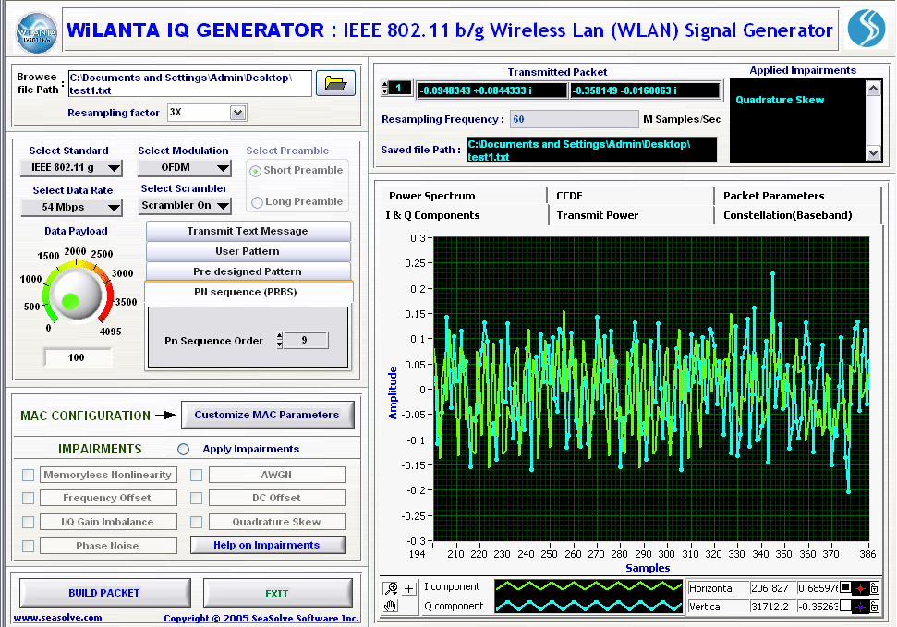



Test Procedure (2/2)
REQUIREMENT OF TESTING :
PROOF OF PAYMENT
RECOMENDATION LETTER OF DEVICE (SP3)
TECHNICAL DOCUMENT (MANUAL BOOK, TECHNICAL SPECIFICATION,ETC)
SAMPEL OF DEVICE ( CPE 2 UNIT & NON CPE 1 UNIT)
CHECKING TESTING REQUIREMENT
DEVICE TESTING
17
WORKING DAYS
STAGE 2
Notes:
SP3 : Surat Pengantar Pengujian Perangkat
SP2 : Surat Pemberitahuan Pembayaran
CPE : Customer Premises Equipment
RHU : Rekapitulasi Hasil Uji
TEST RESULT SEND TO DIRECTORATE STANDARDIZATION
TEST RESULT (RHU)

Slide 18
BBPPT Facilities
BBPPT HAVE MAIN 4 (FOUR) TYPE LABORATORY :
RADIO LABORATORY
  ADVANCE RADIO LABORATORY
  CELLULAR LABORATORY
  SORT RANGE DEVICE LABORATORY
NON RADIO LABORATORY
ELECTROMAGNETIC COMPATIBILITY LABORATORY
CALIBRATION LABORATORY

Slide 19
Radio Laboratory
RADIO LABORATORY WERE USED TO THE TEST THE DEVICE/APPLIANCE BASED RADIO TELECOMMUNICATION SUCH AS:
MOBILE PHONES
BLUETOOTH
WIRELESS LAN
TV AND RADIO TRANSMITTER
THE MEASURING DEVICE ARE :
SPECTRUM ANALYZER
WIRELESS TELECOMUNICATION MANAGER (WTM)
BLUETOOTH TEST SET
WIRELESS TEST SET

Slide 20
Non Radio Laboratory
NON RADIO LABORATORY WERE USED TO THE TEST THE DEVICE/APPLIANCE BASED CABLE LINE, SUCH AS :
FACSIMILE
FIXED TELEPHONE
PABX
OPTIC
THE MEASURING DEVICE ARE :
TELEPHONE ANALYZER
OPTIC METER
OPTIC Spectrum Analyzer

Slide 21
EMC Laboratory
ELECTROMAGNETIC COMPATIBILITY LABORATORY WERE USED TO TESTS THE ENDURANCE PROPERTIES OF TELECOMMUNICATION DEVICE/APPLIANCE TOWARD BOTH OF RADIATED OR CONDUCTED INTERFERENCES. THE DEVICE USED ARE
EMI RECEIVER
SPECTRUM ANALYZER
SIGNAL ANALYZER
GTEM CHAMBER
LISN

Slide 22
Calibration Laboratory
CALIBRATION LABORATORY WERE USED TO CALIBRATE THE GAUGE. CALIBRATION TECHNICAL WERE USED TO KNOW DEVIATION FROM ITS GAUGE.THE GAUGE THAT CAN BE CALIBRATED ARE :
    POWER METER
    POWER SENSOR
    FREKUENSI COUNTER < 2 GHZ
    FREKUENSI COUNTER 2 – 10 GHZ
    FREKUENSI COUNTER > 10 GHZ
    MODULATION ANALYZER
    MULTIMETER ANALOG
    MULTIMETER DIGITAL 4 DIGIT
    SPECTRUM ANALYZER
    SIGNAL GENERATOR
    ATTENUATOR

Slide 23
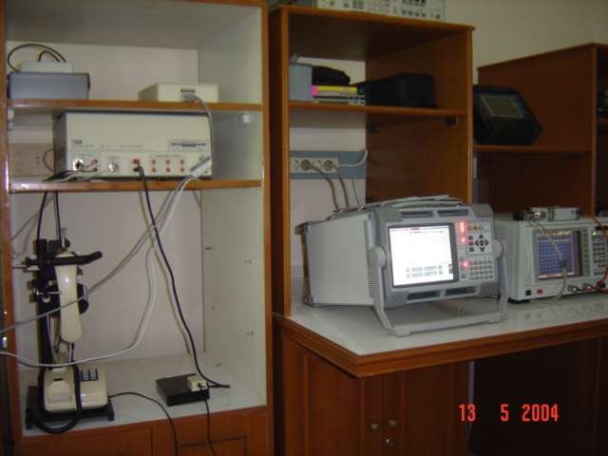
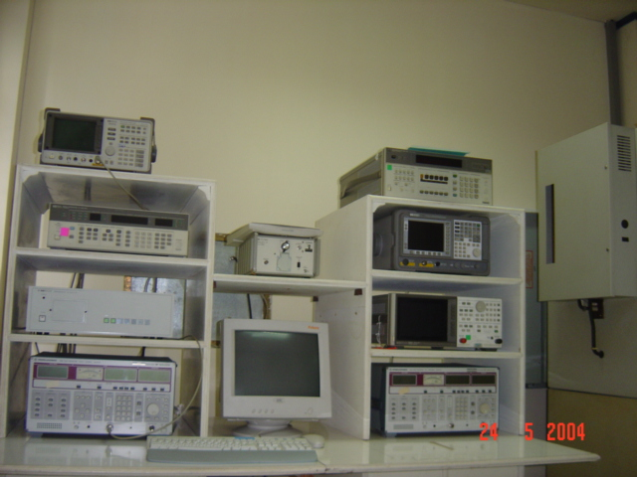
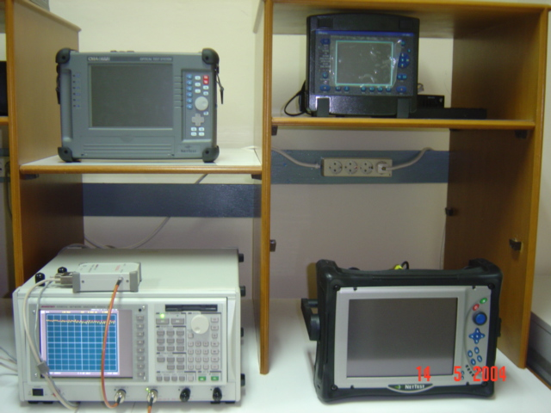
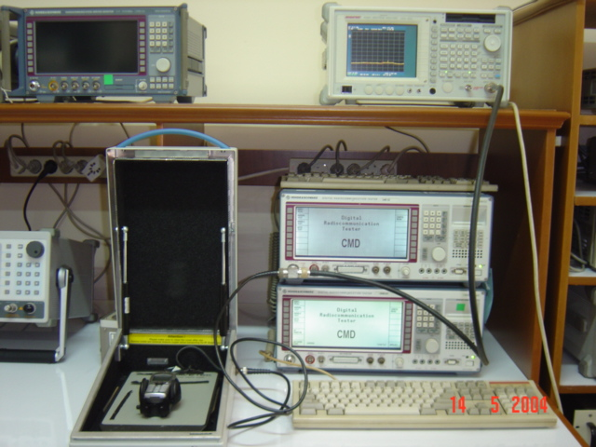
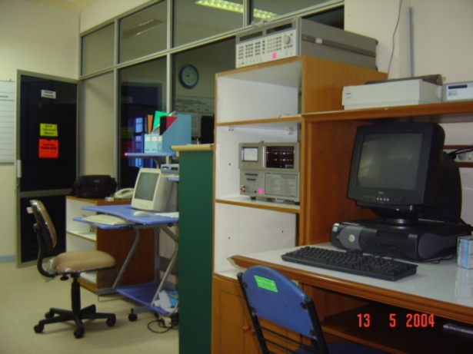
THANK YOU

Slide 24
MOTTO and Service Level Agreement
MOTTO
TRUST , SERVICE , AND QUALITY ASSURANCE IS OUR GOAL
SERVICE LEVEL AGREEMENT:
TESTING PROCESS CONDUCTED DURING 17 WORKING DAYS (IN ACCORDANCE WITH REGULATION OF THE MINISTER OF COMMUNICATION AND INFORMATION TECHNOLOGY NO. 29/PER/M.KOMINFO/09/2009 ABOUT CERTIFICATION OF TELECOMMUNICATIONS EQUIPMENT DEVICE and 18/2014)

