Slide 1
ITU Regional Standardization Forum for Asia-Pacific (Jakarta, Indonesia, 27-28 October 2015)
EMF Policy, research and activity in Korea
Seungwoo Lee, Ph. D.
Research Professor, Chungbuk Nat’l University
leesw@chungbuk.ac.kr

Slide 2
Outlines
Main Organizations of EMF in Korea
EMF Survey Results in Korea
EMF Policies and Researches in Korea
Risk Communication and Activities
Summary

Slide 3
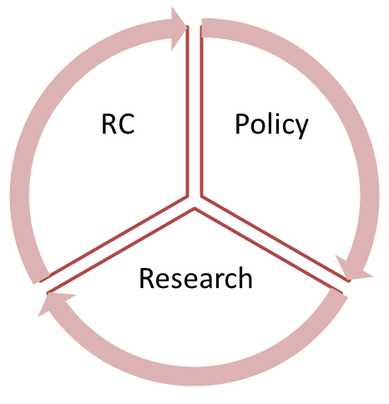
Main Organizations in Korea
Korea has major organizations which are a key role of EMF activities in RF field
to establish EMF policy
to research EMF health effect
to support EMF risk communication
KCA
RAPA
MSIP
RRA
MSIP : Ministry of Science, ICT and Planning
RRA : National Radio Research Agency
KCA : Korea Communications Agency
RAPA : Korea Radio Promotion Agency
KIEES : Korean Institute of Electromagnetic Engineering and Science
ETRI : Electronics and Telecommunications Research Institute
KIEES
ETRI

Slide 4
EMF Survey [1]
Korea has biennially surveyed opinions of general publics about EMF health effect, learning route, and knowledge and its understanding
Classification | Contents
Knowledge and Understanding about EMF | Imagination and Awareness of EMF Recognition rate about EMF hazard and electronic devices Experience of unusual symptoms by EMF Suggestions about limit of usage on mobile phones for kids or teenagers
Acquisition methods for EMF | Searching experience and engines for EMF Perception of information for EMF health hazard books Trusted organizations or institutions announced for EMF hazard
Opinion for mobile phones and base-stations’ EMF | Situation for occurrence of extremely strong EMF by mobile phones Perception of EMF effects by using the earphone Perception about EMF exposure rating system of mobile phone Reliability for EMF regulations for mobile phones and base-stations Reason for increment of civil compliant about removal of base-stations and transmission towers Personal opinions for installation of base-stations Necessity of researches for EMF health hazard for kids Confidence rate for international joint researches

Slide 5
EMF Survey [4]
By the telephone survey results, a civil complaint of EMF was growing from 2011 to 2013
Removal of radio stations (blue line)
Opposition of installation of radio stations (green line)
Total number of the civil complaint (black line)

Slide 6
EMF Survey [5]
The public interest about EMF human hazard was growing
A requirements of preparation for comprehensive EMF countermeasure to reduce the anxiety are
The introduction of precautionary policy for human effect
The vitalization of international researches
The extension of risk communication policy

Slide 7
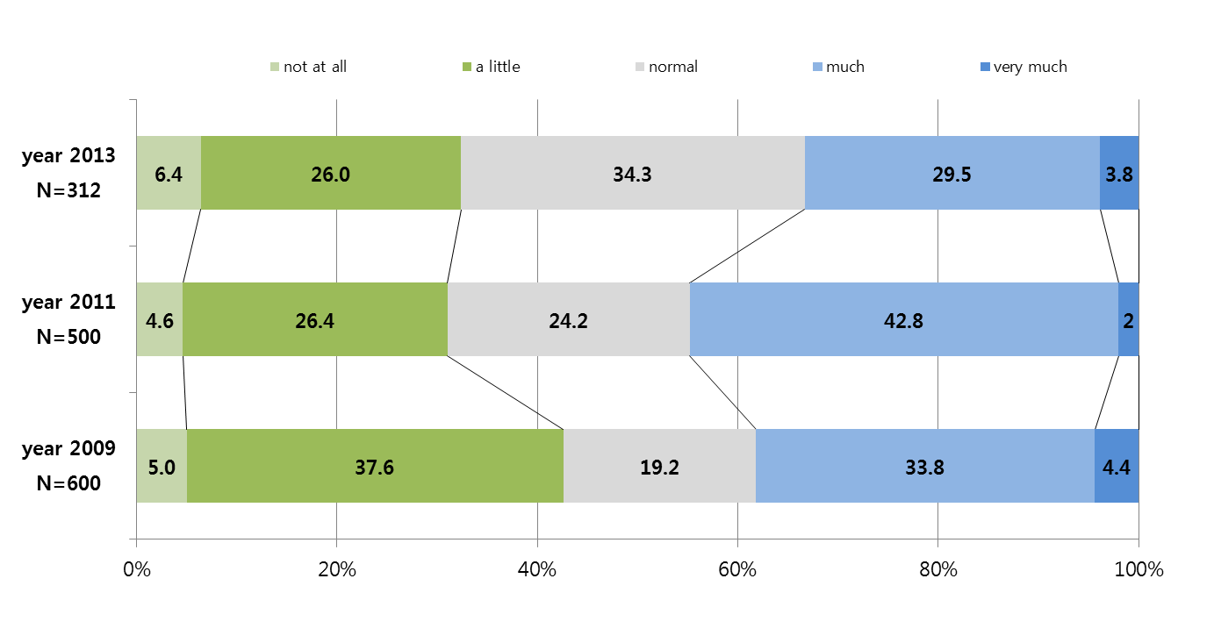
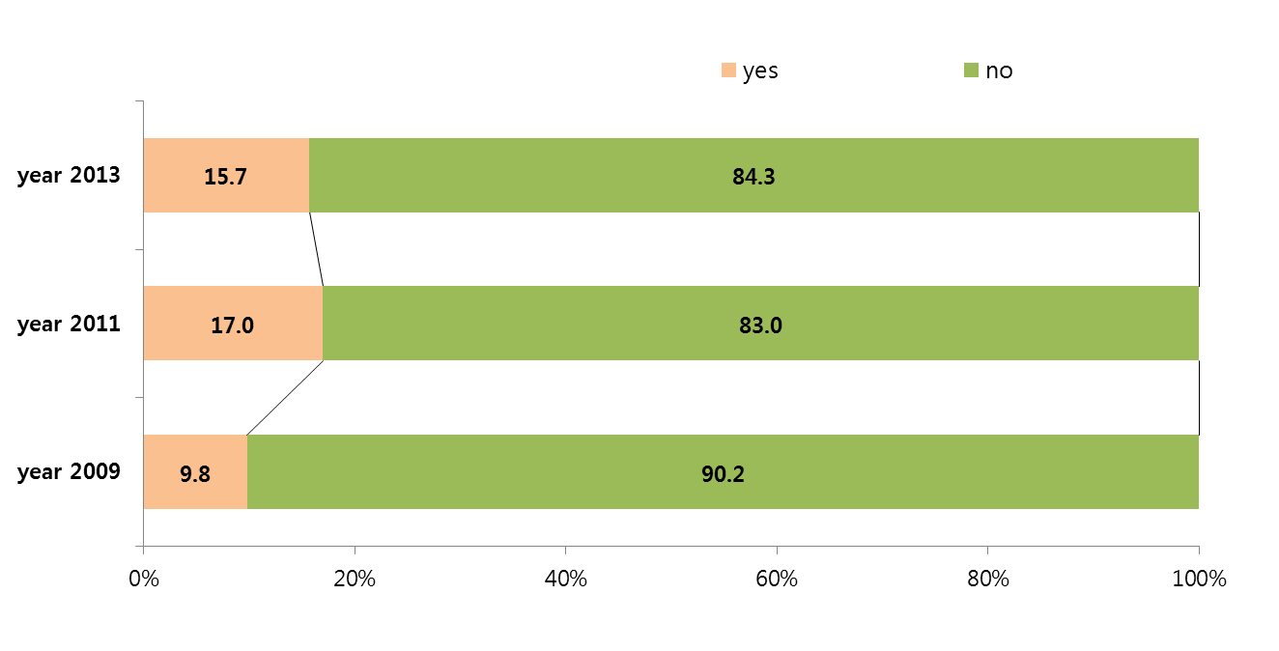
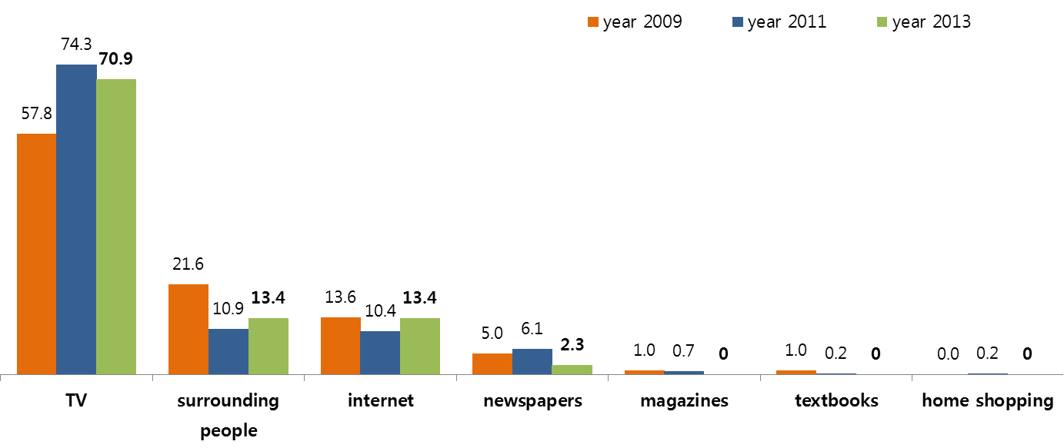
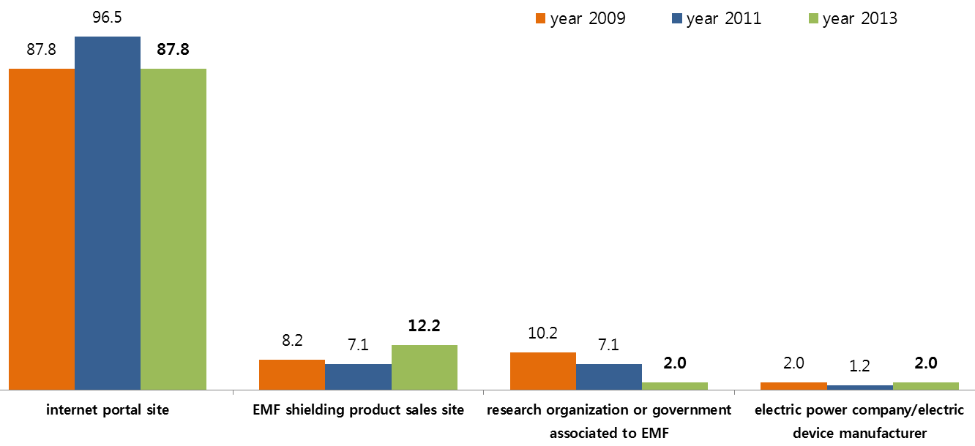
EMF Survey [6]
[Awareness of EMF hazard]
[Searching experience of EMF information]
[Learning Route of EMF hazard information]
[Searching methodology of EMF information]

Slide 8
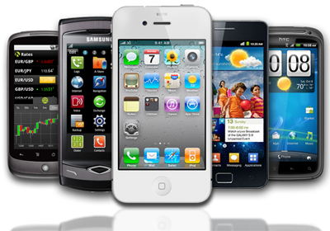
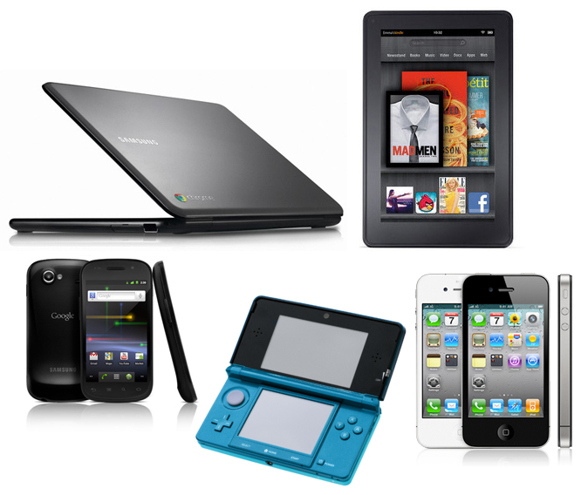
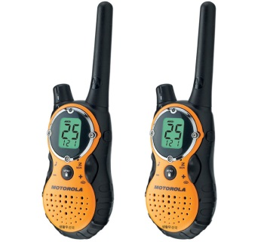
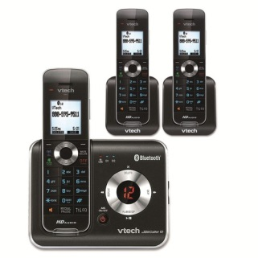
EMF Policy [1]
Summary of EMF standard(Radio Wave Act.) in Korea
Mobile phone and wireless devices
SAR limitation : 1.6 W/kg (1g-averaged)
Obligation : human body protection standard of mobile phones on Apr. 2002
Extension : wireless devices that use within 20 cm from human body on Jan. 2013
Target devices : laptops, tablet PCs, walkie-talkies, cordless phones, etc.
Head SAR limits [W/kg]
Occupation | General publics
8.0 | 1.6
10.0 | 2.0

Slide 9
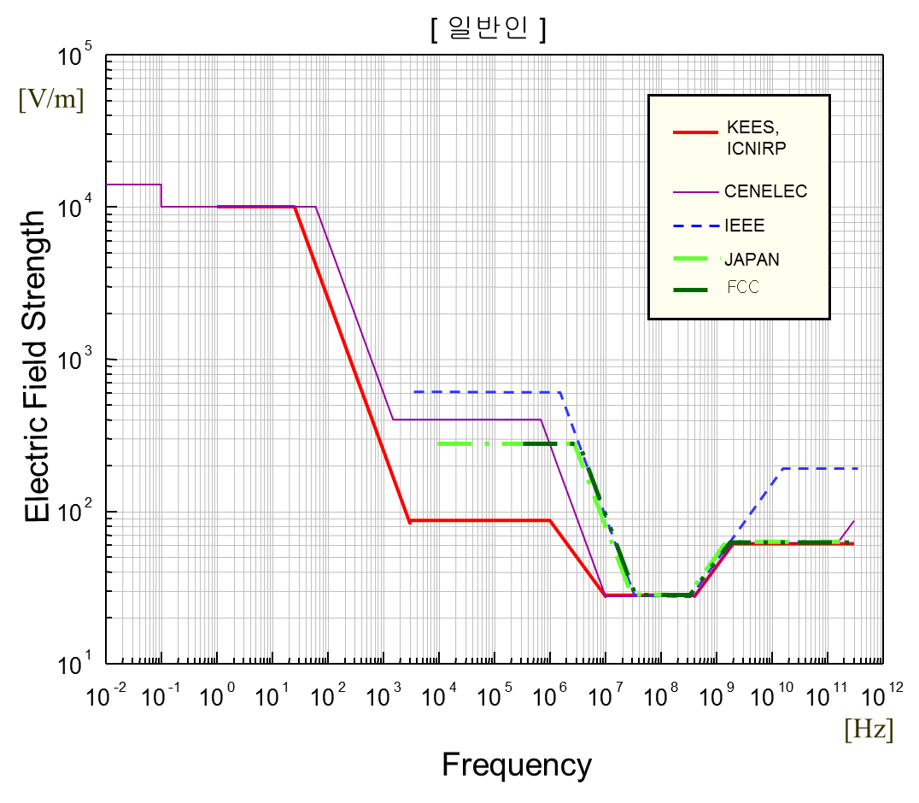
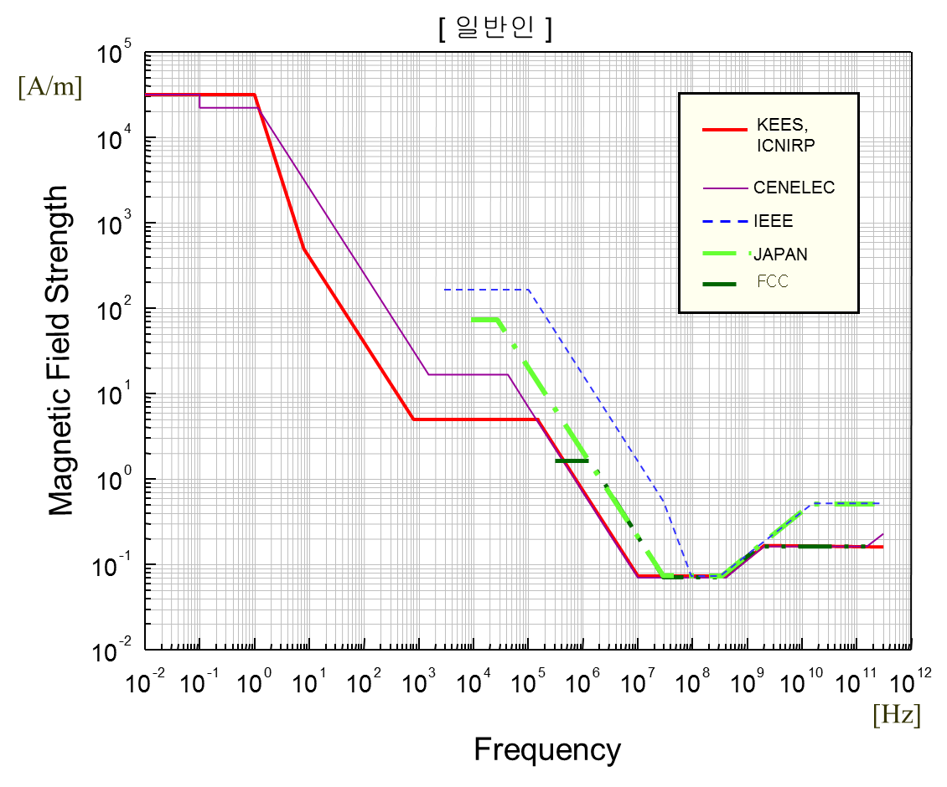
EMF Policy [2]
EMF Standards for general publics

Slide 10
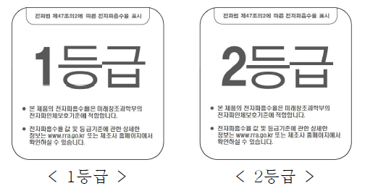
EMF Policy [3]
Radio stations
Report of fields strength of radio stations : Jun. 2007
New guidelines for multi-sources : Mar. 2014
Total exposure index
EMF rating and labeling policy
Startup the standard for EMF rating : 1st Aug. 2014
$$E_{T}= \sum_{i=1}^{M}{{(E)}_{i}}$$
E_{T} : total exposure index
M : number of radio stations
E : exposure index
$$E={\left(\frac{measured level}{reference level}\right)}^{2}$$
<class 1>
<class 2>
<category 1>
<category 2>
<caution>
<warning>

Slide 11
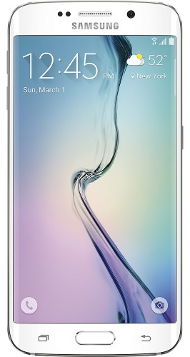
EMF Policy [4]
Class | Criteria of Radio-stations
Class 1 | EMF strength value ≦ 50% of the general public exposure limit
Class 2 | 50% of the general public exposure limit < EMF strength value ≦ the general public exposure limit
Caution | the general public exposure limit < EMF strength value ≦ the occupational exposure limit
Warning | the occupational exposure limit < EMF strength value
※ Number of EMF rating and labeling (8. 1. ~ 10. 31, 2014)
Class | Class 1 | Class 2 | Caution | Warning | Total
Broad-casting | 6 | 3 | - | - | 9
Cellular | 2 | - | - | - | 2
TRS | 41 | - | - | - | 41
LTE | 1,864 | - | - | - | 1,864
IMT-2000 | 151 | - | - | - | 151
Total | 2,064 | 3 | 0 | 0 | 2,067
Class | Criteria of Mobile phones
Class 1 | SAR value ≦ 0.8 W/kg (1g-averaged)
Class 2 | 0.8 W/kg < SAR value ≦ 1.6 W/kg (1g-averaged)

Slide 12
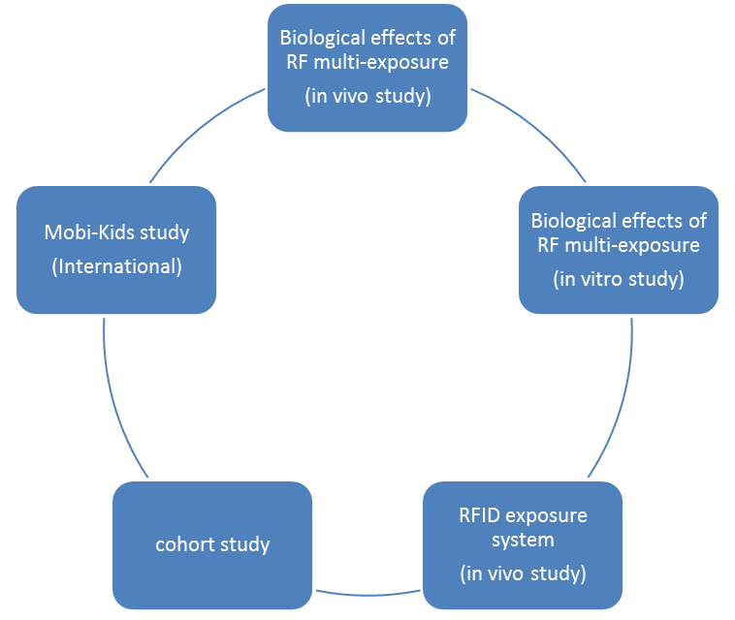
EMF Research [1]
‘Electromagnetic Field and Biology Research Institute’ who consists of experts in the fields of engineering, biology, epidemiology, etc. under KIEES has researched in the fields of biological effect by EMF radiation
1st period (2008-2012) of the project is finished
2nd period (2013-2018) of the project is now ongoing
Researches are supported by MSIP Various scientific papers are published on top-class journals

Slide 13
EMF Research [2]
Biological effects (in vivo study) of RF multi-exposure (849 & 1950 MHz)

Slide 14
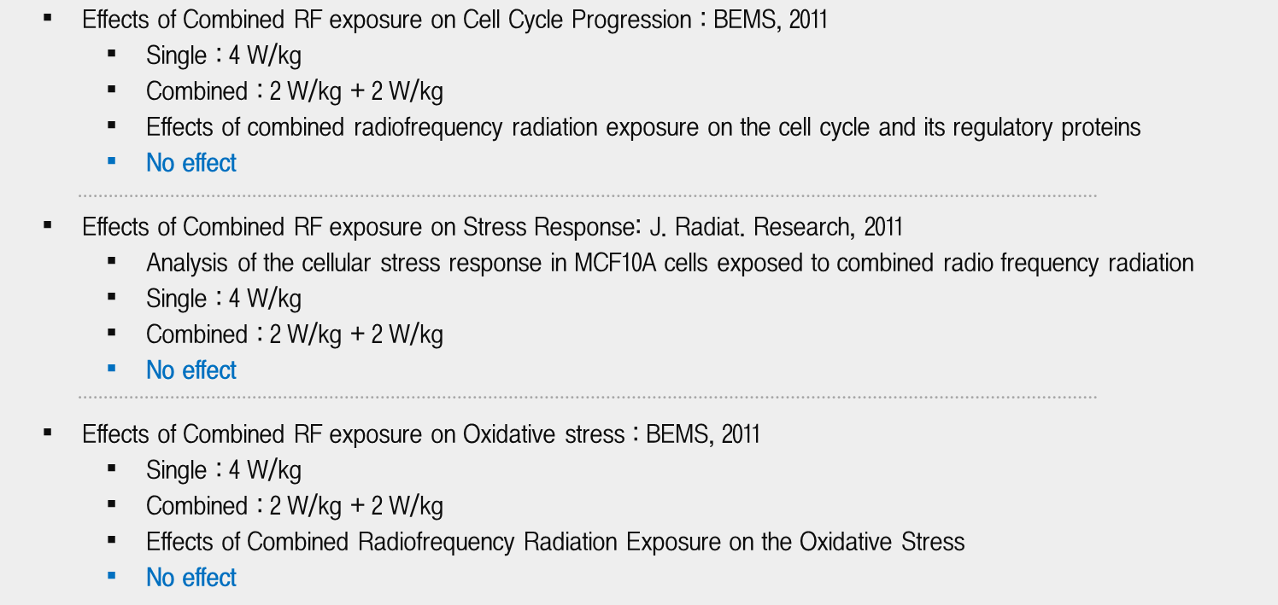
EMF Research [3]
Biological effects (in vitro study) of RF multi-exposure (837 & 1950 MHz)

Slide 15
EMF Research [4]
RFID exposure system (in vivo study)

Slide 16
Risk Communication [1]
3 major points of view for EMF risk communication
Establish of EMF conflict control tower(organization)
Composition of experts from the industry-academy-institute and civic groups
Arbitration by fact, expert consultation, concerned parties
One-stop EMF civil compliant consultation service
Organization of an exclusive window for customer service by government
Open an EMF consultation hot-line
Free measurement service for EMF exposure sites
Extension of risk communication programs (on-going project in 2015)
Development of EMF specialized website
Education of EMF : flash animations, cartoons, video clip, SNS
Open forum for EMF safety : newly EMF issue, human effect information, and opinion discussion

Slide 17
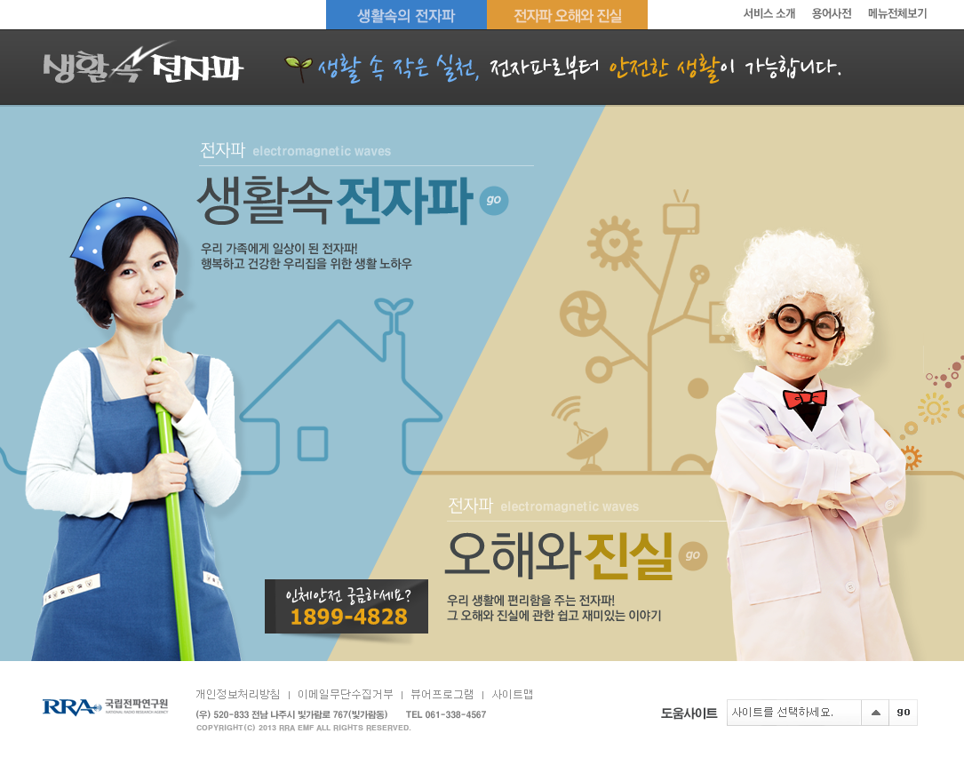
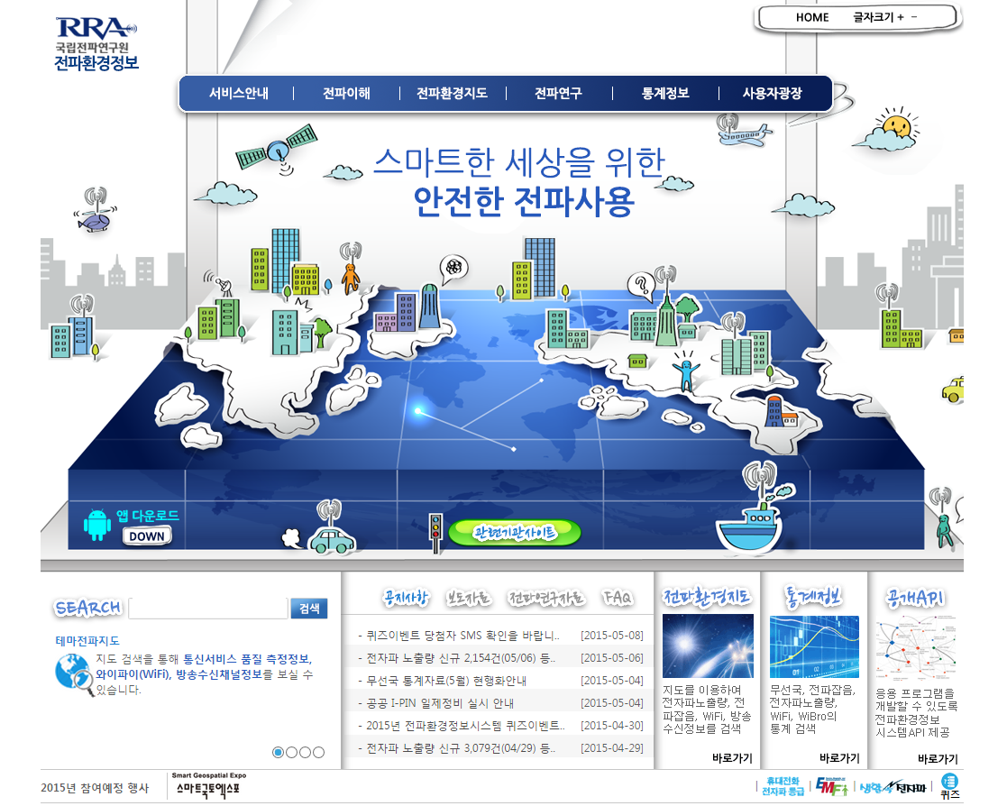
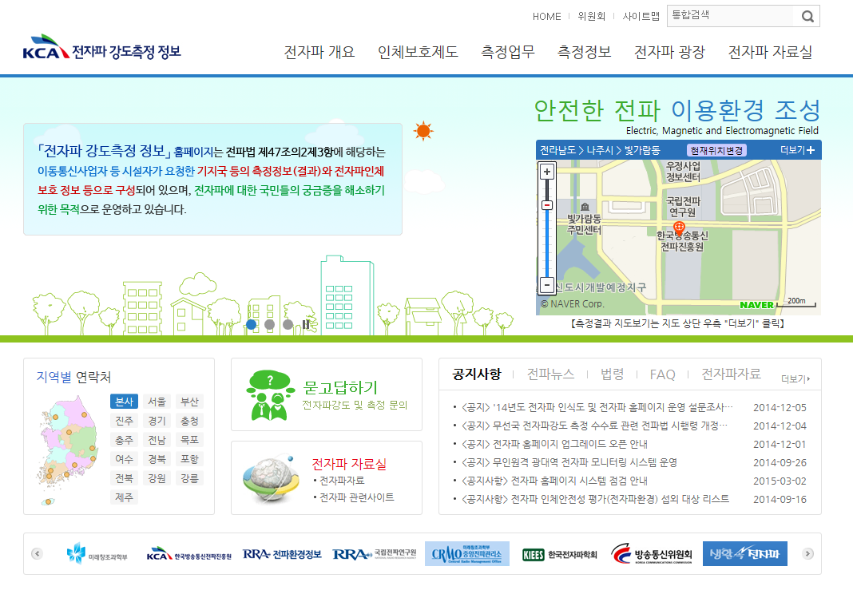
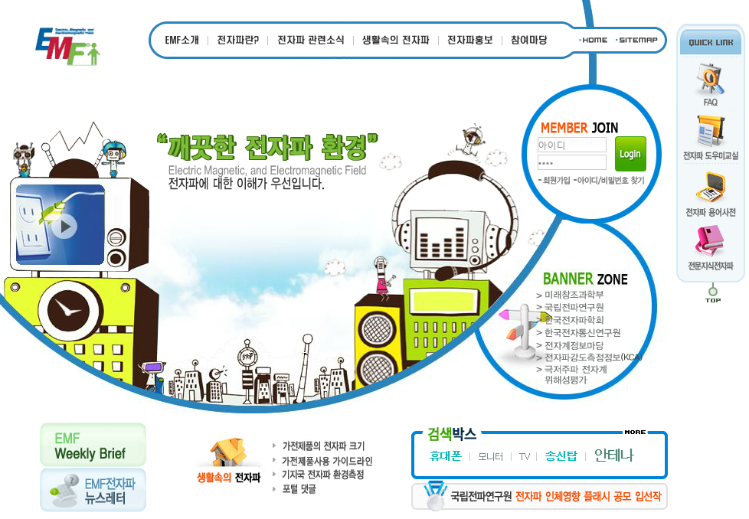
Risk Communication [2]
EMF levels of home appliances and EMF information
emf.go.kr
Radiomap.go.kr
Radio map for all RF sources (base-stations, wifi, etc.)
EMF levels and its map based on GIS for base-stations
emf.or.kr
Most popular EMF website in Korea established in 2007
emf.kca.kr

Slide 18
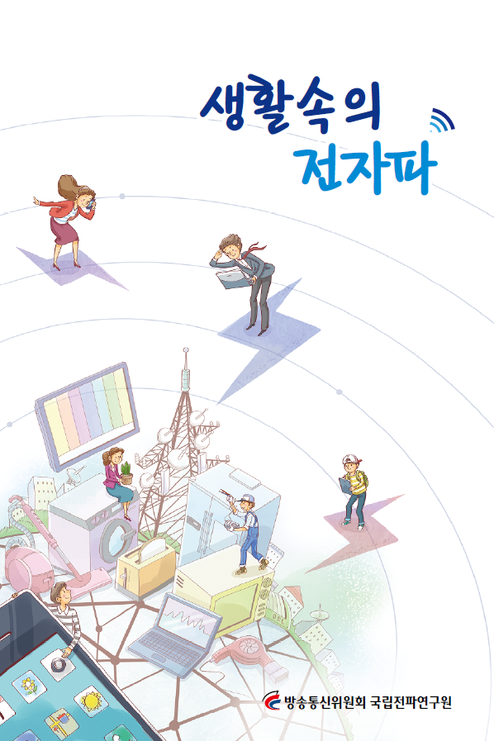
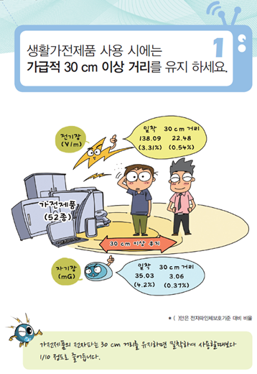
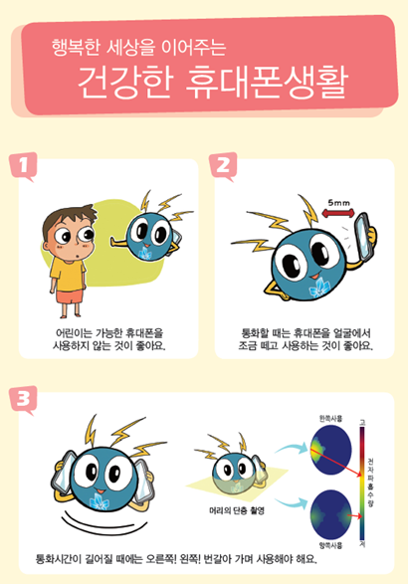
Risk Communication [3]
User guidebooks and pamphlets
EMF principles and basics, EMF use cases, EMF health hazard, user guidelines (electric blanket, microwave oven, hair dryer, truth of EMF shielding filters or cactus or charcoals)
Measured EMF levels of home appliances, mobile phone user guidelines for reducing SAR

Slide 19
Risk Communication [4]
Various extra RC programs in 2015
EMF Safety Forum for publics with experts
EMF Safety Education for children
Technical contests by using radio wave
Art contest (pictures, drawings, webtoons, movies, etc.) with radio wave
Paper contest for university and graduate school
Educational EMF Movies for Youtube
Etc.

Slide 20
Extra Activities [1]
Government activities and future planning (MSIP)
Comprehensive Countermeasures for Health Protection from EMF
Vision : Realization of safety living environment from EMF exposure
Strategies : ① maintenance of law legal system, ② reinforcement of EMF research, ③ RC program for conflict
main projects
Precautionary principles
Expansion of EMF standards to electric/wireless devices on the body and wearable devices
New standards for facilities of vulnerable social groups
Protection for high power and long-term exposure
Management of total EMF exposure index
EMF research
Establish of foundation of researches on EMF health effect to be a world leader
R&D for reduction methods of EMF radiation
Prevention of social conflict
EMF conflict control tower
One-stop EMF civil compliant consultation service
Risk communication programs

Slide 21
Extra Activities [2]
GLORE 2015
2015 Global Coordination of Research and Health Policy on RF Electromagnetic Fields will be held in Seoul Korea, 19-20 November 2015
GLORE is coordination activities that have members from Europe, USA, Japan, Korea, China, and Australia, and related international organizations, such as WHO, ICNIRP, IEEE, etc.
GLORE is annual event to coordinate and harmonize the research activities and the process of health risk management, on the possible human exposure effects from electromagnetic fields (EMF).
GLORE also aims to introduce current policies and regulation status and plans related to the human exposure to EMFs which are implementing and/or scheduled to be enforced in the GLORE member countries.
During the past three years, Japanese Ministry of Internal Affairs and Communications (in 2012), and the US Federal Communication Commission (in 2013), and the European Commission (in 2014) have hosted the GLORE meetings.

Slide 22
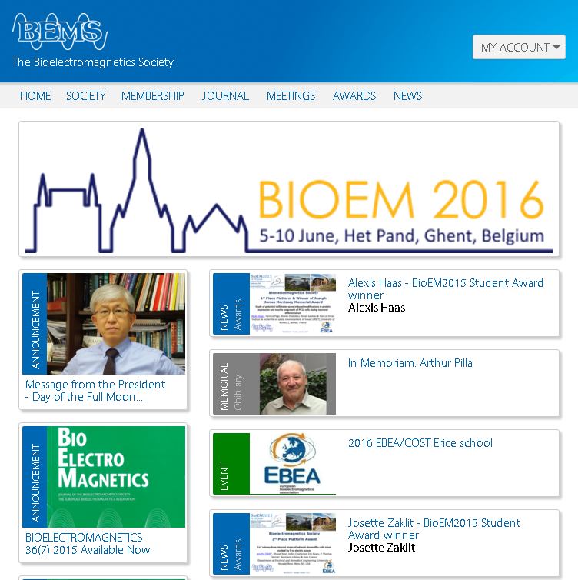
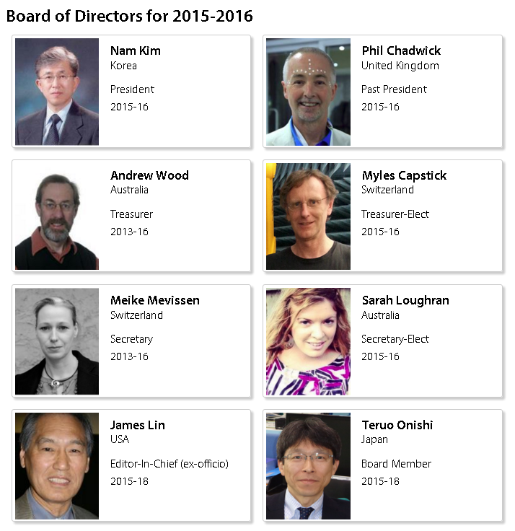
Extra Activities [3]
Elected BEMS President for 2015~2017

Slide 23
Summary
I talked about followed points
Major organizations for EMF policies and activities in Korea
Policy (Government ; MSIP, RRA), RC (Public institute ; KCA, RRA), Research (Academic institute ; KIEES, ETRI)
EMF Survey Results in Korea
Normally, general publics afraid EMF effect and its interest is constantly increasing
EMF Policies and Researches in Korea
New regulations or standards is developed and published
Various researches supported by government are consistently studied
Risk Communication and Activities
Ongoing RC programs are stably managed, and unique RC programs are preparing
Domestic and international activities are cooperated with other nations

Slide 24
Thank you for your attention Q & A

