Slide 1
Electromagnetic Field Radiations : Issues and Challenges Government of India Initiatives
Ashutosh Pandey
Deputy Director General ( Radio )
Department of Telecommunications, Ministry of Communications & IT, Government of India

Slide 2
Outline
Issues and challenges
EMF Radiation Norms in India
Initiatives by the Government to ensure compliance to EMF Radiation norms

Slide 3
Types of EMF Radiation

Slide 4
Common Sources of EMF Radiation

Slide 5
Issues and Challenges: Public Expectations and Apprehensions
Expectations
Apprehensions
Perfect network
Myths about Health hazards due to EMR
Better connectivity & QoS
High speed broadband and multimedia support
Media/NGOs outcry
24x7 service availability

Slide 6
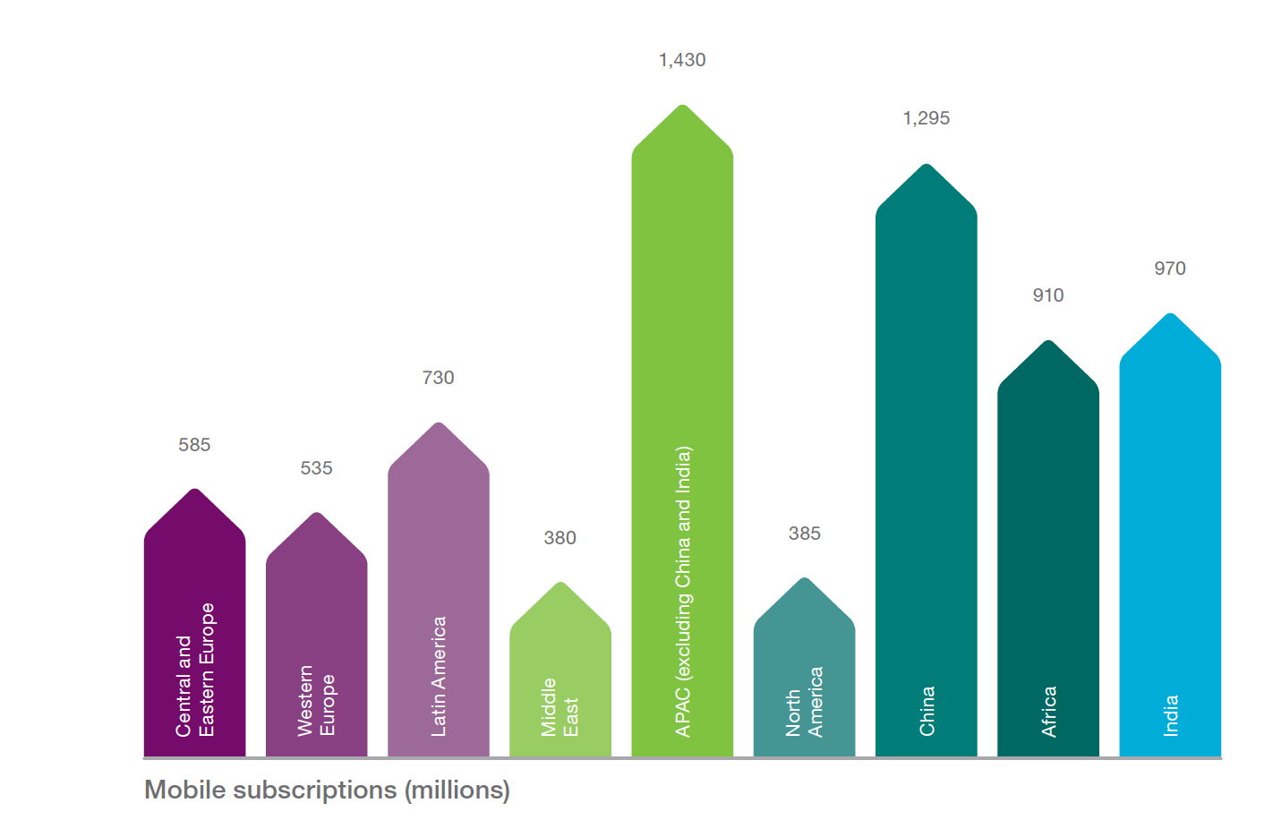
Phenomenal Growth of Mobile Communications
About 50% subscribers are from APAC region including India and China
Mobile Broadband Subscribers were 2.9 Billions
Source: Ericsson Mobility Report June 2015

Slide 7
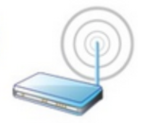
Network Capacity Creation
Average EIRP is Lower
Average Distance of Subscriber from Site may be relatively smaller
By Introducing More Sites
Average EIRP of Out-door Micro may be Lower
Macro-Sites
By Introducing More Layers of Networks and Multiple Radio Access Technologies
Micro-Sites
Femto-Cell, In-building Solutions, WLAN APs
WCDMA with 5MHz, LTE upto 20 MHz, LTE-Advanced much larger carrier sizes
By Introducing Wide band Carriers
1.4 MHz
20 MHz
EIRP/MHz may remain of similar order

Slide 8
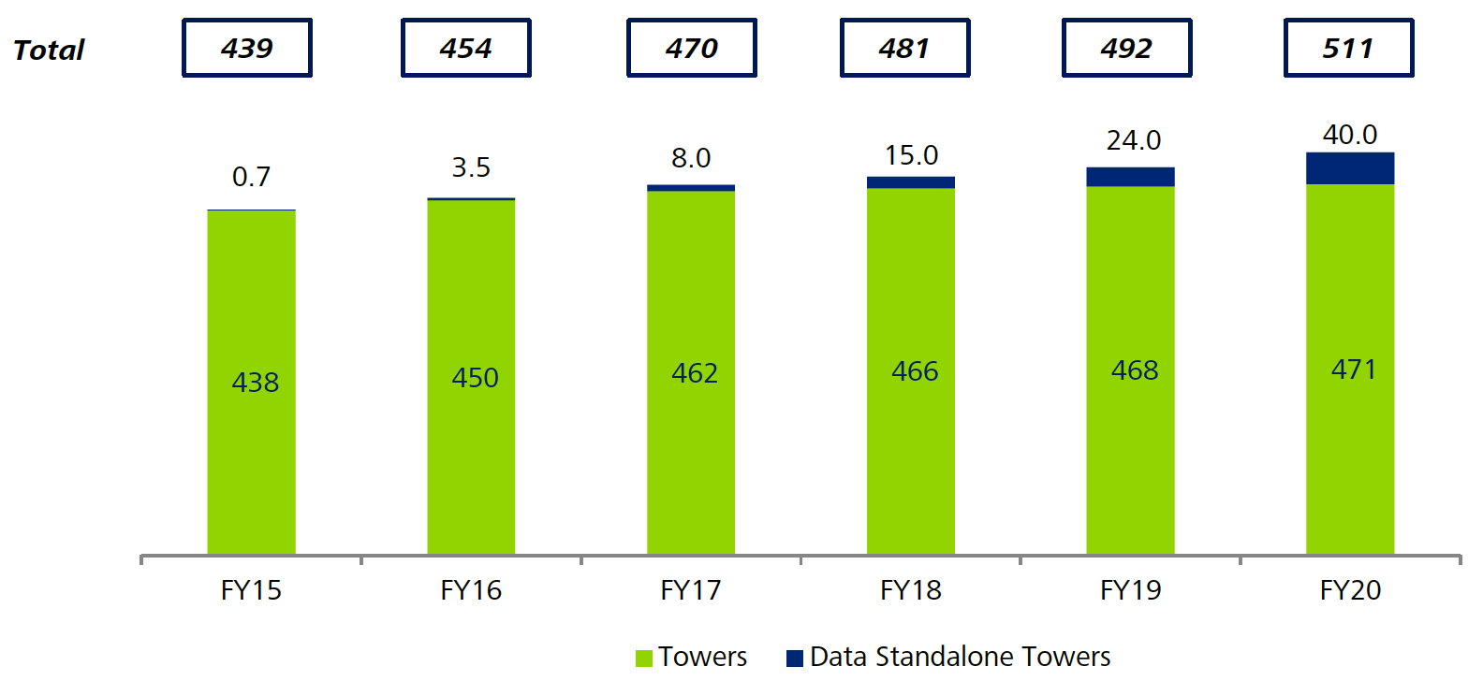
Projections of Number of Tower Sites in India
In Thousands
Source: Deloitte Report- Indian Tower Industry-Future is Data-June 2015

Slide 9
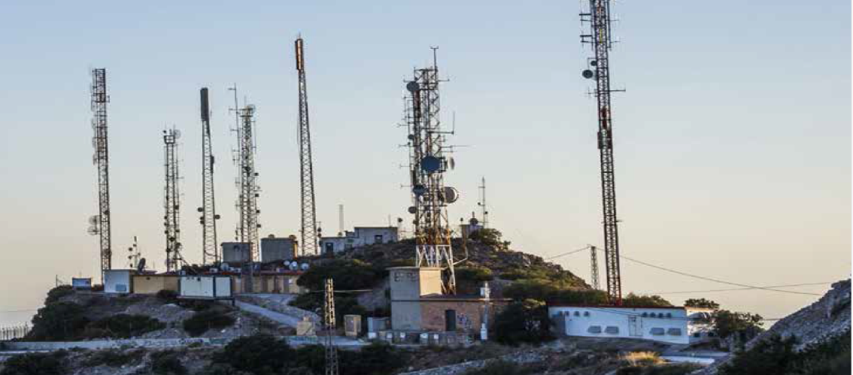
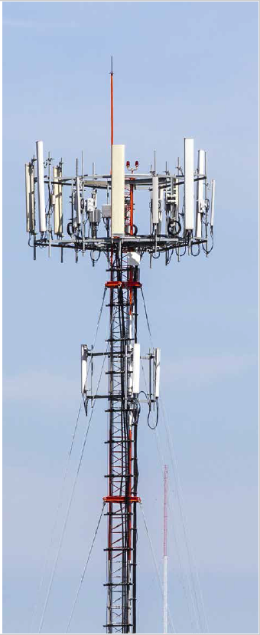
Radiation Levels by Multiple Base Station Sites and Antennas
The Radio Frequency Radiation (RFR) exposure from both mobile phones and mobile towers may have possible thermal/non-thermal effects.
Radiation level by a Mobile Base Station Sites
Every site radiates electro-magnetic power, one of the factor for level of radiation depends upon EIRP of site
More number of Sites may lead to more power intensity in the nearby area, if power of sites remains same
More number of antennas, may lead to more power density, if power of each antenna is same or higher than previous case and type of antenna is same.
The power level varies with the distance from the nearby towers , it reduces with distance.

Slide 10
EMF Radiation norms in India
Govt of India, in the year 2008, adopted the International Commission for Non Ionizing Radiation Protection (ICNIRP) Guidelines
License conditions of Operators were amended on 4.11.2008, with directions to comply to ICNIRP prescribed radiation norms.
Directions to report compliance of radiation limits/ levels through self certification of their BTS to the respective Telecom Enforcement Resource & Monitoring (TERM ) Units of Licensor (DoT).

Slide 11
Revised EMF Radiation Norms
On 24.08.2010, the DoT set up an Inter-ministerial Committee (IMC) consisting of officers from DoT, Indian Council of Medical Research (Ministry of Health), Department of Biotechnology and Ministry of Environment and Forest to examine the effects of Electro Magnetic Field radiation from base stations and mobile phones.
Indian standards are now 10 times more stringent than many countries in the world which follow ICNIRP guidelines.

Slide 12
Based on the Recommendations of an Inter Ministerial Committee constituted by DoT in the year 2010, limiting reference levels of Electromagnetic Radiation from Mobile towers is reduced to 1/10th of the limit prescribed by the ICNIRP with effect from 01.09.2012.

Slide 13
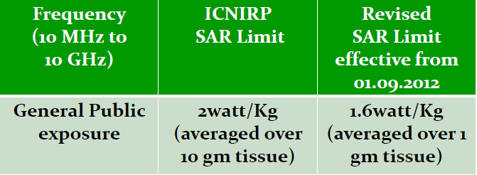
SAR level for Mobile Handsets
Adoption of Specific Absorption Rate (SAR) limit of 1.6watt/Kg (averaged over 1 gm of tissue) also implemented from 01.09.2012.

Slide 14
India has adopted the most stringent SAR values for mobile handsets .
Only mobile handsets with SAR value of 1.6 Watt/Kg are permitted for manufacturing or to import in India for domestic market.
It has been made mandatory for manufacturers to display the SAR level on each mobile handset like IMEI (International Mobile Equipment Identity) display from 01.09.2013.
SAR Test Laboratory has been set up in the Telecom Engineering Centre, DoT, for testing of SAR value of Mobile handsets imported/ manufactured in India.

Slide 15
Manufacturers in India provides self declaration of SAR value of the handset. For imported handset, manufacturers apart from self declaration of SAR specifies the SAR information in user documents for verification.
Indian Telegraph Rule/ Act 1885 is being enacted for strict compliance.
Manufacturer's mobile handset booklet contains the safety precautions

Slide 16
Initiatives by the Government
Stringent Norms for EMF Radiation from Base Stations and Mobile phones.
TERM (Telecom Enforcement & Resource Monitoring ) Cells, field units of DoT, carry out the EMR compliance monitoring.
SAR Lab established to measure SAR levels from mobile phones at TEC (Telecommunication Engineering Centre), DoT.
Setting up of EMF portal : a website mapping all the cellular base stations in the country and their compliance to EMR regulations
Enhancing public awareness.
Guidelines for EMR compliance.
Mobile phones to compulsorily display SAR values on them.
Deployment of Public complaint handling system for EMR.

Slide 17
Precautionary Guidelines in INDIA for mobile phone users
For Mobile Users to minimise RF exposure to human body & advised to take following precautionary measures
Keep distance – Hold the cell phone away from body to the extent possible
Use a headset (or ear bud) to keep the handset
Do not press the phone handset against your head. Radiation proportional to the square of the distance from the source increases energy absorption much more. The farther your brain is from the handset the better it is
Use a wired headset
Limit the length of mobile Calls
Use text as compared to voice wherever possible
Put the cell phone on speaker mode
Use a wireless Bluetooth headset
If the radio signal is weak, a mobile phone will increase its transmission power. Find a strong signal and avoid movement – Use your phone where reception is good.
Metal & water are good conductors of radio waves so avoid using a mobile phone while wearing metal-framed glasses or having wet hair.
Let the call connect before putting the handset on your ear or start speaking and listening – A mobile phone first makes the communication at higher power and then reduces power to an adequate level. more power is radiated during call connecting time
If you have a choice, use a landline (wired) phone, not a mobile phone.
When your phone is ON, don't carry it in a breast or pants pocket. When a mobile phone is on, it automatically transmits at high power every one or two minutes to check (poll) the network.
Reduce mobile phone use by children as a younger person will likely have a longer lifetime exposure to radiation from cell phones
People having active medical implants should preferably keep the cell phone at least 15 cm away from the implant.

Slide 18
Other Guidelines by DoT to ensure compliance to EMF Radiation norms
Broad guidelines issued by DoT for issuing clearances for installation of Mobile Towers.
Precautionary Guidelines issued for Mobile Users advising them to take precautions while using/ purchasing the mobile handsets.
These guidelines are available at DoT website.

Slide 19
A Handbook on EMF Radiation Issues Mobile Communications-Radio is available on DoT website.
The Handbook covers :
Basic introduction to radio waves,
Various Terminologies,
Clarification of various myths
Revised Standards – Mobile Towers & Handsets
Frequently asked questions (FAQs) relating to Mobile phones & Human health.
The handbook enhances awareness of Public and helps creating an environment where everyone can use the radio wave safely.
Advertisement for ensuring safety from radiations of Mobile Towers & handsets are published for awareness of General public in National & Regional Newspapers .

Slide 20
Summary/ Conclusions
Communication is integral part of life, important tool to achieve in Sustainable Development Goals (SDGs)
Evolve to provide excellent QoS with acceptable safety norms
Safety propaganda on unfounded claims may also have serious consequences on socio-economic progress
Not heeding to genuine concerns may impact quality life or survivability. It also impacts social costs
Spectrally Efficient, Energy Efficient technologies, Passive Optical Networks, Fast Copper networks etc. may help to achieve desired objectives.

Slide 21
Thanks
Contact:
Ashutosh Pandey,
DDG(Radio), Telecommunication Engineering Centre, Department of Telecom, Ministry of Communications & IT, Government of India.
E-mail: ddgsat.tec@gov.in

