Slide 1
ITU Regional Standardization Forum for Asia-Pacific
(Jakarta, Indonesia, 27-28 October 2015)
EMF STANDARDIZATION IN ITU
Fryderyk Lewicki
ITU-T SG5, Vice-chair WP2
Orange Polska, Poland

Slide 2
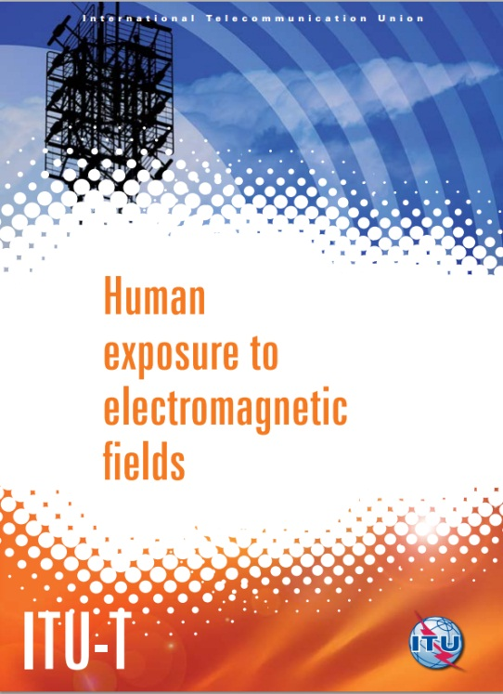
Outline
Introduction (some general information and comments concerning EMF)
International organizations involved in EMF standardization
ITU-T activity in EMF
ITU-T Recommendations (including software, apps and Supplements)
Conclusions

Slide 3
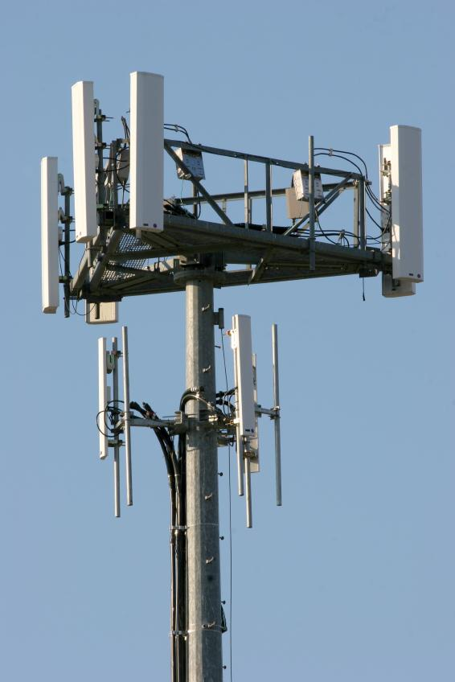
Introduction
Constant development of the radio communication systems and networks
7,1 billions of mobile phones were in use around the world (2014)
Constant growth of the number of base stations
In general there is a bigger concern related to base stations and then to mobile phones
Notes:
3

Slide 4
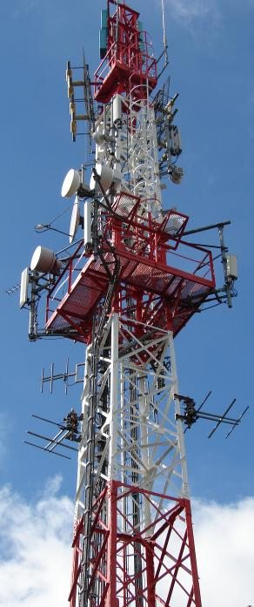
Introduction
There is significant opposition to against the deployment of mobile network antenna sites and other wireless infrastructures
Fears of possible health risks from exposure to EMF, concerns about aesthetics or fears of effect on property values
EMF fields are imperceptible and unknown for the general public
Fears of EMF can result in social conflicts and lead to delays in the deployment of wireless networks
Notes:
4

Slide 5
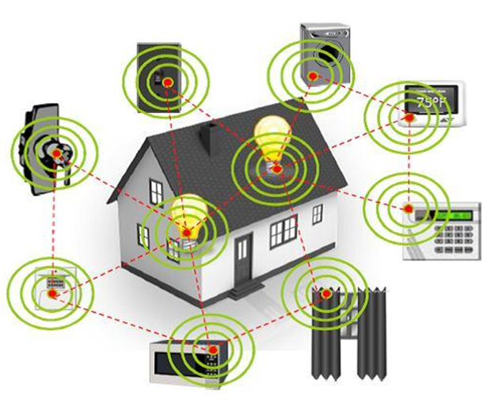
Introduction
The variety of devices that are connected to the internet is rapidly growing – Smart Sustainable City
The connection is mostly wireless – it means that the devices have to radiate EMF
Notes:
5

Slide 6
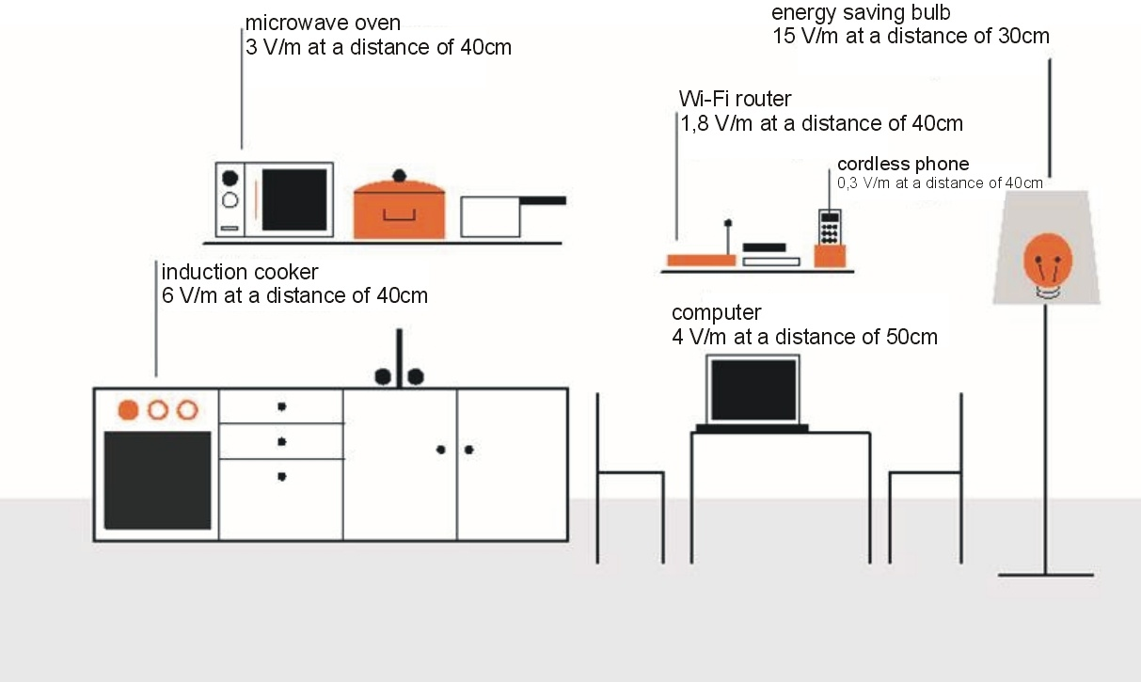
EMF in home environment
Source: Orange
Exposure levels around typical electronic and electric equipment in home environment
Notes:
6

Slide 7
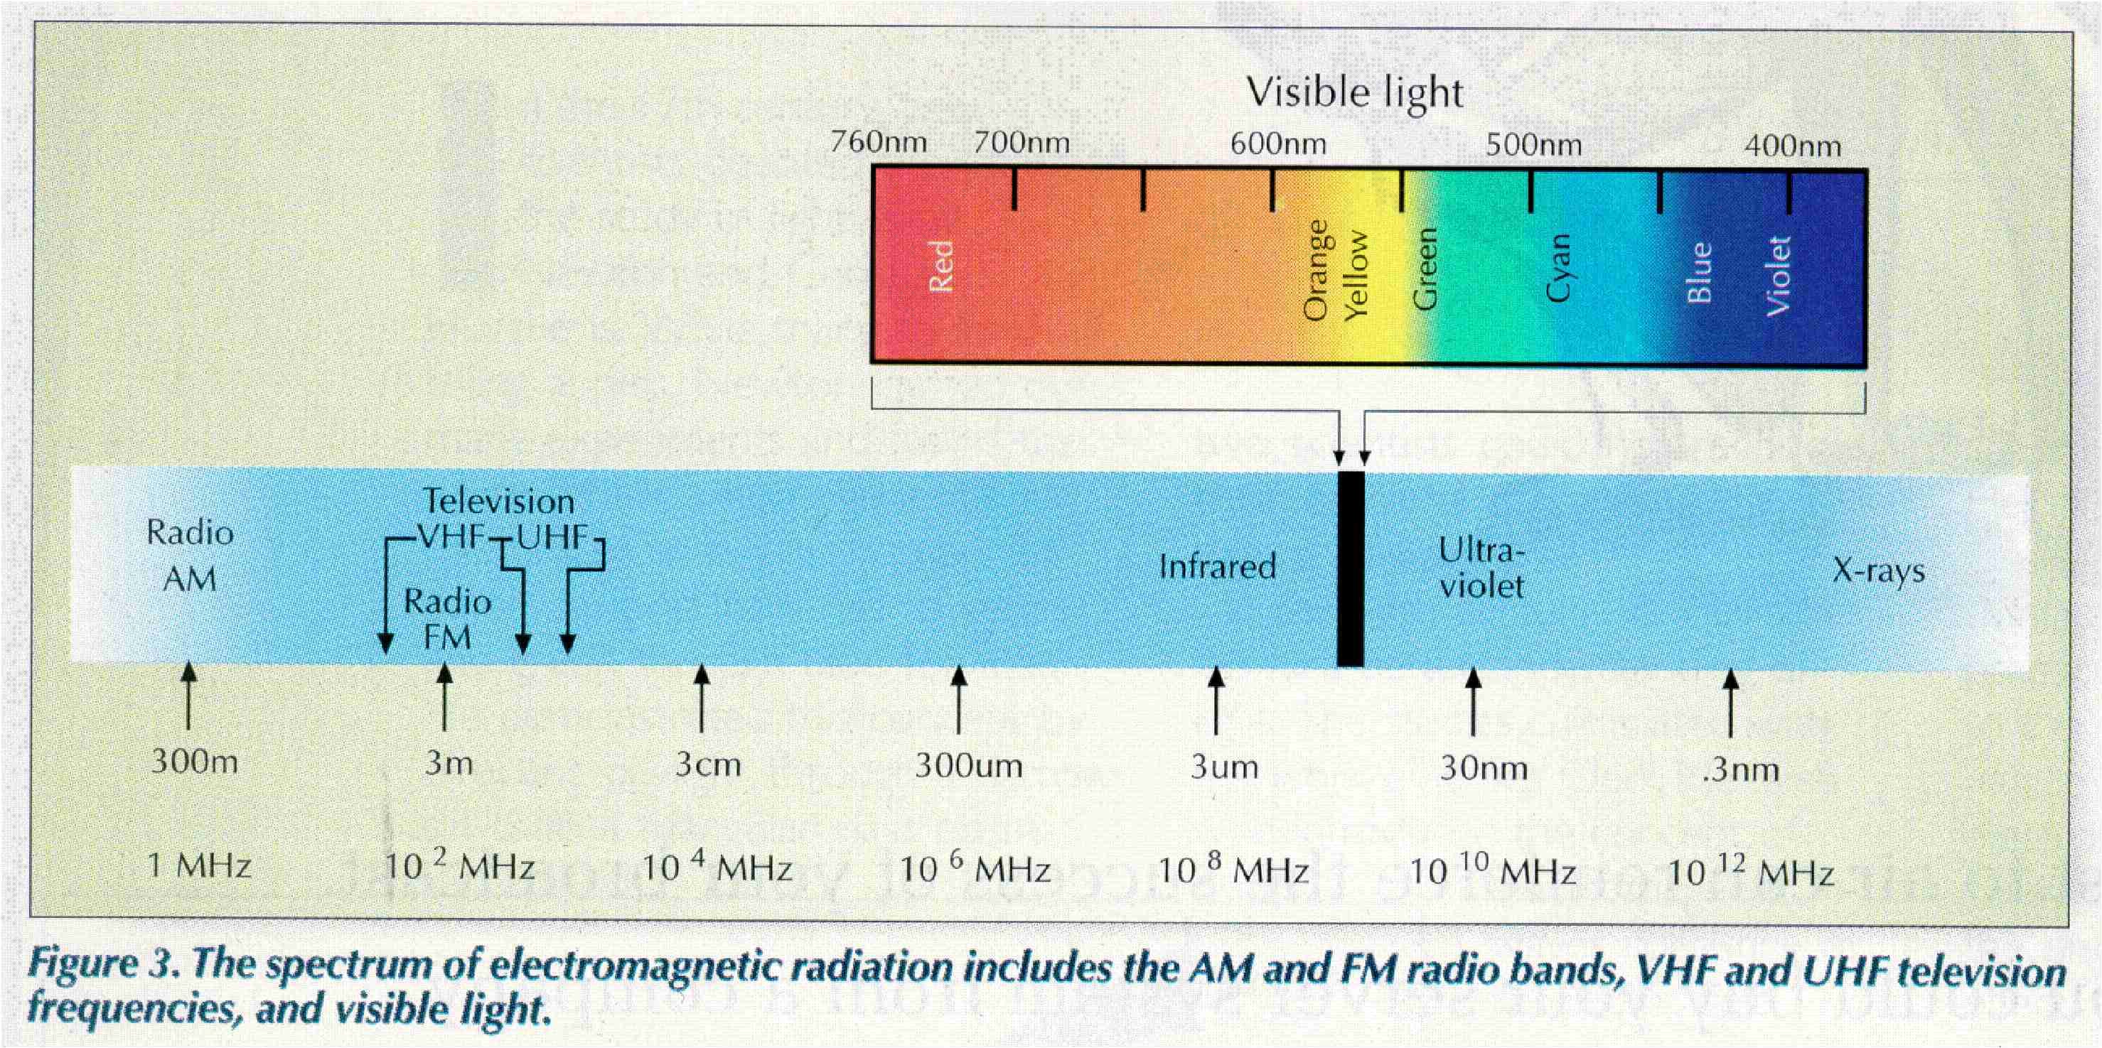
The electromagnetic spectrum
This is a unique resource with limited capacity and strong dependence on the frequency
Source: World Broadcast Engineering 10/2000
RF EMF – frequencies lower then visible light
Ionising radiation – frequencies higher then visible light
Notes:
7

Slide 8
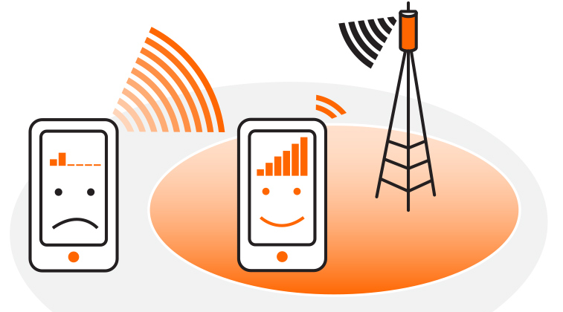
Exposure around mobile phone
Source: Orange
Each mobile phone is equipped with Automatic Power Control system which adjusts the output power level to the minimum required value necessary to establish connection with a BS
Power radiated by the mobile phone is lower if the user is close to a base station and higher if the distance is longer.
Notes:
8

Slide 9
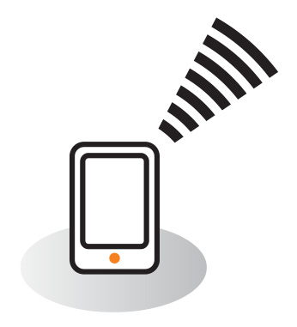
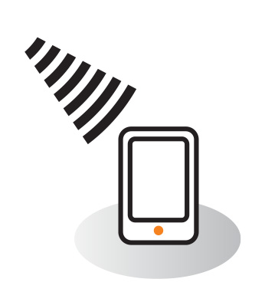
Radiation from the mobile phone
Source: Orange
Mobile phone is a semi-duplex device - the mobile phone can not transmit and receive at the same time
During the voice connection the mobile phone is switching from receiving to transmitting mode many times in a way which is not noticeable for the user
If during the voice call the user is listening then the mobile phone is not radiating
Notes:
9

Slide 10
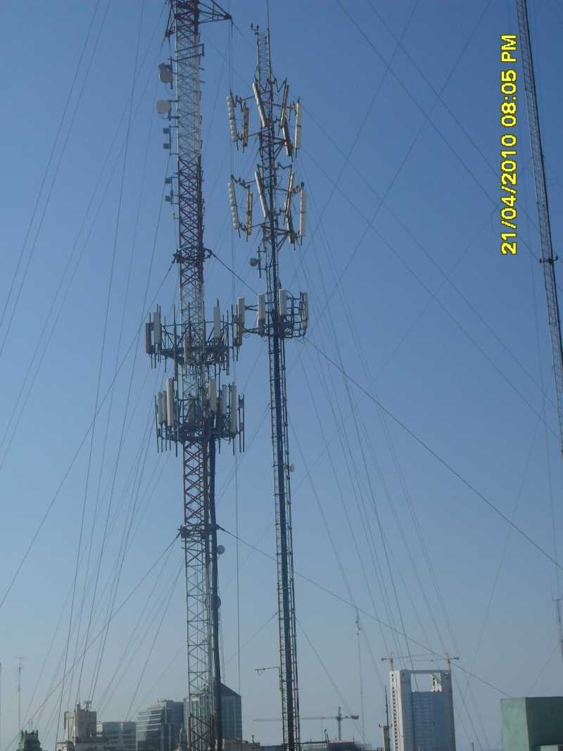
Multi sources environment
Many base stations are collocated at the same or neighboring towers
Other radiating systems: broadcasting, radiocommunication, point-to-point fixed systems
Total exposure have to be evaluated
Notes:
10

Slide 11
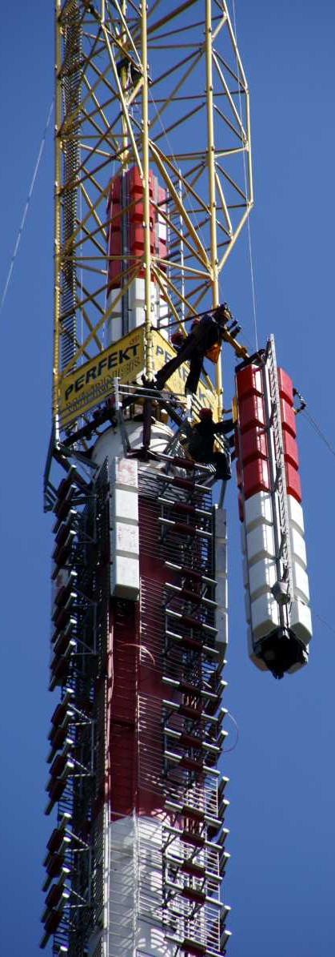
Main tasks in protection against EMF
Assignment of the exposure limits which are safe for people - Medical bodies responsibility:
  WHO (recommend ICNIRP limits)
  IEEE ICES
  National medical authorities
Standards for evaluation and measurement of exposure level
  IEC
  CENELEC
  COST 281
  National standardization committees
Guidance on numerical modeling and measurements of EMFs in the vicinity of telecommunication installations, best practice and mitigation techniques - ITU
Notes:
11

Slide 12
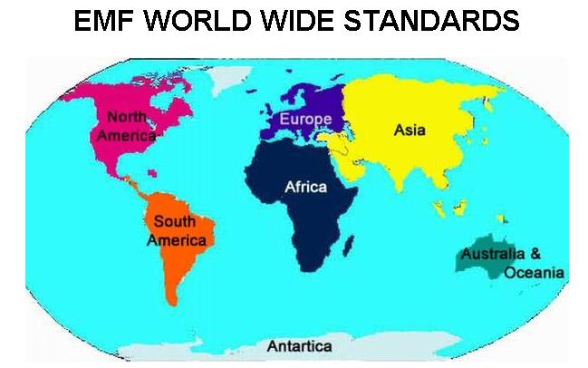
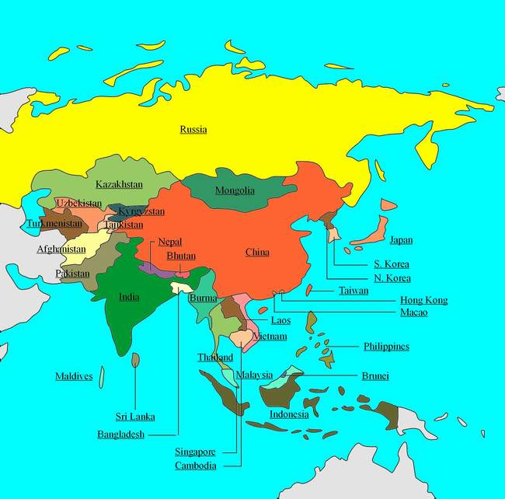
WHO / ICNIRP exposure limits
Data concerning exposure limits in different countries can be found on the WHO website:
  http://www.who.int/docstore/peh-emf/EMFStandards/who-0102/Worldmap5.htm
There is no data in WHO with Indonesia limits
Notes:
12

Slide 13
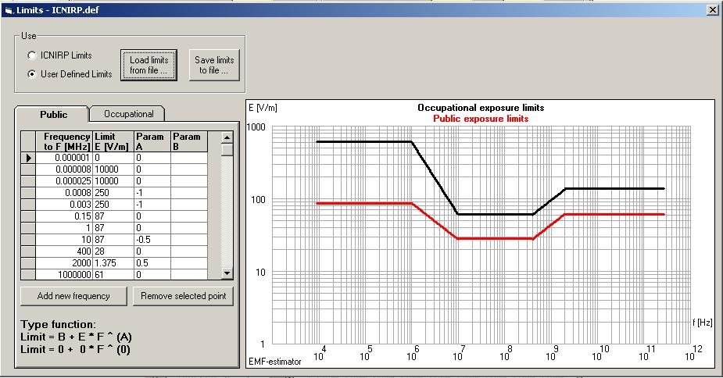
WHO / ICNIRP exposure limits
WHO and ITU recommends the use of the ICNIRP exposure limits
The limits are frequency dependent (chart from ITU-T EMF-estimator)
General public and occupational exposure
Notes:
13

Slide 14
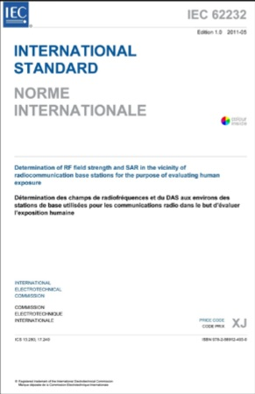
Standards for evaluation and measurement of exposure level
IEC/CENELEC TC106/TC106X „Methods for the assessment of electric, magnetic and electromagnetic fields associated with human exposure”
Standards concerning EMF are:
  IEC: 62xxx series
  CENELEC: EN50XXX series
The coordination of the work between IEC/CENELEC and ITU avoid duplication of the work
Notes:
14

Slide 15
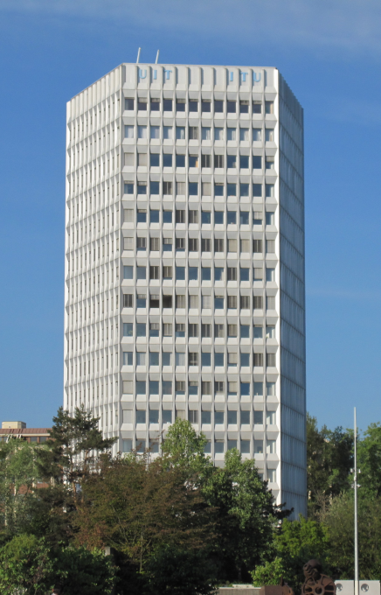
ITU
Best practice and mitigation techniques in the protection against non-ionizing radiation
guidance on numerical modeling and measurements of EMFs in vicinity of radiocommunication installations
Assessment of the human exposure to simultaneously operating many radiocommunication and broadcasting installations
Support to developing countries – ITU-T Resolution 72 (WTSA-12, Dubai, 20-29 November 2012)
http://www.itu.int/en/ITU-T/studygroups/2013-2016/05/Pages/default.aspx
Notes:
15

Slide 16
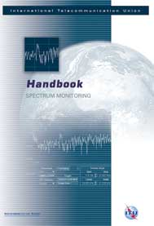
ITU
ITU-R
  SG1 „Spectrum Monitoring” - Handbook
  SG6 „Broadcasting service” – Recommendation BS.1698 (EMF around broadcasting systems)
ITU-D SG2
  Question 7/2 - Strategies and policies concerning human exposure to electromagnetic fields
  Final deliverables online in all six languages at: http://www.itu.int/pub/D-STG-SG01.23-2014
ITU-T SG5
  Q7/5, Human exposure to electromagnetic fields (EMFs) due to radio systems and mobile equipment
Notes:
16

Slide 17
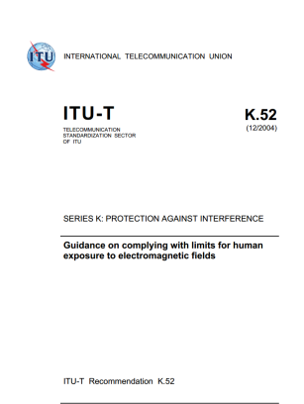
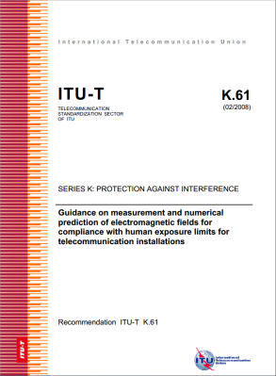
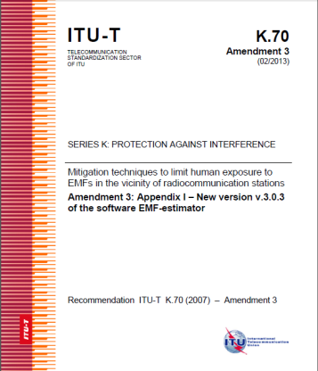
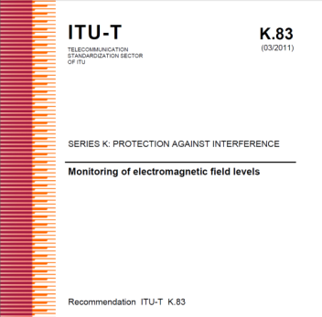
ITU-T Recommendations for EMF assessment
Recommendation ITU-T K.52 (2000/2014) - Guidance on complying with limits for human exposure to electromagnetic fields – includes „K.52calculator software”
Recommendation ITU-T K.61 (2003/2008) - Guidance on measurement and numerical prediction of electromagnetic fields for compliance with human exposure limits for telecommunication installations
Recommendation ITU-T K.70 (2007/2014) - Mitigation techniques to limit human exposure to EMFs in the vicinity of radiocommunication stations – includes „EMF Estimator software”
Recommendation ITU-T K.83 (2011/2014) - Monitoring of electromagnetic field levels

Slide 18
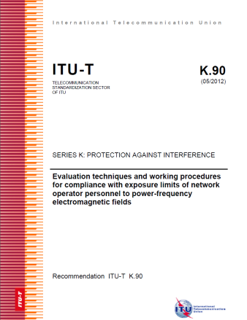
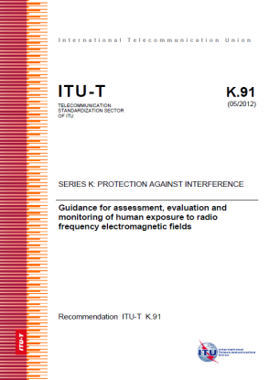
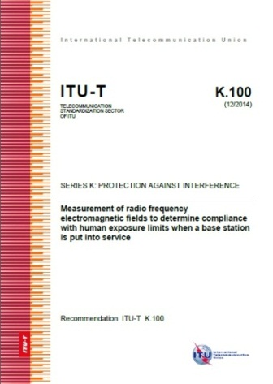
ITU-T Recommendations for EMF assessment
Recommendation ITU-T K.90 (2012) - Evaluation techniques and working procedures for compliance with limits to power-frequency (DC, 50 Hz, and 60 Hz), electromagnetic field exposure of network operator personnel – includes EMFACDC software
Recommendation ITU-T K.91 (2012/2014) - Guidance for assessment, evaluation and monitoring of human exposure to radio frequency electromagnetic fields – includes „Uncertainty calculator” and „Watt_Guard” software and Supplement „EMF-guide”
Recommendation ITU-T K.100 (2014) - Measurement of radio frequency electromagnetic fields to determine compliance with human exposure limits when a base station is put into service

Slide 19
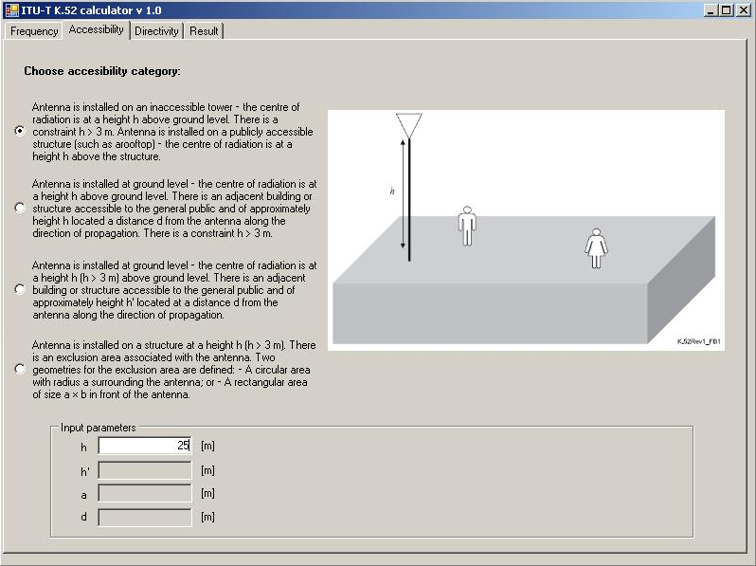
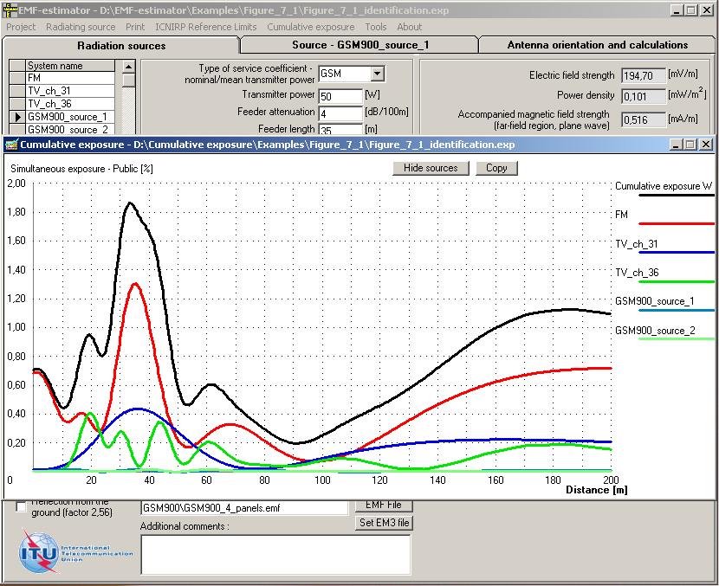
ITU-T Recommendations – additional tools
Software:
  K.52-calculator (Recommendation K.52)
  EMF-estimator (Recommendation K.70)

Slide 20
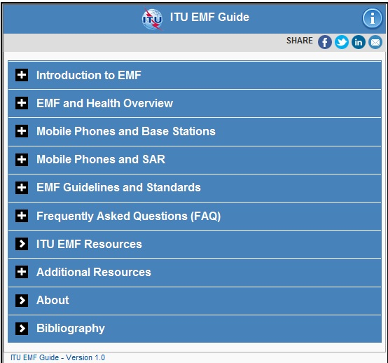
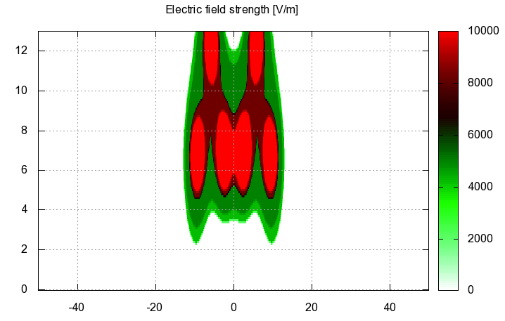
ITU-T Recommendations – additional tools
Software:
  EMFACDC (Recommendation K.90)
  Uncertainty calculator (Recommendation K.91) and „Watt_Guard” (Recommendation K.91)
Application for smartphones and tablets on EMF: „Guide on electromagnetic fields and health”, Supplement 1 to ITU-T Recommendation K.91

Slide 21
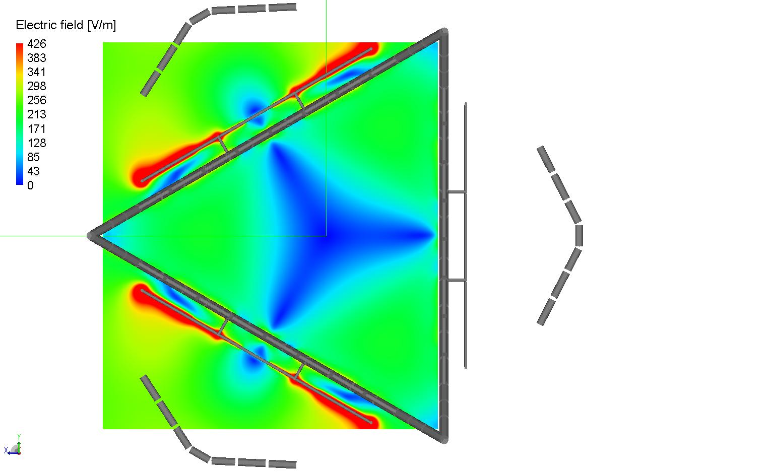
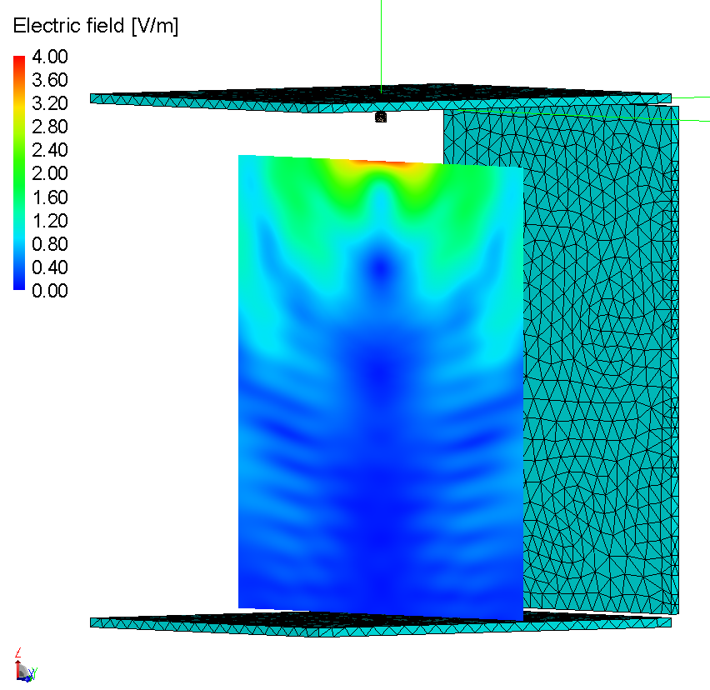
ITU-T Recommendations for EMF assessment
Recommendation ITU-T K.maps (planned for 2015) - Maps of the RF EMF
Recommendation ITU-T K.env (planned for 2016) – Guidance on the Environmental Management for Electromagnetic Radiation from Radiocommunication Base Stations
Recommendation ITU-T K.emf (planned for 2017) - Exposure levels in the close proximity of the radiocommunication antennas”

Slide 22
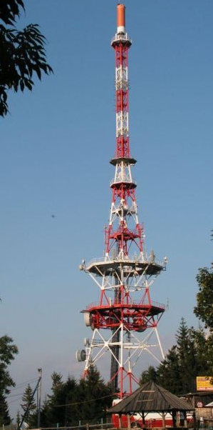
Conclusions
Main goal: the science based EMF standards that provide appropriate level of health protection
EMF standards are required for smooth and safe implementation of wireless systems
ITU-T SG5 is preparing Recommendations, which give appropriate guidance for administrations and telecommunication operators
Notes:
22

Slide 23
Thank you
Questions,
Comments?
fryderyk.lewicki@orange.com
Notes:
23

Slide 24
Recommendation ITU-T K.52
Guidance on complying with limits for human exposure to electromagnetic fields
Figure B.1/K.52 – Illustration of the accessibility category 1
Figure B.7/K.52 – Illustration of terms relating to antenna patterns
Compliance testing in an easy way:
Accessibility category + directivity category
= maximum EIRP Compliance with ICNIRP limits
Notes:
24

Slide 25
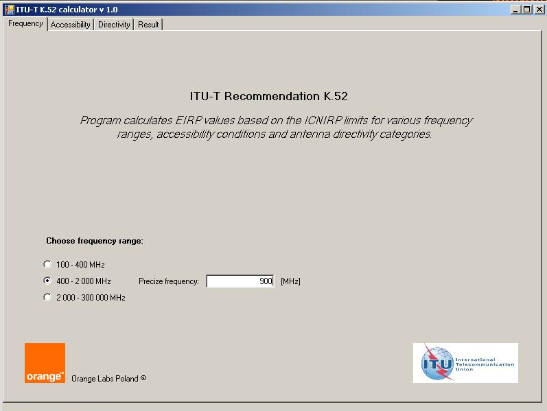

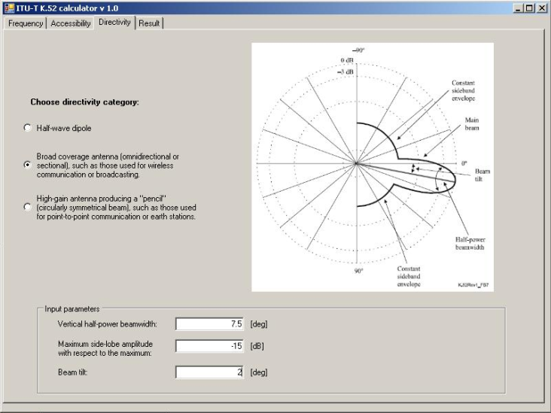
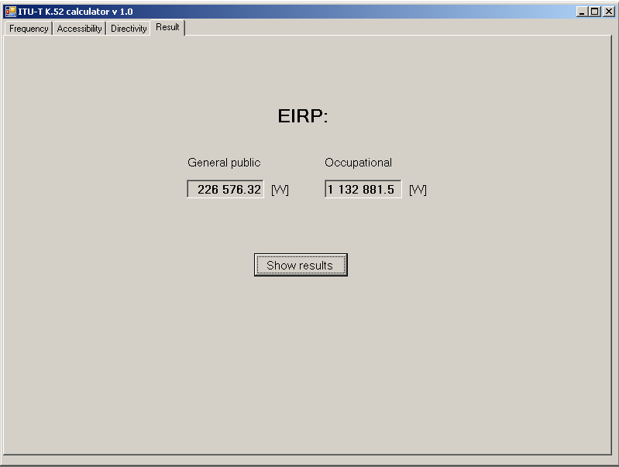
Recommendation ITU-T K.52
Software K.52 Calculator
Notes:
25

Slide 26
Recommendation ITU-T K.61
Guidance on measurement and numerical prediction of electromagnetic fields for compliance with human exposure limits, for telecommunication installations
Measurement instrumentation, measurement uncertainties, Probe selection, Procedures, Safety precautions, Field regions, Multiple sources, Time and spatial variability
List and short description of numerical methods
Notes:
26

Slide 27
Recommendation ITU-T K.61
Guidance to measurement and numerical prediction of electromagnetic fields for compliance with human exposure limits for telecommunication installations
General information concerning measurement and calculation
Notes:
27

Slide 28
ITU-T Rec. K.70, EMF-estimator
Mitigation techniques to limit human exposure to EMFs
in the vicinity of radiocommunication stations
Modeling of the transmitting antennas
Importance of the Vertical Radiation Pattern (VRP)
Identification of the main source of radiation
Mitigation techniques employed to reduce radiation level – if required
EMF-estimator – software including the library of examples of transmitting antennas
Notes:
28

Slide 29
ITU-T Rec. K.70, EMF-estimator
EMF-estimator is the Annex I to the ITU-T Recommendation K.70
The last version of the software (04.2011) may be loaded from the:
http://www.itu.int/rec/T-REC-K.70-201105-I!Amd2
http://www.itu.int/ITU-T/recommendations/index_sg.aspx?sg=5
EMF-estimator is offered by ITU-T since 06.2007
It is periodically updated / expanded according to the needs (in 2009, 2011 and 2013)
Notes:
29

Slide 30
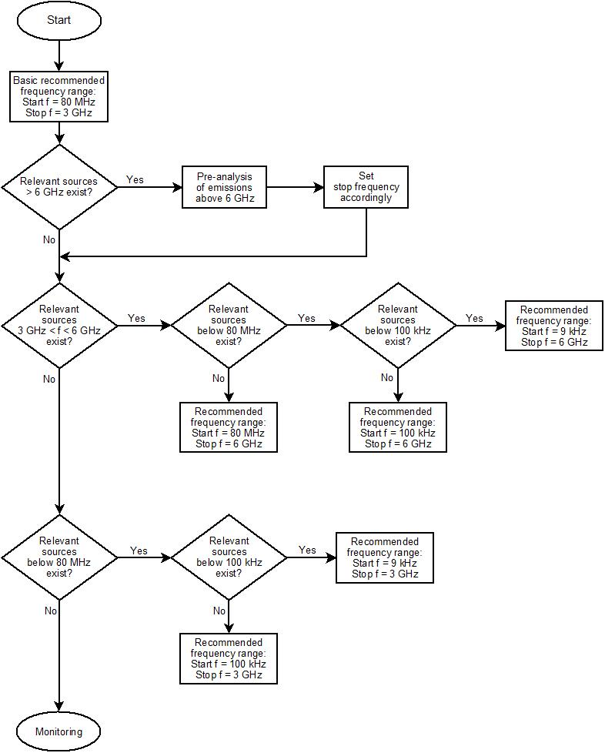
ITU-T Recommendation K.83
Monitoring of EMF levels
EMF fields are unknown to the general public
The confidence may be achieved thanks to the control of the EMF by taking continuous measurements and having a proper communication (for example websites)
The balance between costs and accuracy is very important (broadband and frequency selective measurement)
Notes:
30

Slide 31
ITU-T Recommendation K.90
Evaluation techniques and working procedures for compliance with limits to power-frequency (DC, 50 Hz, and 60 Hz), electromagnetic field exposure of network operator personnel
Guidelines for the compliance with safety limits for the personnel
EMF in the vicinity of medium-voltage (MV) and high-voltage (HV) power lines at power frequencies (DC, 50 Hz, and 60 Hz)
Software: EMFACDC
Notes:
31

Slide 32
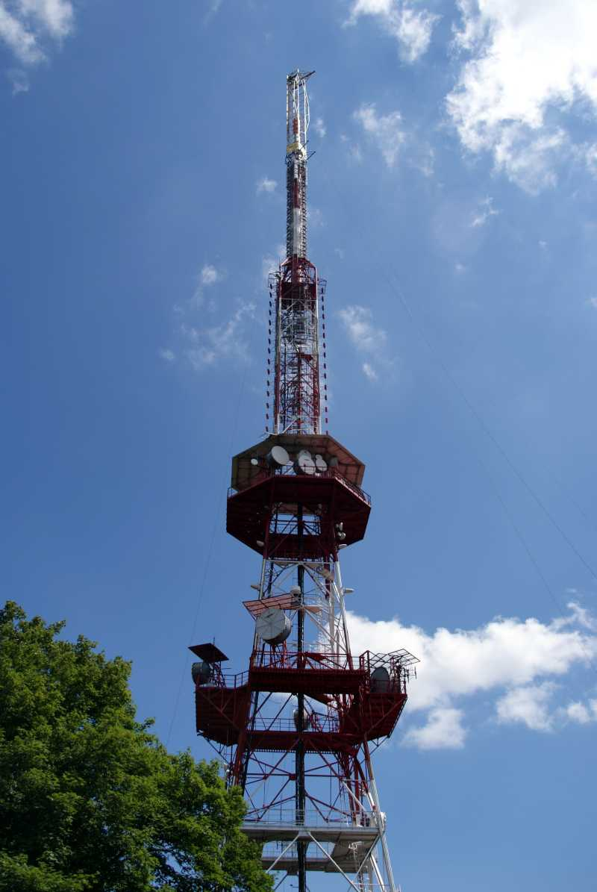
ITU-T Recommendation K.91
Guidance for assessment, evaluation and monitoring of human exposure to
radio frequency electromagnetic fields
There are plenty of standards concerning human exposure assessment
Most of the standards are very general or product oriented
In real environment there are many sources of radiation operating simultaneously
Guidance on the assessment of human exposure is required
Notes:
32

Slide 33
Supplement 1 to ITU Rec. K91
Guide on Electromagnetic Fields and Health
Developed to answer the common questions on EMF asked by the public
Promote EMF information and education resources
provides information most useful in helping to clarify uncertainties concerning EMF
Notes:
33

Slide 34
ITU-T Recommendation K.100
Measurement of radio frequency electromagnetic fields to determine compliance with human exposure limits when a base station is put into service
The procedure to assess compliance with general public EMF exposure limits
Simplified assessment procedures to identify those installations which are known to be compliant with EMF exposure limits without measurements
Notes:
34

Slide 35
ITU-R Recommendation ITU-R BS.1698
Evaluating fields from terrestrial broadcasting transmitting systems operating in any frequency band for assessing exposure to non ionizing radiation
Many practical information concerning exposure assessment around AM antennas (LW, MW and SW)
Guidelines for the exposure assessment in the vicinity of the Fixed Point-to-point antennas
Notes:
35

