Slide 1
ITU Regional Standardization Forum for Asia-Pacific (Jakarta, Indonesia, 27-28 October 2015)
TELECOMMUNICATION STANDARDIZATION IN INDONESIA
Mochamad Hadiyana (hadiyana@postel.go.id),
Deputy Director for QoS and Standardization Cooperation, MCIT Indonesia

Slide 2
Outline of Presentation
Legal Framework
Stakeholders of Standardization
MCIT Role in National Standards Development
Sector Member Participation in ITU-T Study Group
Technical Regulation Scope
Challenges

Slide 3
Legal Framework
Every telecommunications equipment traded, made, assembled, imported and/or used in Indonesia territory required to comply with technical regulation and based on license in line with prevailing laws and legislation – Article 32 clause 1 of Telecommunication Law
Source:
Law Number 36 Year 1999 concerning Telecommunication

Slide 4
Legal Framework
Objectives of technical regulation:
To ensure telecommunication network interoperability
To avoid interference among telecommunication equipment
To ensure public safety
To support national telecommunication industry, innovation and engineering
Source:
Article 72, Government Regulation Number 52 Year 2000 concerning Telecommunication Provision,

Slide 5
Legal Framework
Technical regulation establishment:
Minister endorses technical regulations taking into consideration all inputs from technical committee consisting of stakeholders (industry, telecommunication network operators/service providers, society, research institution, consumer organization and universities)
Technical regulation is formulated based on:
Adoption of international or regional standards;
Adaptation of international or regional standards; or
Adoption of Standards developed by national telecommunication industry (Indonesia National Standard)
Source:
Article 73, Government Regulation Number 52 Year 2000 concerning Telecommunication Provision

Slide 6
Stakeholders of standardization
Organization
ILAC
APLAC
IEC
JTC1
ITU
KAN
National Accreditation Committee for Testing & Calibration Laboratories
ISO
PT Telkom
APT
WTO/TBT
Secretary Gen.
Center of International Affairs
BSN
National Standardization Agency
ETSI
DG PPI
Post and ICT Provision Authority
Secretary of DG SDPPI
MCIT
Ministry of Communications and Information Technology
DG SDPPI
Radio Frequency and Post and ICT Equipment Authority
Directorate of Frequency Planning
DG APTIKA
ICT Application Authority
Directorate of Frequency Usage Revenue Collection
Sub Directorates in charge of Technical Regulations
DG IKP
Information and Public Communication Authority
Directorate of Standardization
Sub Directorate in charge of Certification
BALITBANG
Research and Development Unit
Directorate of Law Enforcement
Regional
Government
INSPECTORATE GENERAL
International
Non-Government

Slide 7
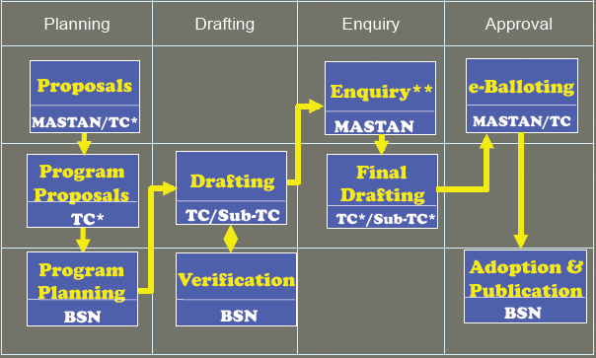
MCIT Role in National Standards Development
Participation in BSN National Standards Development

Slide 8
MCIT Role in National Standards Development
Participation in BSN National Standards Development
MCIT becomes a secretariat of TC 33-02: Telecommunication
WG Electromagnetic Compatibility
MCIT becomes a secretariat of TC 35-01: Information Technology
WG-1 Keamanan Informasi (Information Security)
WG-2 Manajemen Teknologi Informasi (IT Services)
WG-3 Kartu Elektronik (Smart Cards)
WG-4 Dokumen Elektronik (Electronic Documents)
WG-5 Glosarium (Glossarium)
WG-6 e-Health
WG-7 Transaksi Elektronik (Electronic Transactions)
WG-8 Software
The work of the TC is to adopt the ISO/IEC standards only

Slide 9
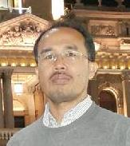
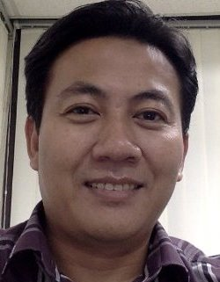
Sector Member Participation in ITU-T Study Group
PT Telkom’s R&D Center began to participate in ITU-T’s SG in SG 4 (Telecommunication Management Network) in 2001-2004 study period. A team of editors was established, consisting of 3 people: Bengris Pasaribu, Ahmed Yasser, and Adi Permadi.
In February 16, 2004, they together with other participants of SG 4 were successful to produce Rec Q.837.1 (SDH-DLC functional requirements for the network and network element views)

Slide 10
Technical Regulation Scope
Technical Regulations (TR) has been issued by Minister to make voluntary standards mandatory.
Equipment:
Wireless module
Fixed module
Wireless radio sets
Vehicle security devices
RFID Equipment
VoIP terminal equipment
Fixed wireless terminal equipment
Broadband terminal equipment
PABX/IP-PBX
Quality of service:
PSTN, mobile, internet telephony, and satellite services

Slide 11
Challenges
Standards | Industry | University/R&D | Government
Access to standards | Lack of access Budget constraint | Lack of access Budget constraint | Easy access
Contribution to standards development | Have knowledge and skill but low level of participation Profit center, not cost center | Have knowledge and skill but low level of participation Budget constraint | High level participation but lack of knowledge, skill and contribution Lack of coordination with industry and universities/R&D
Influence to standard development | Low level of influence | Low level of influence | Easy to influence in high level (policy) but lack of low level influence (technical matters)
Implementation of standards | Lack of testing facilities Profit center, not cost center | Lack of testing facilities Budget constraint | Lack of testing facilities, knowledge and skill

Slide 12
Challenges
Possible Solution
Standards | Industry | University/R&D | Government
Access to standards | Free access to standards | Free access to standards | Sharing the standards obtained with industry and university
Contribution to standards development | R&D center establishment and fellowship for industry to attend standardization meeting | Fellowship for universities/R&D centers to attend standardization meeting | Coordinating the establishment of common contribution with industry and university/R&D centers
Influence to standard development | Fellowship for industry to attend standardization meeting | Fellowship for universities/R&D centers to attend standardization meeting | Coordinating the establishment of common proposals
Implementation of standards | Establishment of regional testing center and capacity building | Establishment of regional testing center and capacity building | Establishment of regional testing center and capacity building

Slide 13
Thank You

