Slide 1
Cloud Computing Myths and Realities Towards a policy Framework for Arab countries
Nasser Kettani
Chief Technology Officer – MEA
Microsoft Corporation
nasser.kettani@microsoft.com

Slide 2
Myth 1 I don’t use Cloud Computing

Slide 3
Then, Turn Off your Smart Phone Internet Connection and See how Smart is your Phone now !

Slide 4
Myth 2 Cloud is just about Datacenter or Hosting

Slide 5
Cloud attributes
Pooled resources
Enables scalability and dynamic provisioning
Pooled resources
Enables scalability and dynamic provisioning
Elasticity
Enables resources to expand or contract based on demand
Elasticity
Enables resources to expand or contract based on demand
Self-service
Enables automated provisioning through a self-service portal
Self-service
Enables automated provisioning through a self-service portal
Usage-based
Enables usage- based resource metering
Usage-based
Enables usage- based resource metering
Notes:
The move to cloud computing should begin inside your own datacenters for 100 percent control over all the variables encountered in such a transition.
This means building a private cloud and realizing the profound effect of the new model on your business.
That profound effect is the result of four core cloud computing attributes:
First, pooled resources: this is the ability to consolidate the key elements of your infrastructure (compute, storage, and network) into pooled, manageable collections of resources, instead of expensive individual or silo’ed pieces. This opens the door for huge scalability and the ability to provision resources dynamically.
Elasticity is the second key benefit. With your resources pooled, they can expand at huge scale dynamically, -- “bursting” to meet new requirements -- and then scale quickly down when they’re done.
Third, the cloud enables self-service. Now you automate provisioning of resources or applications so that your users can go to a self-service portal and get what they need.
Finally, the cloud enables usage based resource metering, so you have the ability to know precisely how your resources are being utilized across the datacenter, which enables better charge-backs and SLAs

Slide 6
Myth 3 Cloud is all about Apps/Services

Slide 7
Traditional IT towards Cloud Computing
Traditional IT
IaaS
PaaS
SaaS
Applications
Applications
Applications
Applications
YOU MANAGE
Data
Data
Data
Data
Runtime
YOU MANAGE
Runtime
Runtime
Runtime
Middleware
Middleware
Middleware
Middleware
YOU MANAGE
O/S
O/S
O/S
DELIVERED AS A SERVICE
O/S
Virtualization
Virtualization
DELIVERED AS A SERVICE
Virtualization
Virtualization
Servers
Servers
Servers
Servers
DELIVERED AS A SERVICE
Storage
Storage
Storage
Storage
Networking
Networking
Networking
Networking
Managed by You
Delivered as Service

Slide 8
Myth 4 Cloud is in Public Data Center

Slide 9
Which cloud is right for me?
Abstraction Level
IaaS
PaaS
SaaS
Datacenter Location
On Site
Partner
Cloud Provider
Access
Private
Community
Public
Notes:
Key points:
Not just Web apps or leveraging a third-party’s datacenter but a fundamental shift in the way IT is delivered
From a competitive standpoint important to broaden the concept of cloud beyond Microsoft’s data-centers and across devices.
Script:
“the cloud” was originally coined to describe the otherness of the Internet but, increasingly, it is synonymous with the move to “cloud computing” or “cloud services”. As with many topics that blend technical subjects with business hype there are a number of competing definitions. Many of Microsoft’s competitors define the cloud in narrow terms that define the current – and often – restricted subset of offerings. Microsoft has a broad portfolio of offerings and these are available to a wide audience of users including consumers, businesses and governments and so Microsoft’s has bigger ambitions with the cloud and thus its definition of the cloud is necessarily broader.
The cloud impacts every aspect of IT and it impacts the users of IT, the administrators and operators of IT, the purchasers of IT and the developers of IT. Because this fundamental impact on IT cuts to the heart of what it means to use the cloud, Microsoft prefers this as the basis for its definition of the cloud: delivering IT as a standardized service.
For many, sound reasons, customers and partners will prefer to host the cloud platform and its services in their datacenters, or their partners’ datacenters. Microsoft – almost uniquely – in the software industry believes that the cloud is a software capability that it will provide in its datacenters but which it will sell to customers and partners to run in their datacenters too.
So what? Why should I care?

Slide 10
Myth 5 You need to strike a balance
Agility, Cost, Flexibility, …
Security, Privacy, Reliability

Slide 11
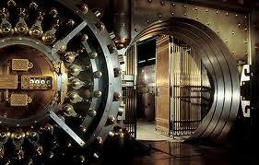
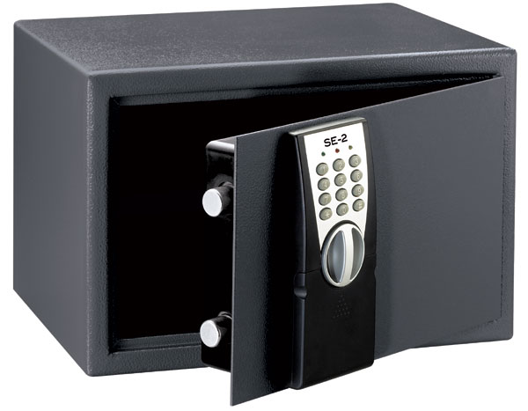
This is the Real Balance
Your Cloud
Public Cloud

Slide 12
This is the Real Balance
Public Cloud
Your Cloud

Slide 13
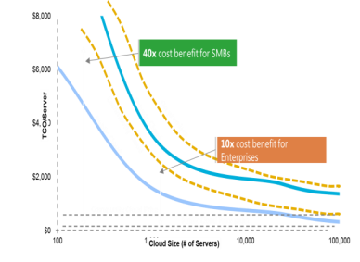
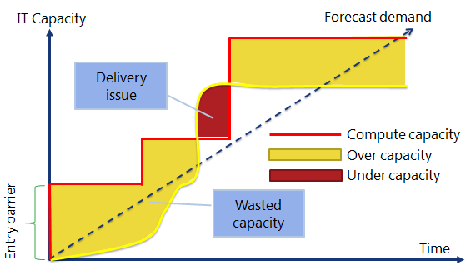
Cloud Economics – beyond theory
How customers are benefit from Cloud Computing
ECONOMICS
AGILITY
Notes:
You are not alone , there are many government around the world that are leading the rest of the industries in harnessing the power of cloud.
They do it for three reasons:
Economics: the cloud is cheaper and i will get into the reason why. In the longe run analysts expect a convergence to public clouds but from a cost model it is easy to see why large governments do not move as quickly or move differently than smaller entities (eg municipalities)
Agility: The cloud offers better demand management without entry barriers. Its promise to provide ‚evergreen‘ latest stage services helps governments to regain agility both from a citizen service but also from a financial perspective (CAPEX -> OPEX)
Innovation: The cloud unleashes innovation potential by taking away CAPEX investment requirements, the ability to open data sources and to connect governments, citizens and businesses way beyond what is possible today

Slide 14
Myth 6 I can fix with my own Policies

Slide 15
Clouds have no barriers

Slide 16
Myth 7 Cloud destroys jobs

Slide 17
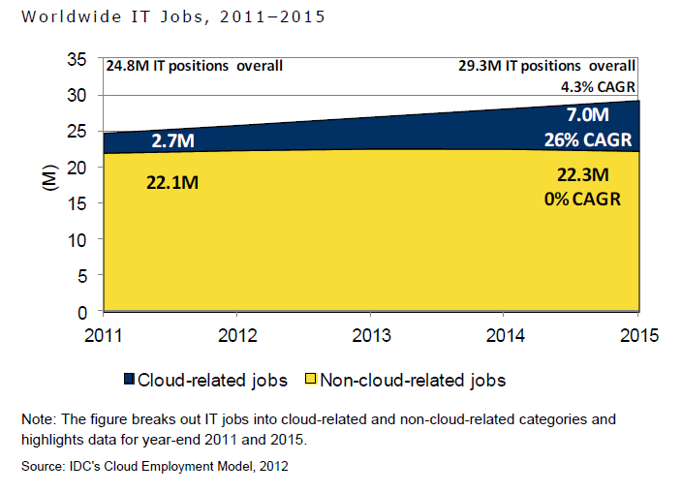
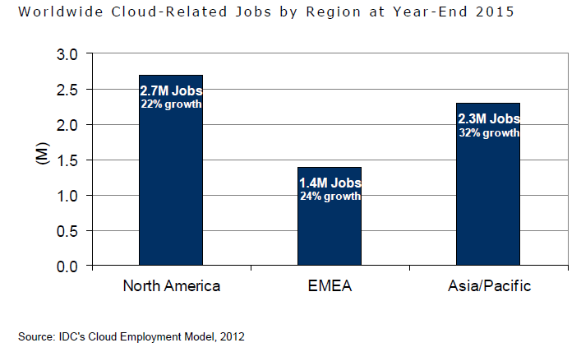
Cloud Dominates IT Job Creation

Slide 18
Myth 8 Priority Policies are about Security, Privacy, …

Slide 19
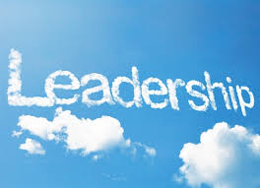
What about?
Infrastructure
Skills
Innovation
Incentive

Slide 20
Yes there are issues that need to be addressed
Transparency
Accountability
Compliance
Child Protection
International Cooperation
Govt Access
Cyber Security

Slide 21
Recommendations
Engage on Standards NOW (ITU, ISO, …)
Build a Cloud 1st Policy
Seek for Harmonized Open Norms and Policies
Develop Strategic Data Classification Framework
Education, Education, Education
Lead Lead Lead

Slide 22
© 2012 Microsoft Corporation. All rights reserved. Microsoft, Windows, and other product names are or may be registered trademarks and/or trademarks in the U.S. and/or other countries.
The information herein is for informational purposes only and represents the current view of Microsoft Corporation as of the date of this presentation. Because Microsoft must respond to changing market conditions, it should not be interpreted to be a commitment on the part of Microsoft, and Microsoft cannot guarantee the accuracy of any information provided after the date of this presentation. MICROSOFT MAKES NO WARRANTIES, EXPRESS, IMPLIED OR STATUTORY, AS TO THE INFORMATION IN THIS PRESENTATION.

