Slide 1
Cloud Computing: ITU-T SG 13 Activities & Tunisie Telecom Experience
Joint ITU-AICTO Regional
Standardization Forum for Arab Region
(Tunis, Tunisia, 27 January 2014)
Rim Belhassine-Cherif, Ph.D.
Executive Director of Products and Services, Tunisie Telecom
Vice-chair of ITU-T Study Group 13
rim.belhassine-cherif@tunisietelecom.tn

Slide 2
Agenda
1. What is Cloud Computing?
2. ITU-T SG 13 Work on Cloud Computing
3. Experience of Tunisie Telecom with Cloud Computing
4. Conclusion & Recommendations

Slide 3
Agenda
1. What is Cloud Computing?
2. ITU-T SG 13 Work on Cloud Computing
3. Experience of Tunisie Telecom with Cloud Computing
4. Conclusion & Recommendations

Slide 4
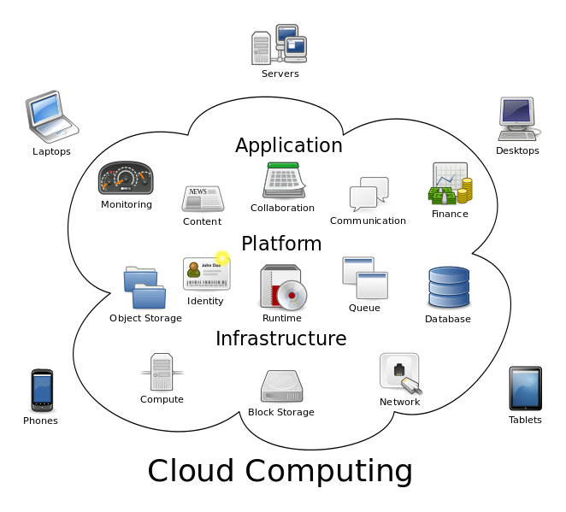
What is Cloud Computing ?
1
ITU-T Focus Group Cloud Definition *
“Cloud Computing is an emerging IT development, deployment and delivery model, enabling service users to have ubiquitous, convenient and on-demand network access to a shared pool of configurable computing resources (networks, servers, storage, applications, and services) that can be rapidly provisioned and released with minimal management effort or service-provider interaction.”
* Partially based on NIST cloud definition

Slide 5
What is Cloud Computing ? Main Characteristics
2
On-demand self-service
Ubiquitous network access
Location independent resource pooling
Rapid elasticity
Pay per use

Slide 6
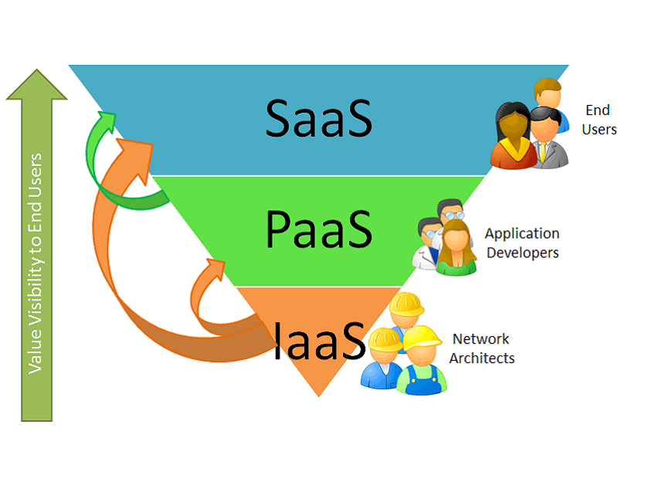
What is Cloud Computing ? Service Models
3
SaaS
Use provider’s applications over a network
PaaS
Deploy customer-created applications to a cloud
IaaS:
Rent processing, storage, network capacity, and other fundamental computing resources

Slide 7
Agenda
1. What is Cloud Computing?
2. ITU-T SG 13 Work on Cloud Computing
3. Experience of Tunisie Telecom with Cloud Computing
4. Conclusion & Recommendations

Slide 8
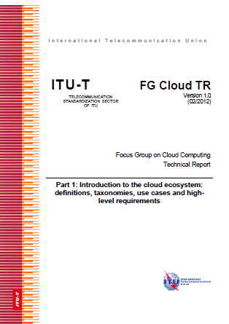
SG 13 Work on CC Prior ITU-T works
1
Focus Group Cloud Computing
Established further to ITU-T TSAG agreement at Geneva meeting, 8-11 February 2010
Concluded in December 2011 with the publication of a technical report in 7 parts :
Introduction to the cloud ecosystem: definitions, taxonomies, use cases and high-level requirements
Functional requirements and reference architecture
Requirements and framework architecture of cloud infrastructure
Cloud resource management gap analysis
Cloud security
Overview of SDOs involved in cloud computing
Cloud computing benefits from telecommunication and ICT perspectives

Slide 9
SG 13 Work on CC Study period 2009-2012
2
Creation of new WP 6/13 : Cloud Computing
(February 2012)
3 questions:
Q26/13
Q27/13
Q28/13
Cloud computing ecosystem, inter-cloud and general requirements
Cloud functional architecture, infrastructure and networking
Cloud computing resource management and virtualization

Slide 10
SG 13 Work on CC Study period 2009-2012
3
Main Questions’ tasks:
Developing New Recommendations on the Cloud Computing regarding:
Definition and vocabulary
Ecosystem , use cases & general requirements
Reference Architecture of cloud computing
Infrastructure functional requirements
Resource Management, DaaS & InterCloud
…

Slide 11
SG 13 Work on CC Study period 2013-2016
4
3 questions under the scope of WP 2/13 :
Cloud Computing and Common Capabilities
Q17/13
Q18/13
Q19/13
Cloud computing ecosystem, general requirements, and capabilities
(Continuation of Q26/13)
Cloud functional architecture, infrastructure and networking
(Continuation of Q27/13)
End-to-end Cloud computing service and resource management
(Continuation of Q28/13)
Common task: Providing necessary collaboration with external SDOs, consortia and forums working on CC

Slide 12
SG 13 Work on CC Study period 2013-2016
5
Q17/13: Cloud computing ecosystem, general requirements, and capabilities
Work Items (under study):
Y.BigData-reqts : Requirements and capabilities for cloud computing based big data
Y.ccdef : Cloud computing - Overview and Vocabulary
Y.daas : Requirement and reference architecture of desktop as a service

Slide 13
SG 13 Work on CC Study period 2013-2016
6
Q18/13: Cloud functional architecture, infrastructure and networking
Q19/13: End-to-end Cloud computing service and resource management
Work Items :
Y.3511 : Framework of inter-cloud for network and infrastructure (consented on 2013-11-15)
Y.cciaas : Functional requirements and architecture of IaaS service
Y.ccnaas : Requirements, use cases and functional architecture of network as a service
Y.ccra : Cloud computing reference architecture
Work Items (under study):
Y.e2ecslm-Req : End-to-end cloud service lifecycle management
Y.e2ecmrgb : Common Model for E2E Cloud Computing Resource Management

Slide 14
SG 13 Work on CC Approved Recommandations
7
Q17/13
ITU-T Y.3501 (Approved in 2013-05)
Cloud computing framework and high-level requirements
Q18/13
ITU-T Y.3510 (Approved in 2013-05)
Cloud Computing Infrastructure Requirements
Q19/13
ITU-T Y.3520 (Approved in 2013-06)
Cloud computing framework for end to end resource management

Slide 15
SG 13 Work on CC Joint Coordination Activity for Cloud Computing (JCA-Cloud)
8
Established after the TSAG agreement in January 2012 meeting with SG13 as parent group (Cf. TSB Circular 261)
Scope :
coordination of the ITU-T cloud computing standardization work within ITU-T
For example: SG2 on telecommunication management, SG5 on ICT and climate change, SG11 on protocols and interoperability, SG12 on QoS and SG17 on security
coordination of the communication with standards development organizations and forums working on Cloud Computing protocols and standards

Slide 16
Active Organizations in cloud standards
Definition, Ecosystem, Network, Access & Architectures
ITU-T - Cloud Computing Focus Group , SG 13 and SG 17
ISO IEC-JTC 1; SC 38: Distributed Application Platforms and Services (SOA, WS, Cloud)
NIST - National Institute of Standards and Technology
W3C – activities on HTML-5 (offline mode, multi-device…)
IETF - Network & Real Time Communication protocols
Management API, Inter-cloud and security
DMTF – Distributed Management Task Force
SNIA - Storage Networking Industry Association
OGF – Open Grid Forum
GICTF - Global Inter-Cloud Technology Forum
TM Forum – Tele Management Forum
OASIS
Cloud Security Alliance

Slide 17
Agenda
1. What is Cloud Computing?
2. ITU-T SG 13 Work on Cloud Computing
3. Experience of Tunisie Telecom with Cloud Computing
4. Conclusion & Recommendations

Slide 18
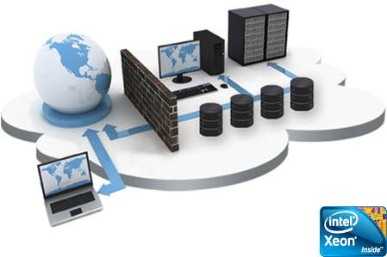
TT Strategy for Cloud Solutions
Offer innovative services and match the market trends
Enrich its service portfolio
Maintain its position as an "Historical Operator" and be a leader in the local market
Reduce Opex and Capex

Slide 19
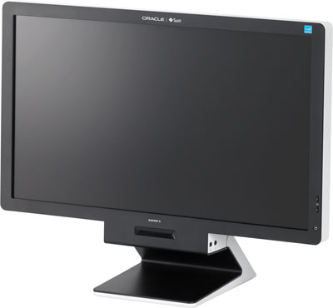
Existing TT Cloud Computing Offers
Corporate Housing
DaaS « Desktop as a Service»
Housing service provides Corporate Customers with space, power, cooling, and physical security for their server, storage, and networking equipment in TT Data Center
DaaS: A thin Client is provided to customer while the back-end of a virtual desktop infrastructure (VDI) is hosted by TT cloud.
SaaS « Software as a Service »
Hosted Conferencing Solutions
Microsoft MCS2010 platform based Solution. The following services are provided:
- Exchange
- Link
- Sharepoint
Audio conference
Video conference
Web Meeting

Slide 20
Future TT Cloud Computing services
1
Tunisie Telecom intends to implement a Cloud Computing platform being secured, scalable and efficient
In the first phase, the following services will be provided:
IaaS : Infrastructure as a Service (DS, VPS, Storage)
BaaS : Backup as a Service
Web Hosting
Firewalling as a Service
Load Balancing as a Service

Slide 21
Future TT Cloud Computing services
2
The platform is characterized by the following features:
High availability
Flexibility and scalability
High security
end-to-end physical and logical security
Fully automatic service provisioning
➔ reduce activation time

Slide 22
TT DATA Centers
TIA-942 Standard
Kasbah Data Center (First TT DC )
Area: 280 m², 92 42U Racks
Redundant power and redundant air conditioning
Hosts TT SaaS platform and Cloud Platform (nearly)
Used for Corporate Housing TT offers
Carthage Data Center
A second Data Center : Hosting new platforms and can be used for load balancing. This DC is ready since October 2013
Kairouan Data Center
Data Center for «Disaster Recovery»
Installation is in going

Slide 23
TT Preparations for the Cloud
Qualification and certification of TT Team in many technical fields (Networks, Security, Infrastructure, virtualization, storage…)
Network and Data Center Monitoring centers
(24 x 7)
Processes for services , conform to international standards (ITIL or eTOM)
Assisting the companies as a long-term partner for telecom and IT services

Slide 24
Agenda
1. What is Cloud Computing?
2. ITU-T SG 13 Work on Cloud Computing
3. Experience of Tunisie Telecom with Cloud Computing
4. Conclusion & Recommendations

Slide 25
Conclusion
1
Cloud Computing, with its interesting characteristics and different service models, is seen as an opportunity for customers but also as a challenge for telecom stakeholders that should more concentrate their activities on this concept
ITU, as other worldwide SDOs, was interested in the Cloud Computing concept, and that, since 2010 and it is continuing its work on Cloud Computing under the lead of its ITU-T Study Group 13
SG 13 is deploying serious efforts in developing standards that encloses many Cloud Computing-related aspect (definition, ecosystem , general requirements, Reference Architecture, Infrastructure, Resource Management, DaaS,...) and that, in collaboration with other study groups through the JCA-Cloud

Slide 26
Conclusion
2
Tunisie Telecom is aware of the emergence of cloud computing
Exciting Revolution in Computer Infrastructure
TT has focused since 2010 on Cloud Computing offers : "SaaS", "DaaS“,…
TT is still investing in Cloud computing infrastructure for cloud services to host more enhanced services: Storage as a service, Firewall as a service, Load balancing service, …
TT capitalizes on its teams: training, certifications …
The main aim is to offer cloud services supporting quality of service, in order to ensure customer satisfaction

Slide 27
Recommendations
1
Cloud Computing standards should follow the accelerating rhythm of Cloud Computing growth and evolution and that, in order to make it reach its full potential, become universally accepted and implemented and avoid service provider lock-in
Cloud computing standardization should be managed to support both innovation and competition, maximize contribution in the standardization process and minimize incompatibility of competing cloud services
Standardization should focus on the most important challenges of Cloud Computing (efficiency of service provisioning, effectiveness of service usage and control, transparency of service delivery and billing, information security, data privacy, interoperability, portability between providers, ensuring fair competition in the market and compliance with regulatory requirements*) which are slowing down the adoption of Cloud Computing in markets around the world
* Booz & Company, “The Standardization Environment for Cloud Computing”, 2013

Slide 28
Recommendations
2
Cloud Computing standardization stakeholders should further collaborate and work together in order to avoid standards fragmentation
Governments need to promulgate the legal and regulatory standards to ensure the consistent regulatory environment to concentrate on specific CC issues such as privacy
Since telecommunication technologies, infrastructure and networks varies from a region to another, it is important for SG13 to incorporate more regional groups in order to encourage national authorities and operators from region’s countries to work together and better contribute to the SG 13 activities in general and to Cloud Computing in particular

Slide 29
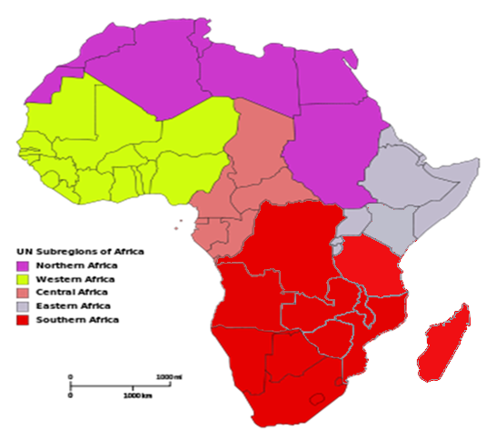
Recommendations
3
A similar approach were proposed for the SG13RG-AFR in the last SG 13 meeting in November 2013 (work partitioning on 5 different African regions). This approach will be approved during the SG13RG-AFR second meeting next 10-11 April in Tunisia, which will be hosted by Tunisie Telecom
Arabic region, having many similarities between its countries regarding language, culture, and telecommunication attributes (infrastructure, technologies Networks,…) can present opportunities for the creation of a Task Force around Cloud Computing in order to further and effectively contribute to the standardization activities of the ITU-T SG 13 on the Cloud Computing

Slide 30
Thank you for Your Attention
Joint ITU-AICTO Regional
Standardization Forum for Arab Region
(Tunis, Tunisia, 27 January 2014)
Rim Belhassine-Cherif, Ph.D
Executive Director of Products and Services, Tunisie Telecom
Vice-chair of ITU-T Study Group 13
rim.belhassine-cherif@tunisietelecom.tn

