Slide 1
Overview of ITU Standards For Broadband
Bilel Jamoussi, ITU

Slide 2
Notes:
Do you remember the narrowband times… ?
No YouTube, hardly any Skype, never-ending progress bars. Billing per minute online.
Figure illustrates the handshake of a dialup modem connecting to the Internet.
With audio

Slide 3
We’ve come a long way...
Broadband subscriptions (millions)
Total: 2.8bn (estimate 2013)
Source: ITU
Notes:
Much has happened since: We have left the narrowband era
ITU’s estimate for 2013: 2.8bn broadband subscriptions
Important to note: subscriptions in so-called developing countries have rapidly caught up and by now overtaken developed countries…

Slide 4
Broadband to go…
Broadband subscriptions (millions) by access
Total: 2.8bn (estimate 2013)
Source: ITU
Notes:
This is largely due to the rapid uptake of mobile broadband, which now represents ¾ of all broadband subscriptions.
We also note that fixed broadband is continuing its growth and will reach a total of 0.7bn subscriptions in 2013.

Slide 5
Fixed broadband by technology
Total: 321 million subscriptions in OECD countries (June 2012)
Source: OECD
Notes:
Having a closer look at fixed broadband, we see 3 dominating technologies: DSL, Cable, and Fiber.
This is based on statistics in the OECD countries.
ITU STAT data for some countries, but no global estimate.

Slide 6
DSL
Copper based
Available in any region of the world
Capable of providing up to 100 Mbps, today
Zphaze (CC BY-NC 2.0)
Notes:
Digital Subscriber Line (DSL) service provides a connection to the Internet through the telephone network. Unlike dial-up, DSL can operate using a single phone line without preventing normal use of the telephone line for voice phone calls. DSL uses the high frequencies, while the low (audible) frequencies of the line are left free for regular telephone communication. These frequency bands are subsequently separated by filters installed at the customer's premises.

Slide 7
DSL
Type | ITU-T | Initial approval | Max down
HDSL | G.991.1 | 1998 | 2 Mbps
ADSL | G.992.1 | 1999
SHDSL | G.991.2 | 2001
ADSL2 | G.992.3 | 2002
VDSL | G.993.1 | 2004
VDSL2 | G.993.2 | 2006 | 100 Mbps
 | G.fast | [2014] | 1 Gbps
Zphaze (CC BY-NC 2.0)
Notes:
The family of ITU-T Recommendations on DSL includes 19 ITU-T Recommendations. (G.Sup50 : Overview of digital subscriber line Recommendations: http://www.itu.int/rec/T-REC-G.Sup50-201109-I/en)
A few key xDSL technologies and their ITU-T designation are listed here. What started with maximum downlink and uplink speeds of about 1 Mbps has now reached 100 Mbps.
Experts in ITU-T Study Group 15 are enhancing working on the next generation of DSL standards.
“Bonding”, “Vectoring” and “Phantom mode” are enabling technologies for the next generation of DSL standards, realizing speeds up to 1 Gbps.
ITU-T G.fast is the working title for an upcoming ITU-T Recommendation.
G.fast will and other copper innovations allow operators to gradually build up their fiber networks.

Slide 8
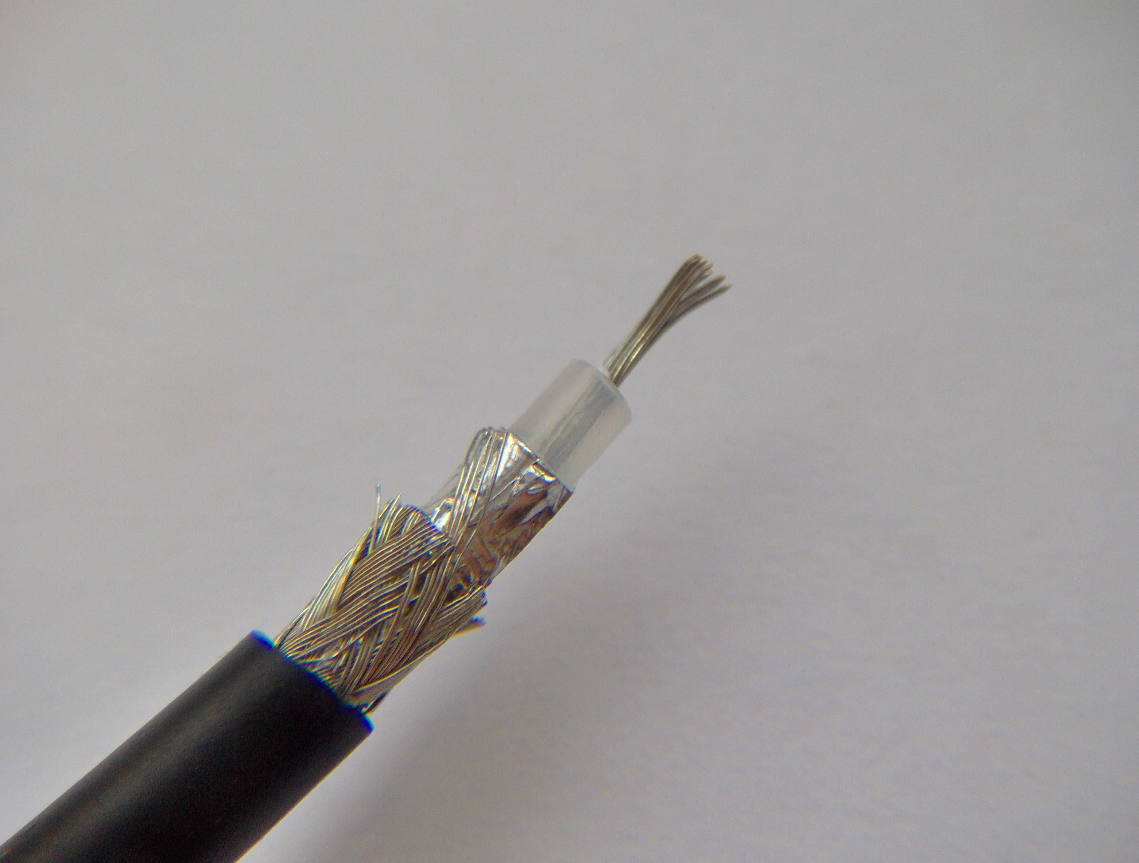
Cable
Hybrid Fibre Coaxial wiring
Originally developed to carry TV signals
Up to 250 Mbps
FDominec (CC BY-SA 3.0)
Notes:
Current commercial deployments provide up to 250 Mbps downstream and 15 Mbps up.
The U.S. Federal Communications Commission (FCC) urged U.S. providers to make 100 Mbit/s a standard speed available to 100 million households before 2020, and cable is a technology seen to contribute to achieve this speed on a large scale in that time frame.

Slide 9
Cable
Type | ITU-T | Initial approval | Max down
 | J.83 | 1998 | 38 Mbps
DOCSIS 1.1 | J.112 (Annex B) | 2001 | 50 Mbps
DOCSIS 2.0 | J.122 | 2002 | 50 Mbps
DOCSIS 3.0 | J.222.1 | 2007 | n x 50 Mbps
 | J.atrans | [2013]
DOCSIS: Data Over Cable Service Interface Specification
FDominec (CC BY-SA 3.0)
Notes:
ITU-T Study Group 9
ITU-T J.83 : Digital multi-programme systems for television, sound and data services for cable distribution, parts of it are basis for DOCSIS specifications
Max down and uplink for DOCSIS 3.0 depends on number of channels n x 50 Mbps
An update of J.83 is proposed in J.381 (Requirements for advanced digital cable transmission technologies) and the J.atrans family of standards. Atrans - advanced digital cable transmission technologies

Slide 10
Fibre
Optical fibre to replace all or part of the metal local loop
High speed over (relatively) long distances
flakeparadigm (CC BY-SA 2.0)
Notes:
Different configurations

Slide 11
Fibre
PON: Passive Optical Network
Type | ITU-T | Initial approval | Max down
BPON | G.983 | 1998 | 622 Mbps
GPON | G.984 | 2003 | 2.5 Gbps
XG-PON | G.987 | 2010 | 10 Gbps
NG-PON2 | G.989 | 2013 | 40 Gbps
flakeparadigm (CC BY-SA 2.0)
Notes:
ITU-T SG15 is spearheading the GPON standards world.
A passive optical network (PON) is a point-to-multipoint, fiber to the premises network architecture in which unpowered optical splitters are used to enable a single optical fiber to serve multiple premises, typically 16-128.
A PON consists of an optical line terminal (OLT) at the service provider's central office and a number of optical network units (ONUs) near end users.
A PON reduces the amount of fiber and central office equipment required compared with point-to-point architectures. A passive optical network is a form of fiber-optic access network.
BPON – broadband PON – 622 Mbps down / 155 Mbps up
GPON – Gigabit PON – 2.488 Gbps down / 1.244 Gbps up
XG-PON – 10 Gig PON – 10 Gbps down / 2.5 Gbps up
NG-PON2 – Next Generation PON – 40 Gbps down / 10 Gbps up
Fibre expected to be used in combination with G.fast copper on the last meters (e.g., from curb to home)

Slide 12
Optical Transport Networks (OTN)
Key enabler for fixed and mobile Broadband uptake
Mechanism to build multiple networks and services (e.g., video, Internet) over a single infrastructure
Key standards: ITU-T G.709, ITU-T G.798
Outlook: Faster, more efficient, resilient, cheaper core transport solutions – beyond 100 Gbps

Slide 13
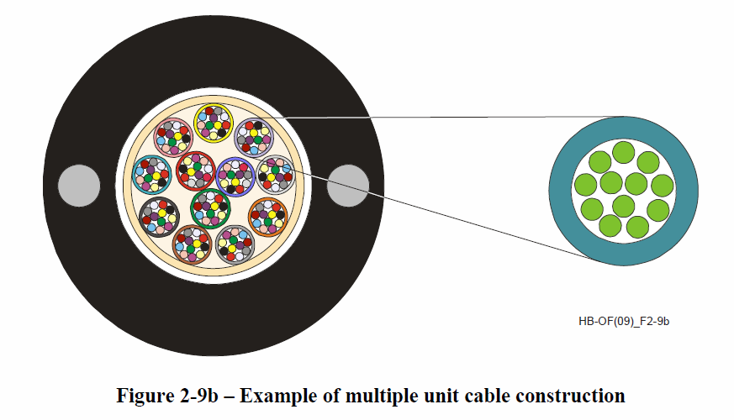
The Fibre Basics
ITU-T L series standards for characteristics of fibres and cables, installation, system design, etc.
Notes:
Upper figure: Example of multiple unit cable construction
Lower figure: Installation of optical cables with the mini-trench technique (For further information on this installation technique, see Recommendation ITU-T L.48).

Slide 14
Taking Broadband to the Next Level
Ever faster broadband transport and access solutions over fibre, copper and fibre plus copper are in the pipeline.
ITU-T standards are an essential aid to countries in building and upgrading their infrastructure and encouraging economic development.
Through economies of scale, standards help reduce costs for manufacturers, operators and consumers.

Slide 15
ITU-R Studies for WRC-15 on IMT
Agenda items for WRC-15 (Resolution 807 (WRC-12)):
1.1 to consider additional spectrum allocations to the mobile service on a primary basis and identification of additional frequency bands for International Mobile Telecommunications (IMT) and related regulatory provisions, to facilitate the development of terrestrial mobile broadband applications, in accordance with Resolution 233 (WRC‑12);
1.2 to examine the results of ITU‑R studies, in accordance with Resolution 232 (WRC‑12), on the use of the frequency band 694-790 MHz by the mobile, except aeronautical mobile, service in Region 1 and take the appropriate measures;
Spectrum requirements for the mobile service including suitable frequency ranges, and other specific requirements
Spectrum sharing and compatibility with other services
including consolidation of draft CPM text

Slide 16
Spectrum identified for IMT
Frequency bands identified for IMT in the Radio Regulations (RR):
Band (MHz) | RR Footnotes identifying the band for IMT
450 – 470 | 5.286AA
698 – 960 | 5.313A, 5.317A
1 710 - 2 025 | 5.384A, 5.388
2 110 - 2 200 | 5.388
2 300 - 2 400 | 5.384A
2 500 - 2 690 | 5.384A
3 400 - 3 600 | 5.430A, 5.432A, 5.432B, 5.433A
16

Slide 17
Proposed frequency ranges
Description | Freq. ranges (MHz) | Inputs to WP 5D
< 1 GHz | 470-694 | 470-598
 |  | 598-608
 |  | 608-614
 |  | 614-694
 | 694-790 | 694-790
~ 1.5 GHz | 1000-1700 | 1000-1300
 |  | 1300-1375
 |  | 1375-1400
 |  | 1400-1427/1427.9
 |  | 1427/1427.9-1452
 |  | 1452-1462.9
 |  | 1462.9-1475.9
 |  | 1 475.9-1492
 |  | 1492-1510/1510.9
 |  | 1510/1510.9-1518
 |  | 1518-1525
 |  | 1525-1559
 |  | 1559-1610
 |  | 1610-1660.5
 |  | 1660.5-1668
 |  | 1668-1675
 |  | 1675-1700
17

Slide 18
Proposed frequency ranges
Description | Freq. ranges (MHz) | Inputs to WP 5D
~ 2 GHz | 2025-2110 | 2025-2090
 |  | 2090-2110
 | 2200-2290 | 2200-2215
 |  | 2215-2290
 | 2700-3400 | 2700-2900
 |  | 2900–2930
3-5 GHz |  | 2930-3100
 |  | 3100-3200
 |  | 3200-3300
 |  | 3300-3400
 | 3400-5000 | 3400-3492.5
 |  | 3492.5-3542.5
 |  | 3542.5-3575
 |  | 3575-3600
 |  | 3600-3800
 |  | 3800-4200
 |  | 4200-4400
 |  | 4400-4900
 |  | 4900-5000

Slide 19
Proposed frequency ranges
Description | Freq. ranges (MHz) | Inputs to WP 5D
~ 2 GHz | 2025-2110 | 2025-2090
> 5 GHz | 5350-5470 | 5350-5470
 | 5850-6425 | 5850-5925
 |  | 5925-6425
> 6 GHz | Above 6000 | Above 6000

Slide 20
Initial views on spectrum requirements
Review of the methodology (Rec. ITU-R M.1768-1)
WP 5D members are considering the following Total/Additional spectrum requirements (in MHz):
by 2014: 275*;
by 2015: 600-800**;
by 2017: 300*; by 2020: 1081/300*; 1065/385*; 2020**; 1700-2100**; 1240ª/1880^{b}**; 1600-1800* or (300)+200*
*Using an original methodology **Using Rec. ITU-R M.1768
ª for lower user density ^{b} for higher user density

Slide 21
IMT-Advanced is the next generation set of standards in the International Mobile Telecommunications (IMT) framework for global wireless broadband communications.
IMT Standards Evolution
1985
WCDMA
CDMA2000
HSPA
LTE
EV-DO
HSPA+
TD-SCDMA
HSDPA
Following a detailed evaluation against stringent technical and operational criteria, ITU has determined that “LTE-Advanced” and “WirelessMAN-Advanced” were accorded the official designation of IMT-Advanced.
EDGE (UWC-136)
EDGE Evolution
3G
IMT-2000
CDMA-DS, CDMA-MC
CDMA-TDD
TDMA-SC
FDMA-TDMA
OFDMA-TDD-WMAN
4G
IMT-Advanced
IMT-Next Decade
Studies are underway to harmonize the existing spectrum identified for IMT and to determine the additional spectrum required to support the burgeoning demand for mobile broadband
LTE-Advanced
WirelessMAN-Advanced
2 Mbit/s 1 Gbit/s

Slide 22
The Technologies of IMT
IMT-2000 Technologies
Rec. ITU-R M.1457-11, Detailed specifications of the terrestrial radio interfaces of International Mobile Telecommunications-2000 (IMT-2000)
First Released in year 2000
Updated approximately annually to accommodate the continuous improvement/evolution of the technology - Revision 12 in progress
Six Technologies in IMT-2000 today
IMT-2000 CDMA Direct Spread
IMT-2000 CDMA Multi-Carrier
IMT-2000 CDMA TDD
IMT-2000 TDMA Single-Carrier
IMT-2000 FDMA/TDMA
IMT-2000 OFDMA TDD WMAN.

Slide 23
The Technologies of IMT
IMT-Advanced Technologies
Rec. ITU-R M.2012, Detailed specifications of the terrestrial radio interfaces of International Mobile Telecommunications Advanced (IMT-Advanced)
Call for technology proposals in March 2008 (5/LCCE/2)
Candidate Technology Proposals Received in October 2009 & Evaluation/Selection of Technologies for IMT-Advanced completed in December 2010
First Release of M.2012 in year 2012 - Revision 1 is in the approval phase to accommodate the underway improvement/evolution of the technology
Two Technologies in IMT-Advanced today
“LTE-Advanced” - Developed by 3GPP as LTE Release 10 and Beyond (LTE-Advanced).
“WirelessMAN-Advanced” -Developed by IEEE as the WirelessMAN-Advanced specification incorporated in IEEE Std 802.16 beginning with approval of IEEE Std 802.16m.

Slide 24
IMT-Advanced The advanced future of IMT mobile broadband is happening now and happening rapidly!

Slide 25
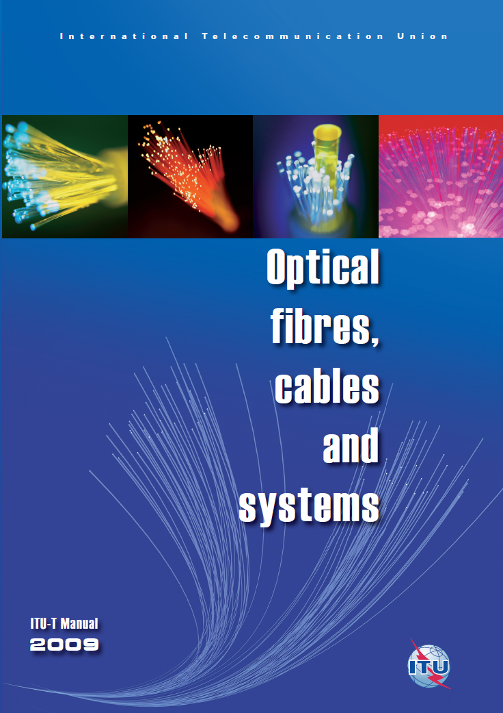
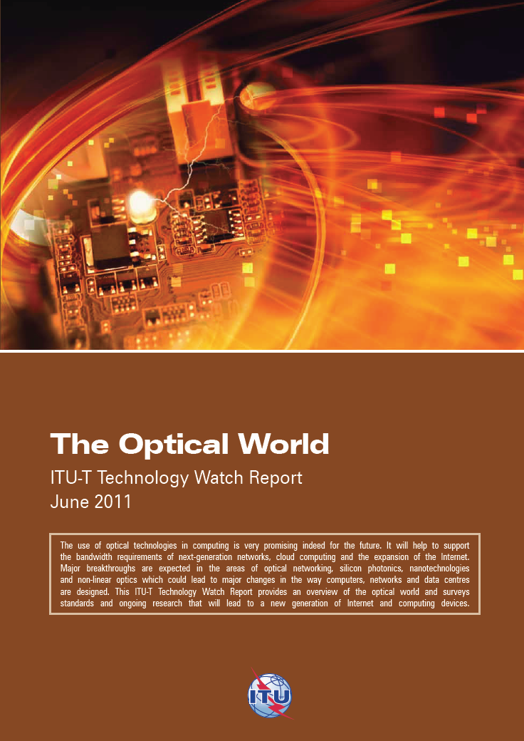
Find out more:
http://www.itu.int/en/ITU-T/techwatch/Pages/optical-standards.aspx

