Slide 1
Setting up a National Standardization Secretariat (NSS)
Joint ITU-AICTO Regional
Standardization Forum for Arab Region
(Tunis, Tunisia, 27 January 2014)
Vijay Mauree,
Programme Coordinator
ITU

Slide 2
WTSA Resolution 44 (BSG)
Recognizing
e) that it is of high importance for developing countries to increase their participation in the establishment of telecommunication standards;
f) that, based on the findings of the ITU study on standardization capability of developing countries, there is a need to improve the coordination of ICT standardization activities in many developing countries in order to improve their contribution in ITU-T SGs, and that the establishment of national standardization secretariats could enhance both the standardization activities at national level and the contribution in ITU-T SGs;
g) that the development of guidelines would enhance the participation of developing countries in ITU-T SGs,
Programme 2: Assisting developing countries with respect to the application of standards
To assist developing countries in Establishing a standardization secretariat to coordinate standardization activities and participation in ITU-T study groups.

Slide 3
Challenges
A developing country might not have assigned the responsibility for ITU-T to a particular government agency or official
Each developing country might have a different goal regarding its ultimate involvement in ITU-T
Conclusion: One size does not fit all. Options will be needed to match different countries’ different situations

Slide 4
Benefits of a NSS
Link national standards to ITU-T Recommendations
Clearly defined roles, responsibility and authority within the country on ITU-T matters
Coordinate requirements for ICT standards
Have a role in approval of ITU-T Recommendations
Enhance contribution in ITU-T Study Groups

Slide 5
Best-Practice Example
Responsible Agency
Funding
Secretariat
National Advisory Committee for ITU
(D)
(R)
National Advisory Committee for ITU-T
NSG 2
NSG 3
• • •
NSG 17
NSG: National Study Group

Slide 6
Functions of the NSS
Management of the national organization and processes
Dissemination of information from ITU-T
Responses to ITU-T inquiries/consultations
Development of national positions, strategies and action plans for ITU-T
Leading international delegations

Slide 7
Functions of the NSS (cont.)
Development and approval of contributions
Reporting on national and international meetings
Authorizing applications to join ITU-T from private sector entities and requests for TIES accounts
Coordination of capacity building for standardization

Slide 8
Legal Basis for the NSS
Authority for NSS is established under appropriate legislation
Responsibility will be assigned to the gov’t agency (or official position) responsible for ITU, or another governmental organization designated by the Member State.
This will be the “Responsible Agency” (RA)

Slide 9
Responsible Agency – Best Practice
Only the Responsible Agency (RA) has decision-making authority
Other subordinate groups are advisory to RA
Work takes places in the subordinate groups and is approved by RA

Slide 10
Responsible Agency – Best Practice
RA is needed for
Policy or strategic issues
Resolution of internal disagreements
Creating secretariat staff positions
Creation of ITU or ITU-T national advisory committees
Member State representation at ITU events

Slide 11
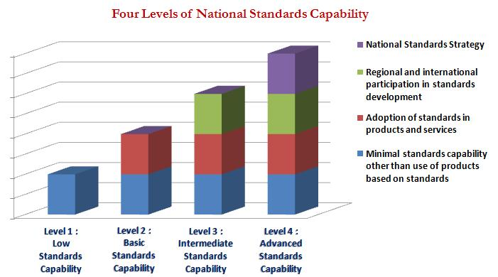
Evolution of NSS

Slide 12
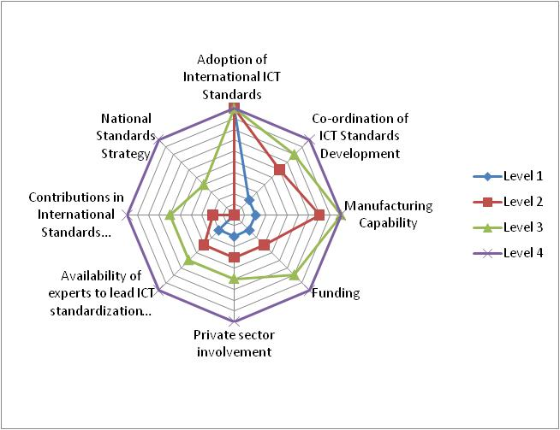
Evolution of NSS
3 options
General Level
Study Group Level
Full Sector Level

Slide 13
General Level NSS
Limited resources
Use ITU-T standards mainly
Not much involvement in ITU-T study groups

Slide 14
General Level NSS
Use existing resources as much as possible
Responsible Agency could exist, or one can be agreed informally among involved agencies:
Responsible for PP, Council, MS issues
Point of contact to ITU
Approve contributions, SM applications
Provide MS delegations to ITU meetings
Create T-NAC and appoint T-NAC Chairman

Slide 15
General Level NSS
T-NAC:
The main working level advisory committee for the NSS-General Level
Responsible for all ITU-T matters of interest, including WTSA, TSAG and SGs
Open to all interested public and private organizations
Can create ad hoc groups as needed, e.g.: WTSA, TSAG, a SG
Draft national process procedures
Acts as preparatory group for ITU-T meetings

Slide 16
General Level NSS
Secretariat staff functions are provided from within RA or contracted by RA
Monitor Circulars and other ITU communications, and facilitate responses
Develop and maintain website
Support national level meetings
Record-keeping
Top priority for the NSS-General Level:
Draft enabling legislation (if required)
Funding!
Establish national procedures

Slide 17
Study Group Level NSS
There is participation in ITU-T study groups
Hold positions of responsibility in ITU-T study groups
Operational functions of RA move down to NAC
Responsible Agency
Funding
Secretariat
National Advisory Committee (NAC) for ITU
(PP, Council, Budget, MS dues…)
D-NAC
R-NAC
T-NAC
(Subcommittees: WTSA, TSAG, SGs)
NSG A
NSG B
• • •
NSG X

Slide 18
Study Group Level NSS
RA:
Overall responsibility for ITU matters, assigned under enabling legislation
Ensure stable funding
Approve national procedures
Approve MS contributions
Official point of contact with ITU
Approve SM applications for membership
Appoints NAC Chair and T-NAC Chair

Slide 19
Study Group Level NSS
NAC:
Open to public and private sectors
Chairs of T-NAC, R-NAC, D-NAC and NSGs are members of NAC
Preparatory group for ITU-level events, e.g., Plenipot, Council
Maintain national procedures for ITU
Parent body to T-, R- and D-NACs

Slide 20
Study Group Level NSS
T-NAC:
Continues from T-NAC of General Level
Open to public and private sector
Create National Study Groups, only as needed, one-to-one with ITU-T SGs
T-NAC chair appoints NSG Chairs
Change former ad hoc groups into permanent subcommittees of T-NAC, e.g.:
SC-Policy: ITU-T policy matters and WTSA
SC-TSAG: TSAG
SC-SG: General and cross-SG matters

Slide 21
Full Sector Level NSS
Participation in most ITU-T study groups
Develop own standards
Responsible Agency
Funding
Secretariat
National Advisory Committee (NAC) for ITU
(PP, Council, Budget, MS dues…)
D-NAC
R-NAC
T-NAC
(SCs: WTSA, TSAG, SGs, Other Committees)
NSG A
NSG B
• • •
NSG X

Slide 22
Implementation Roadmap
Determine if there is enabling legislation
Determine if there are sufficient human resources for desired structure
Determine if there are sufficient financial resources for desired structure
Appoint RA leader, support staff and secretariat staff
Undertake a national ICT standards requirements assessment
Establish necessary committees and appoint leadership
Begin operations

Slide 23
NSS Pilot Programme
If you are interested in implementing a NSS in your country:
NSS Pilot Programme of ITU-T Telecommunication Standardization Bureau (TSB)
Member State provides programme support
TSB provides information and assistance
Please contact at TSB:
Mr. Venkatesen (Vijay) Mauree
e-mail: vijay.mauree@itu.int

Slide 24
Thank You
vijay.mauree@itu.int

