Slide 1
ITU Activities on Bridging the Standardization Gap (BSG)
Joint ITU-AICTO Regional
Standardization Forum for Arab Region
(Tunis, Tunisia, 27 January 2014)
Vijay Mauree, TSB
ITU
Vijay.mauree@itu.int

Slide 2
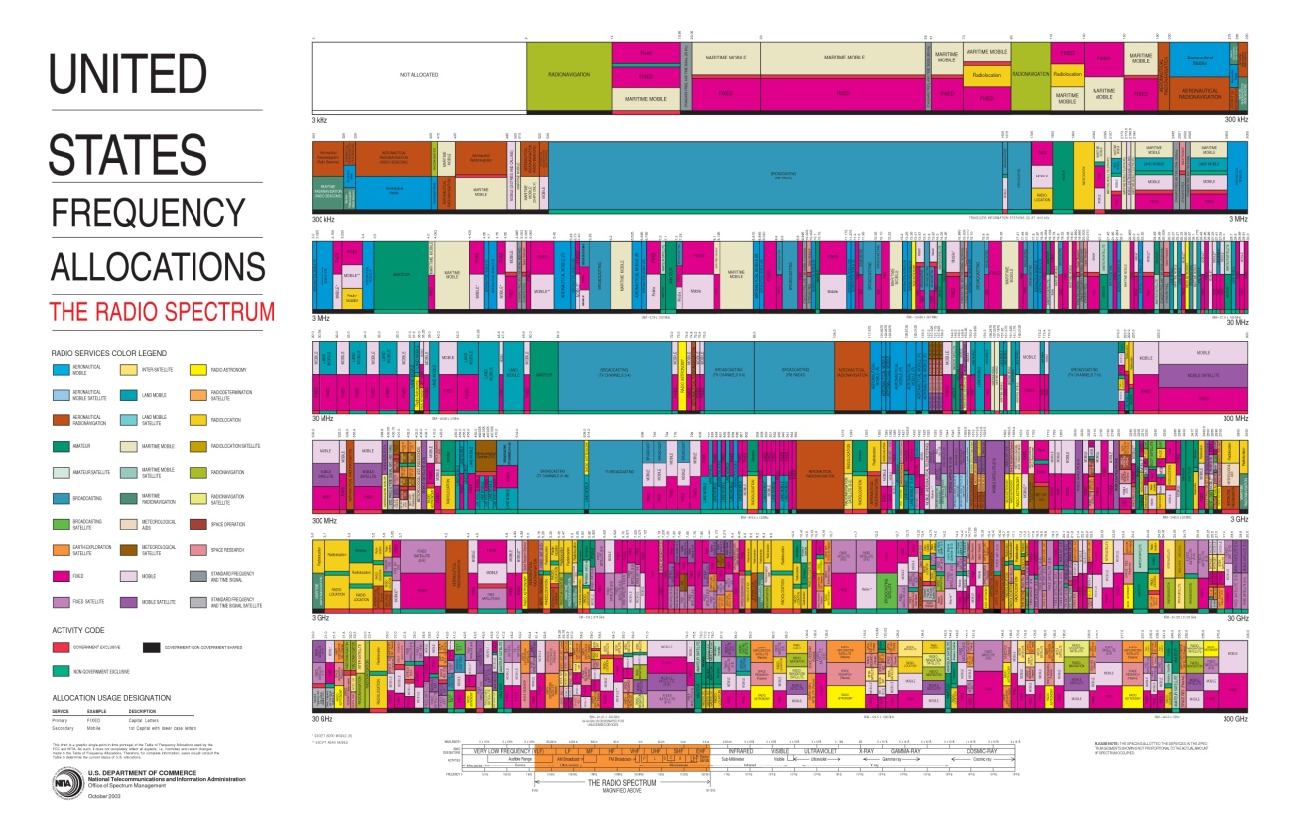
ITU allocates (1) frequency spectrum to different services, (2) satellite orbit assignments, (3) numbers and identifiers

Slide 3
ITU develops standards
Notes:
ITU-T
- Develop interoperable, international standards (ITU-T Recommendations)
- Bridge standardization gap
- Cooperation among standardization bodies
ITU-T study groups look at issues such as: multimedia, security, environment and climate change, network and transport, broadband access, quality of service and experience, next generation networks, cloud compuring, intelligent transport systems, numbering and addressing, tarrif, security.
Some examples:
Internet Access through ITU standards
95% of all international traffic runs over fibre = ITU standards
Access:
ADSL: ITU-T G.992
Powerline Transmission:
ITU-T G.9960 (G.hn)
FTTX (Fibre to the <x>):
GPON (Gigabit Passive Optical Networks) ITU-T G.984
Bendable fibers: ITU-T G.657
Multimedia
Advanced video coding: ITU-T H.264
Used to compress billions of clips on YouTube, high-definition content on Blu-ray Discs
New work H.265:
Joint Collaborative Team (ITU-T, ISO/IEC) to reduce data rate by 50%

Slide 4
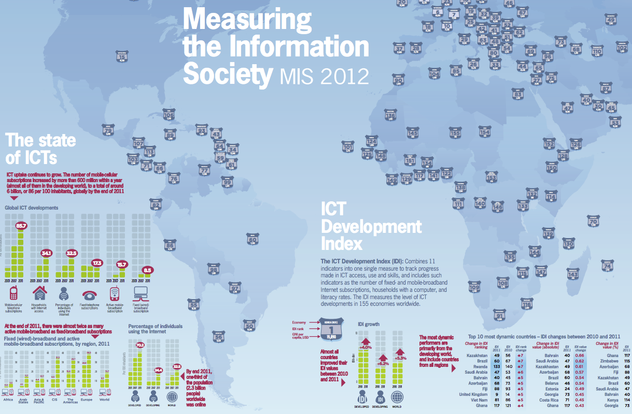
ITU assists developing countries
Notes:
ITU-D
- Neutral broker for multi-stakeholder partnerships, resource mobilization
- Executing agency for project implementation
Building capacity among members: technical assistance, advice on policy-regulatory frameworks for investment
Statistics and policy/regulatory trends
Membership Benefits:
- Support your CSR agenda. Build profile and relationships in new markets.
ITU-D Study groups looking at issues such as policy and regulatory reforms needed to stimulate ICT investment. Public-private partnership models for infrastructure roll-out, such as infrastructure sharing. Tax incentives. Licensing. How to expand rural connectivity.
ITU-D publishes its very much acclaimed annual report “Measuring the Information Society”. The report, which has been published annually since 2009, features two benchmarking tools to measure the information society: the ICT Development Index (IDI) and the ICT Price Basket (IPB). The 2012 IDI captures the level of ICT developments in 157 economies worldwide and compares progress made during the last year. The 2012 IPB combines the consumer prices for (fixed and mobile) telephone and Internet broadband services for 161 economies into one measure and compares these across countries, and over time. The 5th edition of the ITU Measuring the Information Society (MIS) report was launched on 7 October 2013, at ITU headquarters, Geneva, Switzerland

Slide 5
The Standardization Gap
BSG is one of strategic goals of ITU-T
Defined as the disparities in the ability of developing countries, relative to developed ones, to access, implement, contribute to and influence international ICT standards, specifically ITU‐T Recommendations.
Bridging the standardization gap: PP Res 123, WTSA Res 44 and WTDC Res 47
Notes:
PP Res 123 firstly adopted by PP 2002
WTSA Res 44 1st adopted by WTSA-04

Slide 6
The Standardization Gap
Resolution 44 revised at WTSA-12, Dubai
Disparities between developed and developing countries in standardization have 5 main components:
disparity of voluntary standardization,
disparity of mandatory technical regulations
disparity of conformity assessment,
disparity in human resources skilled in standardization
disparity in effective participation in ITU-T activities

Slide 7
The Standardization Gap
The Standardization Ladder Concept

Slide 8
BSG Fund
Objective
Facilitate the participation of developing countries in the standards development process
Allow developing countries to profit from access to new technology development
Ensure that the requirements of developing countries are taken into account in the development of standards
Donors
Ministry of Science, ICT and Future Planning, Korea
Nokia Siemens Networks,
Microsoft,
Cisco and
Canada

Slide 9
ITU Activities to Bridge the Gap
Strengthen Standard Making Capability
Assist Developing Countries in Standards Implementation
Develop Human Resources
Regional Groups (Resolution 54)
Notes:
Main actions implemented for BSG
Strengthen Standard Making Capability (Programme 1 of Annex in WTSA-12)
Assist Developing Countries in Standards Implementation (Programme 2 of Annex in WTSA-12)
Develop Human Resources ((Programme 3 of Annex in WTSA-12)
Regional Groups ( WTSA-12 Resolution 54)

Slide 10
Strengthen Standard Making Capability
Mentoring programme for newcomers to Study Groups
Mentor role in study group
Research on measuring and reducing the standardization capability gap
Free access to ITU-T Standards
Increase remote participation and collaboration
Reduced fees (CHF 3,975) for developing countries including academia
Study on assessing the standardization capability of developing countries
Notes:
Slide shows actions that have been implemented in period 2009-12

Slide 11
Strengthen Standard Making Capability
New Actions From WTSA-12
Developing guidelines to assist developing countries in their involvement in ITU‑T activities.
Improving procedures and electronic tools for remote participation.
Conducting consultancy projects designed to support developing countries in the development of standardization plans
Studies on ICT innovations and standardization in developing countries

Slide 12
Assist Developing Countries in Standards Implementation
Technical Reports
Handbook on Testing (2011)
Convergent Networks (2010),
ITU-T Manual on Optical Transport Networks from TDM to Packet (2010)
DSL Story (2010),
Deployment of packet based networks (2009)
Handbook on Fibre Optic Cables and Systems (2009),
Security in Telecommunications and IT (2009)
Standards Q&A Online Forum
Notes:
Handbooks have now been replaced by e-learning courses, technical reports and web based guides.

Slide 13
Standards Q&A
http://groups.itu.int/itu-t/StandardsQA.aspx
Objectives
Enable developing countries to seek advice directly from ITU-T study group experts
Ensure developing countries have a better understanding of ITU-T Recommendations
Enhance the application of ITU-T Recommendations in developing countries
Open to everyone

Slide 14
Assist Developing Countries in Standards Implementation
New Actions From WTSA-12
Assist developing countries to
Establish a standardization secretariat to coordinate standardization activities and participation in ITU-T study groups
Determine whether their existing national standards are consistent and in accordance with the current ITU‑T Recommendations
Develop implementation guidelines for new ITU-T Recommendations
E-learning courses on ITU-T Recommendations

Slide 15
Develop Human Resources
Capacity Building
In Depth Technical Manuals/ Tutorial
Workshop
Webinar
E-Learning
Notes:
Currently TSB organises workshops for general awareness on ITU-T standardization activities and in-depth technical tutrorials for training on implementation of ITU-T Recommendations. Webinars and E-learning courses will now also be proposed in the future. Member states are invited to contact TSB if they would like to host an in depth technical tutorial pertaining to a particular ITU-T Recommendation(s) or workshop in the near future.

Slide 16
Develop Human Resources
In-depth technical tutorials on ITU-T Recommendations
Increase number of officials (Chairs / Rapporteurs) from developing countries in ITU-T Study Groups
E-learning course on ITU-T Meeting Procedures (ITU-T A.1) and Quality of Service ^{NEW!}
New Actions From WTSA-12
Fellowships to be provided under TSB budget to eligible countries to attend relevant ITU-T meetings.
Encouraging secondment and short-term employment opportunities for developing countries experts in test laboratories of international standards development organizations (SDOs) and manufacturers, in particular in the area of conformance and interoperability testing
Notes:
First three bullets shows the actions that have been implemented in the period 2009-12.

Slide 17
Regional Groups
SG2 Groups for Arab and East Africa Regions
SG3 Groups for Asia and Oceania, Africa, Europe and Mediterranean, Latin America and Caribbean (Tariff and accounting principles)
SG5 Groups for Arab, Africa, Latin America and Caribbean, Asia-Pacific (Feb 2013) (ICT and Climate Change)
SG12 Group for Africa (Performance, QoS)

Slide 18
Regional Groups
Regional Offices to collaborate closely with TSB
Promote ITU-T Meetings and Regional Group events
Assist TSB to coordinate standardization activities in the region
Provide assistance to establish regional standardization bodies
New Regional Groups established at WTSA-12
SG2 Group for Latin America
SG5 Group for Latin America
SG 13 Group for Africa

Slide 19
Conclusions and Recommendations
WTSA-12 strengthen ITU-T’s mandate for BSG
Bridging the Standardization Gap
Enhanced co-ordination on ICT standardization at national level
Regional offices to work closely with TSB
Enhance implementation of ITU-T Recommendations
Capacity building on standardization and ITU-T Recommendations
Increase participation in Study Groups, Workshops, Meetings and number of contributions

Slide 20
Thank You
vijay.mauree@itu.int

