Slide 1



ITU Regional Workshop on
Bridging the Standardization Gap
(Yangon, Myanmar, 28-29 November 2013)
Broadband Tariff in Myanmar
U Kyaw Soe
Principal
Telecommunications Postal Training Centre,
Myanma Posts & Telecommunications
Ministry of Communications and Information Technology

Slide 2
Contents
Broadband Situation and Tariff Rates in Myanmar
Broadband Application Areas
The broadband ecosystem
Broadband building blocks and measures
Policies and programs to build broadband
Future Trend of Myanmar Telecommunications Tariff
Conclusion

Slide 3
Broadband Contribution
Every 10 percent increase in broadband penetration provides a 1.38 per cent increase in GDP.
Growth Effects of Telecommunications?
Source: Qiang, Christine, Carlo Rossotto, and Kaoru Kimura. 2009. “Economic Impact of Broadband.” In Information and Communications for Development 2009: Extending Reach and Increasing Impact, 35–50. Washington, DC: World Bank.

Slide 4
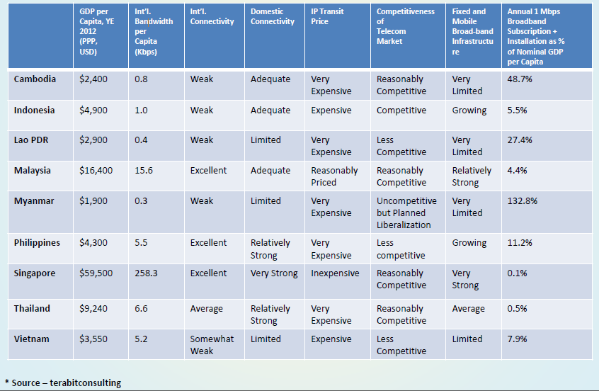
Overview of the Broadband Status (2012)

Slide 5
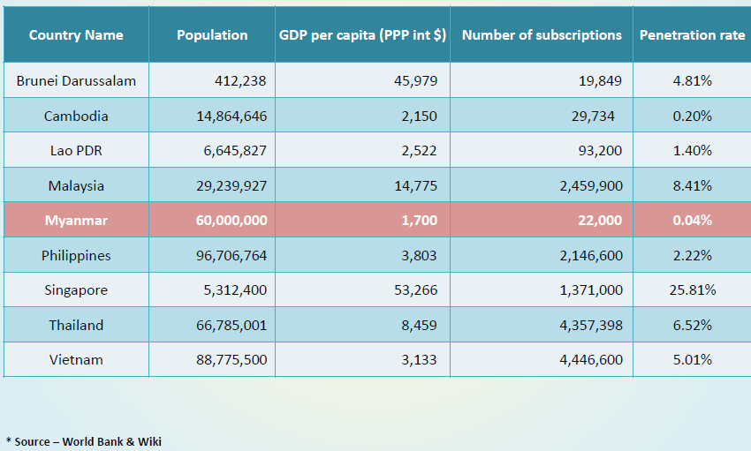
Broadband Penetration in ASEAN Region (2012)

Slide 6
The Telephone Tariff Rates in Myanmar
Fixed Line Telephone Tariff Rates (Local & Overseas)
ADSL Line Tariff Rates
Broadband Tariff Rates
Mobile Telephone Tariff Rates

Slide 7
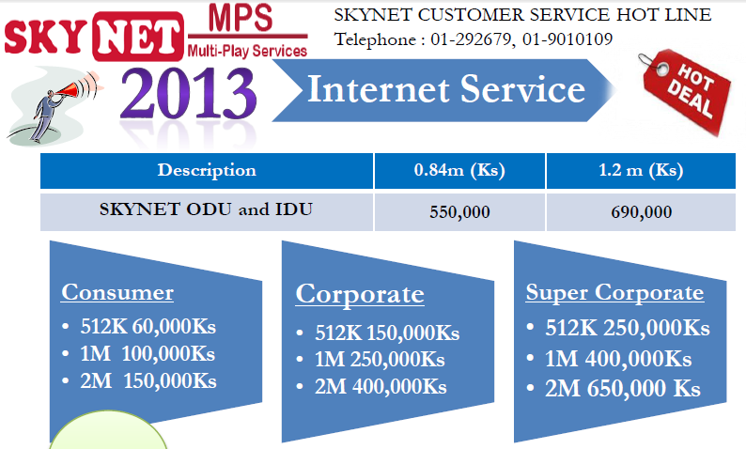
Broadband Tarriff(SKYNET)

Slide 8
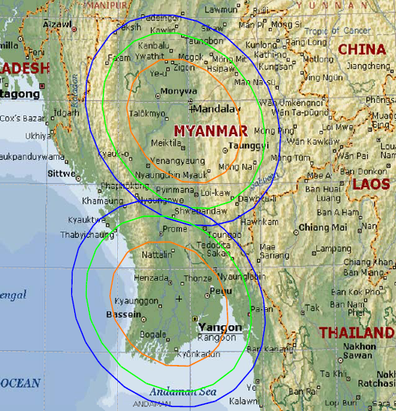
Thaicom 4 (ipstar)
Coverage

Slide 9
Prices for Broadband (YTP)
Broadband Service Name | Service Type | Price per month | Capacity | Additional Fees
WLLCOND Consumer Data Only | Consumer Data Only | FEC 35/M | 400MB | FEC 0.20/MB
WLLJAD$ Jade | Jade | US$ 35/M | 400MB | US$ 0.20/MB
WLLPLA Platinum | Platinum | Ks 30000 | 400MB | Ks 250/MB
WLLCON Consumer | Consumer | FEC 45/M | 400MB | FEC 0.20/MB
WLLSAP$ SAPPHIRE | Sapphire | US$ 45/M | 400MB | US$ 0.20/MB
WLLBRO Bronze | Bronze | Ks 38000 | 400MB | Ks 250/MB
WLLENT Enterprise | Enterprise | FEC 75/M | 2000MB | FEC 0.20/MB
WLLRUB$ Ruby | Ruby | US$75/M | 2000MB | US$ 0.20/MB
WLLSIL Silver | Silver | Ks 64000 | 2000MB | Ks 250/MB
WLLCOR Corporate | Corporate | FEC 130/M | 10000MB | FEC 0.20/MB
WLLGOL Gold | Gold | Ks 111000 | 10000MB | Ks 250/MB
WLLDIA$ Diamond | Diamond | US$ 130/M | 10000MB | US$ 0.20/MB
Wllvpn | Vpn | FEC 100/M | 10000 MB | -

Slide 10
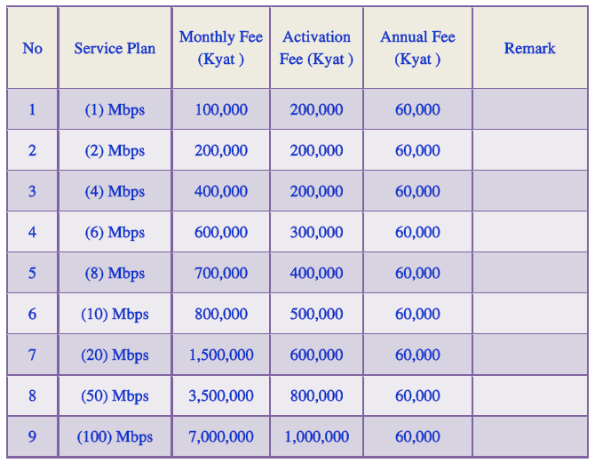
MPT Broadband Fees for E1 and Fibre
Government/Personal/Local Co.,/Foreign Co.,/Embassy

Slide 11
MPT Internet Users and Capacity in Myanmar (Oct 2013)
Sr.No | Particulars | Capacity | Number of users
1 | Fibre Line | 217 | 2,170
2 | MPT Satellite Terminal | 797 | 7,970
3 | E1 Line | 142 | 1,420
4 | ADSL Line | 7,754 | 77,540
5 | Dial up Line | 1,875 | 9,375
6 | Mobile Telephone(EDGE) | 1,243,923 | 1,243,923
7 | Mobile Telephone( WCDMA) | 167,522 | 167,522
8 | Mobile Telephone(EVDO) | 105,124 | 105,124
9 | Mobile Telephone(MEC) | 179,052 | 179,052
 | TOTAL | 1,706,406 | 1,794,096

Slide 12
Broadband Market Share in Myanmar
Company Name | Market Share
Redlink | 38%
MPT | 27%
YTP | 24%
SKYNET | 11%
Source: Redlink

Slide 13
Broadband Application Areas
Video–based applications;
    Downloading media
    Online multiplayer video gaming
    Multi–point video conferencing
Telehealth applications;
Distance learning applications;
E–government applications; and,
Emergency management operations applications

Slide 14
The broadband ecosystem

Slide 15
Goals
  Appropriate balance between
    Raising revenues
    Facilitating economic expansion in a broadband environment

Slide 16
Broadband building blocks
Be visionary yet flexible
Use competition to promote market growth
Facilitate demand
  Source: Building broadband: Strategies and policies for the developing world ,Yongsoo Kim, Tim Kelly, and Siddhartha Raja, Global Information and Communication Technologies (GICT) Department,World Bank,January 2010

Slide 17
Measures
Supply Side
Demand Side
  Promote the competition and investment
  Reduce the cost of infrastructure
  Expand broadband network
  Support policies on promoting the use of broadband
Increase affordability with the proper cost for handset and the service access
Help government’s leading broadband use and online activities
Increase ICT technology, online and local contents (application, new technology and services included)
Activate policies to protect the consumers’ right
Source: Kang, Shin-Won, Professor, Sunchon National University

Slide 18
List of parameters affecting penetration of broadband services
Source: HOW TO ACHIEVE THE GOAL OF BROADBAND FOR ALL : Morten Falch, Dan Saugstrup & Markus Schneider Center for Tele-Information, Technical University of Denmark,

Slide 19
3 Factors
Attracting investment in
broadband
Addressing persistent gaps
in the market
Funding broadband

Slide 20
Policies and programs to build broadband
Early stage: promote
  Supply-side promotion policies
  Demand-side promotion policies
Mass market: Oversee
  Facilitate competition-led growth through consistent oversight
Universal service
  Focus on widespread diffusion as broadband market grows

Slide 21
POLICY INTERVENTION AND REGULATION
Facilitation
Regulation
Direct Intervention

Slide 22
Future Trend of Myanmar Telecommunications Tariff
Fair or reasonable prices
Cheap rates
The tariff rates according to international standard rates
Perfect competition market rates
It is too early to say whether the rates are equilibrium rates or not.

Slide 23
CONCLUSION
Public policy does matter.
Successful implementation of broadband also depend on the kind of policy measures to be taken
  Although technical and economic parameters such as income level play a role for the development of broadband services,.
These measures may include
  stimulation of both demand and supply of both content and infrastructure.

Slide 24
References
Wireless broadband masterplan for the Union of Myanmar, October 2012,ITU
Building broadband: Strategies and policies for the developing world, Yongsoo Kim, Tim Kelly, and Siddhartha Raja, Global Information and Communication Technologies (GICT) Department, World Bank ,January 2010
Strategies for Installation and Diffusion of Broadband Network in Developing Countries,Kang, Shin-Won, Professor, Sunchon National University
Future Broadband Trend and Myanmar Landscape, Min Swe Hlaing, Vice Chairman and Co-Founder, Redlink Co. Ltd
HOW TO ACHIEVE THE GOAL OF BROADBAND FOR ALL,Morten Falch, Dan Saugstrup & Markus Schneider ,Center for Tele-Information, Technical University of Denmark
Evaluating Factors Affecting Broadband Readiness in Kenya: A Pilot Study,Gilbert Barasa Mugeni, Gregory Wabuke Wanyembi, Joseph Muliaro Wafula ,Department of Computer Science, Masinde Muliro University of Science and Technology, Kakamega, Kenya and Department of Computing, Jomo Kenyatta University of Agriculture and Technology, Nairobi, Kenya
Myanma Post and Telecommunications

Slide 25
THANK YOU.

