Slide 1
Considerations in deployment of broadband infra. and value-added services
ITU Regional Workshop on Bridging the Standardization Gap
(Yangon, Myanmar, 28-29 November 2013)
Donghoon Yi,
Manager, KT R&D Group
donghoon.yi@kt.com
Notes:
Thank U. 밍글라바~, Good morning everyone. Nice to meet U.
My name is Donghoon Yi and I’m from KT where I’m a research manager and
I am participating in developing architecture of content distribution network and its services.
In this presentation, based on KT’s IP network & service deployment experience during past 20 years.
I would like to introduce several issues and technical considerations in deployment of broadband infra. for providing emerging value-added service.

Slide 2
Contents
Broadband Status – KOREA, KT
Wire/Wireless penetration, Traffic …
Evolution to a Converged All-IP Network
Major considerations, service requirements
Case Studies
KT NGN Backbone & Access, IPTV, VPN, Wibro, LTE
Conclusion
Notes:
With brief touch of KT broadband deployment status, I hope to share Telco’s trend and major issues first.
And form our concerns due to the traffic explosion and dumb pipe problem,
I will show what is our big picture and what we have to consider in evolving our infra more smart & intelligent
by introducing several cases in terms of delivery and service network.
In conclusion, I would like to share our insight on what we have to do for next broadband infra.

Slide 3
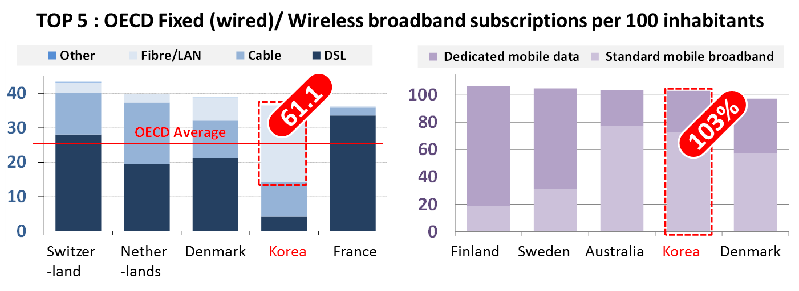
Broadband Status Update : KOREA
`Worldwide Testbed for broadband’
36.5 fixed broadband subscription per 100 inhabitants
(61.1% of broadband users are connected via FTTH, active Ethernet)
Wireless broadband penetration exceed 100% in 2012
Source: OECD, Dec. 2012
Notes:
First, I would like to review the broadband status in KOREA and KT.
As some of you already knows, KOREA is worldwide testbed in fixed and wireless broadband infrastructure.
This graph shows the Top 5 broadband subscriptions status in OCED 2012.
In case of Korea, we have about 61% of subscription that are connected via high-speed internet line using FTTH, Active LAN.
This is most remarkable ratio among OECD country and we are now planning to upgrade our internet speed up to 1Gbps and holding Giga internet pilot services in several test-site.
And also, in wireless broadband, penetration ratio already surpassed 100% in 2012

Slide 4
Broadband Status Update : KT
Triple play service via 100Mbps residential & LTE broadband
Service coverage (100Mbps residential BB) > 90 %
DSL lines are being faded out and rapidly replaced by FTTH since 2006
FTTH for SFU (Single Family Unit) area : IEEE 1G-EPON
FTTB for MDU (Multi Dwelling Unit) area: Active Ethernet
LTE service has exploded (starting LTE BB service in 2013)
Source: Korea Communications Commission
Notes:
Here is the broadband status of KT. In fixed internet service, we have about 8 million subscribers and we provide TPS (IPTV, VoIP, VPN, Cloud) via high-speed residential internet lines
The service coverage with 100Mbps line has surpassed 90%.
Since 2006 when we start FTTH service, DSL lines are being faded out and replaced by fiber-based lines such FTTH.
In wireless, we start the broadband LTE service in this year which is twice faster than LTE service using existing LTE infrastructure
Since 2011 when we start LTE service, we have seen the remarkable switching ratio from 3G to LTE and now 40% of total subscribers are using LTE services.
So it becomes natural scene in KOREA where users watch high-qualiy HD drama and sports events while they are in bus and subways.

Slide 5
Traffic Growth
Mobile traffic volume has increased by 88% during 2012
LTE traffic volume showed a 885% rise during the same period
Backbone traffic has increased 4 times during the past 6 years
Spreads of emerging IP-based multimedia services (IPTV, VoIP)
BTW, Subscription is almost saturated (decoupling of revenue & investment)
Source: Korea Communications Commission
Notes:
Now let’s see the status of traffic growth.
This picture summarize the mobile traffic volume in 2012 and # of subscriber and traffic of broadband services using fixed internet line since 2006.
The catch here is that the traffic that telco should deliver is skyrocketing but the BB subscription is almost saturated.
In case of mobile traffic, total traffic volume has…
And as spreading of emerging…., the backbone traffic ….
These situation means that we are facing the decoupling problem between revenue and deployment cost.

Slide 6
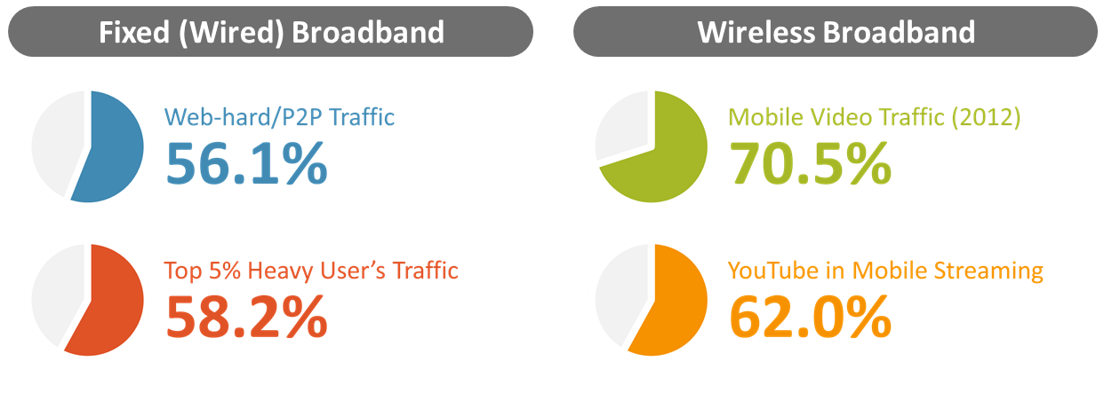
Dilemma
58.2% of total backbone traffic is generated by 5% heavy user
Web-hard/P2P : illegal content distribution, unfairness problem in BE
70.5% of mobile traffic is generated from video streaming
OTT video (e.g., YouTube) : boost investment in BB capacity (dumb pipe)
Source: Cisco, Allot
Notes:
We have a clear trend ‘expense up and revenue down’ in most broadband provider.
Even though the capex/opex continuously increasing, but the revenue is saturated or even decreasing.
Comparing to 15 years ago, we have a ultra high-speed Broadband infrastructure which has 2,000 times bigger capacity
But we are still struggling for the shortage of broadband capacity.
This means any broadband infrastructure can not be free from this trend
Here comes our dilemma. The major trend is convergence and mobile, however we cannot control the users traffic for IT welfare
Even though … and …. Because of the network neutraly.
So what reaming ways we think is evolving our broadband infra become more flexible and cost effective to deliver such huge amount of traffic.

Slide 7
Evolution to a ‘Service on-demand’ Network
from ‘Dumb’ to ‘Smart Pipe’
[NGN] All-IP / Multi-service Network
Multimedia, Voice, Data, IPTV and emerging service delivery
[next-NGN] Service on-demand Broadband Infrastructure
Flexibly/Efficiently configurable & operable networking (using SDN, NfV)
Context-aware service & content-centric delivery (using Cloud infra)
Notes:
In the evolutionary step, we already defined the concept of NGN (…) where the network can deliver multiple services concurrently comparing to legacy network.
In legacy network, because each network was designed and deployed for the specific service, the deployment and operation cost become a major big burden of telco. as increasing # of service.
However, in the future, requirements of services will be more diverse and each service will be personalized.
That means service delivery infra should be more flexible and smart in every way.
So we are now imagine a ‘service on-demand’ network as a next step of NGN.

Slide 8
Major Considerations
Cost Efficiency
Long-term cost saving by introducing cost-effective H/W and developing in-house technological leverage
e.g., Simplifying network topology, unifying service edges
Flexibility & Agility
Ensuring optimal interconnection between element services to provide excellent QoE of emerging services
e.g., Soft-defined N/W operation (SDN, NvF), content-/context-aware service delivery (in-network cache, Smart network)
Extensibility
EaaS (* as a Service) - able to call up re-usable, fine-grained software components across a programmable network
e.g., SaaS, PaaS, IaaS, BasS
Notes:
Here is the major considerations in deployment of BB infrastructure what we imagine.
For this, there are several considerations in
2. Designed to have a duplex configuration and dualization of major systems and security solutions and be customizable to expected traffic patterns
3. Today, nearly any type of hardware, software, IT process or business process can be offered as a cloud-based service. This has created an as a service economy that empowers both IT and the business

Slide 9
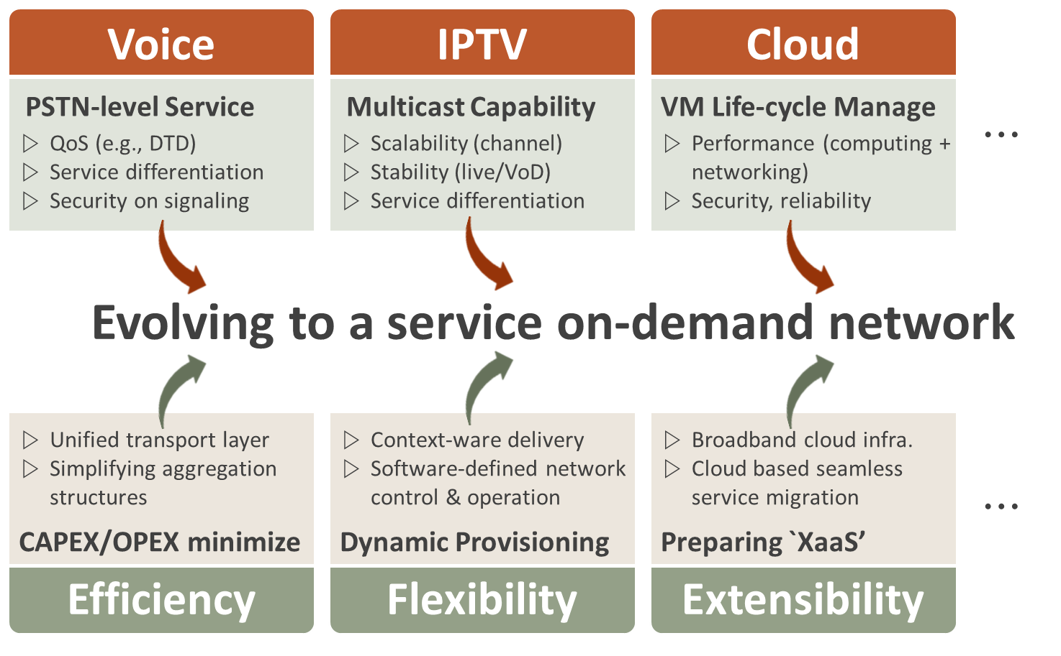
Requirements on KT-NGN Service & Infra.
Notes:
Along with the requirements on infrastructure, we also considers the service specific requirements and think a lot about how to effectively
converging them into and differentiating from each other .
That means we should consider these requirements concurrently when deploying and evolving broadband infra.

Slide 10
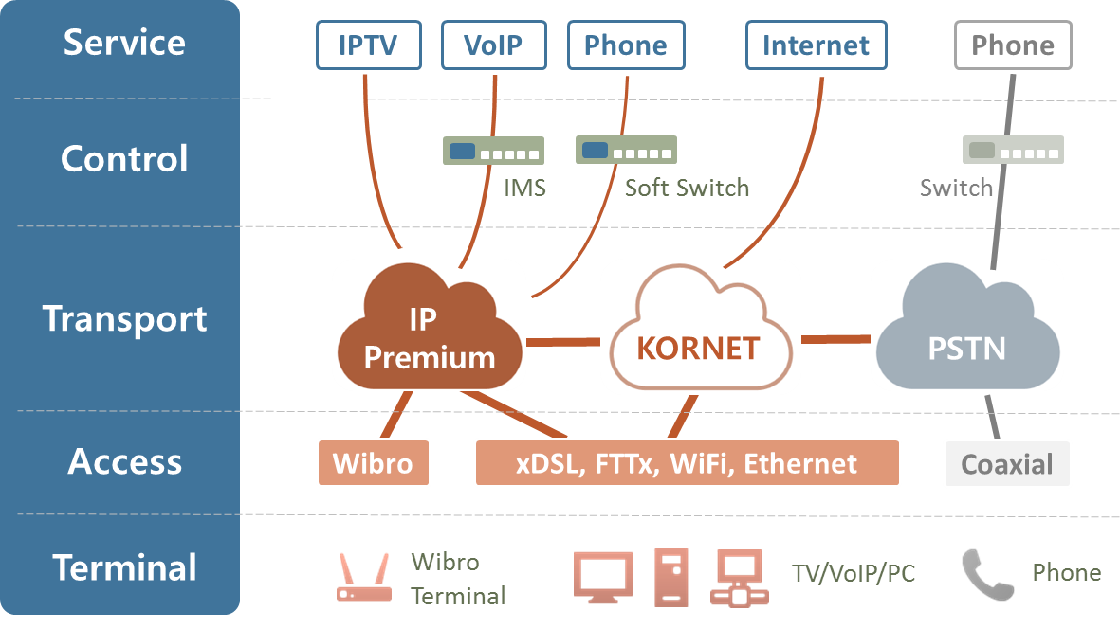
Architecture of KT-NGN
Dual Backbone structure
KORNET : General Internet services
IP Premium : IPTV, Wibro, VPN services (IP/MPLS, Diffserv, PIM-SM…)
Notes:
So I will show you several examples regarding our efforts on evolving broadband infrastructure.
This is the architecture of KT-NGN. We have dual backbone structure, KORNET and IP premium where the IP Premium backbone is deployed for our triple play services such as IPTV, wibro, VPN.
Of course we have legacy PSTN backbone, but phone service is almost taken over IP Premium backbone now.
To provide premium service, we apply several technologies such as MPLS, and DiffServ that differentiating QoS and PIM-SM that deliver the IPTV multicast traffic.
Here the red boxing area, we have a challenge on making cost effective infrastructure.
To deliver multiple services, we have deployed many kind of service gate way between transport and access layer.
We successively realize the concept of NGN, we are now facing a new problem in managing and operating those service gateways.
And also, FTTH has become the great part of access network in KT instead of legacy DSL lines,
there too many aggregation point and too many different facilities deployed to connect heterogeneous technologies.
So, to minimize the operation cost, we are now considering the L2-based simple transfer network infrastructure and try to unifies the service gateway by using the cloud computing, software-defined networking and virtualization technology.

Slide 11
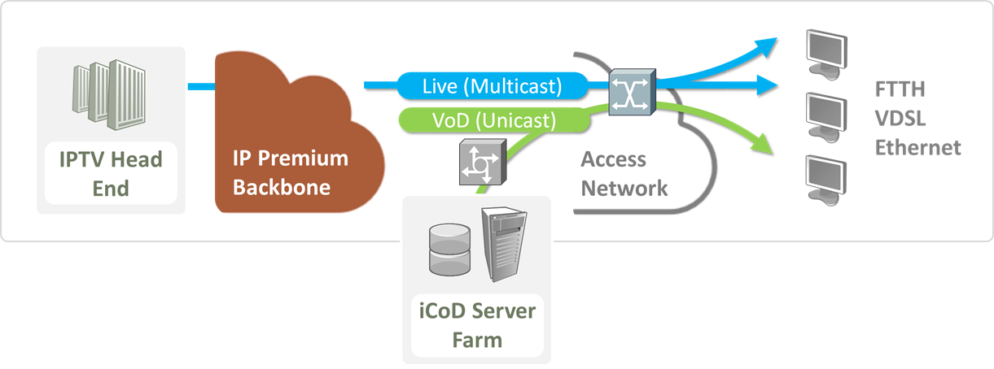
Case Study: IPTV
Interactive IPTV service
180 Live Channels (multicast), 140,000 VoD Contents (unicast)
100 HD Channels, 80 SD channels
HTML5 web-based IPTV
multi-platform compatibility, various services (T-commerce, etc.)
Notes:
Next example is IPTV where we provide ~~. And currently we are developing HTML5 web-based IPTV for ~~~
As you know, HTML5 is very attractive and promising standard.
For the guarantee of stable real time broadcasting transmission,
we absolutely need for multicast HA and QoS, and stable multicast routing infrastructure and secured multicast features.

Slide 12
Case Study: IPTV
Considerations for Multicast
RP position & redundancy for optimal PIM-SM topology
Relation between RP position and multicast traffic delay/stability
Address allocation
For interoperable multicast channel, ‘GLOP’ address should be used
Ex) KT KORNET ASN = 4766 = 00010010 10011110 → 233.18.158.0/24
High availability
Static IGMP Join for sub-second channel zapping time
IGP fast convergence for Multicast fast convergence (LSA-/SPF-delay, etc.)
Security
Group range filtering (using GLOP address)
PIM register filtering : only approved source can register to RP
MSDP SA filtering, Multicast route limit, BSR message filtering
Etc.
Multicast traffic load balancing based on source IP address
Notes:
So here is the major considerations on IPTV service over Broadband infra.
Because the time is limited, let me just list up the several issues.
---
There are some important design consideration issues for IPTV multicast. For example, multicast address issue, and multicast high availability issues including QoS, and multicast security issues and topology issue. Those issues are very important design consideration points.
First check point is multicast address issue. For the compatibility or interoperability of each IPTV SP’s multicast channels, we need some agreement between each service providers. In case that if we don’t keep that agreement, we have to use separate multicast address translator.
Anyway, IANA is recommending the allocation assignment of class D address. According to that assignment, for providing interoperability of each SP’s multicast channels, we should use GLOP address 233/8. In GLOP address expression, by inserting each SP’s 16bit official AS number in 233 class D address range, we can identify each IPTV SP’s channel address area. Not interoperable case, we can use private AS number in GLOP expression or site-local address 239/8.
There are some important design consideration issues for IPTV multicast. For example, multicast address issue, and multicast high availability issues including QoS, and multicast security issues and topology issue. Those issues are very important design consideration points.
First check point is multicast address issue. For the compatibility or interoperability of each IPTV SP’s multicast channels, we need some agreement between each service providers. In case that if we don’t keep that agreement, we have to use separate multicast address translator.
Anyway, IANA is recommending the allocation assignment of class D address. According to that assignment, for providing interoperability of each SP’s multicast channels, we should use GLOP address 233/8. In GLOP address expression, by inserting each SP’s 16bit official AS number in 233 class D address range, we can identify each IPTV SP’s channel address area. Not interoperable case, we can use private AS number in GLOP expression or site-local address 239/8.
Here, we have a very important design considering point for Stable IPTV multicast Topology.
RP positioning and redundancy are critical issues for optimal PIM-SM topology design. To get the optimal RP position, we can consider the relation between RP position and multicast traffic delay, and the relation between RP position and multicast stability. And we can consider optimal RP position to exchange SA information amongst multicast service providers. KT IP network is a typical tree-base topology, and whole traffic source and IPTV contents are located in the metropolitan area, like Korea’s population distribution. In such topology, we did take a lot of test to get the optimal RP position with considering such conditions and various scenarios. Here U can see an interesting test result. In the tree topology case like KT, the optimal RP position is HE router. HE router means the nearest PIM router that sources can register to. According to test result, if the RP is located to more receiver side, we can expect more unstable PIM-SM topology. In the process of PIM link failure and recovery, some loop problem can be occurred, caused by timer gap between RPF check and PIM hello. Let’ talk about RP redundancy. We have two implementation ways for RP redundancy. One is Dynamic RP redundancy; we usually know that dynamic RP redundancy is BSR way. The other is anycast RP redundancy, which is providing same RP address for each RPs and static RP configuration at each PIM routers. We compared those two implementation ways with 4 criteria, and a lot of tests also. As you can see in this table, we found that anycast RP is the best way for RP redundancy. In configuration and troubleshooting point, anycast RP is much easier than dynamic RP. As you know, BSR is using a little bit complex procedure to choose RP from their candidate PIM routers, like priority calculation or the calculation of hash function table. The most critical reason that we can not accept BSR is that a lot of vendors do not support BSR feature except cisco and juniper. And in BSR case, service recovery time of RP failure is around 3 minutes, but anycast case only less than 1 sec. And the final multicast topology issue is load balancing feature of multicast traffic. Multicast traffic should be load balanced based on source and multicast group in multiple PIM links.

Slide 13
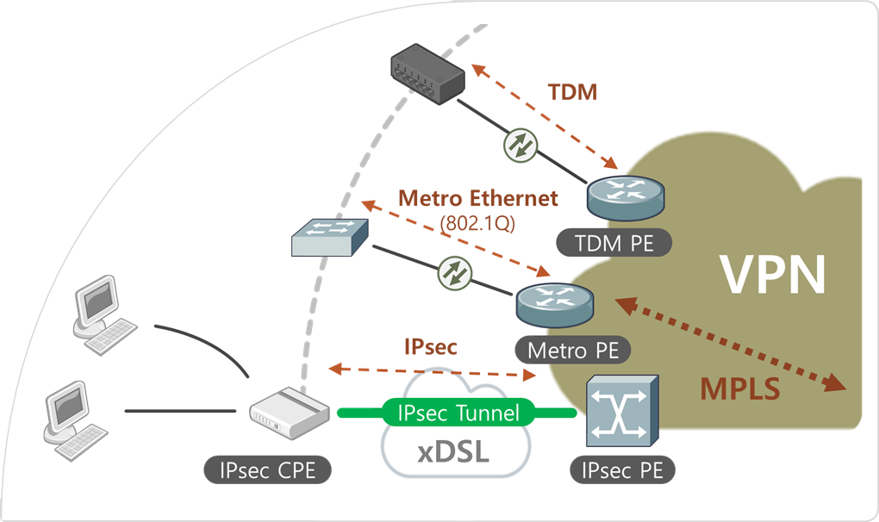
Case Study: mVPN
mVPN services for enterprise
Bidirectional e-learning/internal broadcasting service for VPN customer
Customized Advertisement service for Bank/Hospital/Gas station/Fast-food chain store/Department store/Government agency etc.
Issues
Multicast for MPLS VPN
IP in IP
MDT (multicast distribution tree)
Multicast in IPsec VPN
GRE encapsulation
Reliability
Notes:
We provide several types of VPN service according to the access line.
By using of multicast VPN technology, it is possible to provide bidirectional e-learning, internal broadcasting services for VPN customers.
Major issues here is that MPLS and Ipsec technology are not support one-to-many communications in nature.
So we need to address this by using several standard such IP in IP, GRE encapsulation

Slide 14
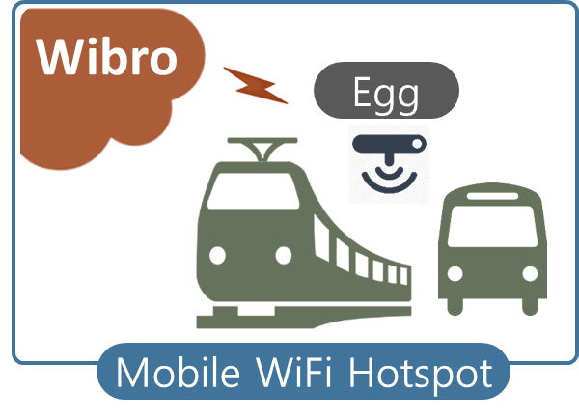
Case Study: Wibro
High-Speed Mobile Internet
Upload (Avg. 1.2Mbps) | Download (Avg. 3Mbps)
Support various type of devices : Laptop, USB dongles, and etc.
Mobile data offloading
Egg: Wibro-WiFi gateway
Issues
IPv6, Mobile IP, QoS, Security
Notes:
Next major service is wibro, everybody knows wibro is mobile internet service.
For stable wibro service in our Premium BB, we need IPv6 capability and QoS and security.
Those are the basic feature of mobile service over wired and wireless line.
We provide the Wibro egg that is small & portable modem device and it is used in mobile traffic offloading in bus, subways.

Slide 15
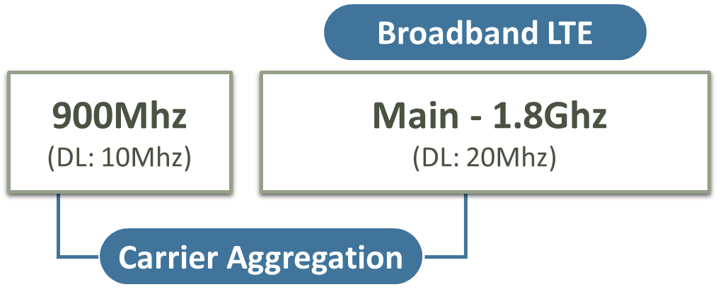
Case Study: LTE
Frequency Bands & Spectrum allocations
Main (1.8Ghz) 20Mhz, Sub (900Mhz) 10Mhz
Broadband LTE, CA, MC
CCC (Cloud Comm. Center)
DU/RU separation (virtualization), quad antenna
Increasing capacity, speed, coverage
Notes:
Next example is LTE service.
We have 20Mhz major band on 1.8Ghz and 10Mhz sub-band on 900Mhz. By using these spectrum, we are now providing the broadband LTE services by using carrier aggregation and multi-carrier technology.
The most remarkable things here is the CCC (…) technology which enable us to deployment of LTE infrastructure and extend it coverage very fast
Key idea of this technology is to separate data and radio units in radio station (eNodeB).
By apply the virtualization technology on centralized data units, we can accommodate more users simultaneously .

Slide 16
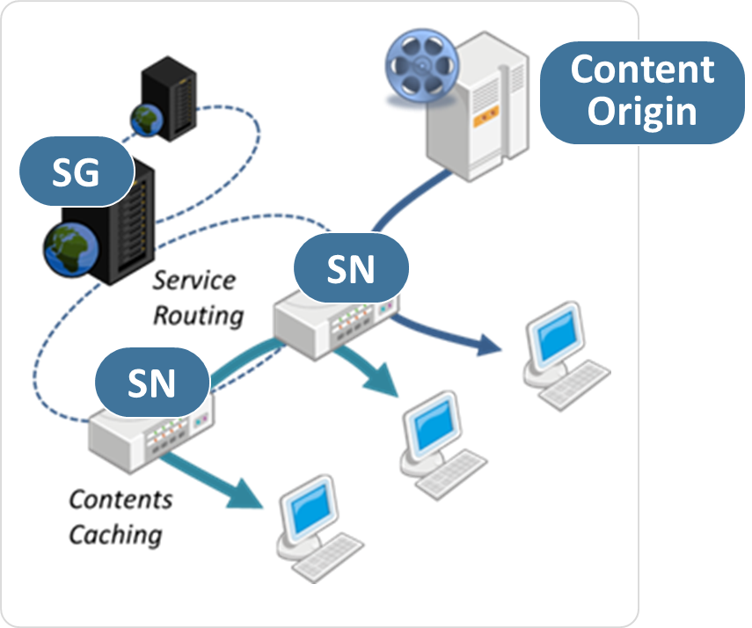
Case Study: Smart Network
Reducing the duplicated content delivery
Traffic localization (ALTO, P4P) + providing user QoE
Smart Gateway
Determine optimal delivery route (proximity & topology info.)
Smart node
Content delivering, caching, exchanging
Issues
DHT-based content search & routing
Dynamic caching algorithm & policy
Transparency
Notes:
In the content distribution area, we are developing smart network tech. which can effectively reducing…. By using in-network cache and content-based routing.
To reduce the duplicated content delivery, we deploying the traffic localization technology such as ALTO, P4P and dynamic in-network caching system.
The most important issues in in-network cache is transparency.
Because the cache system stores the traversed content and deliver the content instead of the original server when users request same content, it should not touch the any business model of the service provider such as advertising.
This is very sensitive issues and closely related with the network neutrality problem.
So when deploying cache-like system, we should carefully considers such issues

Slide 17
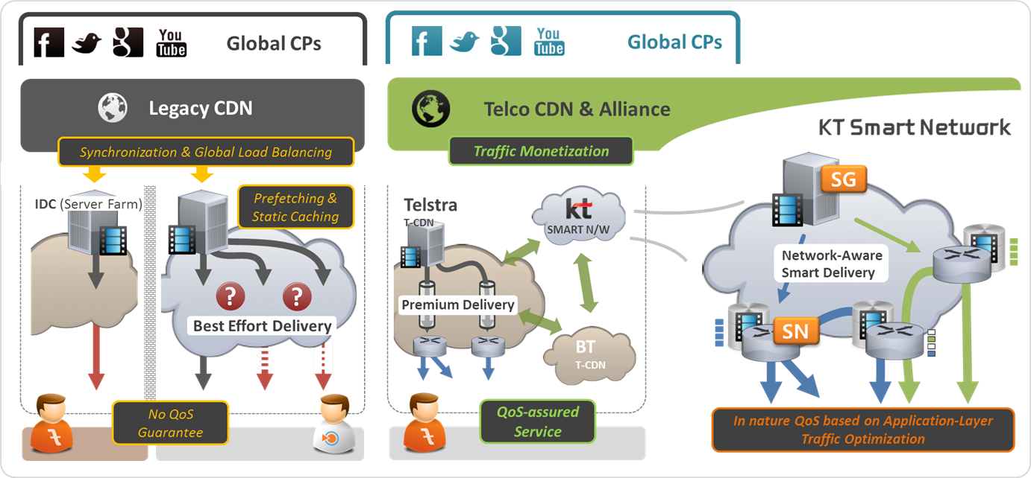
Case Study: CDNi
Reduce IX/Overseas traffic
Telco CDN interconnection
CDNi Pilot Phase2 (~April.2012), CDNi Pilot Phase3 (~November.2012)
Guarantee QoS for such Inter ISP Content Delivery service.
Notes:
Regarding the cost-effective content delivery, we are also now participating in CDN interconnection efforts.
This is a kind of telco’s alliance to deliver content globally in highly effective manner.
We expect that by this effort we can reduce the IX and overseas traffic volume, and consequentely it will help us to reduce the cost.
Currently, the CDNi efforts is in phase 3 started in
Here is several standardization issues such as
1) exchange of metadata between CDNs, 2) exchange of transaction logs & monitoring information, 3) exchange of request-routing information, 4) exchange of policies & capabilities, and 5) content management/flushing

Slide 18
Other Considerations
Routing policy
How to maximize the operational convenience
BGP(Route Reflector), IGP(OSPF), MPLS(LDP)
Network stability
How to eliminate single point of failure
How to deploy fast convergence to minimize routing failure time
Security
How to prevent massive malicious traffic attacks
Notes:
Also there are other issues we should consider regarding operational stability.
For example, how to maximize the operational convenience and how to eliminate single point of network failures.
We should address the fast convergence to minimize routing failure time and also consider and prepare the massive malicious traffic attacks.

Slide 19
Conclusion
So far, what is not in doubt is
Mobile, Video, Cloud continue to dominate broadband
Traffic mix of tomorrow is fundamentally different
Broadband network should evolve to ‘Smart Pipe’
Not just focus on providing ‘connectivity and data delivery’ in cost-effective manner
Have to look ‘content-oriented’ & ‘cloud-based service delivery’ infra. to overcome the telco’s crisis and promote competitive power
Notes:
What we can say to survive in future, is that broadband should not remain a simple connectivity provider, But create new value as a smart service deliverer.
So we need to evolve our infra to smart pipe and consider these issues when deploying broadband infrastructure in every stage.

Slide 20
KT Advanced Institute of Technology (AIT)
Dong-Hoon Yi
E-Mail: donghoon.yi@kt.com
Notes:
That’s all I want to touch in this presentation. Thank you for your patience, Any question? ~~~~~~~~ Thank you very much.

