Slide 1

L.1410:Methodology for environmental impact assessment of information and communication technologies (ICT) goods, networks and services
ITU Workshop on
“Greening the Future: Bridging the Standardization Gap on Environmental Sustainability”
(Colombo, Sri Lanka, 3-4 October 2013)
Takafumi Hashitani
ITU-T Study Group 5,
Q.18 Associate Rapporteur
thashi@jp.fujitsu.com

Slide 2
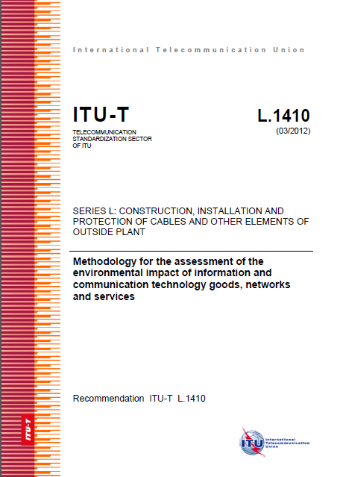
Agenda
Background
Introduction
What is LCA? What is LCA for?
Recommendation L.1410
ICT Goods, Networks and Services
  Part I: ICT life cycle assessment: framework and guidance
  Part II: Comparative analysis between ICT and a reference product system(baseline scenario): framework and guidance
Implementation using a part of L.1410

Slide 3
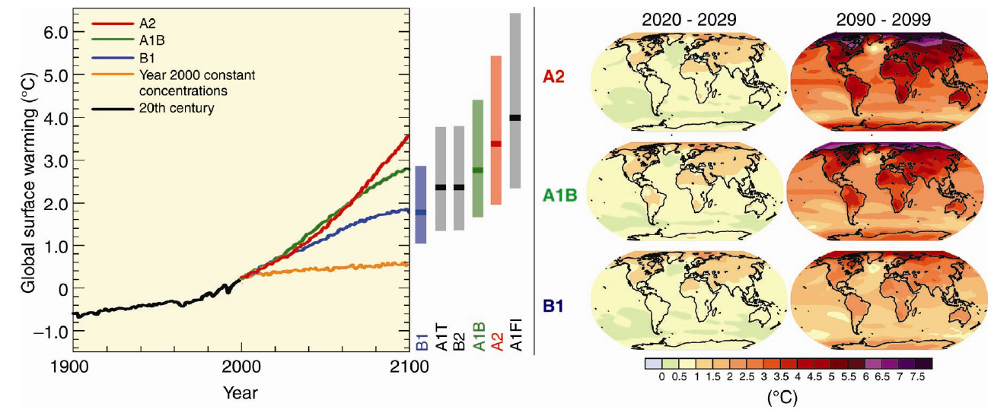
Current State of Global Warming
 Compared to the end of the 20th century, the average global ground temperature in the 21st century is predicted to increase by about 1.8˚C(1.1-2.9˚C) in societies realizing both environment conservation and economic growth on a global scale, and by about 4.0˚C(2.4-6.4˚C) in societies realizing high economic growth while placing importance on fossil energy.
Efforts to reduce greenhouse gases are being implemented worldwide to achieve the targets established for the Kyoto Protocol first commitment period (2008 to 2012).
Elevated levels of world ground temperature （℃）
<Increase in annual average temperature in 21st century
(comparison with 1980 to 1999)>
Source: IPCC 4th evaluation report (Integrated report) (November 2007)

Slide 4


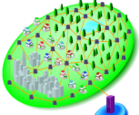


Global Warming Issues and ICT
 ICT itself produces CO2 emissions through consumption of electric power to operate equipment / systems.
 On the other hand, ICT usage can contribute to a reduction in CO2 emissions through a marked improvement in efficiency in regarding production, consumption, and business activities, also in traffic alternatives, and a reduction in traffic volume.
Improvement of energy use efficiency
Improved efficiency in production and consumption of products
• ＩＴＳ(Intensive control of ETC, VICS, and traffic lights)
• BEMS(Building energy management system)
• HEMS(Household energy management system)
General households
• Supply chain management
• e-publication and distribution
• Paperless office
Environmental measurement and predictions
Reduced movement of people and products
Production/
distribution/
transportation
Offices/shops
• Radar for measuring CO₂
• Sensing network
• Global simulator
• Online shopping, online trading
• Telework, TV conferencing
• Music, video, and software distribution
• e-application (tax declaration, online receipt)
Use of ICT
Contribute to tackling global warming issues by promoting spread of ICT use

Slide 5
Agenda
Background
Introduction
What is LCA? What is LCA for?
Recommendation L.1410
ICT Goods, Networks and Services
  Part I: ICT life cycle assessment: framework and guidance
  Part II: Comparative analysis between ICT and a reference product system(baseline scenario): framework and guidance
Implementation using a part of L.1410

Slide 6
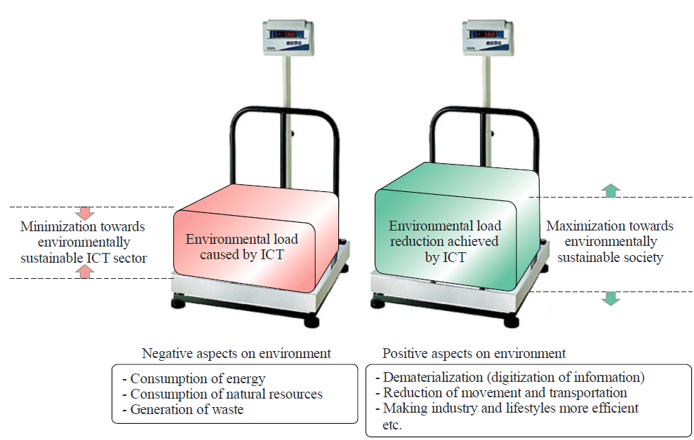
Environmental aspects of ICT
Positive and Negative aspect on Environment

Slide 7


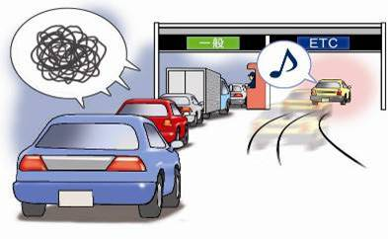
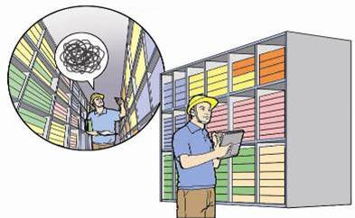
Reduce Environmental impact By ICT
Reduction in movement of people and goods
- Teleconferences -
Reduction in volume of goods consumed
- Electronic account settlement -
Improve energy efficiency
- ITS (Intelligent Transport Systems) -
Effective use of space
- Stock control -

Slide 8
Agenda
Background
Introduction
What is LCA? What is LCA for?
Recommendation L.1410
ICT Goods, Networks and Services
  Part I: ICT life cycle assessment: framework and guidance
  Part II: Comparative analysis between ICT and a reference product system(baseline scenario): framework and guidance
Implementation using a part of L.1410

Slide 9
What is LCA? What is LCA for?
The increased awareness of the importance of environmental protection, and the possible impacts associated with products, both manufactured and consumed, has increased interest in the development of methods to better understand and address these impacts. One of the techniques being developed for this purpose is life cycle assessment (LCA).
LCA can assist in
⎯ identifying opportunities to improve the environmental performance of products at various points in their life cycle,
⎯ informing decision-makers in industry, government or non-government organizations (e.g. for the purpose of strategic planning, priority setting, product or process design or redesign),
⎯ the selection of relevant indicators of environmental performance, including measurement techniques, and
⎯ marketing (e.g. implementing an ecolabelling scheme, making an environmental claim, or producing an environmental product declaration).
For practitioners of LCA, ISO 14044 details the requirements for conducting an LCA.

Slide 10
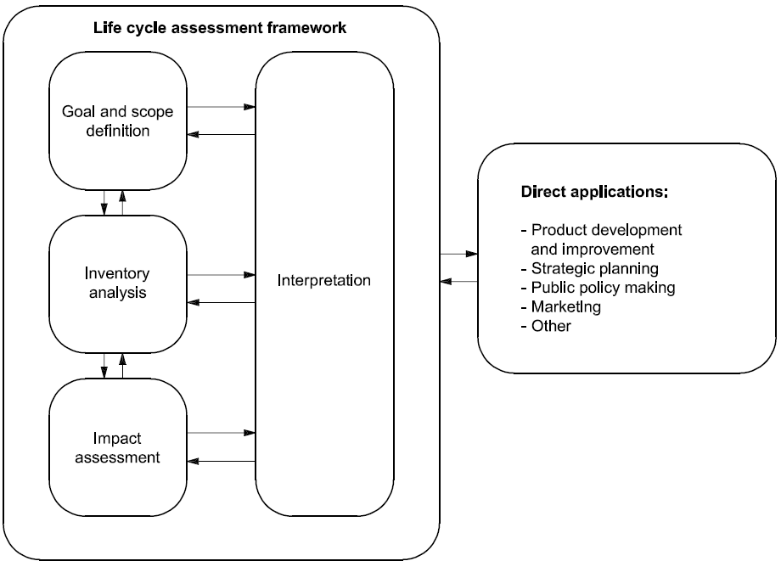
LCA Framework
Direct applications of the results of LCA or LCI studies, i.e. the applications intended in the goal and scope definition of the LCA or LCI study, are depicted in this Figure

Slide 11
Benefits of an LCA approach
To provide an assessment of the environmental impact of a product system as a basis for improving it
To understand the relative importance of different life cycle stages /activities - where to put best efforts for improvement
To monitor performance improvements over time
RAW MATERIAL ACQUISITION
PRODUCTION
USE
END OF LIFE

Slide 12

ISO has standardized the Life Cycle Assessment methodology with the publication in 2006 of 2 documents
  ISO 14040 “Environmental management- Life cycle assessment-Principles and framework”
  ISO 14044 ”Environmental management- Life –cycle assessment- Requirements and guidelines”

Slide 13
Limitations of LCA
“LCA addresses potential environmental impact:
LCA does not predict absolute or precise environmental impacts due to the relative expression of potential impacts to a reference unit, the integration of environmental data over space and time, the inherent uncertainty in modeling environmental impacts, and the fact that some possible environmental impacts are clearly future impacts”
ISO 14040: 2006 Section 4.3

Slide 14
Agenda
Background
Introduction
What is LCA? What is LCA for?
Recommendation L.1410
ICT Goods, Networks and Services
  Part I: ICT life cycle assessment: framework and guidance
  Part II: Comparative analysis between ICT and a reference product system(baseline scenario): framework and guidance
Implementation using a part of L.1410

Slide 15
Impact of Goods, Networks and Services
L.1410 : What is it ? What is it for ?
It is a Recommendation that complements ISO 14040 and ISO 14044 and provides guidance on how to assess environmental impacts of ICT Goods, Networks and Services
  It has been built with a large number of representatives from the ICT sector and governments. It has been built to be consistent with EC/JRC, ETSI, IEC and GHG Protocol ICT supplement initiatives
There are 2 Parts in the Recommendation:
  Part I : ICT Lifecycle assessment: framework and guidance
  Part II : Comparative analysis between ICT and baseline scenario : framework and guidance
The 2 Parts describe clear steps to follow in order to assess environmental impacts over the entire life cycle
  This helps identify what are the major activities and life cycle stages impacting the environment, design and prepare action plans and prioritize actions
  This helps identify risks, save costs and develop new opportunities

Slide 16
L.1410 Part I
Relationship between methodologies of LCA for ICT Good Networks and services
ICT Networks are composed of ICT goods and ICT services utilize ICT networks: ICT Goods are the basis for the methodologies for ICT networks and ICT services.

Slide 17
L.1410 Part I: What are the steps to follow?
General requirements
Goal and scope definition
Functional unit definition
System boundaries definition
Cut-off rules
Data quality requirements
Life Cycle Inventory
  Data collection
  Data calculation
  Allocation procedure
Life Cycle impact assessment
Life cycle interpretation
Reporting
Refer in detail:
Information and Training Session on ITU Methodologies for
Assessing the Environmental Impact of ICT
http://www.itu.int/en/ITU-T/Workshops-and-Seminars/ITS/201204/Pages/programme.aspx

Slide 18
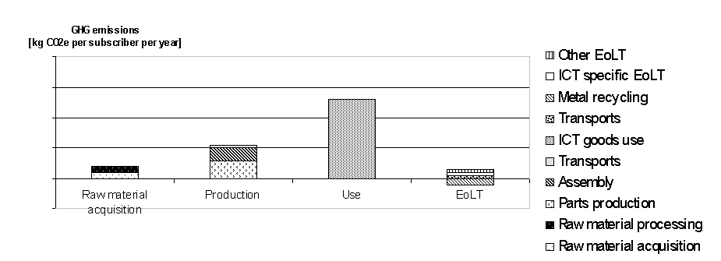
L.1410 Part I Reporting : example

Slide 19
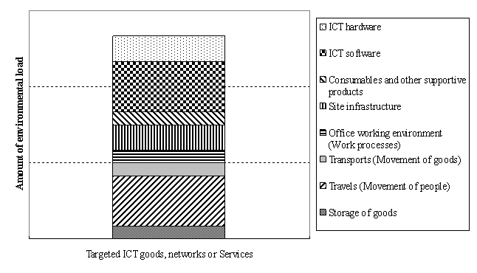
L.1410 Part I Reporting : example

Slide 20
L. 1410 Part II : key principles
There are two target systems for comparative analysis
Comparison between a reference product system and an ICT service
e.g. travel to a face to face meeting (flight, train, car, hotel stays) versus the use of a Video conferencing service
Comparison between two ICT goods or two ICT networks or two ICT services
e.g. an old data centre compared to a “Green” efficient one
Key principles : Systems must be compared using the same functional unit and equivalent methodological considerations, such as system boundary, data quality, allocation procedures and cut off rules (if applied)
In a comparative analysis what one is seeking to capture is the difference between the two systems rather than the magnitude of both

Slide 21
L.1410 Part II : What are the steps to follow ?
General requirements
Goal and scope definition
Functional unit in the case of comparison
System boundaries definition
Cut-off rules
Data quality requirements
Life Cycle Inventory
Life Cycle impact assessment
Life cycle interpretation
Reporting
N.b. For Part II which is a comparative analysis between an ICT system and a reference product system the above steps need to be carried out on BOTH the ICT system and the reference product system

Slide 22
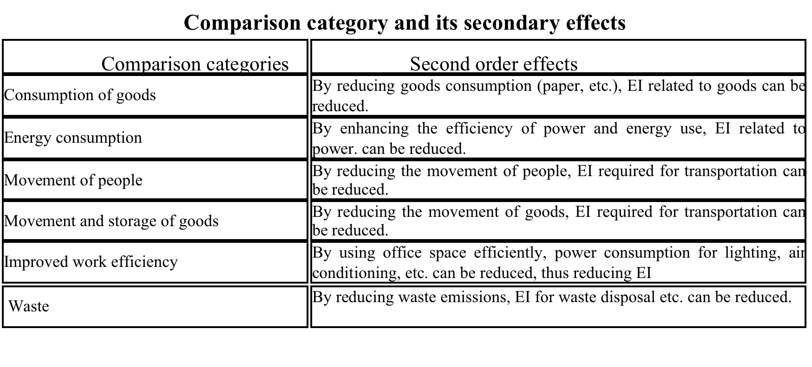
Comparison categories
EI: Environmental impact

Slide 23
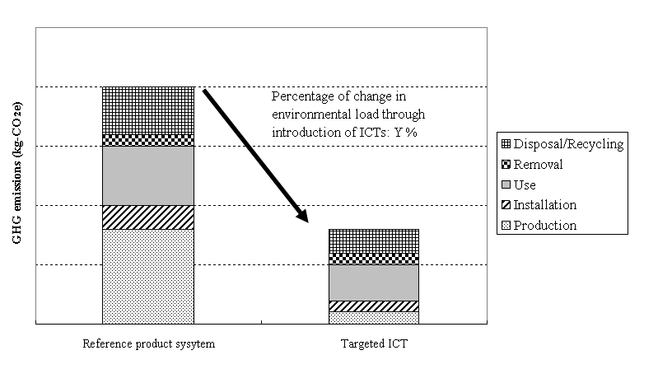
L. 1410 Part II, example of reporting
Example of comparative evaluation between ICT and reference product system with categories of life cycle stages.

Slide 24
Agenda
Background
Introduction
What is LCA? What is LCA for?
Recommendation L.1410
ICT Goods, Networks and Services
  Part I: ICT life cycle assessment: framework and guidance
  Part II: Comparative analysis between ICT and a reference product system(baseline scenario): framework and guidance
Implementation using a part of L.1410

Slide 25
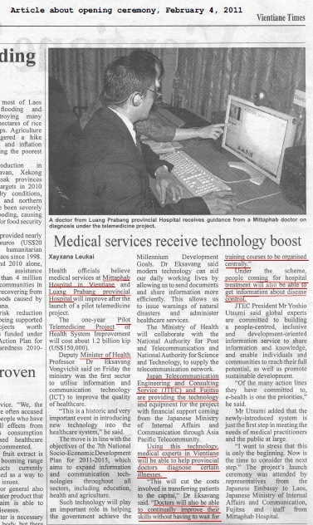
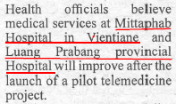
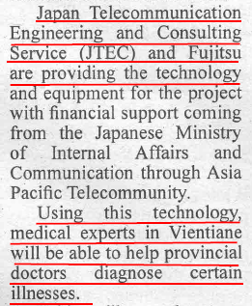
Pilot Telemedicine Project (in Laos)

Slide 26



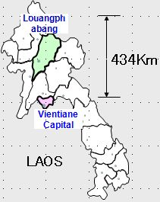
Pilot Telemedicine Project (in Laos)
Remote medical diagnosis saves CO₂ emitted by transporting patients
Before implementation
After implementation
Implementation of ICT
■ It was necessary to move patients 434km by air.
* About 180 patients/year
CO₂ was reduced by 16.5 tons/year
mainly energy used to transport patients
・ Removed burden of transport costs from patients.
・ Reduced personnel costs and work time of medical treatment personnel.
・ Lowered burden on medical staff at both locations.
・ Improved quality and efficiency of medical treatment services.

Slide 27






Details
CO₂ emissions at each term
Term | Before | After | (-) Saving (+) Impact
Travel - Transportation of patients - Business trip of physicians and nurses | 49.1 | 32.1 | -17.0
Person-Hour - Diagnosis for patients - Trainings and information exchange | 5.1 | 4.4 | -0.7
Office space for ICT equip. - Facility energy for ICT equip. | 0.0 | 0.1 | +0.1
Power consumption of ICT -Power consumption installed ICT equip. | 0.0 | 0.1 | +0.1
Data communication - Consulting and information exchange on internet. - Reporting the state of patients by telephone | 0.0 | 1.0 | +1.0
Total | 54.2 | 37.7 | -16.5
[t-CO₂/year]

Slide 28
Result
CO₂ Savings 16.5 t-CO₂/year (- 30%)

Slide 29

Thank you for your attention !
Photo by
Takafumi Hashitani,
Associate Rapporteur
Question 18 SG 5 ,ITU-T
Fujitsu
thashi@jp.fujitsu.com

