Slide 1
Telco Engagement In Building Smart Cities
Janaka R. Abeysinghe
General Manager – Enterprise Sales Division
Sri Lanka Telecom PLC
janaka@slt.com.lk
ITU Workshop on “Greening the Future: Bridging the Standardization Gap on Environmental Sustainability”
Colombo, Sri Lanka, 3-4 October 2013

Slide 2
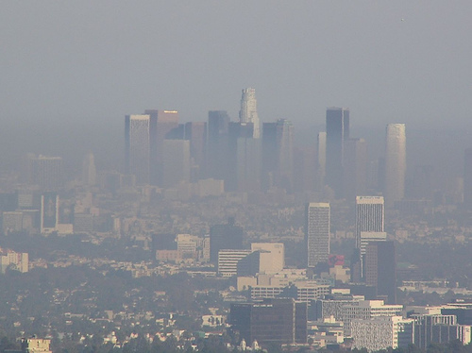
A Changing World
- Challenges Faced By Cities
Percentage Urban Population (World)
1950
2000
2010
2050
29%
47%
53%
70%
Percentage Urban Population (Sri Lanka)
1950
2000
2010
2050
15%
16%
16%
30%
(Source: World Urbanization Prospects: The 2011 Revision, United Nations)
60 to 80% of global GHG emissions
Produce 50% of global waste
(Source: Global Initiative for Resource Efficient Cities, United Nations
Environment Programme (UNEP))
Notes:
2

Slide 3

Move Toward Smart Cities
Growing Population
Traffic Congestion
Public Safety Issues
Smart City
Pollution
Increased Energy Usage
Education &
Health
  Quality of Life
  Sustainability
  Service Improvement
  Cost Effective
  Well Managed
  A Strong ICT Infrastructure
Notes:
3

Slide 4






Smart City – A Complex Value Network
City Services
Transportation
Education
Gather information about environment
Share information among service departments
Analyze data to predict resource needs and intelligent operations
Utilities
(Energy & Water)
Healthcare
Communication
Governance
People
Living
Economy
Environment
Mobility
Man-made systems are interconnected to interact with one another
Notes:
The city’s agenda and the city’s governance create the framework within which a city exists
A number of city services support the vision of a city
A number of core systems support the city’s services, and as such, the city’s vision
Six core systems act as both resources and users of resources
There are two main city user systems, including subsystems, such as health, education, public safety etc.
The are four main city infrastructure systems, supporting services that relate to a city’s key utilities and to a city’s mechanisms for moving and distributing people, goods, and information
In the following slides, I will explain in more detail the various systems of a city, starting at the bottom with the most basic infrastructure ….
City services: <add defition for each to speaker notes> !!!
People:
Businesses:
Water:
Energy:
Transport:
Communications:

Slide 5
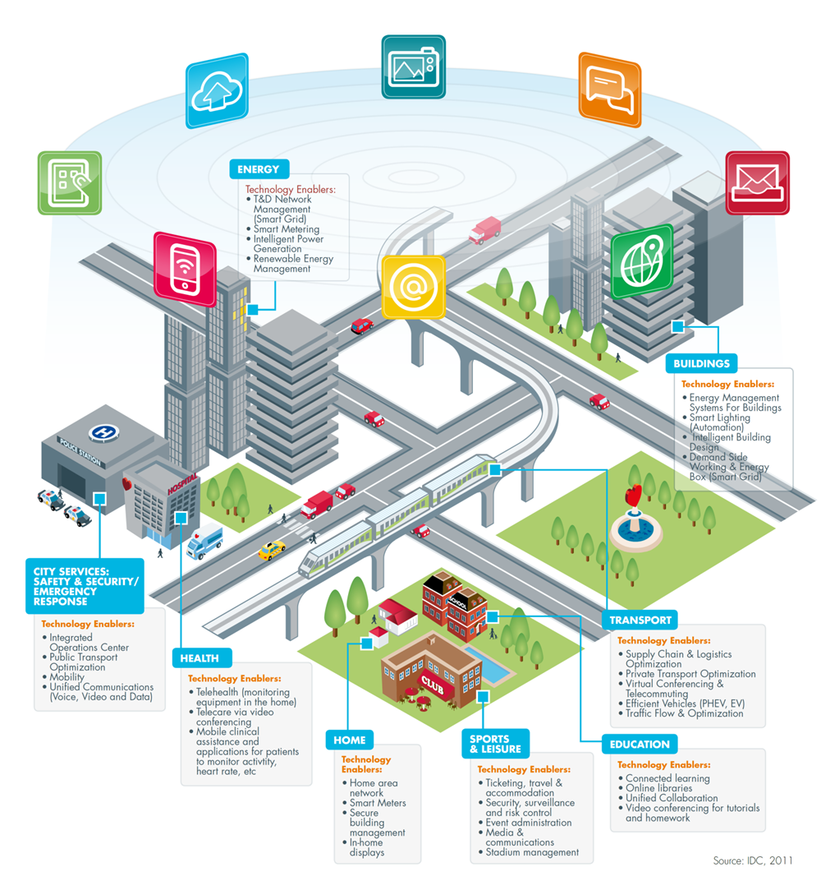
Smart city – At A Glance
Source: IDC, 2011

Slide 6
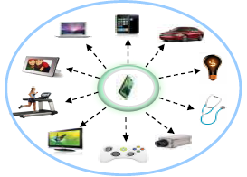

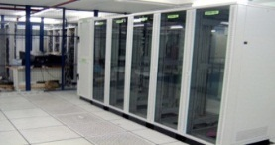

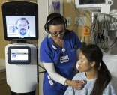
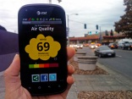
An E2E Smart City Solution
Sensors/ Terminals
Access & Core Network
Smart City Cloud
Smart Mobility
NGN
Fixed/Mobile
Internet
Smart People
Smart Living
Smart
Environment
A City with the ability to sense and respond to its environment
Sensors to gather data from environment
Smart Devices with M2M capability
(eg: traffic flow
electricity usage
water quality
citizen emergencies)
Communicate and share information with other Government entities
Reliable, High Speed, High Availability, Secure, QoS enabled end-to-end IP Network
E2E IP Network to support TDM, IP & Ethernet Applications
FTTH, 4G LTE & WiFi for M2M
connectivity
Deep discovery, analysis and forecasting
City authorities can take smarter decisions
Notes:
The city’s agenda and the city’s governance create the framework within which a city exists
A number of city services support the vision of a city
A number of core systems support the city’s services, and as such, the city’s vision
Six core systems act as both resources and users of resources
There are two main city user systems, including subsystems, such as health, education, public safety etc.
The are four main city infrastructure systems, supporting services that relate to a city’s key utilities and to a city’s mechanisms for moving and distributing people, goods, and information
In the following slides, I will explain in more detail the various systems of a city, starting at the bottom with the most basic infrastructure ….
City services: <add defition for each to speaker notes> !!!
People:
Businesses:
Water:
Energy:
Transport:
Communications:

Slide 7
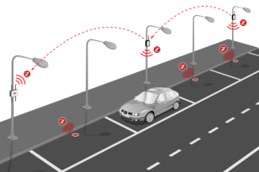
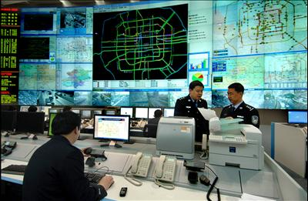

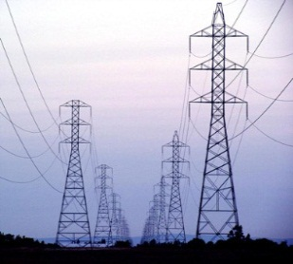


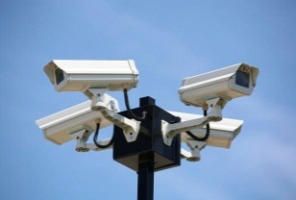
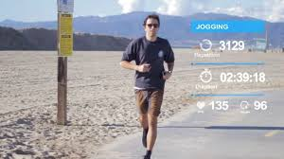
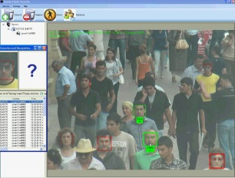


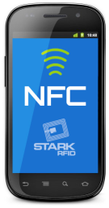
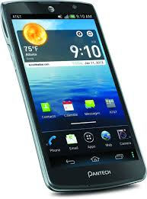
Multiple Service Delivery
Sensors/
Terminals
Network
Smart City Cloud
Transport
City Authority
Network
NGN
City Managers
Energy
City Authority
Citizens
Network
Real-time data transfer for collaboration across city agencies
(water, electricity, transport)
Public Safety
City Authority
Multiple Systems/ Disconnected Departments
Multiple Applications/ Multiple Devices
Connected City Authorities

Slide 8
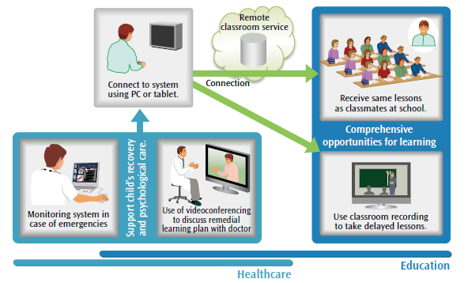
Multiple Service Delivery
Source: Hitachi

Slide 9
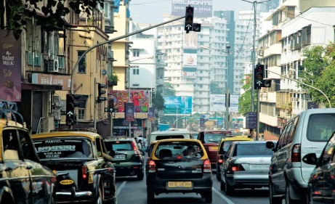
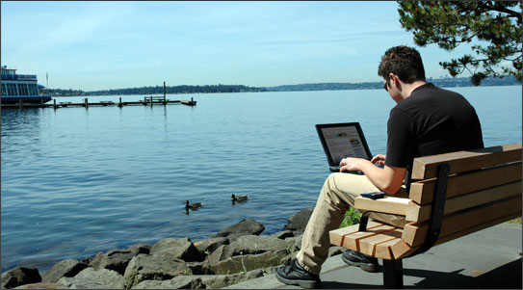
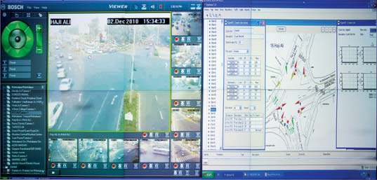
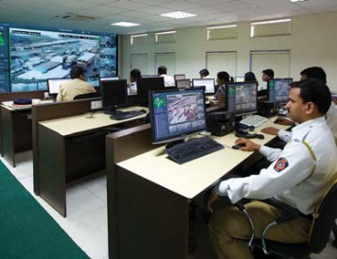
Smart City on Cloud - SaaS
information sharing platform
“Cloud”
Utilities
Other City Authorities
Healthcare
Transport
e-Government
Citizens
Lower TCO
(Less upfront investment, Predictable operating costs)
Access Services on the Internet from multiple devices
Scalable infrastructure; Quick service provisioning
(add new services, add new government entities)
Easier planning for future growth
Flexibility to implement at City’s own pace
Pay-as-you-go model for Cities
City Operator
Notes:
9

Slide 10

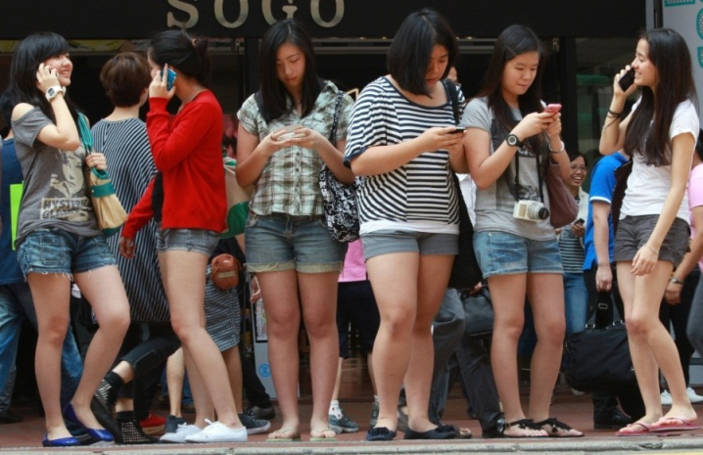
Explosive Growth in Internet and Smartphones
By 2014, Mobile Internet usage will overtake desktop Internet usage
The Smartphone is Connecting People to the World
- more than 700 million Smartphone users
By 2016 (Globally),
- 2 Billion Smartphone users
(40% of total mobile subscribers)
- 700 Million tablets
(Source: Huawei, 2012)
Mobile is Changing User Behavior
Notes:
10

Slide 11
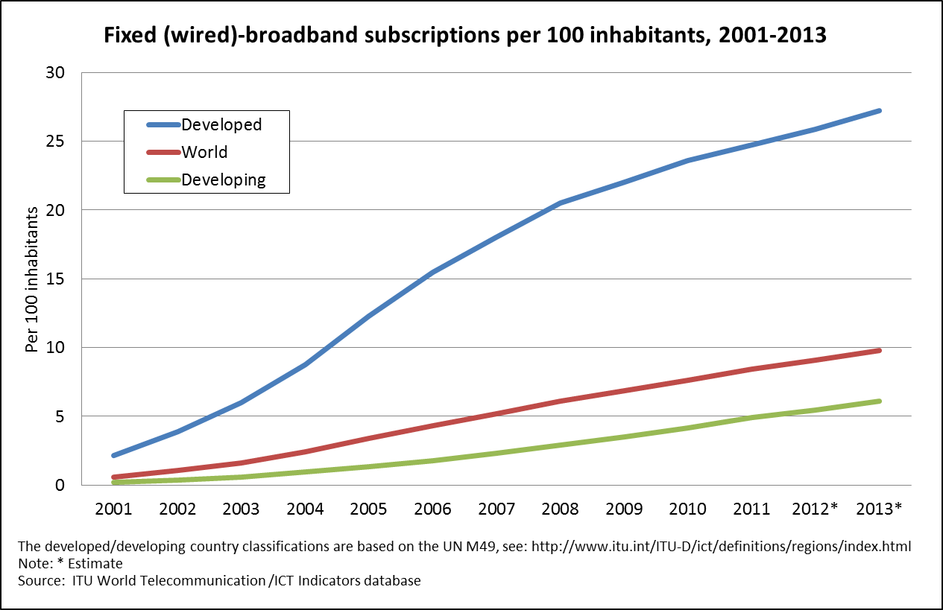
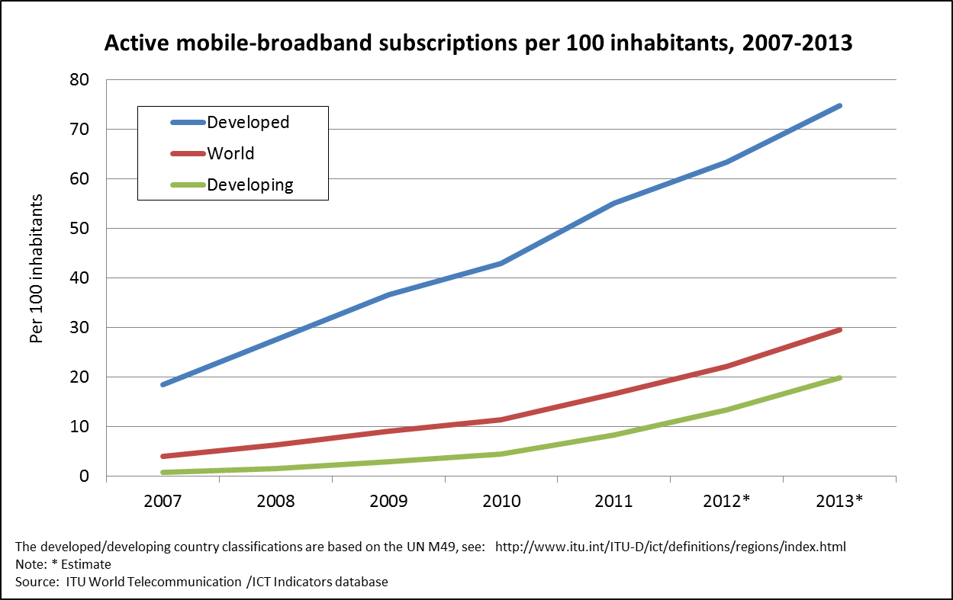
Growth in Broadband – Globally
27.2
74.8
Sri Lanka fixed
Broadband, 2.0%
9.8
29.5
6.1
19.8
Sri Lanka Mobile Broadband, 4.5%
Growing trend in Fixed and Mobile broadband
service in both developed and developing countries
Sri Lanka fixed and wireless broadband
penetration is below the developing countries
and only a fraction of world average.
Substantial growth in SL broadband will occur
over the coming years
In Sri Lanka at end 2012,
  Fixed Broadband Penetration : 2.0%
  Mobile Broadband Penetration : 4.5%
  Total Broadband Penetration : 6.5%

Slide 12
Building A National Backbone Network (NBN)
Fiber Optic Super Highway Network Connecting Any Province in Sri Lanka
Covers all 329 Divisional Secretariats within next 5 years
Facilitate Broadband connectivity across Sri Lanka
  High-speed connectivity
  Uninterrupted access to services
  (e-learning, e-health, e-commerce)
  Highest redundancy
Broadband Access to Services
  xDSL
  Metro Ethernet/ IP VPN
  WiFi
  LTE
Improved Accessibility to Services
More Affordable Services
J
a
f
f
n
a
#
S
N
L
E
G
E
N
D
#
S
S
C
S
C
e
n
t
r
a
l
R
i
n
g
(
6
7
0
K
m
)
#
p
r
o
p
o
s
e
d
N
o
r
t
h
-
E
a
s
t
C
e
n
t
r
a
l
R
i
n
g
(
5
6
5
K
m
)
M
a
n
n
a
r
S
P
r
o
p
o
s
e
d
E
a
s
t
-
U
v
a
C
e
n
t
r
a
l
R
i
n
g
(
4
7
0
K
m
)
P
r
o
p
o
s
e
d
S
o
u
t
h
e
r
n
R
i
n
g
(
3
5
0
K
m
)
V
a
u
n
#
i
y
a
S
#
T
r
i
n
c
o
m
a
l
e
e
S
#
S
A
n
u
r
a
d
h
a
p
u
r
a
T
a
m
b
u
t
t
e
g
a
m
a
P
u
t
t
l
a
m
G
a
l
g
a
m
u
w
a
P
o
l
o
n
n
a
r
u
w
a
#
S
M
a
h
o
#
B
a
t
t
i
c
a
l
o
a
S
C
h
i
l
a
w
#
S
K
u
r
u
n
e
g
a
l
a
M
a
t
a
l
e
#
S
#
S
#
K
a
l
m
u
n
e
S
K
a
n
d
y
A
m
p
a
r
a
#
#
S
#
S
N
e
g
o
m
b
o
K
S
#
e
g
a
l
l
e
S
#
G
a
m
p
a
h
a
S
N
a
w
a
l
a
p
i
t
i
y
a
#
S
B
a
d
u
A
w
i
s
s
a
w
e
l
l
a
#
l
l
a
N
u
w
a
r
a
E
S
#
l
i
y
a
#
S
C
o
l
o
m
b
o
#
S
S
#
S
H
a
t
t
o
n
#
B
a
n
d
S
a
r
a
w
e
l
a
#
R
a
t
n
a
p
u
r
a
S
#
K
a
S
l
u
t
a
r
a
#
S
H
a
m
b
a
n
t
o
t
a
#
G
a
l
l
e
S
#
S
M
a
t
a
r
a

Slide 13
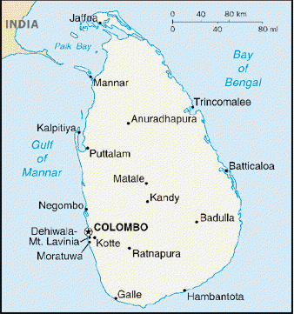
Largest Internet Backbone – 21.5 Gbps
Europe
USA
●
6.1G
0.6G
●
India
Asia Pacific
●
●
7. 5G
7.35 G
  High speed, low latency connectivity
Deliver more affordable services
Better accessibility

Slide 14

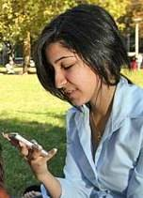
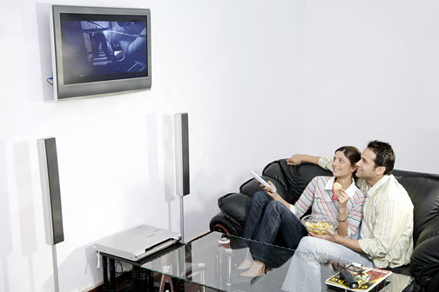

Convergence and Multi-Play Services
- Personnalized services & Convenience
Any Network
Any Where
Any Time
Any Device
New Services
On “Cloud”

Slide 15




SchoolNet
– Dedicated Internet Access to 1450+ locations
Requirement:
Enabling E-learning for Secondary Schools
NOC at UoM
SchoolNet
Computer Resource Centers
School
School
Notes:
15

Slide 16



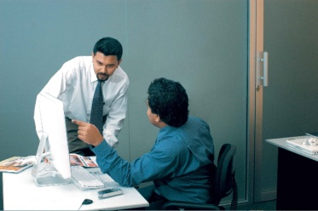
Lanka Government Network (LGN)
– 500+ Government Offices Connected
Citizens
Requirement:
Enabling E-Government
Internet
LGN Hub at SLT iDC
Govt. Offices
Lanka Government Network
Government Office
Server Farm
VoIP
Email
Management
Citizens can quickly inquire about
or apply for services at home
Government Office
Notes:
16

Slide 17
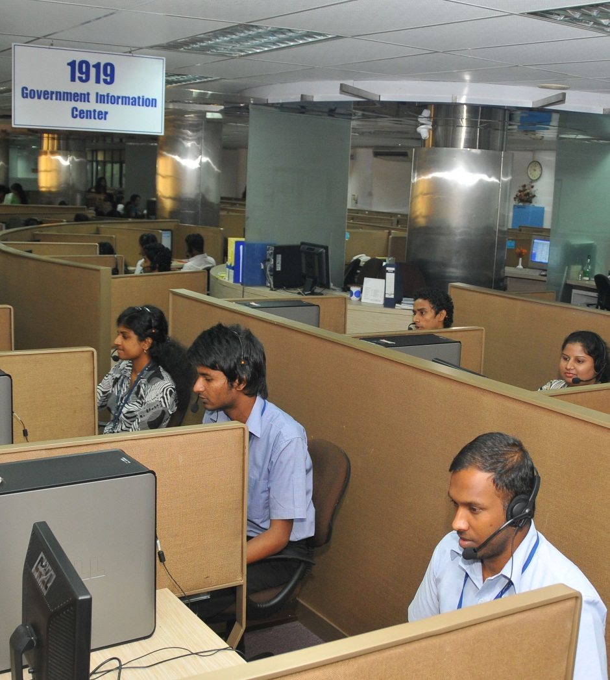
Government Information Center - 1919
Easy access to Government information
  Telephone numbers
  Addresses of Gov. institutes
  Information on special events
  (Exam results)
Information on Government procedures
  Documents, procedures (NIC, Passports)
Information on routine events
  Train schedules
Remote support for Government E-Services
(e-Revenue License)
Complain handling
  - Acknowledge complains regarding Government Organizations
SLT is the infrastructure provider for GIC 1919 service
Notes:
17

Slide 18
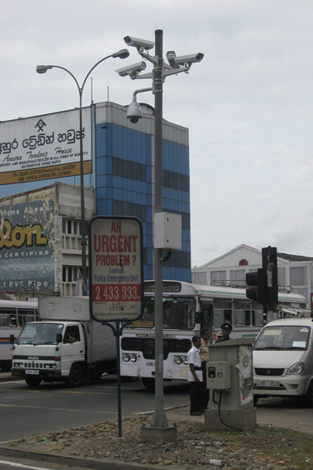
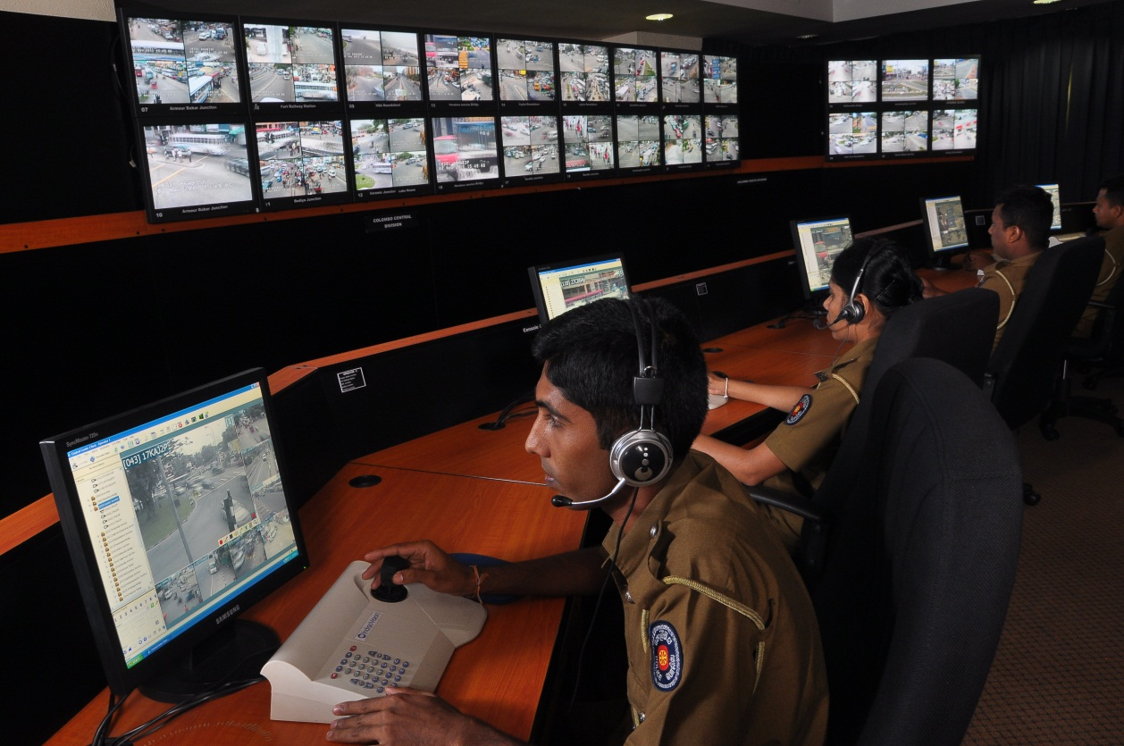
Colombo Police CCTV Surveillance System
CCTV cameras at main intersections
Central Control Room
Information can be used,
  for crime detection/prevention
  for traffic management
  for confirmation of incidents
  to record events over a time period
Notes:
18

Slide 19
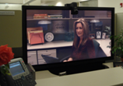


Smart Cities Will Revolutionize The Way We
Live.. Work.. & Learn..
More Convenient
More Comfort
Healthier
Safer
Work
Live
Learn
Meetings
Virtual Specialists
TeleMedicine
Family Visits
Remote Classrooms

Slide 20
Thank You

