Slide 1
Industrial Inter-Dependency for Sustainable Growth
Hasith Karunasekera & Dr. Shamil Appathurai
Mobitel (Pvt) Ltd
Sri Lanka

Slide 2
ICT Growth proportional to Data Growth/Internet penetration
Between 2010 and 2011
Almost all countries increased their IDI values but..
… developed countries have twice the IDI value of the developing ones
Source: ITU

Slide 3
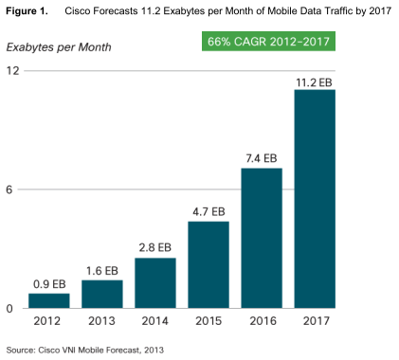
ICT Growth and Data Consumption
Global Data consumption is growing exponentially:
- Is this trend different in Sri Lanka?

Slide 4
Sri Lanka’s Data demand
Source: TRCSL
Similar trend for demand in Data BUT….
Significant contribution from Mobile Broadband

Slide 5
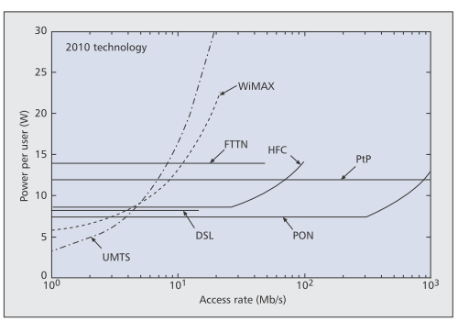
Energy Consumption – Access Technologies
Source: IEEE Communications Magazine • June 2011

Slide 6
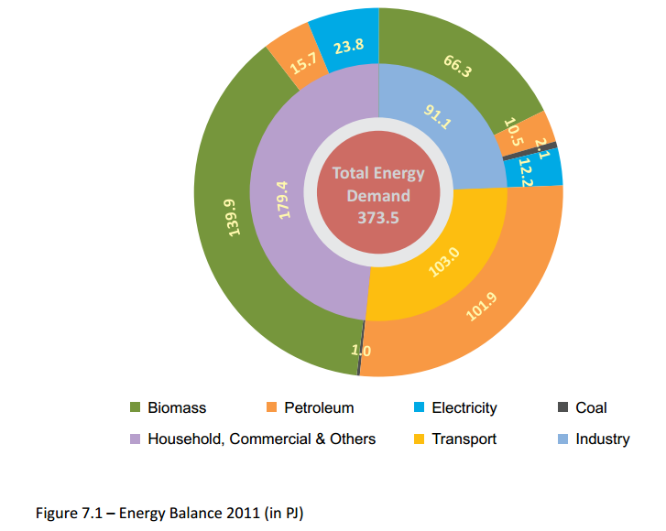
Sri Lanka – Energy Balance
Units: Peta Joules
Energy Balance, 2011
Source: Sri Lanka Sustainable Energy Authority

Slide 7
Sri Lanka’s power consumption based on ICT (Telco) Infrastructure
UMTS network Access Rate per user ~ 1 Mbps
UMTS power per user ~ 4W
Mobile Data Subscriber ~ 1 Million
Power consumption of Mobile Data users ~ 4 MW
ADSL network Access Rate per user ~ 4 Mbps
DSL power per user ~ 8W
Fixed line Data subscribers ~ 500k
Power consumption of Mobile users ~ 4 MW
Estimated Energy Requirement for Data consumption in Sri Lanka (2013) ~ 8 MW

Slide 8
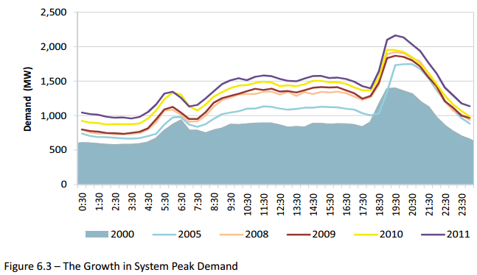
Sri Lanka Electricity – Demand
Growth in System Peak Demand
Source: Sri Lanka Sustainable Energy Authority
Catering for the peak demand is costly
Energy is wasted in non peak hours

Slide 9
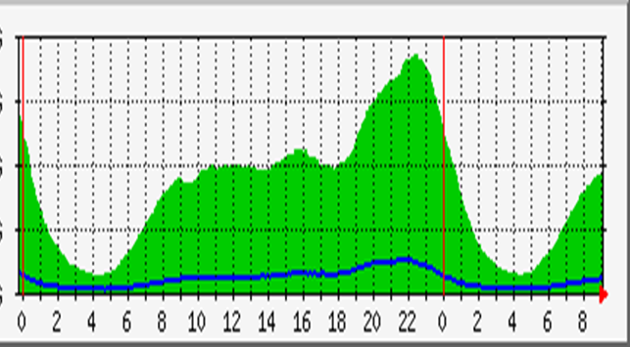
Sri Lanka ICT Consumption - Demand
Data Consumption Peak Demand
Source: Mobitel Data
Catering for the peak demand is costly
Capacity is wasted in non peak hours

Slide 10
Infrastructure solutions for Optimal Energy Utilisation
Spectrum Re-arrangement for maximum coverage with minimal base-station sites
Avoid network duplication through RAN Sharing among operators
Provide energy to grid when power generated during off-peak through Net-Metering

Slide 11
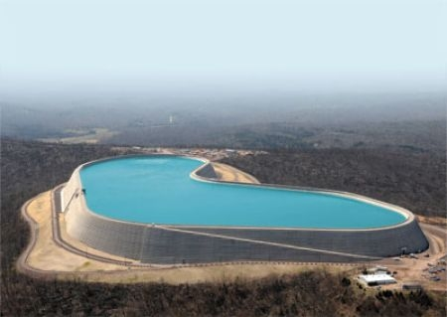
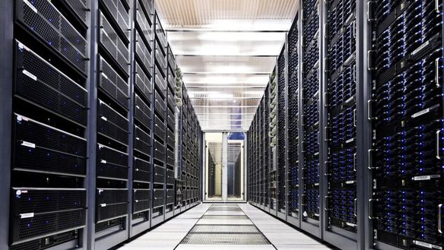
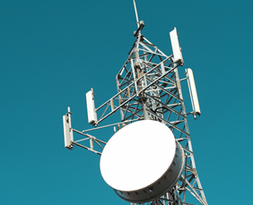
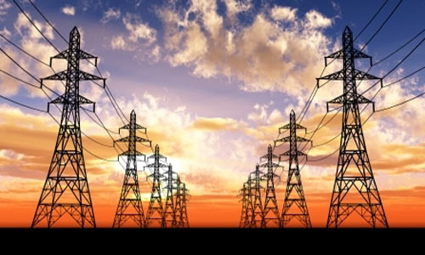
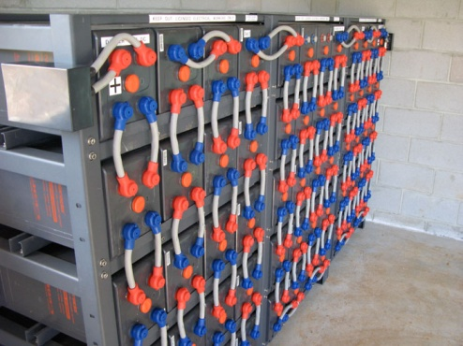
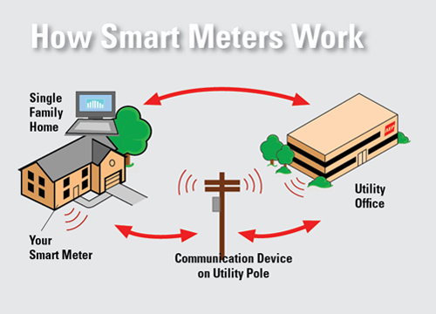
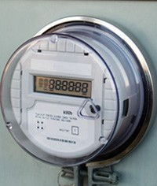
Solutions for Peak Demand Catering
Storage & Re-use
Pumped Storage Hydro Electricity
Cache
Battery
Smart Grid – Time Shift

Slide 12
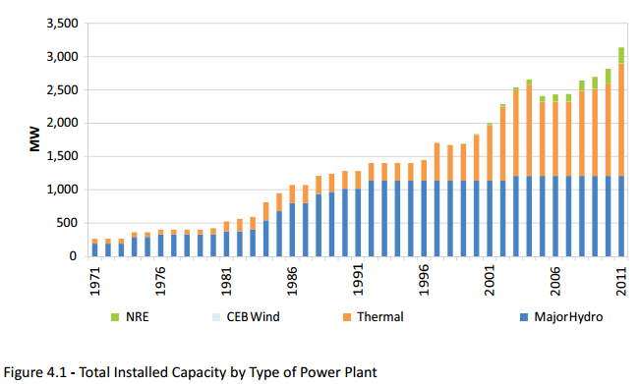
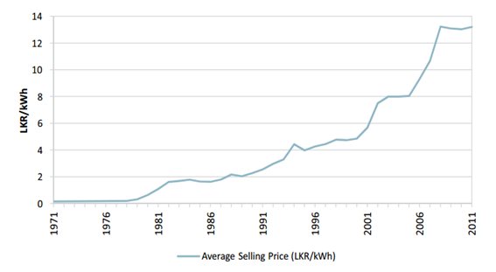
Sri Lanka Electricity - Supply
Grid Installed Capacity by Type
Capacities from Major hydro power plants have become constant
The increasing demand will be supplied in the future through thermal power plants
NRE sources have also entered the play.
Source: Sri Lanka Sustainable Energy Authority
Source: Sri Lanka Sustainable Energy Authority

Slide 13
Sustainable Business = Sustainable Energy Costs
Typical Operating Expenses

Slide 14
Electricity prices & Fuel Prices
Electricity prices have high correlation with world crude oil prices
Higher proportion of thermal energy being powered through crude oil
In Sri Lanka future electricity prices will be more correlated with coal prices
Noracholai, Sampur

Slide 15
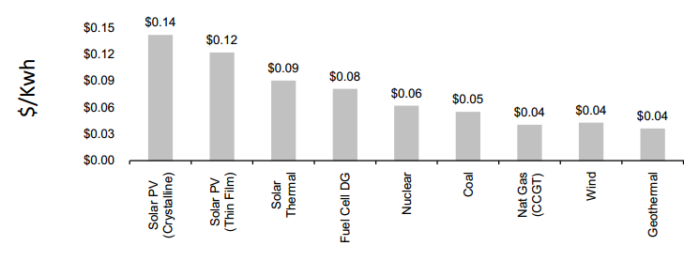
Thermal Energy (SL) – Now & Future
Higher portion of thermal power primarily through fuel oil.
Sri Lanka identified coal as a low cost energy source
Eg: Norocholai (900MW), Sampur (500MW)
Risk of increase in pollution
Annie Hazlehurst
Joint MBA / MS Environment & Resources Candidate
Stanford Graduate School of Business

Slide 16
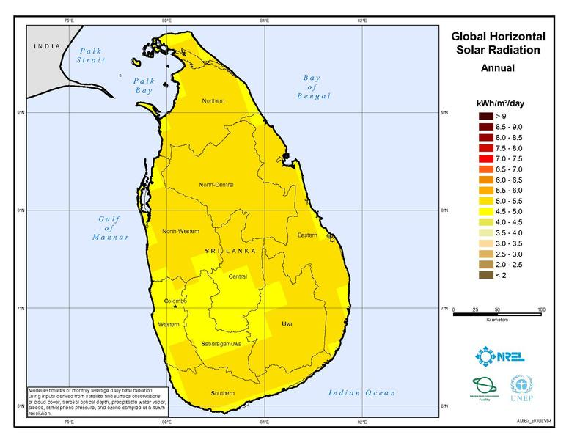
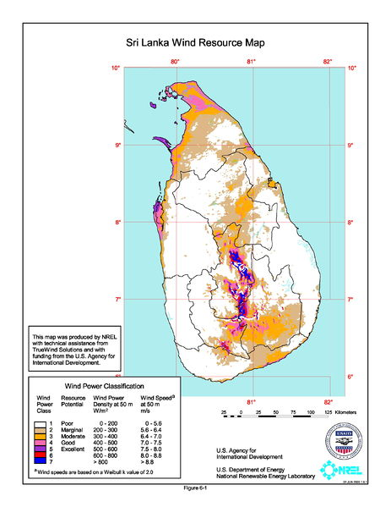
New Renewable Energy – Sri Lanka
Sources of NRE
Tidal Energy
Solar Energy
Geothermal Energy
Wind Power

Slide 17
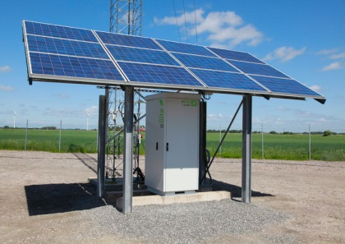
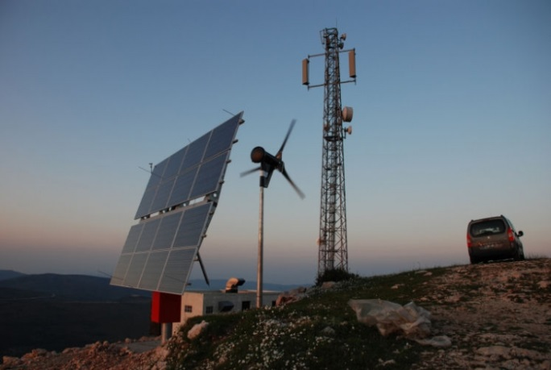
Telco Challenges - for Wind and Solar
Constraints on deployment of wind or solar system
Site Location – in the solar and wind map
Tower height
Site Area – considerable area required for solar
Hybrid solutions – to provide 24 hour continuous power supply
Solar with Generator
Wind with Generator
Solar and Wind with Generator
Re-use existing Infrastructure
Eg: battery bank
Note: Wind is more efficient than solar cells but much more scarce based on the location of the site.

Slide 18
Power Cost Variance in Sri Lanka
Grid Power
Generator Power
Electricity Powered
Directly impacted by Ceylon Electricity Board’s Strategy
Generator (Diesel) Powered
Requirement for alternative renewable energy sources

Slide 19
Cost-Benefit Analysis - Solar
Solar System (kW) | 4 | 5 | 6 | 7 | 8 | 9 | 10
Area Required (m2) | 24 | 33 | 39 | 49 | 56 | 62 | 66

Slide 20
Conclusion
Data consumption will increase energy consumption
ICT solutions and Infrastructure design can be optimised through active collaboration
Renewable Energy is cost-beneficial and MUST supplement grid power

Slide 21
Thank you !
Don’t commute; Communicate!
Dr. Arthur C. Clarke
Think Smart, Use Less and Use Better

