Slide 1
ICT Infrastructures- Indian Green Solution prospective
RAKESH Kumar Bhatnagar
Advisor (Technology), Department of Telecommunications
Government of India
Contact : +91-9868133450 bhatnagarrk@gmail.com

Slide 2
ICTs Enabler for Sustainable Development
Information and Communications Technologies (ICTs) have been recognized by India as a key enabler for sustainable socio-economic development and Pillars of ICT needing Green Solutions include:
  IPv6
  M2M Communication
  Cloud Computing
Implementation based on National and International Standards instead of proprietary vendor driven solutions. Hence Government intervention through National Telecom Policy 2012 and focused attention.

Slide 3








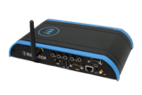


Pillars of ICT for Green Solutions
Future Internet : 2020
M2M Devices
Internet of Things
Open Ipv6 Based communication protocols
M2M Cloud Platform
Cloud based Applications
Smart M2M application

Slide 4
Government Initiatives
GoI Initiatives
IPv6 Deployment Roadmap-I
IPv6 Deployment Roadmap-II
M2M Policy Formation
International level IPv6 test bed
Center of Innovation
IPv6 Task Force
Awareness:
Conferences, webinars, Facebook, LinkedIn
Facilitating Cloud Policy Formation

Slide 5
Roadmap V-II: Adoption Timelines and Guidelines on IPv6
SERVICE PROVIDERS
CONTENT PROVIDERS
New contents & applications: 30-06-2014
Existing: 01-01-2015
EQUIPMENT MANUFACTURER
All mobile phone handsets/ data card dongles/ tablets and similar devices 30-06-2014
All wire line broadband CPEs 01-01-2014
GOVERNMENT ORGANIZATIONS
Enterprise Customers : 01-01-2014
Retail Customers (Wire line): 30-06-2014
Retail Customers (Wireless):
LTE customer: 30-06-2013
GSM/ CDMA: 30-06-2014
Financial ecosystem: 30-06-2013
The new registrations on ‘.in’ domain: 01-01- 2014
The entire ‘.in’ domain: June 2014
Transition plan for transition to IPv6 by December 2017 to be prepared by December 2013
The public interface for delivery of citizen centric services 01-01-2015.
The Government procurement to be either TEC certified or IPv6 Ready Logo certified.
The IPv6 to be included in the curriculum of technical courses being offered by various institutes / colleges

Slide 6
Glimpse of IPv6 Deployment in India
SERVICE PROVIDERS
15 Service Providers ready to handle IPv6 traffic and Enterprise IPv6 services
CONTENT PROVIDERS
6 out of Top 10 Websites are on IPv6
GOVERNMENT
All Government Organizations, including its PSUs, have been sensitized and geared up for IPv6 transition.
ENTERPRISE
Banking Sector is going to be ready soon
9 ready to offer Broadband services on IPv6.
More than 20 enterprises across India have enabled IPv6 in their network.

Slide 7



Standardization & Testing Facilities
MOU with IPv6 Forum
Setting up IPv6 Test Bed in TEC
NGN Lab & IPv6 Test bed for IPv6 Conformance testing of Telecom Equipment
Ready Logo Certification

Slide 8
Planned Initiatives
INDIA IPv6 TRAINING & CERTIFICATION
It is proposed to develop an in country standard Training and Certification program on IPv6 with the objectives as listed below:
To build an industry recognised IPv6 certification program
To empanel organizations for IPv6 training
To build a talent pool on IPv6 skill set in the country
The training and certification proposed to be targeted towards 3 stratum of the resource pool :
-Basic level
-Professional Level
-Expert Level
INDIA IPv6 CENTER OF INNOVATION
A Centre of Innovation for IPv6 is planned with the vision to provide an environment of end to end IPv6 services under a single umbrella with the following main objectives:
To implement IPv6 based pilot projects
To develop model Experimental IPv6 Network
Technical support to Central and State Government units.
Conducting certified training programmes ,R& D in collaboration with premier institutes for new RFC/New applications, IPRs etc.
Consultancy support at National / International level.
Auditing of the networks & its certification.

Slide 9
IPv6 Across Verticals
Communication
Service providers
Smart Grid
Defense
Transportation
Healthcare
Regulatory Agencies
Data centers
ASP/Web Host
Smart Meters
Intelligent transportation
Smart vehicles
Emergency rural healthcare
Smart healthcare management systems
Network centric warfare
Intelligent warfare systems
Regulatory agencies
Domain Registrar’s
Internet Exchange
Media
Banking and finance
Payment gateways for e-commerce
Internet banking and e-broking services
Energy
IPTV
Mobile TV

Slide 10
Smart City: Needs
Massive urbanization
Pressure on existing resources due to population explosion
Need to manage them efficiently & effectively
Need for sustainable development
Reduce green house gases emission
Evolution of ICTs (IoT, IPv6, sensors etc.) to support such initiatives on a societal scale.
Smart City concept is centered around the utilization of networked infrastructure to improve socio-economic conditions and enable sustainable urban development.
Network infrastructure that is open, scalable and supports interoperability is the need of the time and planned activities include:
Intelligent Transport System
Integrated Health Care
Integrated Disaster Management System
Smart Buildings / Smart Homes
Smart Grid / Smart Meters
e-Governance
Smart water / gas management

Slide 11










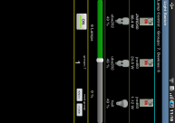




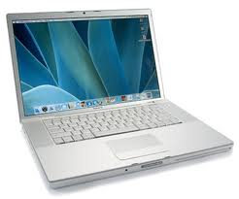






Smarter Home – Talking to the Internet
Typical Implementation
Distributed electricity generation and storage
Displays
Wind Turbine
Home Displays
In-Home Energy
Display
Solar Panel
IPv6 network
Security
Home Gateway
Light
Appliances
Water
Meters
Gas
Meters
Smart
Meters
Load Control
Sensors
Smart metering devices
Home network

Slide 12
Smart City: Indian Scenario
The Government plans to develop two ‘smart’ cities in each State.
Medium-sized cities with half a million to one million population are planned to be developed as smart cities.
Other State Initiatives include
  Smart City, Kochi
  Smart Cities along high speed rail corridors:
  Dadri-Noida-Ghaziabad Investment Region, Uttar Pradesh;
  Manesar-Bawal Investment Region, Haryana;
  Khushkhera-Bhiwadi-Neemrana Investment Region, Rajasthan;
  Pithampur-Dhar-Mhow Investment Region, Madhya Pradesh;
  Ahmedabad-Dholera Investment Region, Gujarat;
  Shendra-Bidkin Industrial Park city near Aurangabad, Maharashtra;
  Dighi Port Industrial Area, Maharashtra

Slide 13


IPv6 Applications: Health Care
Caller in distress
Dispatch Officers (DO) – Control Room
IPv6 Backbone
Dial (102)
Doctor
3G
Wi-Max
Bio-sensors help collect
Vital sign info which is
transmitted in real-time
helping doctor provide
effective healthcare
Central Co-ordination Contact Center
Ambulances located at strategic places in districts
GPS helps Locate
Ambulance, guides
Ambulance driver
To destination

Slide 14
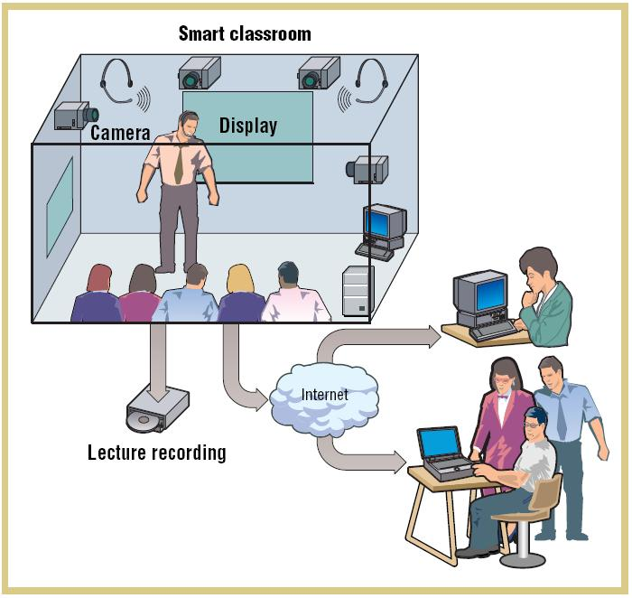
IPv6 Applications: Smart Class Room
Universalization of Education
Extending Quality Education to Remote and Rural Areas
Partially mitigate, non-availability of good teachers in sufficient numbers

Slide 15
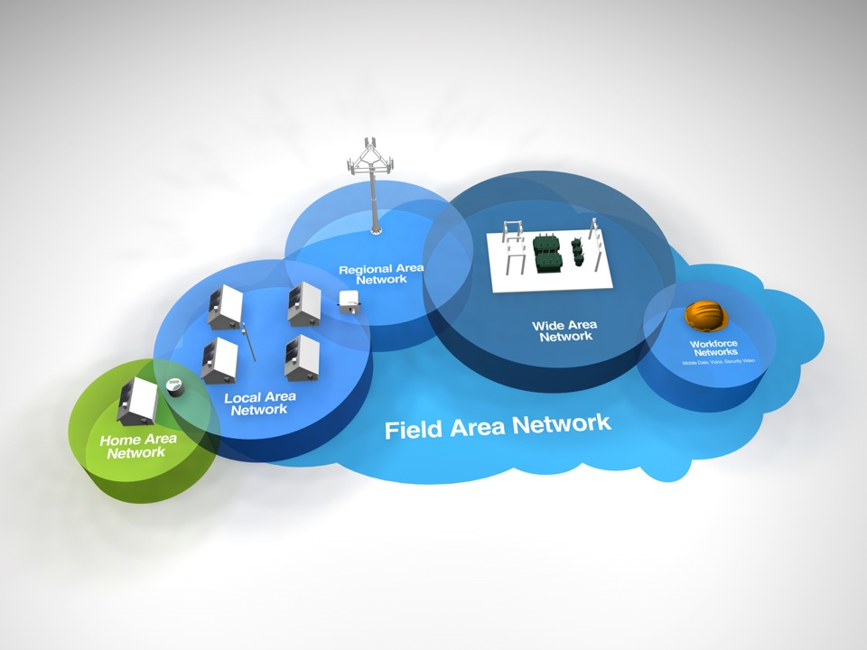
SMART GRID: A NETWORK OF NETWORKS
SMART Grid refers to the next generation power grid.
SMART Grid incorporates advanced two-way communications and pervasive computing capabilities for improved
  Control, Efficiency, Reliability and Safety

Slide 16
Smart Grid Pilot Projects
14 such pilots announced by Ministry of Power
Average Customer base is around 20000
Requires robust communications over long distances and at each consumer level
Provide usage information to consumers
Provide information from and control of the power grid
Bi-directional and net metering for new power sources
Electric consumption data on hourly or sub-hourly basis
Support business logistics
    On-request reads
    Operational control

Slide 17


















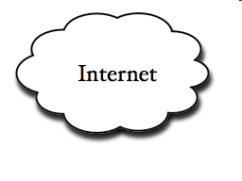





Smart Grid Communication Network (SGCN)
Microgrid
Substation
Substation
Smart
Meter
Customer
Non-renewable Enegy
Electric Vehicle
Wind Enegy
Solar Enegy
Microgrid
Power Generation
Power Transmission Grid
Power Distribution Grid
Power Consumption
(a) Power System Layer
Control Center
Wireless
Backhaul
Base
Station
Concentrator
Smart
Home
Device
Wired Backhaul
Network
Smart
Meter
Data Aggregation
Point (DAP)
Wide Area Network (WAN)
Neighbor Area Network (NAN)
Home Area Network (HAN)
(b) Communications Layer

Slide 18


Connected Devices: A transforming industry… M to M
Today:
Penetration 120%
New Challenges
Tomorrow:
Penetration 1200%
Networked Society
CAGR 60% - 80%
Automation
Self service
Flexibility
Low cost
Visibility & control
SLA
Custom process
Multi level distribution

Slide 19




View Of 2020 : EVERYTHING connected
Drivers
Entertainment, security, healthcare
productivity, new revenue streams
sustainability and regulation
Devices connecting the masses, such as Consumer Electronics and Home Automation
Specialized M2M applications across all government, industry & society
Ubiquity of Broadband
Declining cost of connectivity
Propagation of embedded M2M Devices
Enablers

Slide 20
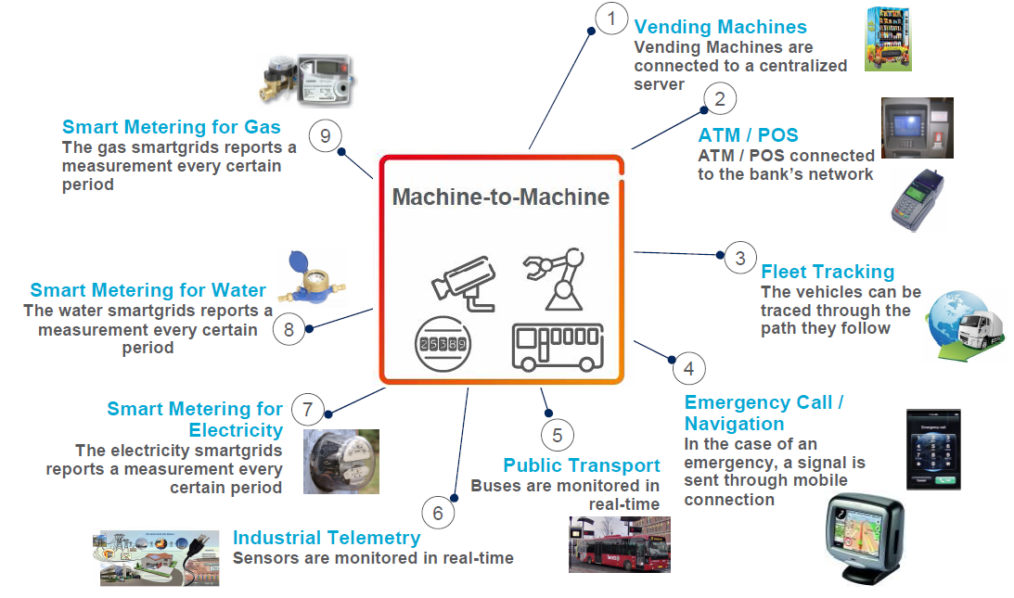
Potential M2M services

Slide 21
Potential Face Changer M2M Projects in India
National Mission for Electric Mobility (NMEM):
  6 million Electric Vehicles announced by Ministry of Heavy Industry by 2020.
    2 millions 4 wheelers
    4 millions 2 wheelers
  Needs to be efficiently connected to Power Grid for charging without overload.
  Requires robust communications spread over geography for each vehicle owner at multiple locations.
  To support different Battery Charging Business Models.
  Provide information from and control of the power grid

Slide 22
Issues for consideration…
Bring Standards for M2M in line with global standards
Allocating Spectrum for M2M local area network Layer
Revisit National Numbering Plan to accommodate M2M
To ensure the ‘Always on’ requirements –
  Inter-Operator Roaming and Inter-Network Mobility
To ensure Interoperability
  Guidelines for Bundled Services
Address Privacy and Data Protection
Address Know Your Client and customer traceability issues.
Address Security and Lawful Interception for M2M
To have policy around Customers ethical Issues
Close coordination with relevant global organizations

Slide 23
Cloud Computing: Regulator’s Recommendations sought
Cloud computing promises to radically change the way the organizations deploy and use ICT.
Represents a paradigm shift and provides them a platform to quickly ramp up their IT enablement and offer innovative services through access to low cost and efficient computing and storage.
It obviates the need for separate IT infrastructure for each individual user thereby resulting in energy conservations and reducing carbon footprint.
Data centers power requirement fed by Renewable Energy sources.
Placing the data centers at location - wind power availability/easy to install Solar power system.
Virtualization - Virtualized Computing Platform
Scalable use of computing resources

Slide 24
NTP-2012 : Cloud Computing
To recognise that cloud computing will significantly speed up design and roll out of services, enable social networking and participative governance and e-Commerce on a scale which was not possible with traditional technology solutions.
To take new policy initiatives to ensure rapid expansion of new services and technologies at globally competitive prices by addressing the concerns of cloud users and other stakeholders including specific steps that need to be taken for lowering the cost of service delivery.
To identify areas where existing regulations may impose unnecessary burden and take consequential remedial steps in line with international best practices for propelling nation to emerge as a global leader in the development and provision of cloud services to benefit enterprises, consumers and Central and State Governments.

Slide 25
Cloud Computing: Indian Scenario
TEC has released GR on cloud infrastructure to facilitate the cloud ecosystem.
The matter has been referred by DoT to TRAI for its recommendations regarding issues related to:
  regulatory framework
  security,
  interoperability
  QoS
  data privacy
  multiple jurisdiction / areas of operation
  legal framework
  licensing etc.

Slide 26
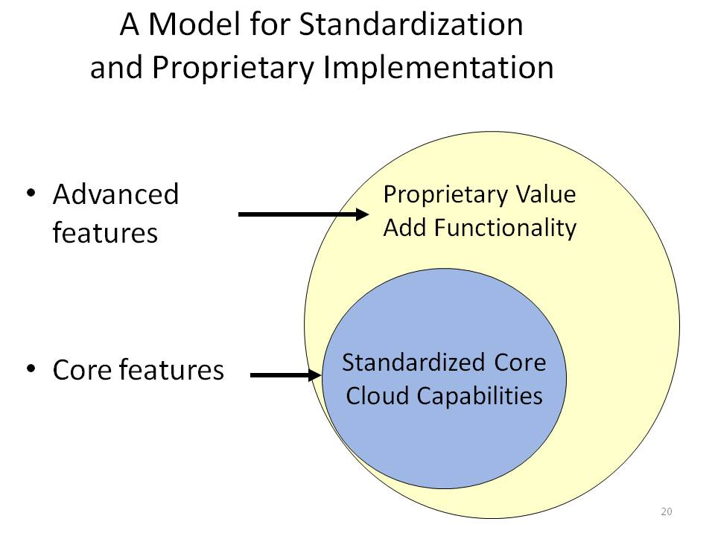
Cloud Computing: Indian Scenario
Cloud customers knowingly choose the correct mix for their organization of
  standard portable features
  proprietary advanced capabilities

Slide 27
Green Telecom : Other Issues
Telecom Growth in India
Power Challenges
Energy Efficiency
Clean Telecom Strategies
Need of Green Telecom
Key benefits of Green Telecom
Regulatory Framework on Clean Telecom – India
EMF Radiation in Mobile Network
Energy Efficiency in Mobile System – Steps Ahead

Slide 28
Growing Mobile Communication
Remarkable growth in the Mobile Telecommunication sector in recent years => Leads to increase of Power requirement - A continuous process
Exponential growth of BTSs & cellular towers in the country.
  Reduction in power requirement ?
  Reduction of Environmental Impacts?
No of BTS in India: | 0.746 Millions
No of cellular towers : | 0.585 Millions
July 2013 data

Slide 29
Low Carbon Solutions:
Energy Saving Strategies to reduce energy consumption
Optimisation of Network for Energy Usage.
Infrastructure Sharing – Active & Passive.
New Licensing Options
Transition to Renewable/ Clean Energy Technology.
Highest energy saving potential lies with BTS
Variation in Energy consumption - Different BTS typology ; Shelter, Room, Outdoor
Encourage use of outdoor/ fresh air cooled BTS - Say ‘No’ to Air-conditioning.
RF planning optimally (no-overdesign) with careful attention to Energy Efficiency for BTS [Macro, Micro ( with maximum EIRP upto 4 watt)]
Indoor Pico base station deployment to enhance indoor coverage.
Simple & clean installation – Micro/ Pico/ Femto
Encourage use of Energy efficient switch suiting local climate conditions.
To set the Energy Consumption benchmark for different Telecom network elements
Renewable Energy Technologies (RET) , including lithium-ion batteries & Energy Management System (EMS), introduced at India’s telecommunication towers, thereby reducing diesel oil and energy consumption.

Slide 30
Adoption of Renewable Energy Technologies & reduction in carbon footprints
India has Incorporated a Clause in Unified License Agreement; stipulating:
“The Licensee to adopt RETs for powering Telecom Network, deploy energy efficient equipment and reduce the carbon footprint as per prevailing directions……..”
Nation to encourage RETs deployment and replacement of old equipment with energy efficient equipment by giving incentives rather than penalizing – Key drivers to combat global climate changes.
Reducing Total Cost of Ownership (CAPEX + OPEX)
Conserving & Protecting the Environment
  A one KW SPV system every month prevents 136 kg CO2 from entering the environment.
No Noise Pollution

Slide 31
Regulatory & Policy Framework on Clean Telecom: India
At least 50% of rural towers and 20% of urban towers to be powered by hybrid power by 2015 (RET + Grid Power) &
Minimum 75% of rural towers and 33% of urban towers are to be powered by hybrid power by 2020 (RET + Grid Power).
Energy & Performance assessment of Products, Equipments and Services in Telecom Network .
Certified green passport rating by 2015.
All service providers to declare the carbon footprint of their network operation twice in a year.

Slide 32
Regulatory & Policy Framework on Clean Telecom: India
Service providers to adopt voluntary code of practice encompassing energy efficient network planning, infrastructure sharing, deployment of energy efficient technology and adoption of renewable energy technology.
Telecom service providers to have their cell sites particularly in rural areas powered by hybrid renewable sources : wind energy, solar energy, fuel cells or combination thereof to ensure that around 50% of all towers in rural areas are powered by hybrid renewable sources by 2015.
Service providers to evolve a carbon credit policy in line with carbon credit norms to the ultimate objective of achieving:
a maximum of 50% over the carbon footprint levels of the base year 2011 in rural areas and maximum of 66% in urban areas by the year 2020

Slide 33
Regulatory & Policy Framework on Clean Telecom: India
The service providers should aim at carbon emission reduction target for the mobile networks:
  5% by the year 2012-2012
  8% by the year 2014-2015
  12% by the year 2016-2017
  17% by the year 2018-2019‘
Green’ Parameters for Monitoring Mobile Networks:
  (a) Units / mobile connection / month
  (b) Units / mobile traffic / month
  (c) Units / revenue generation / month
  (d) Units / Cell site / month
  (e) Carbon (Kg) / Cell site / month
Comparability of performance results shall improve the quality / energy efficiency of different operators - turns into Greening the Telecom & reducing the carbon emissions.

Slide 34
Monitoring Mechanism for Clean Energy Implementation & Carbon Reduction Targets
Web Based Cloud application to :
  Facilitate for uploading the Data by Telecom Operators
  Monitor the progress for Implementation Renewable Energy Technology
  Keep Track of Carbon Emission Reduction Targets
  Analyse & examine various scenario & generate various reports.

Slide 35
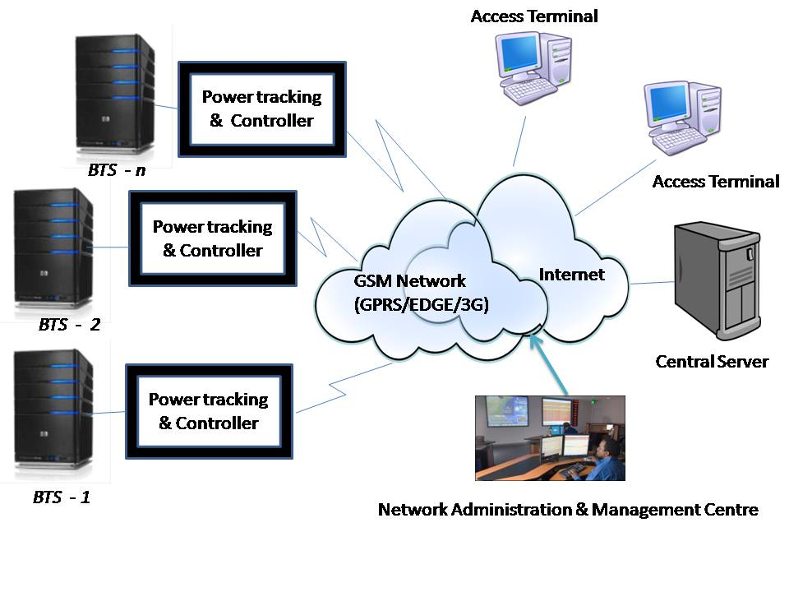
Centralized Energy & Carbon Emission Monitoring System

Slide 36
Centralized Energy & Carbon Emission Monitoring System
Power Tracking & controller:
    Integrates solar, wind, grid and diesel power
    Keeps on tracking which power is available
    Does switching power supply to feed the loads.
    Sends the power status to a central server in real-time.
    Supports various alerts/alarms & sends to central server in real-time
Access Terminal:
    A computer with Web browser connected to internet.
    Provides access to power usage pattern data, alerts of any BTS at any time.
    Provides access to various reports .

Slide 37
Centralized Energy & Carbon Emission Monitoring System
Central Server:
Connected to Internet for receiving data from all the Power tracking and controller.
Stores the collected data in local persistent database.
Processes the received data for generating various reports
Grid/diesel/Renewable power availability pattern reports.
Carbon emission Estimation/calculation reports.
Provides web based graphical user interface (GUI) for displaying power availability/usage pattern at various BTS.
Supports reporting capabilities for generating various reports and displaying them on Web based GUI.
Provides exporting of measurement data from central server into CSV format.

Slide 38
Centralized Energy & Carbon Emission Monitoring System
Energy efficient & clean Energy solutions are imperative need of the time for sustainability.
Payback period from the cost analysis of DG operated system vs. Green systems is approximately 3 - 4 years.
Sharing of the passive infrastructure in a BTS site having more than one operator has resulted in low CAPEX and 30% energy savings. For new operators this will result in faster roll out of network.
Substantial Reduction of Green House Gas (GHG) emissions.
A one kilowatt PV system each month:
Saves 68 kg coal
prevents 136 kg CO2 entering into the atmosphere
keeps around 568 liters water from being consumed
keeps NO2 and SO2 from being released into the environment

Slide 39
ITU-T Recommendations & Climate Change (1/2)
ITU-T Recommendations & Climate Change:
  ITU-T L.1000: Universal power adapter and charger solution for mobile terminals and other hand-held ICT devices
  ITU-T L.1001: External universal power adapter solutions for stationary information and communication technology devices
  ITU-T L.1100: Procedure for recycling rare metals in information and communication technology goods
  ITU-T L.1200: Direct current power feeding interface up to 400 V at the input to telecommunication and ICT equipment
  ITU-T L.1300: Best practices for green data centers
Link : http://www.itu.int/en/ITU-T/climatechange/Pages/standards.aspx

Slide 40
ITU-T Recommendations & Climate Change (2/2)
ITU-T Recommendations & Climate Change:
  ITU-T L.1310: Energy efficiency metrics and measurement methods for telecommunication equipment
  ITU-T L.1400: Overview and general principles of methodologies for assessing the environmental impact of information and communication technologies
  ITU-T L.1410: Methodology for the assessment of the environmental impact of information and communication technology goods, networks and services.
  ITU-T L.1420: Methodology for energy consumption and greenhouse gas emissions impact assessment of information and communication technologies in organizations​.
Link : http://www.itu.int/en/ITU-T/climatechange/Pages/standards.aspx

Slide 41
Recent International Developments/ ITU Reports
Forum on Greening Mobile Devices: Building Eco-Rating Schemes Madrid, Spain, 17 Sept. 2013
Eco-Rating Schemes and the Need for Standardization
Eco-Rating Schemes: Driving Green Innovation
Discussed on possible challenges related to the implementation of a standardized eco-rating scheme and the role that the ICT sector can play to drive green ICT innovation for mobile devices.
  http://www.itu.int/en/ITU-T/Workshops-and-Seminars/gsw/201309/Pages/programme-17-Sep.aspx
B. Sustainable ICT in Corporate Organizations
The document with following link focuses on the main sustainability issues that companies face in using ICT products and services in their own organizations across four main ICT areas: data centers, desktop infrastructure, telecommunications networks and broadcasting services.
  http://www.itu.int/dms_pub/itu-t/oth/4B/04/T4B0400000B0011PDFE.pdf

Slide 42
Recent International Developments/ ITU Reports
  C. Sustainable Products (September 2012)
The document provides technical guidance on environmentally conscious design principles and best practices, covering development and manufacture, through to end-of-life treatment
  http://www.itu.int/dms_pub/itu-t/oth/4B/04/T4B0400000B0010PDFE.pdf
  Sustainable Buildings (September 2012)
  The document provides technical guidance on environmentally conscious design, maintenance, repair and operating principles and best practices from construction through to lifetime use and de-commissioning.
  http://www.itu.int/dms_pub/itu-t/oth/4B/04/T4B0400000B0012PDFE.pdf
  E. End of Life Management for ICT Equipment (September 2012)
  The document covers the various End-of-Life (EOL) stages, and their accompanying legislation. It also provides support in creating a framework for environmentally-sound management of EOL ICT equipment.
  http://www.itu.int/dms_pub/itu-t/oth/4B/04/T4B0400000B0013PDFE.pdf

Slide 43
Recent International Developments/ ITU Reports
F. Assessment Framework for Environmental Impacts of the ICT Sector (Sept. 2012)
This document explores how the various standards and guidelines can be mapped so that an organization can create a sustainability framework that is relevant to its own business objectives and desired sustainability performance.
  http://www.itu.int/dms_pub/itu-t/oth/4B/04/T4B0400000B0008PDFE.pdf
G. Toolkit on Environmental Sustainability for the ICT Sector (ESS)
Companies in the ICT sector are increasingly being asked by customers, investors, governments and other stakeholders to report on sustainability performance. However, in the absence of agreed standardized method, companies that do not measure their environmental performance find it very difficult to manage and improve that performance. The Toolkit on Environmental Sustainability for the ICT sector, an ITU-T initiative provides detailed support on how ICT companies can build sustainability into the operations and management of their organizations through the practical application of international standards and guidelines. The toolkit provides a set of agreed upon sustainability requirements for ICT companies allowing a more objective reporting of how sustainability is practiced in the ICT sector in the key areas of sustainable buildings, sustainable ICT in corporate organizations, sustainable products, end of life management, general specifications and KPIs, and an assessment framework for environmental impacts of the ICT sector.
  http://www.itu.int/dms_pub/itu-t/oth/4B/01/T4B010000060001PDFE.pdf

Slide 44
Recent International Developments/ ITU Reports
Boosting Energy Efficiency Through Smart Grids
The report discusses the role of ICT in the smart grid with a view of energy efficiency, with the ultimate goal of hindering climate changes. ICT equipment's consume significant high levels of energy and any ICT architectural choice and implementation should focus first efficiency. Deployment of additional communication infrastructures for smart grids should therefore carefully consider the trade-off between the gain in terms of energy saving and the cost of the operating devices while avoiding the of posing an unnecessary energy burden to end-customers. The broad choice among the technologies and networks available will enable the most efficient, early, and economically viable implementation of SGs.
  http://www.itu.int/dms_pub/itu-t/oth/4B/04/T4B0400000B0008PDFE.pdf
I. Guidance on Green ICT Procurement
ICT companies have the power and legitimacy to innovate, transform and de-materialize the economy, but the increasing proliferation of ICTs has led to concerns regarding their environmental impact. ICT Goods, Networks and Services (GNS) require relevant investments and generate particular environmental impacts that must necessitate special considerations. The document provides information on addressing the environmental impact of ICTs in a standardized way using ITU-T Methodologies to assess the environmental impact of ICTs in goods, networks and services and in Organizations.
  http://www.itu.int/dms_pub/itu-t/oth/4B/01/T4B010000040001PDFE.pdf

Slide 45
Thank You!

