Slide 1
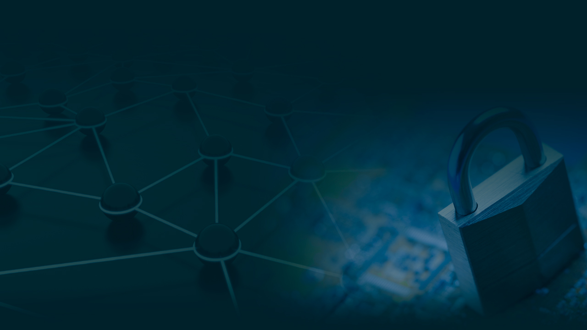

Standardization Opportunity for India
Forces Changing our World!
Mahbubul Alam
Head of IoT/M2M, ITS and Auto Mfg
Connected Industries Group
ITU/GISFI, December, 2012

Slide 2
Force # 1
Social Networks

Slide 3
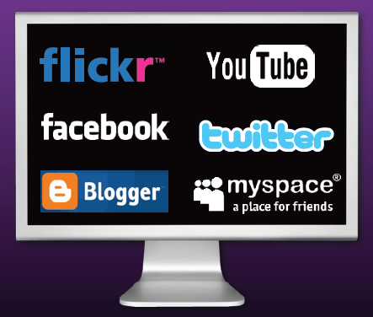
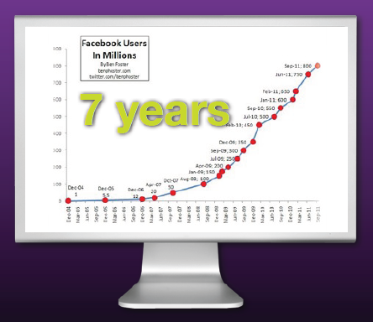
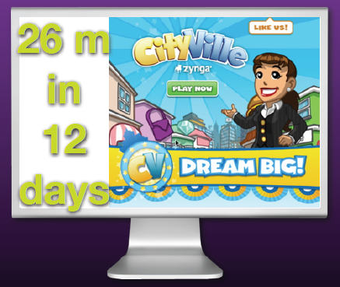
Ten years ago there were no social networks

Slide 4
“Is The World Changing at a Comfortable Pace?”
POLL QUESTION?

Slide 5
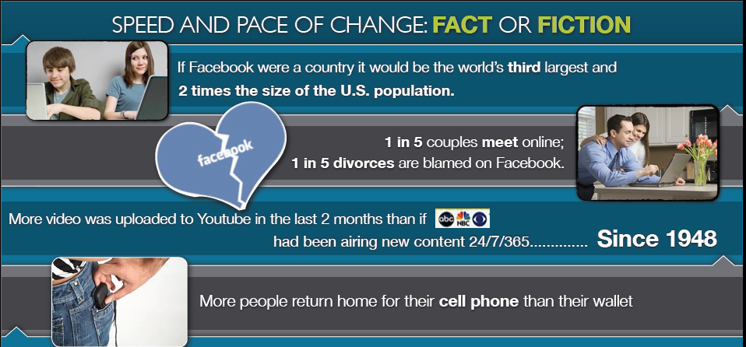

Slide 6
In 10 years over 40% of the FORTUNE 500 will no longer be here*
*Babson Olin School of Business Advertisement, Fast Company April 2011, page 121
PREDICTION
More Change Next 3 Years than Previous 25 years!

Slide 7
Force # 2
Innovation Driven by Consumer

Slide 8
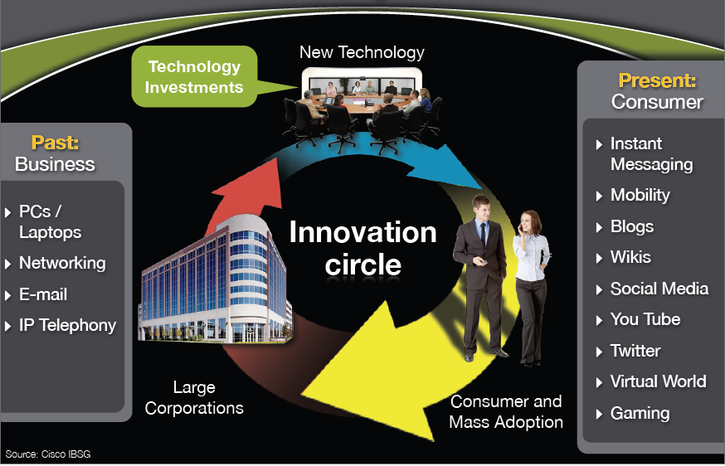
Role reversal: consumers are
NOW driving the innovation cycle
Notes:
These are our new students, customers and employees!
→ EXPECTATIONS are CHANGING ←

Slide 9
Force # 3
Power to the People

Slide 10
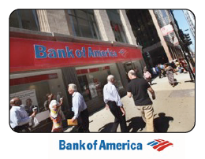
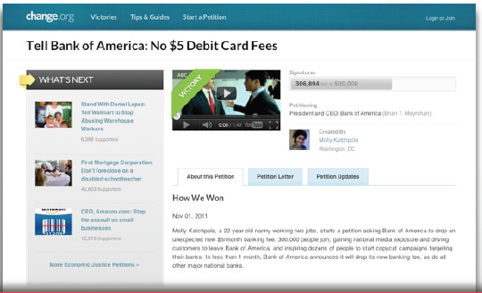
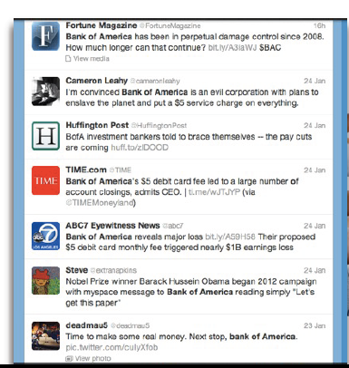

Customers now have the power of social media to battle companies
22 year old “Molly Katchpole of Washington started online petition on change.org
300,000 sign up!
She got personal call from bank executive
BofA backs off on fee
Bank of America says they’ll charge customers $5/month fee to use their credit cards

Slide 11
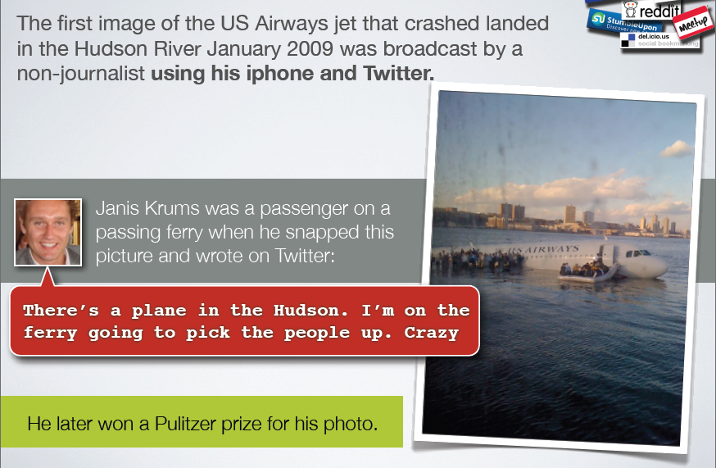
The power of social media

Slide 12
Force # 4
Next Generation 100% Digital
- All the Time!

Slide 13
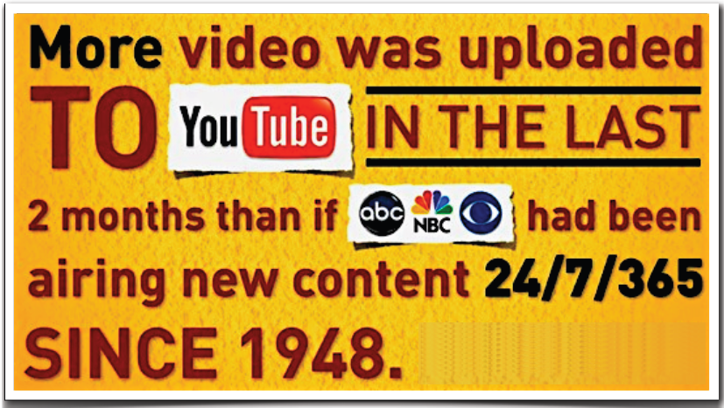
User Generated Personal Video
What are architectural & business implications?

Slide 14

How many man hours are invested in Wikipedia?
5 Million
25 Million
50 Million
100 Million
Interesting Facts?
*100M Hours = The number of hours American spend every weekend watching television
……. Commercials!

Slide 15
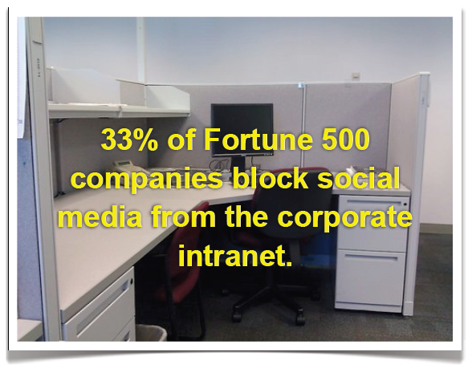
Block social media at work
Think! How to leverage “Millennial Generation”
Get them out of the cubicle
Identify them
Create a group provides feedback
Reverse mentoring executives
Beta test new

Slide 16
Force # 5
Internet-of-Everything
Connected World!

Slide 17
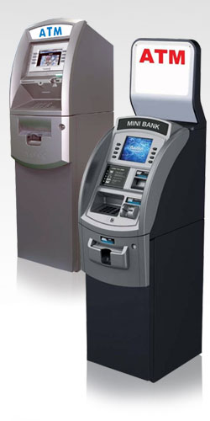

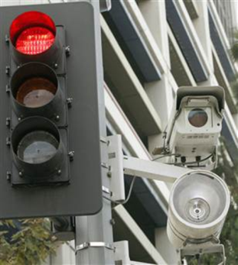
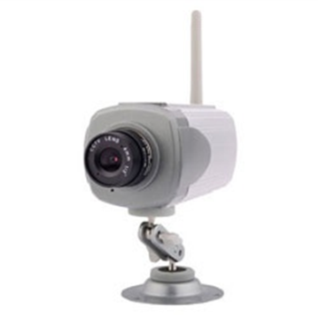
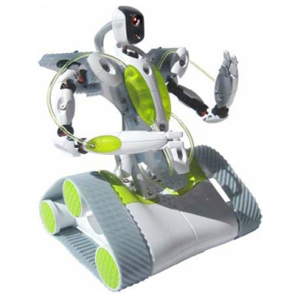
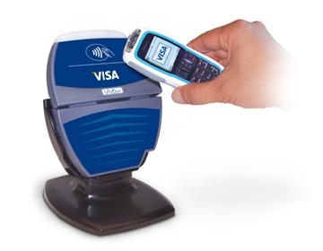
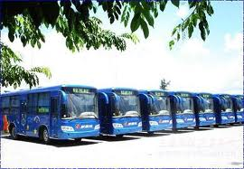
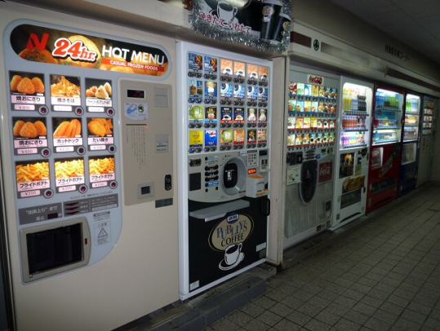
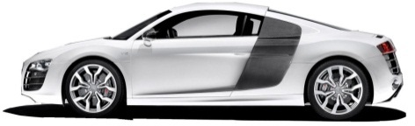
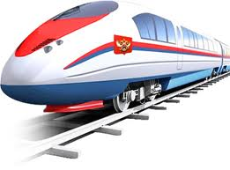

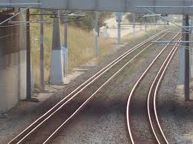
Today more than 99% of our world is still not connected to the Internet!
Payments
Security
Traffic
Video
Robots
ATMs
Bus Fleets
Trains
Eventually…
every vehicle
Public Safety
Rail
Vending
ITS
Intelligent Transport Systems
SCV
Smart Connected Vehicles
Smarter Payments…
Smarter Transportation…
Smarter Security…

Slide 18
Change Creates New Opportunity!

Slide 19
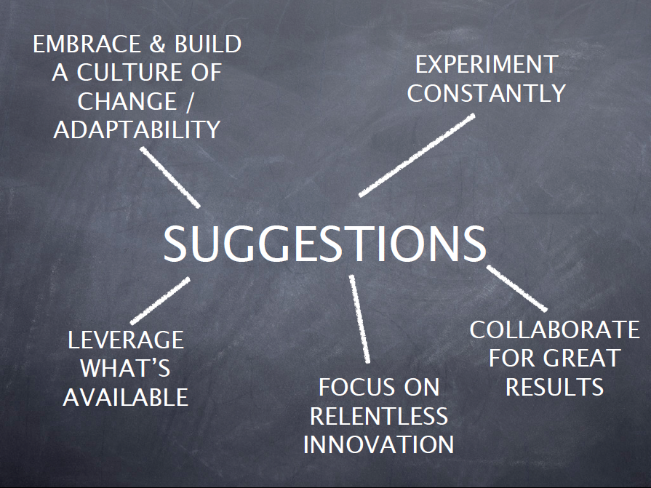
Role of Indian Indigenous companies at GISFI

Slide 20

Big Picture:
Connected Network Society
Technology
Societal Impact
Policy
Towards Standardization
Start thinking and start now!
“TOMORROW starts here”
Trillion’s
of Connected
Devices

